Slide 1
PRIVATE GÖKYÜZÜ PRIMARY SCHOOL

Slide 2
This is our beautiful school. We really love it!

Slide 3
We have our ceremonies in our big playground.

Slide 4
Our students play games during the breaks...

Slide 5
… and they sometimes rehearse here.

Slide 6
This is our Founder - General Manager, Dr Hüseyin Emin ÖZTÜRK.

Slide 7
This is our Assistant General Manager, Mr Baki KESİK.

Slide 8
This is our Principal, Kemal SARI.

Slide 9
This is our Vice Principal, Sevilay ÖZTÜRK.

Slide 10
This is our ground floor. It is orange.

Slide 11
This is our first floor. It is pink.

Slide 12
This is our second floor. It is green.

Slide 13
This is our third floor. It is blue. You see, it is a colourful school!

Slide 14
We have written some classroom instructions in different languages on our stairs.

Slide 15
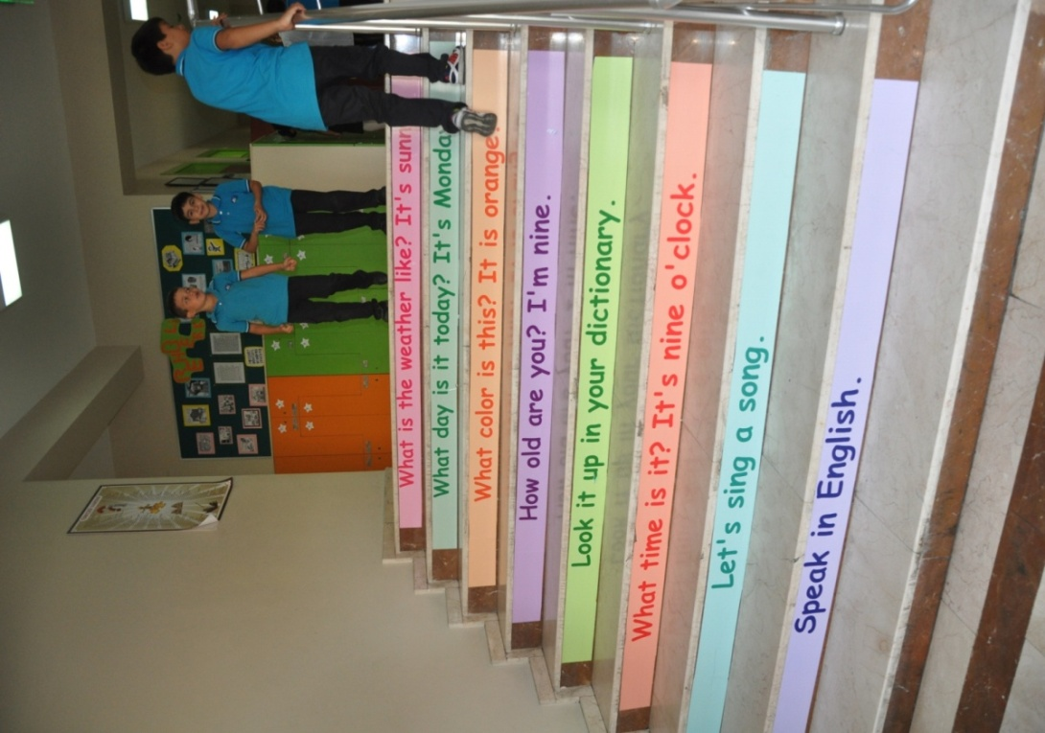
Our students can read and learn them during the breaks.

Slide 16
This is one of our second grades classrooms.

Slide 17
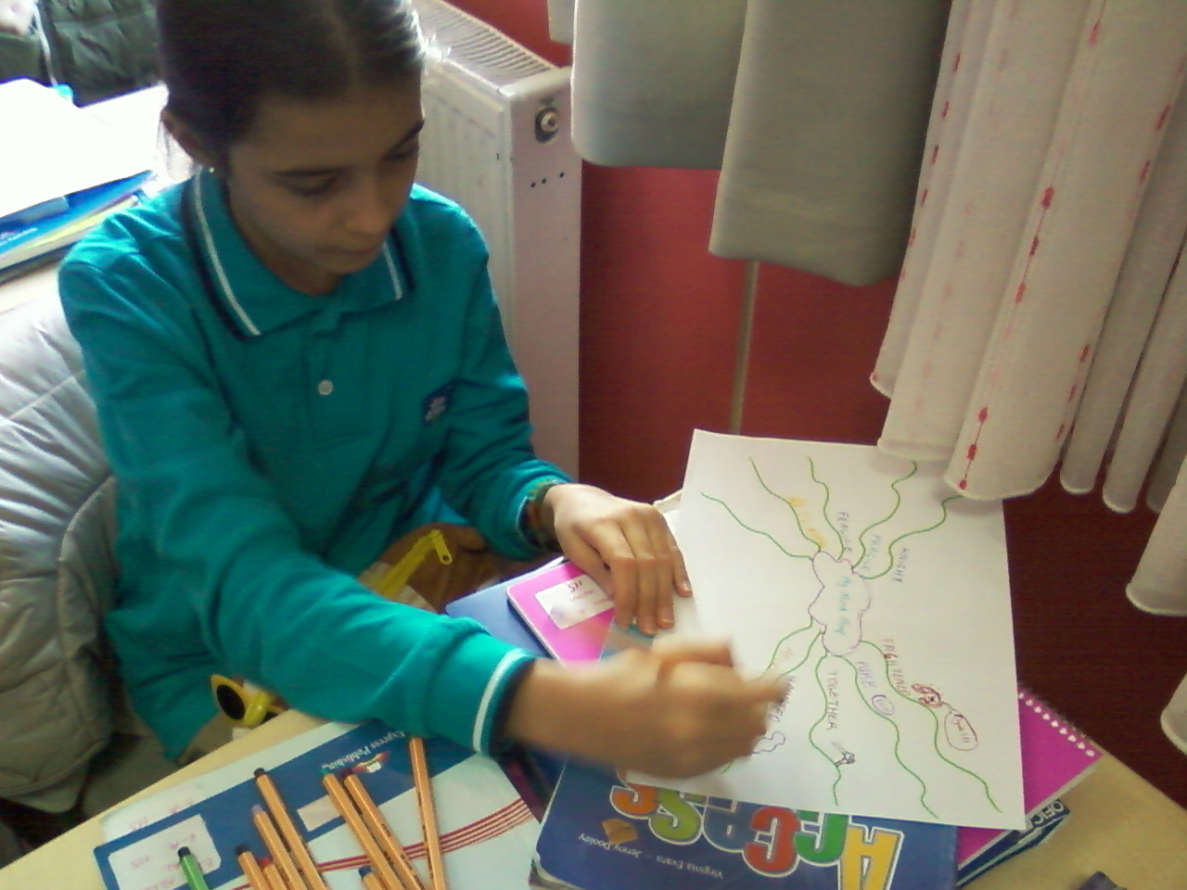
Our students learn English words by using mindmaps.

Slide 18
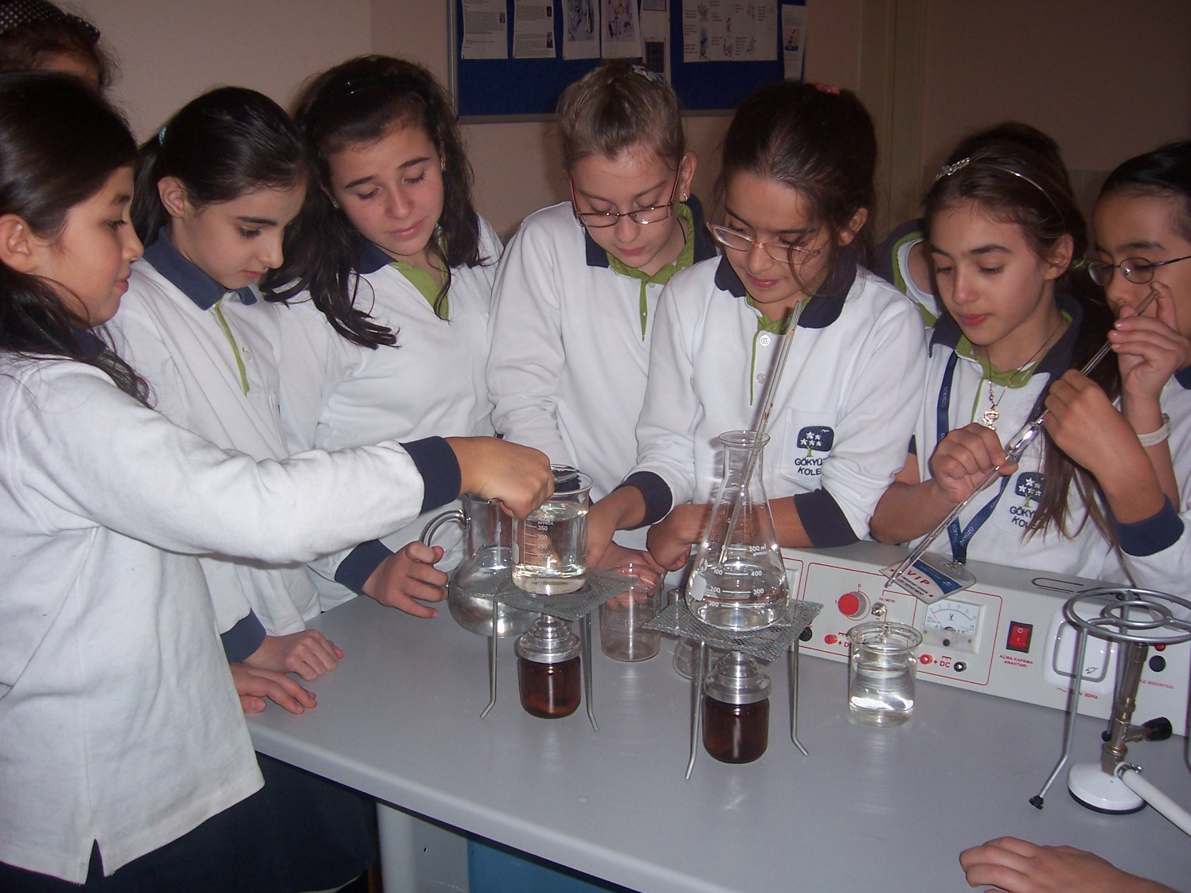
This is our science laboratory.

Slide 19
Our students learn best by practicing.

Slide 20
This is our music room.

Slide 21
Our students perform a music show with different musical instruments.

Slide 22
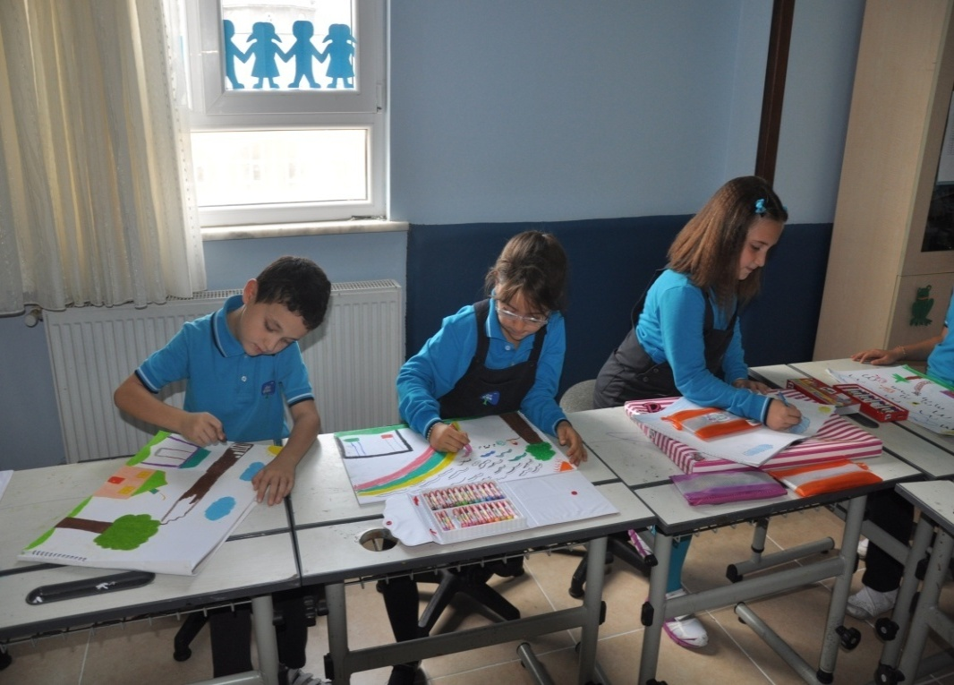
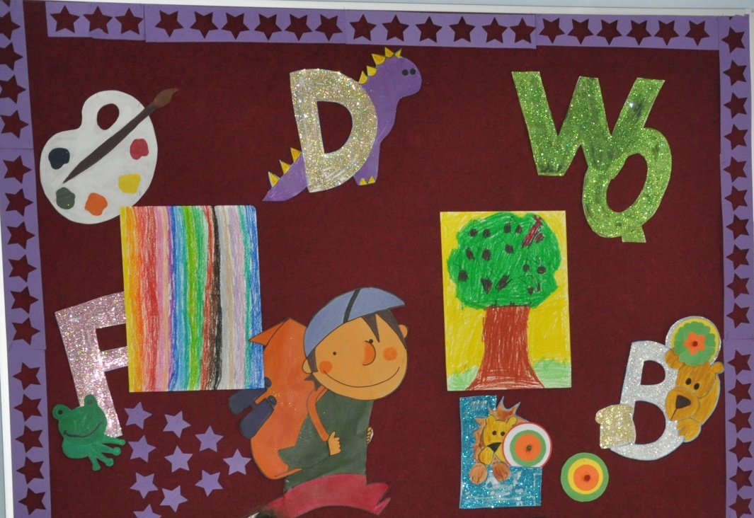
This is our art room. Students draw lots of pictures here.

Slide 23
This is our sports hall.

Slide 24
Our students play football, volleyball and basketball here.

Slide 25
This is our swimming pool.

Slide 26
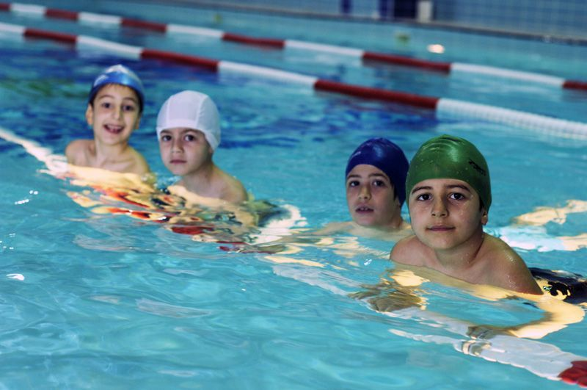
Our students swim and have fun here.

Slide 27
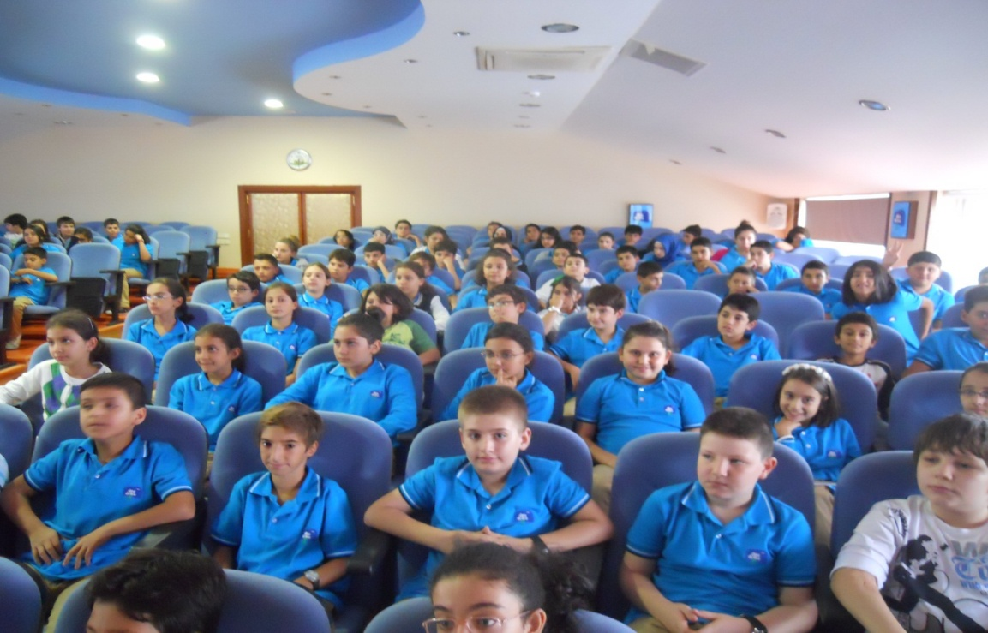
This is our conference hall.

Slide 28
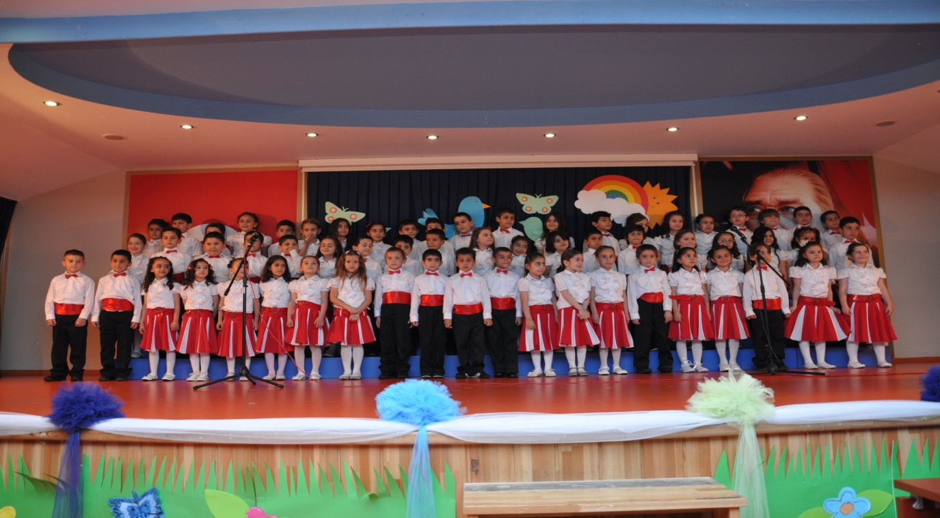
Our students perform lots of shows here.

Slide 30
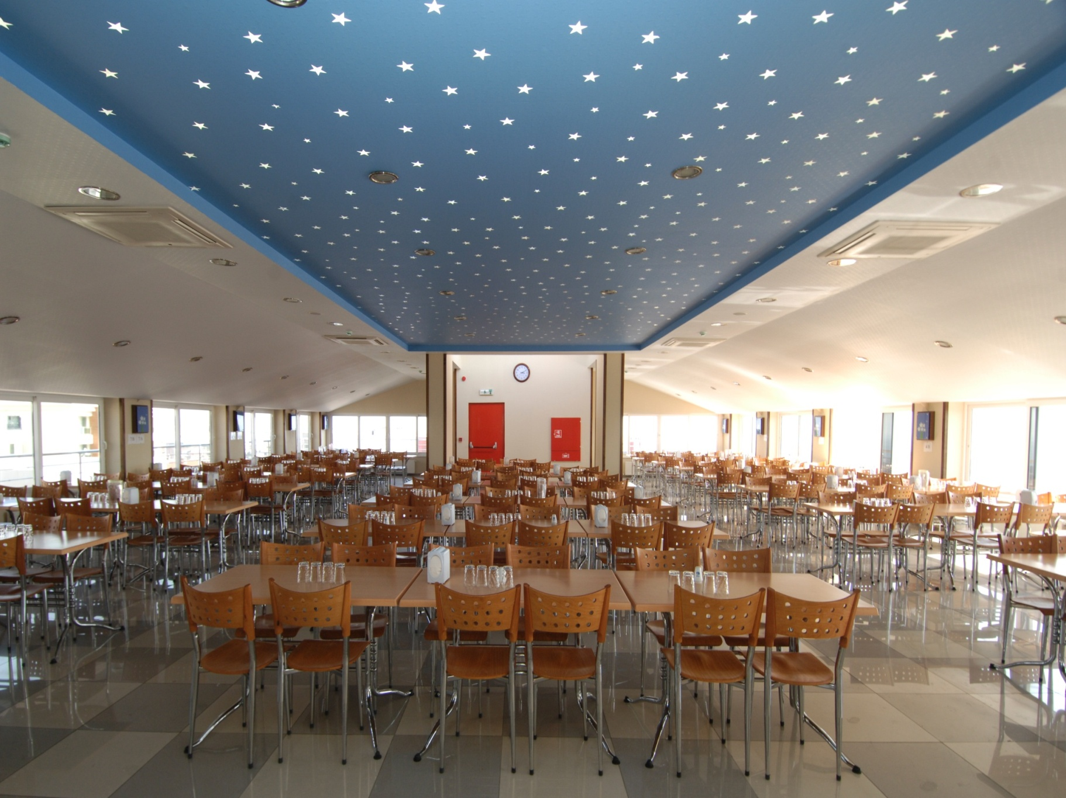
This is our dining hall. As you can see, there are so many stars on the ceiling. It means that, each student is a unique star for us!

Slide 31
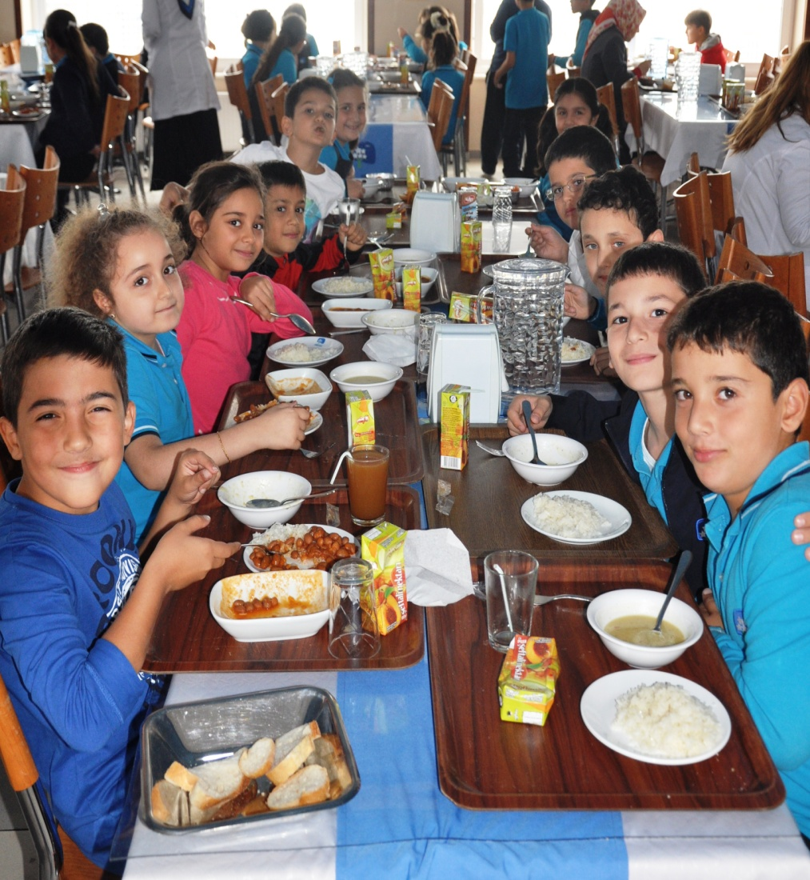
Our students have their lunch with their teachers.

Slide 32
This is our Comenius Corner of our previous project.

Slide 33
We read books for 15 minutes every morning. This is one of the most important activities for us.

Slide 34
Nice emotion
Nice person
Gökyüzü Centre of Educating Emotions
We teach these emotions here;
*Love
*Justice
*Compassion
*Loyalty
*Empathy

Slide 35
We have a centre for searching and revealing the hidden abilities in each student!
Here are some of their classes:
Memory Techniques
Speedy Reading Comprehension
Analytical Thinking
Character Education
There is not an unsuccessful student!
There is a student whose ability is undiscovered!

Slide 36
We believe that “Our students can change the world.”

Slide 37
If you want to learn more about us,
you can come to our school or
visit http://www.gokyuzu.com.tr/ !

