Slide 1
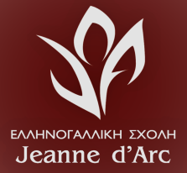
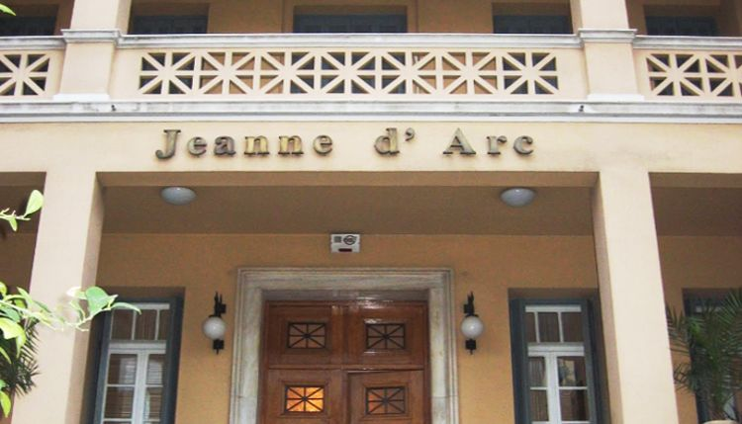
Our school
Jeanne d’arc

Slide 2
In 1859 three sisters began running a non-profit organization for orphaned children in Piraeus. The orphanage, school and clinic ended up in 1861 at the School “Jeanne d’Arc”. The School went through a lot of difficulties, especially during the two world wars. During the bombing of Pireaus,a wall collapsed and two of the sisters passed away. Today the school continues his educational work with Primary, Middle School and High school.
History

Slide 3
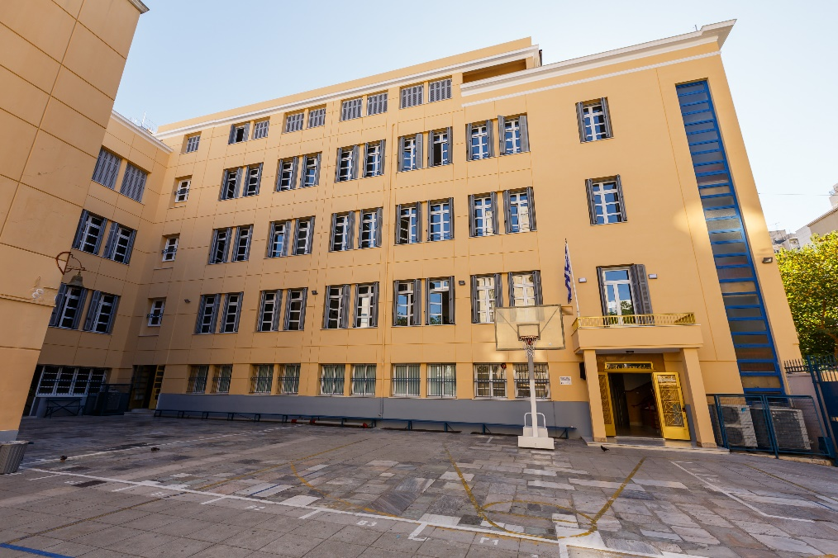
Welcome to our school…

Slide 4
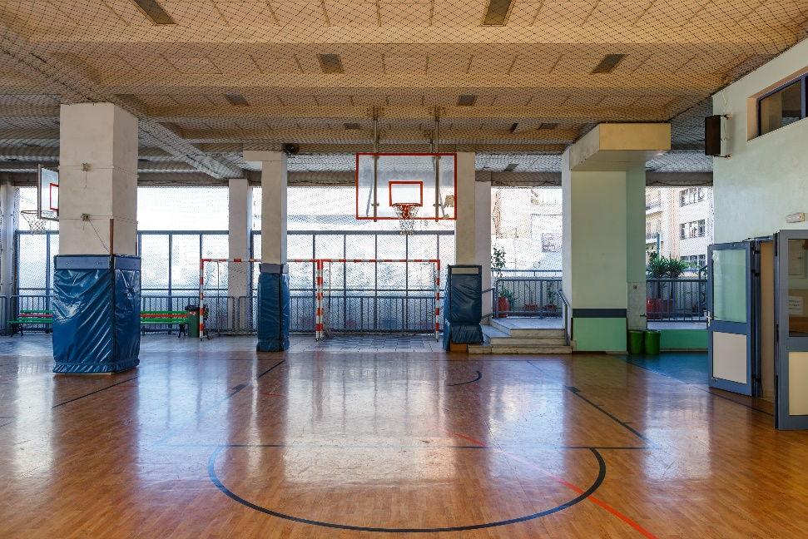
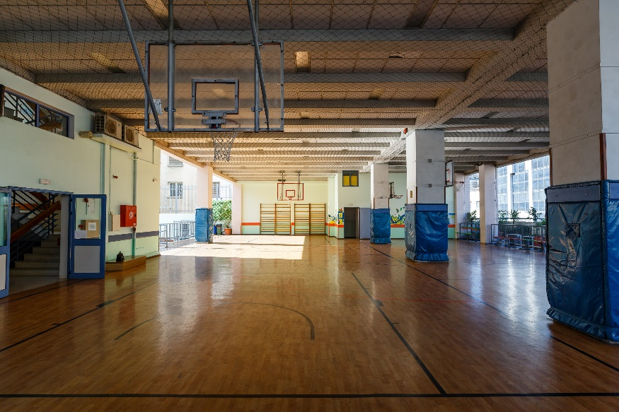
Our playground…

Slide 5
Two of our classes…

Slide 6
Our informatic rooms…

Slide 7
Our cafeteria…

Slide 8
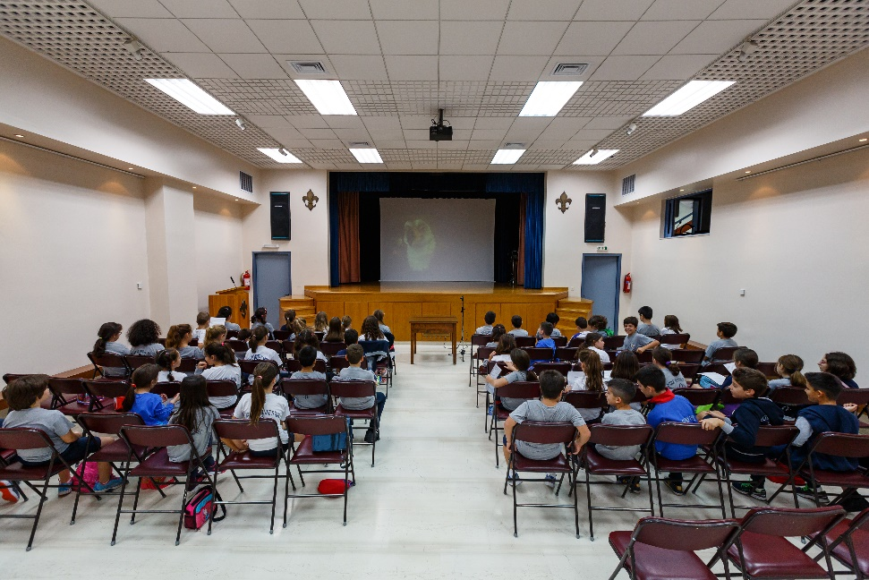
Our theater…

Slide 9
Our library…

Slide 10
Our chemistry lab…

Slide 11
Οur school also provides a small church.

