Slide 1
EASTER IN SPAIN

Slide 2
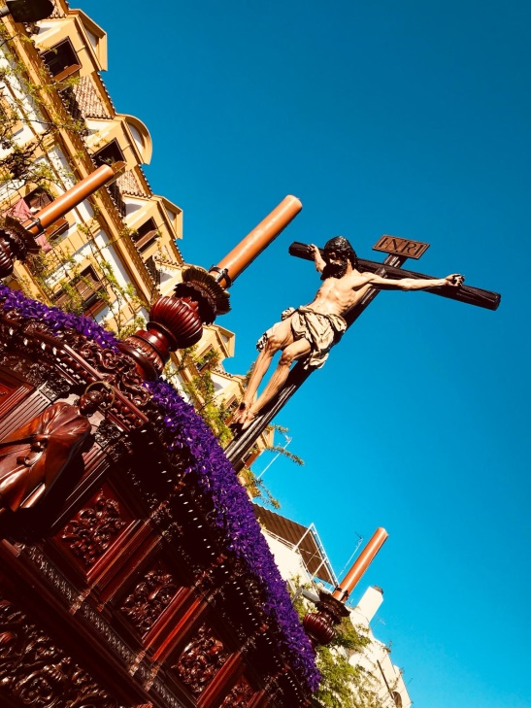
PROCESSIONS
FLOWS
RELIGIOUS IMAGES
REPENTANT MARCHES
MUSIC BANDS

Slide 3
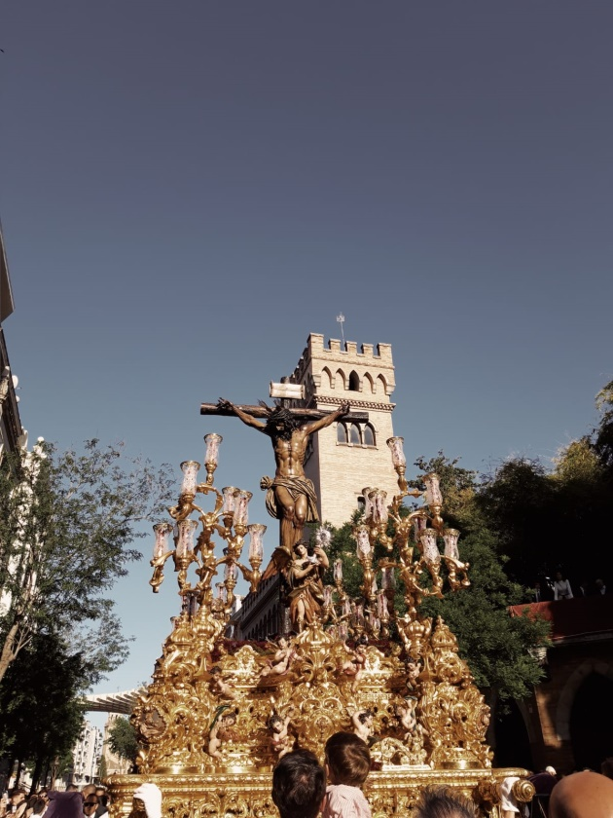
FLOWS
THE CRUCIFIED

Slide 4
VIRGIN MARY

Slide 5
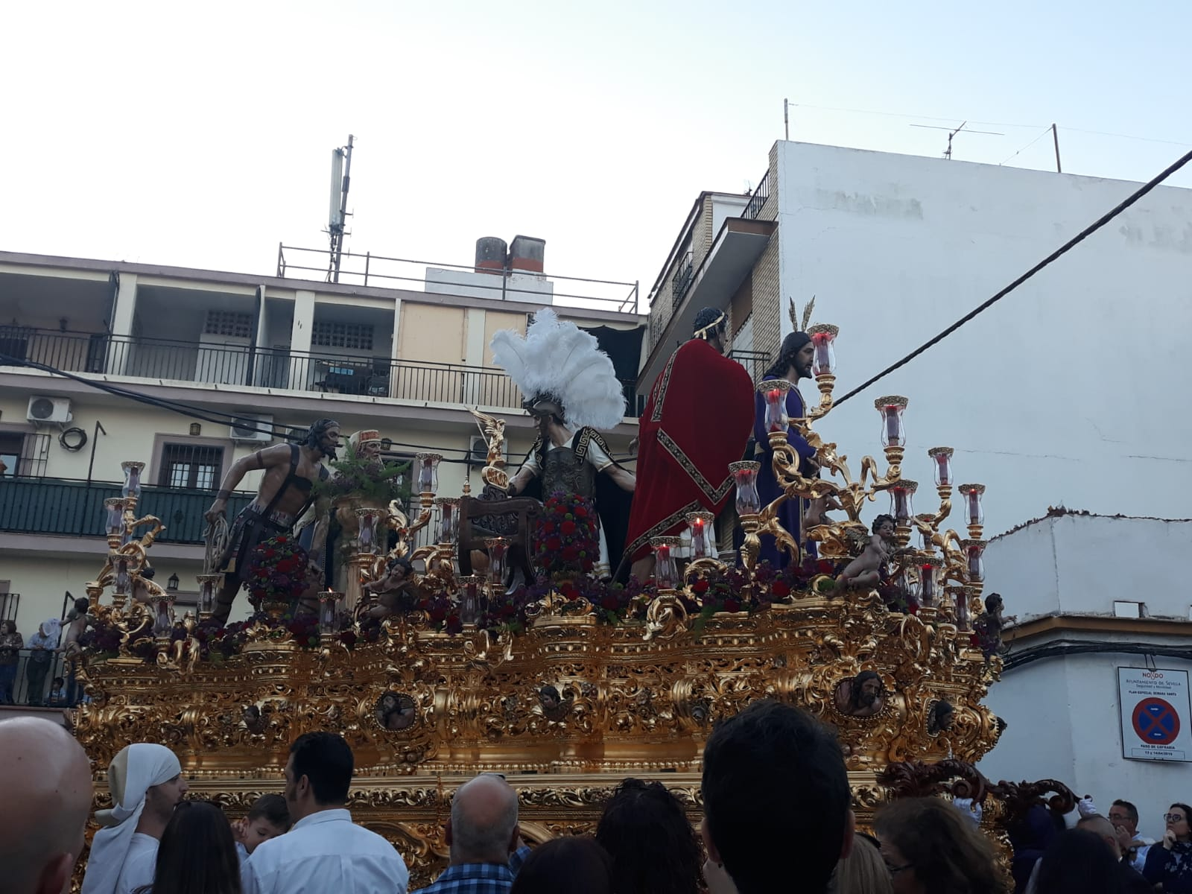
BIBLE SCENES

Slide 6
THE FLAGELLATED

Slide 7
ROMAN CENTURIONS

Slide 8
MUSIC BANDS

Slide 9
GASTRONOMY

Slide 10
EASTER EGGS

