Slide 1
Uneployment in Poland
Men and women

Slide 2
What is unemployment?
Unemployment is when people above a specified age are not in paid employment or self-employment and are currently available for work during the reference period.

Slide 3
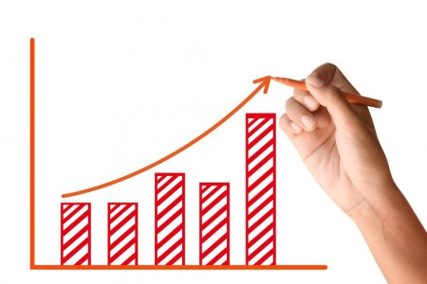
The highest jobless rate in Poland
The highest unemployment rate was reached in Poland in February 2003 and it was 20,7%.

Slide 4
The lowest unemployment rate in Poland
The lowest unemployment rate was reached in Poland in September 2019 and it was 5,1%.

Slide 5
Men and women
In the end of 2017 in Poland was 45,2 % working women and 62,2% working men.

Slide 6
Which specialists we need?
1. IT specialists
2. Projects managers
3. Technologists
4. Analitics
5. Content managers
6. CSR project managers
7. Employer branding manager
8. Sellers
9. Dietician
10. Sewers, plumbers

Slide 7
Thank you!
“The European Commission support for the production of this publication does not constitute an endorsement of the contents which reflects the views only of the authors, and the Commission cannot be held responsi­ble for any use which may be made of the information contained therein.”
By Paulina Pałkowska I LO im. Stefana Żeromskiego

