Slide 1
Women and men Politics
Aniela Dubicka

Slide 2
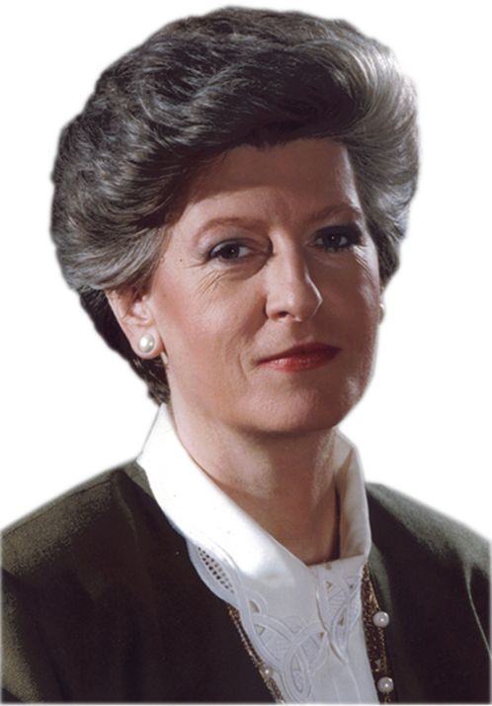
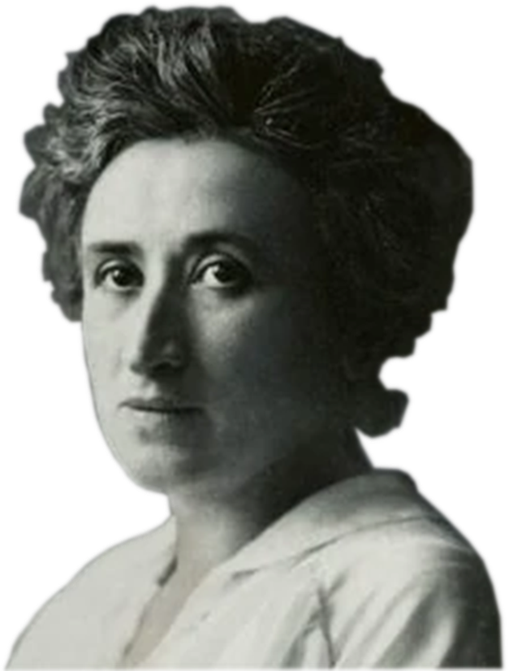
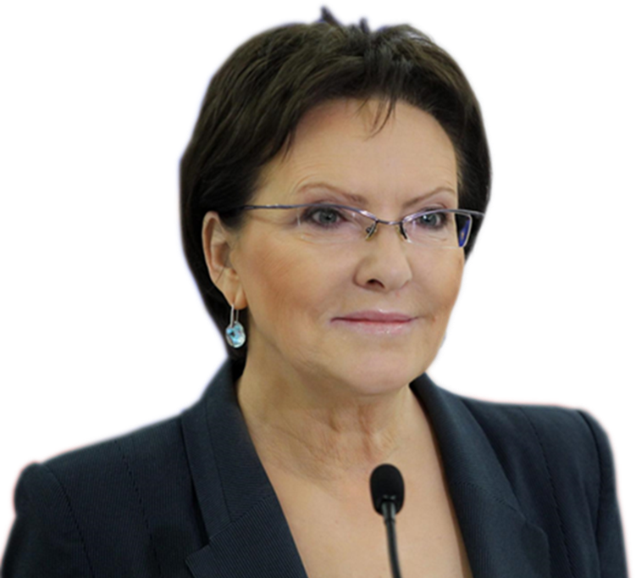
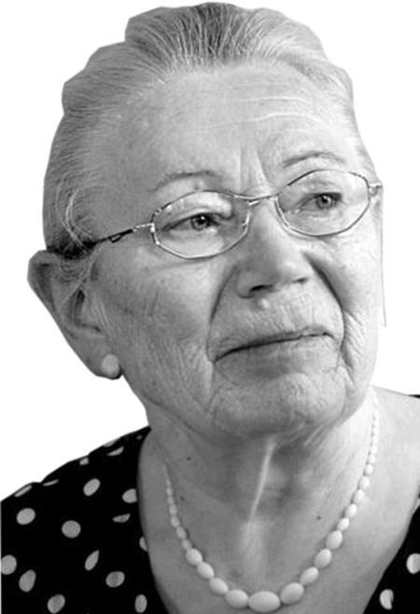
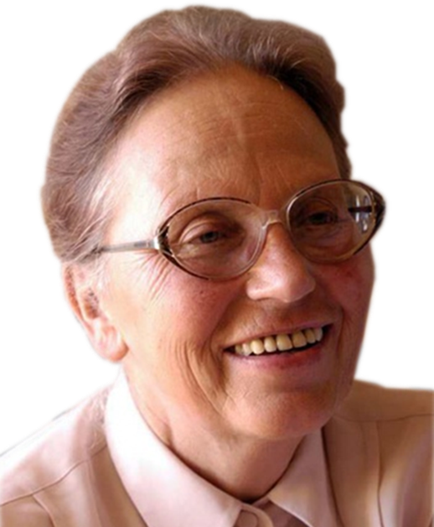
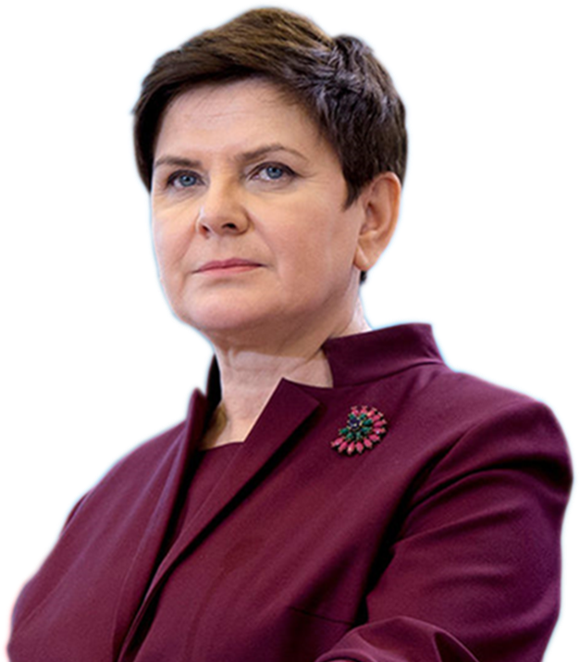
Women

Slide 3
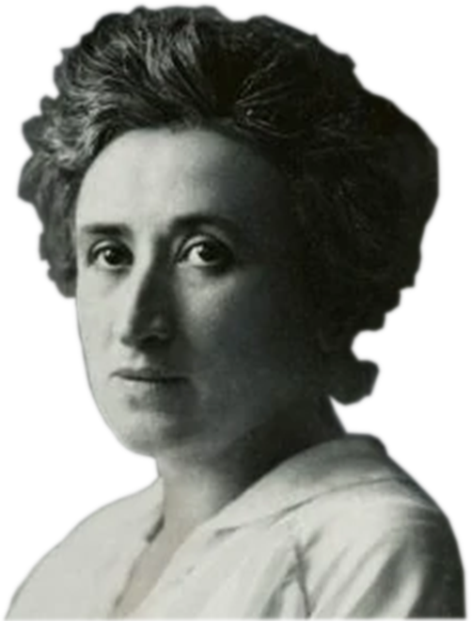
Róża Luksemburg
She was a Marxist, philosopher, economist, anti-war activist and revolutionary socialist. She was a member of the Social Democracy of the Kingdom of Poland and Lithuania (SDKPiL), the Social Democratic Party of Germany (SPD), the Independent Social Democratic Party (USPD) and the Communist Party of Germany (KPD). During World War I, Róża Luksemburg and Karl Liebknecht founded the Spartacus Union, which was to make the coup in Germany. Its main objective was to change the government in Germany. She criticised Lenin.

Slide 4
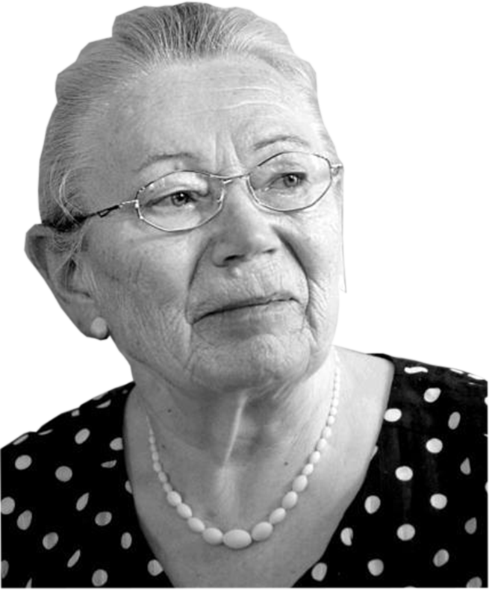
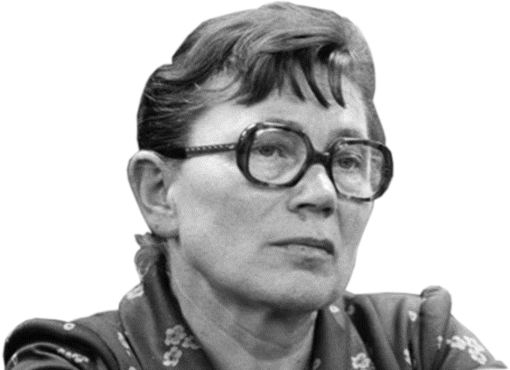
Anna Walentowicz
She was a social activist, dissident in PRL, activist of free trade unions, co-founder of NSZZ Solidarność. She initiated protest hunger after the murder of KS. Jerzy Popiełuszka. In 2006, she was awarded Poland's highest honour, the Order of the White Eagle. In 2020, Time magazine included her on the list of 100 Women of the Year who influenced the world over the last 100 years.

Slide 5
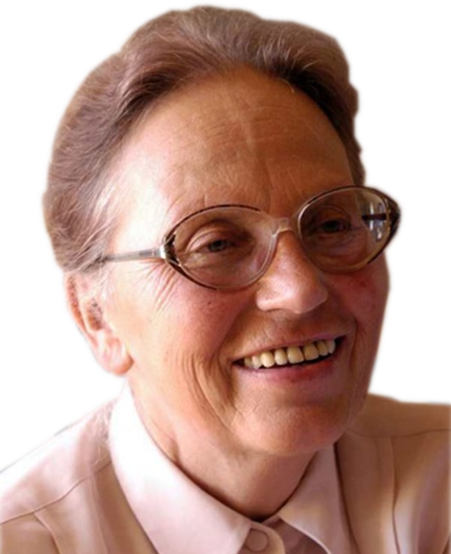
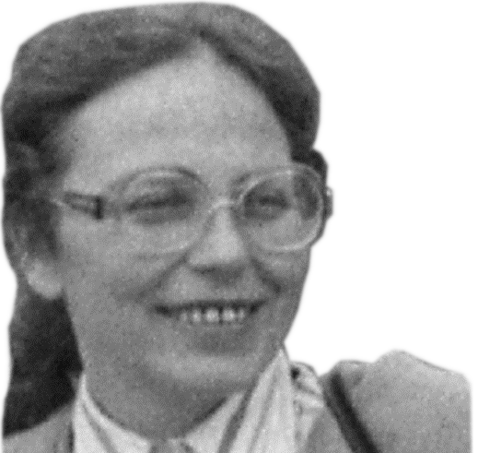
Joanna Duda-Gwiazda
She was an engineer, publicist and activist of the democratic opposition in PRL. She was member of the Polish United Workers’ Party. In August 1980 she participated in a strike in the Gdańsk shipyard and took a part in a hunger protest.

Slide 6
Head of Government
Hanna Suchocka
She is a political figure, lawyer, professor and Chair of the Constitutional Law Department, former First Vice-President and Honorary President of the Venice Comission. She is the first female Head of Government.
Ewa Kopacz
She is a politician and a Vice-President of the European Parliament . She was Marshal of the Sejm and she was Minister of Health. She is the second female Head of Governemnt.

Slide 7
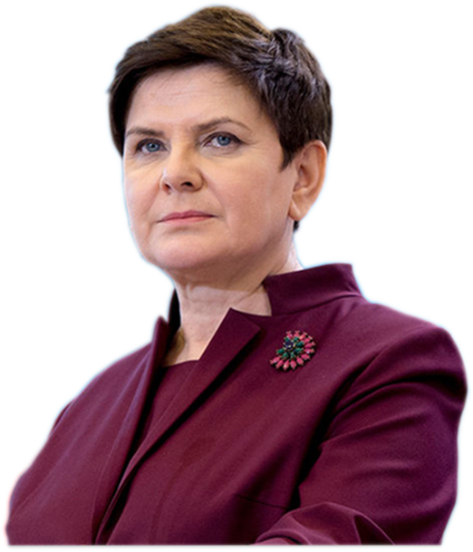
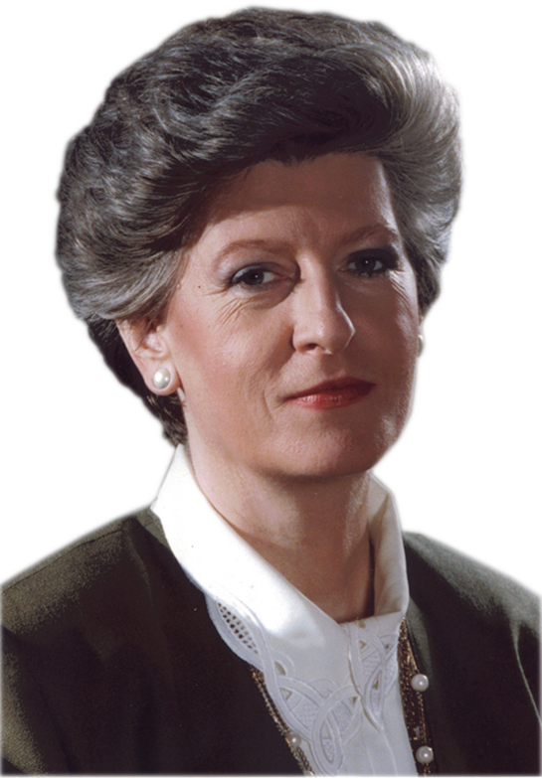
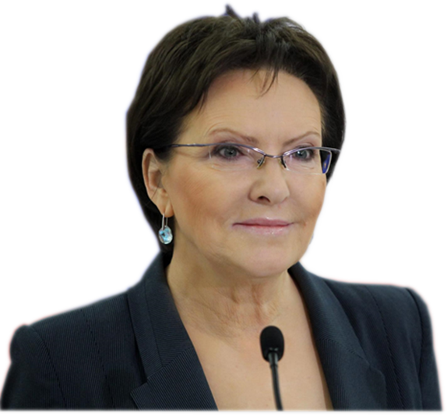
Beata Szydło
She is a politician who has been a Member of the European Parliament , as a member of the Law and Justice party. Szydło is Vice-Chair of the European Conservatives and Reformists group. She is the third female Head of Governemnt.

Slide 8
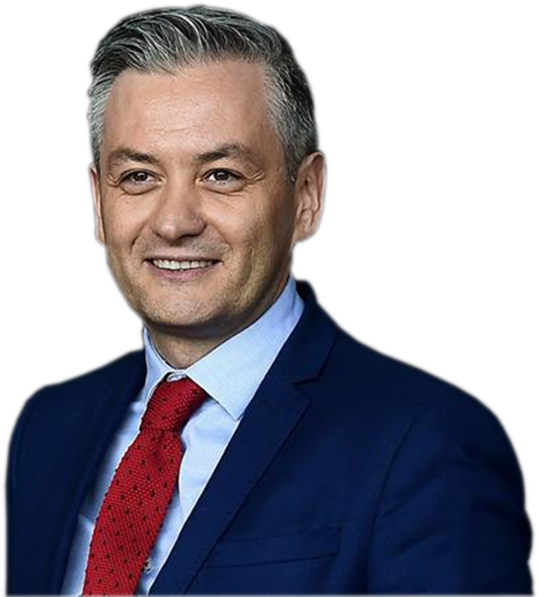
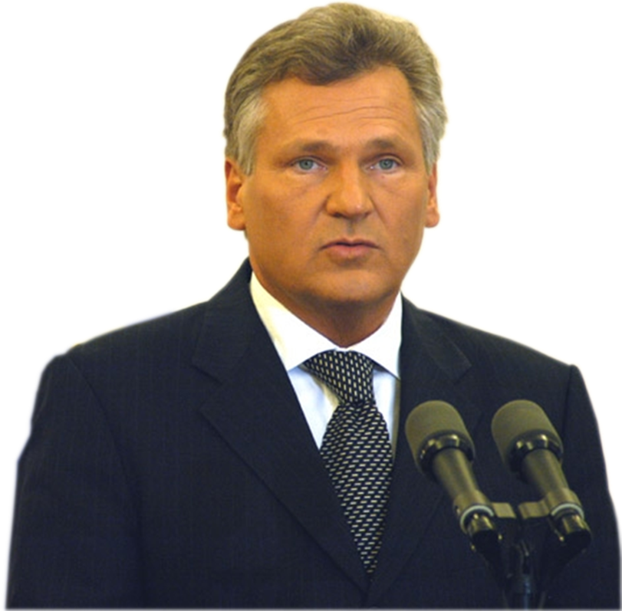
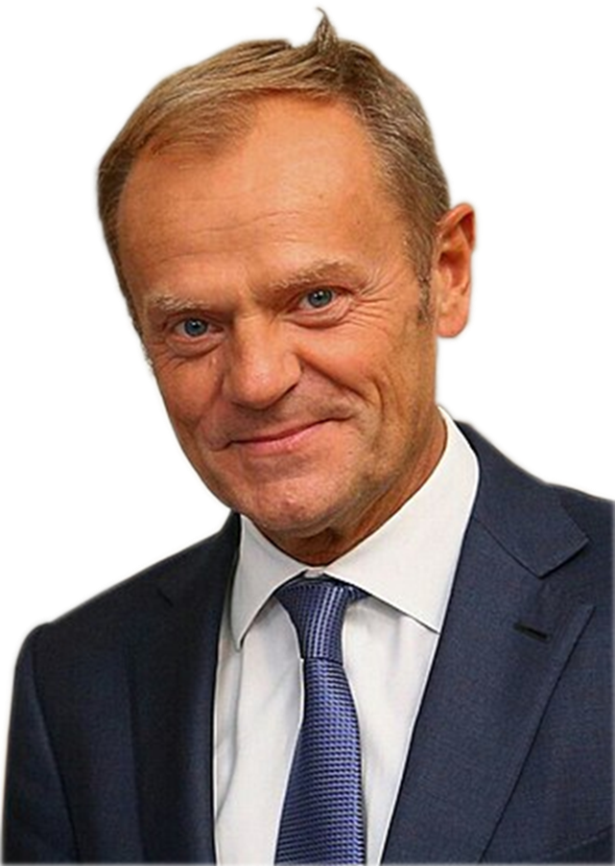
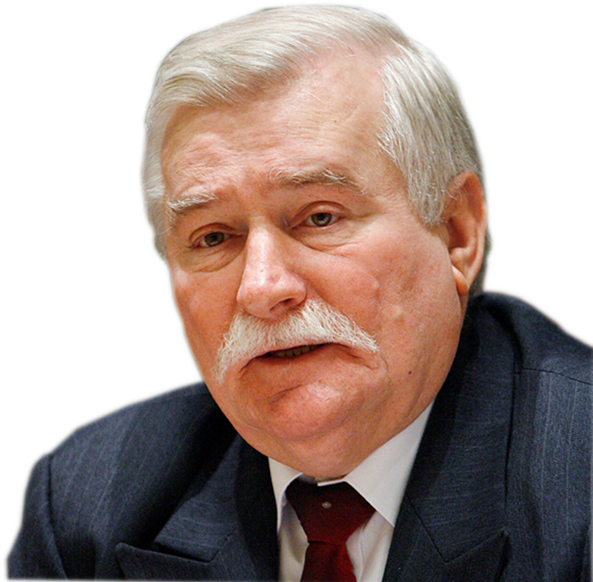
Men

Slide 9
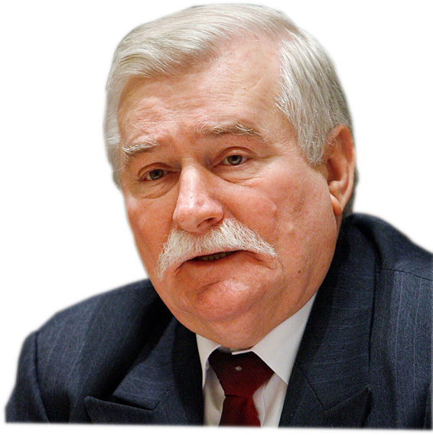
Lech Wałęsa
He is politician and trade union activist, professional electrician. One of the leading opponents in the period of PRL, co-founder and first president of the NSZZ Solidarność, in 1983 recipient of the Nobel Peace Prize. He was the President of the Republic of Poland from 1990 to 1995, he also initiated a strike in the Gdańsk shipyard, which was a breakthrough moment for Polish community.

Slide 10
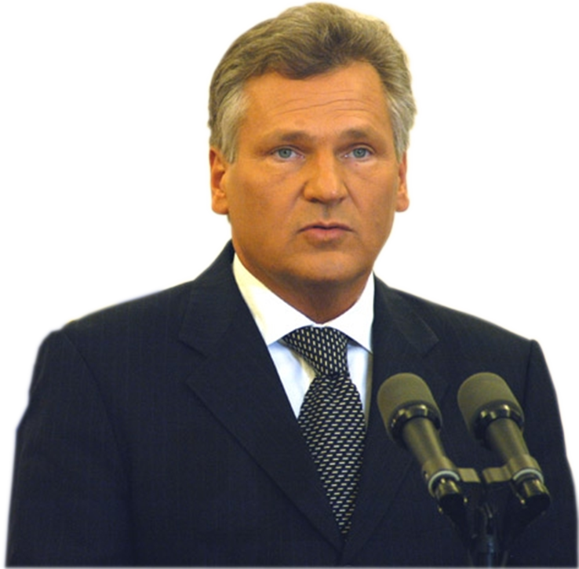
Aleksander Kwaśniewski
He is a politician and journalist, served as a President of Poland between 1995 and 2005. In the period of PRL activist of the Polish United Workers’ Party. He participated in the campaign for the accession of Poland to the European Union. He ratified the Treaty on the Accession of the Republic of Poland to the European Union. On 26th February 1999 Aleksander Kwaśniewski ratified the Polish accession to host the North Atlantic Pact (NATO).

Slide 11
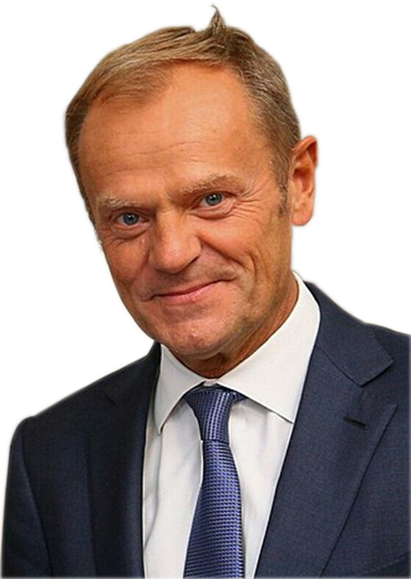
Donald Tusk
He is a politician who was President of the European Council. He served as the 14th prime minister of Poland and was a co-founder and chairman of the Civic Platform political party. On 20 November 2019, Tusk was elected as the president of the European People’s Party (EPP), Europe's largest transnational political party.

Slide 12
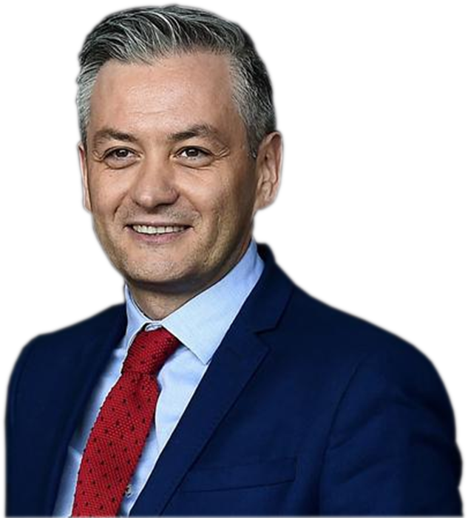
Robert Biedroń
He is a politician, former mayor of Słupsk, and LGBT activist who has been serving as a Member of the European Parliament since 2019. Biedroń was a member of the Sejm, launched a new political party called Spring. He is one of the three leaders of The left. He was a candidate for president of Poland in 2020 election.

Slide 13
“The European Commission support for the production of this publication does not constitute an endorsement of the contents which reflects the views only of the authors, and the Commission cannot be held responsible for any use which may be made of the information contained therein.”
Aniela Dubicka

