Slide 1
Stereotypes

Slide 2
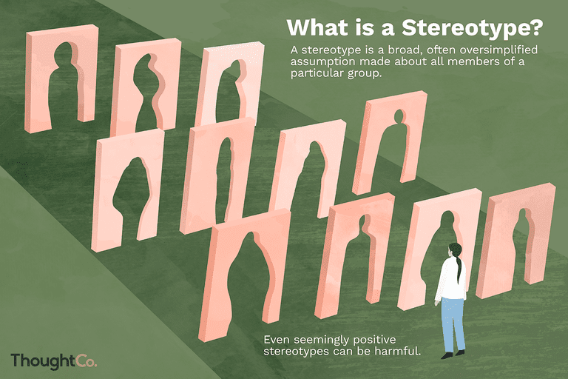
What is it?
Stereotype is an over-generalized belief about a particular category of people.

Slide 3
Common gender stereotypes
For women:
Praise women who are thin and fashionable, and put down those who have other body shapes and styles
Treat women and girls as sexual objects
Portray women's key role in life as the caretaker or homemaker
Show women as dramatic, catty, and over-emotional

Slide 4
Women with blonde hair are stupid
Every women want to get married
Beautiful woman can’t be inteligent
Women shouldn’t be successful, only men

Slide 5
For men:
Idealise a buff and toned body shape
Stigmatise boys who show emotion instead of being brave
Depict boys who act recklessly, even at the expense of others, as cool
Men shouldn’t cook and clean
Men are always more inteligent than women

Slide 6
Stereotypical occupations only for women
Nurse
Beautician
Hairdresser
Babysitter
Flight attendant
Cleaner
Kindergartner

Slide 7
Stereotypical occupations for men
Engineer
Developer
Mechanic
Politician
Soldier
Builder

Slide 8
Polish stereotypes
The Polish like vodka
They don’t like different nationalities
They like complaining
They aren’t very intelligent

Slide 9
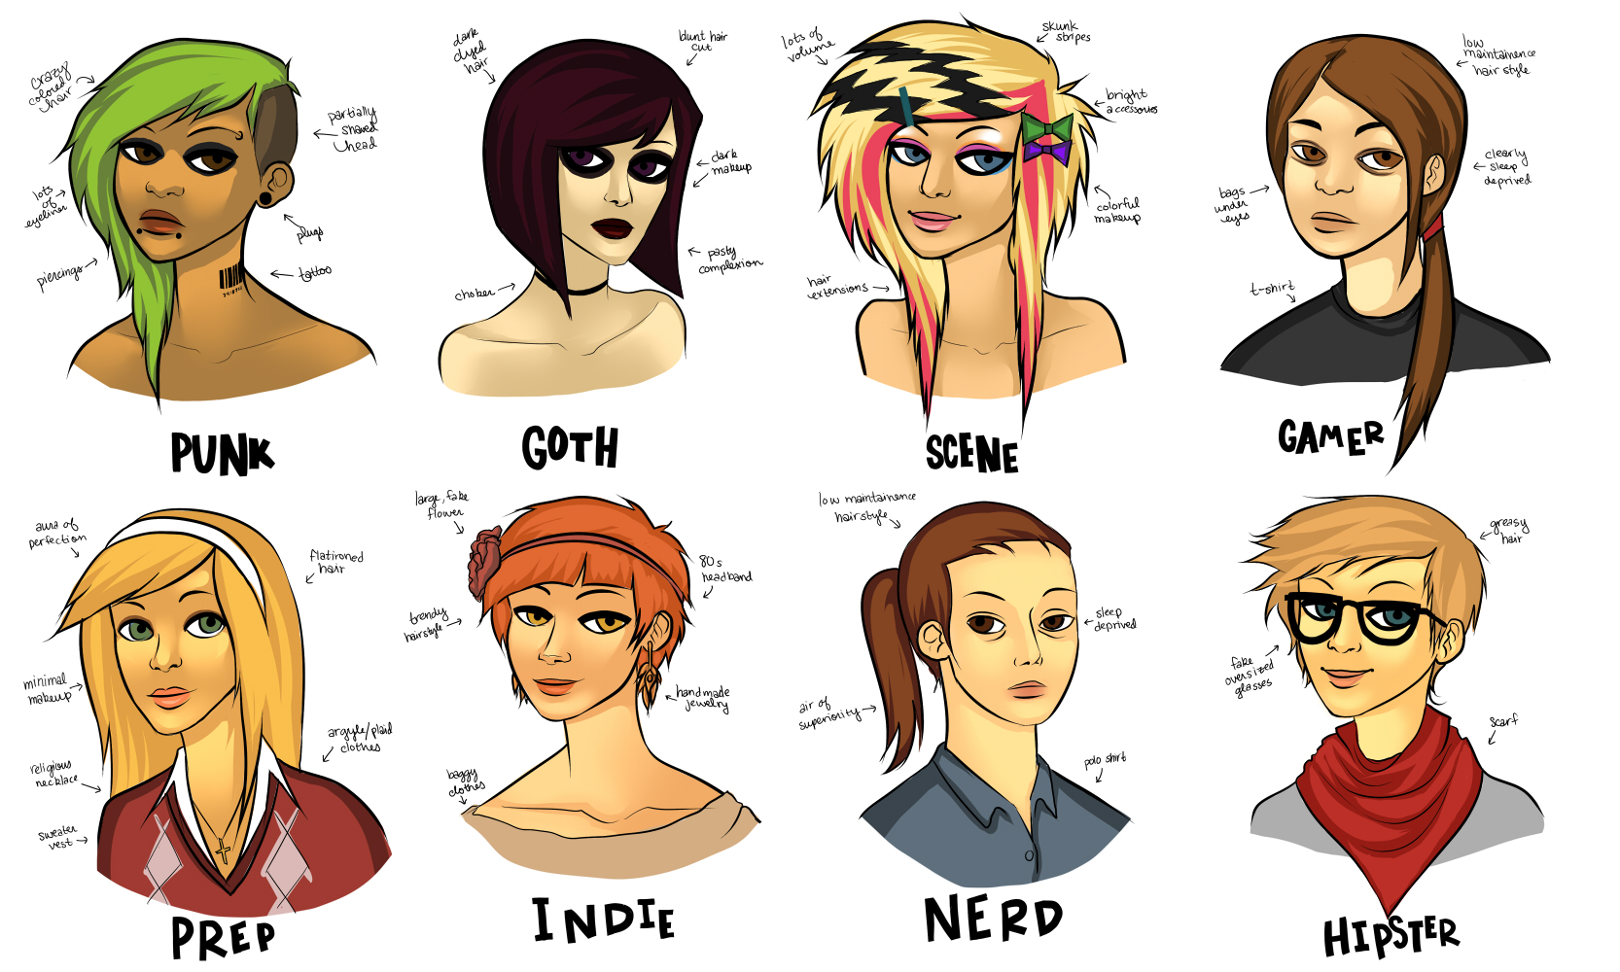
Stereotypes usually aren’t true. People are hurt when they are put into one general bag. Everyone is different, has a different story. Unfortunately stereotypes hurt people and that’s why we shouldn’t believe them.

Slide 10
“The European Commission support for the production of this publication does not constitute an endorsement of the contents which reflects the views only of the authors, and the Commission cannot be held responsible for any use which may be made of the information contained therein.”
By Paulina Pałkowska I LO im. Stefana Żeromskiego w Pucku

