Slide 1
EDGE TALKS ON CURRENT FACTS
CURRENT ISSUES

Slide 2
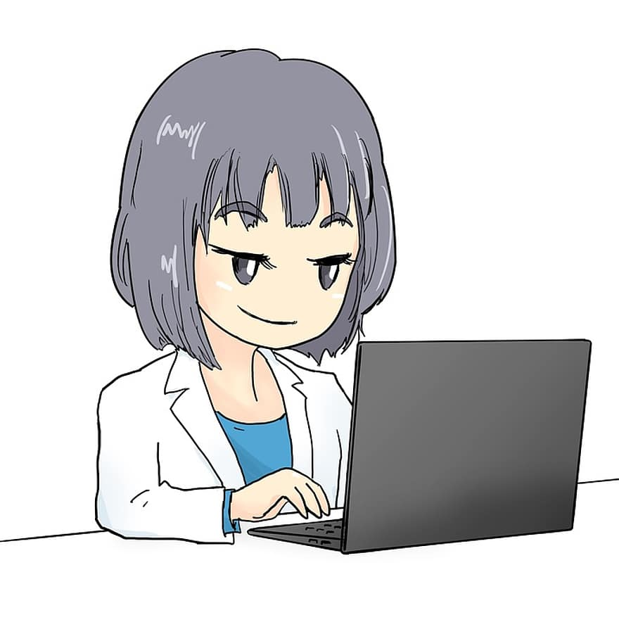
Hello! I’m...

Slide 3
Here is where you add your talking points.
EQUALITY
DIVERSITY
GENDER
EDUCATION

Slide 4
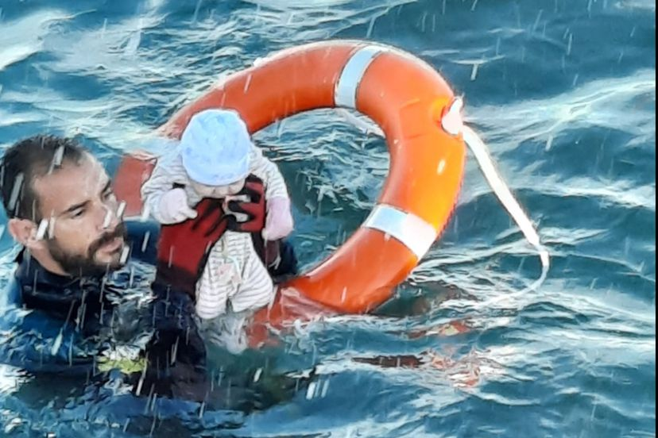
EUROPE VS AFRICA
01

Slide 5
Did you know?
LAST WEEK MORE THAN 8000 YOUNG MOROCCAN PEOPLE CROSSED THE BORDER.
THE SPANISH ARMY AND EMERGENCY SERVICES HAD TO INTERVENE TO PRESERVE THEIR HUMAN RIGHTS.
THE MOROCCAN POPULATION IN SPAIN REACHES 900000 PEOPLE AT THE MOMENT

Slide 6
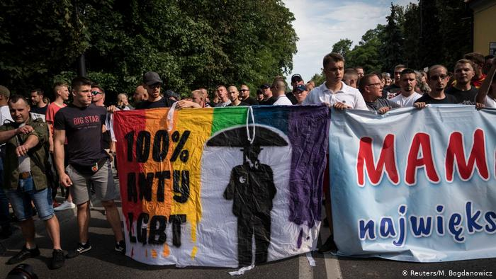
02
LGBT VS POLAND

Slide 7
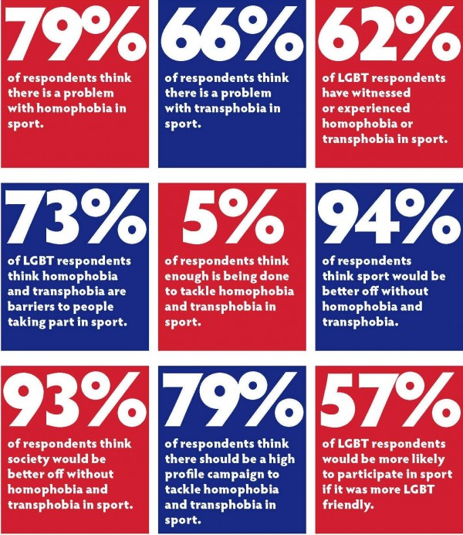
Did you know?

Slide 8
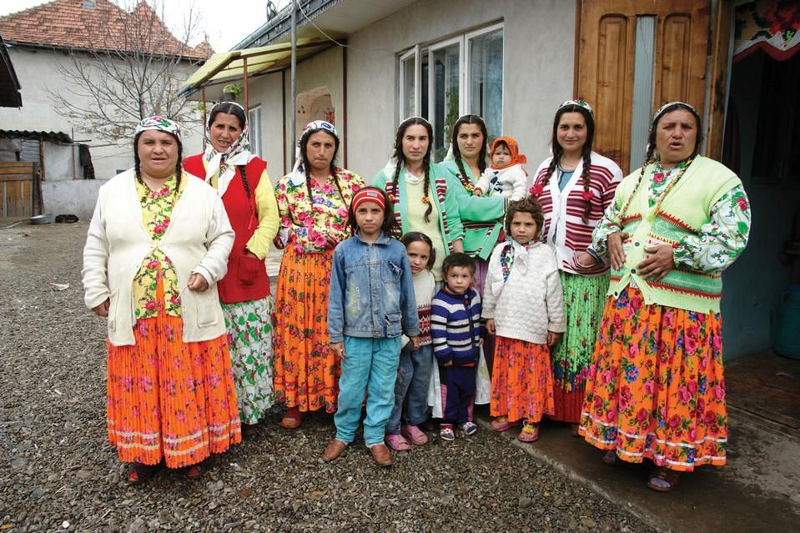
03

Slide 9
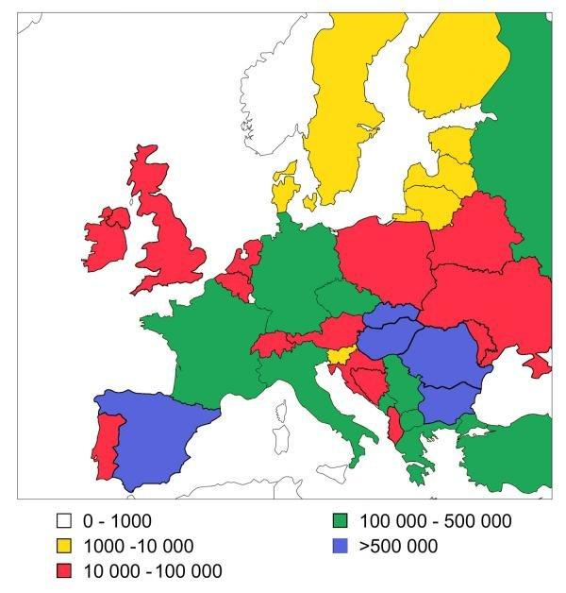

Slide 10
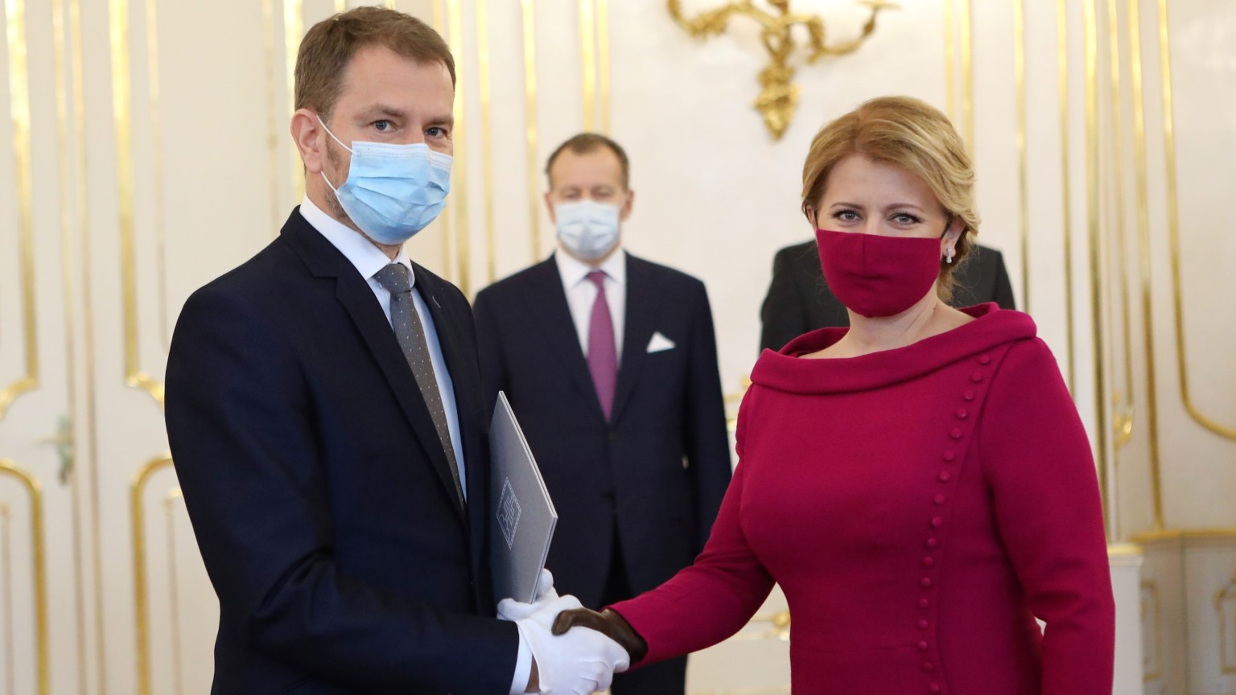
FIRST FEMALE PM IN SLOVAKIA
04

Slide 11
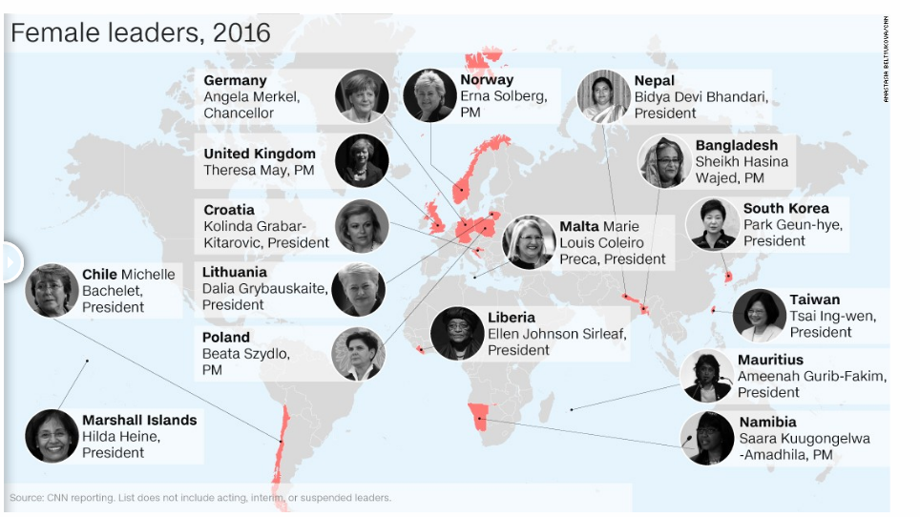
Did you know?

Slide 13
Pandas don’t hibernate.
“The European Commission support for the production of this publication does not constitute an endorsement of the contents which reflects the views only of the authors, and the Commission cannot be held responsi­ble for any use which may be made of the information contained therein.”

