Slide 1
Job satisfaction

Slide 2
Job satisfaction – what does it mean?
It is a measure of workers’ contentedness with their job, whether or not they like the job or individual aspects or facetes of jobs, such as nature of work or supervision

Slide 3
Components of job satisfaction are :
Evaluative component – I like / I dislike my job,
Cognitive component – My work is challenging and interesting,
Behavioral component – I am reliable and I work hard,

Slide 4
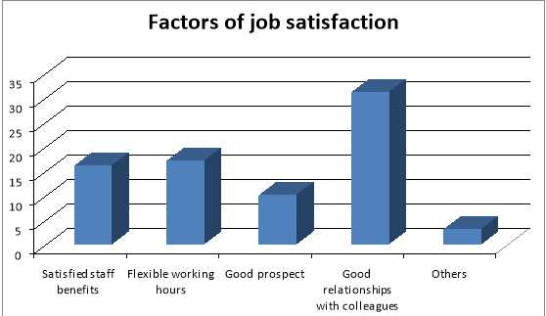
Which affects job satisfaction?
Organizational factors,
Social factors,
Personal factors,

Slide 5
Organizational factors
These are factors directly related to work. These include : the type of tasks performed by employee (for example their degree of difficultry and curiosity), salary appropriate to the employees duties, work safety and company policy.

Slide 6
Personal factors
These are the individual characteristics of employees that affect the level of satisfaction. Belong tho them : age, sex, race, cognitive abilities and personality traits.

Slide 7
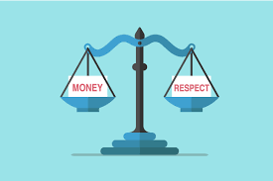
Social factors
Examples of social factors : organizational climate, mutual respect, arrangement with supervisors and co-workers and relationship with customer

Slide 8
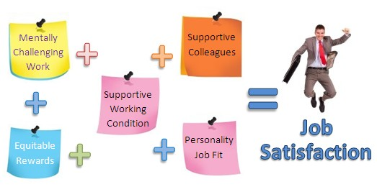
Reasons for job satisfaction :
Money,
New friendships,
Higher qualifications,
New experiences,
Improving skills,
A lot of oppurtunities,
Psychical condition,
Make dreams come true,

Slide 9
Wiktoria Nowak
Julia Krampichowska
Julia Wesołowska
I Bg

