Slide 1
MEN AND WOMEN UNEMPLOYMENT
IN THE WORLD

Slide 2
What is the unemployment?
Unemployment, according to the Organisation for Economic Co-operation and Development (OECD), is when persons above a specified age (usually above 15) are not in paid employment or self-employment and are currently available for work during the reference period.

Slide 3
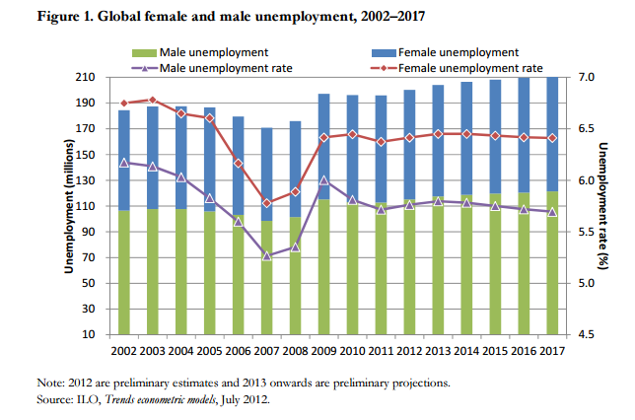
How many people are unemployed?

Slide 4
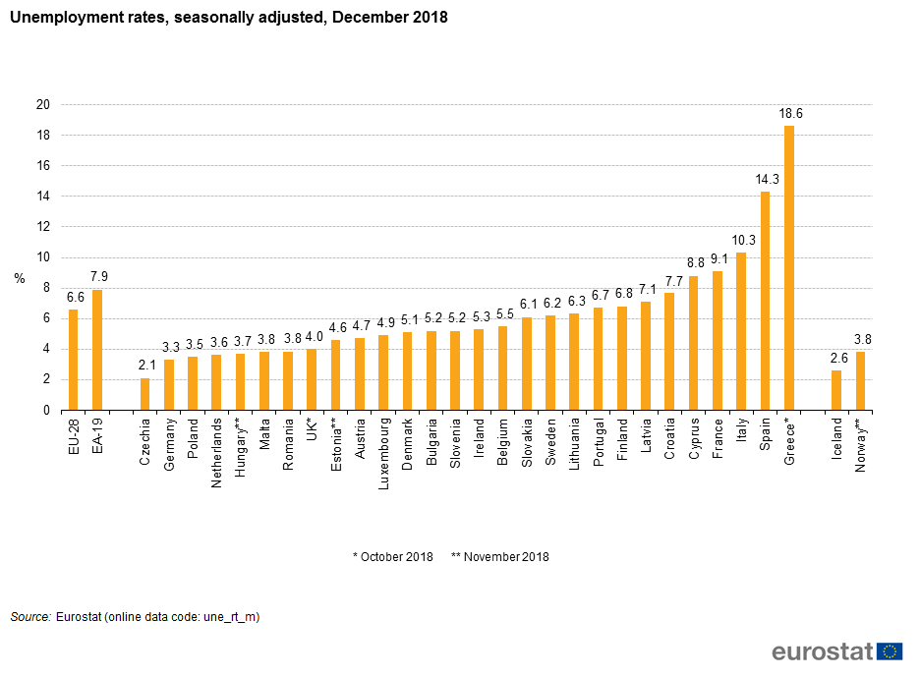
Unemployment in europe

Slide 5
Do you know that...
172 Million people globally or 5% of the reported workforce of the world were without a job in 2018 according to the International Labour Organization (ILO).

Slide 6
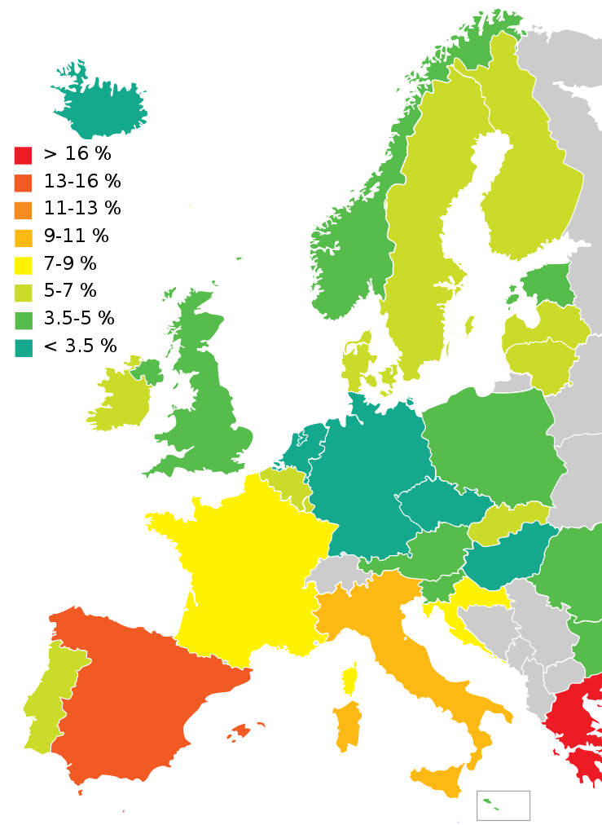
Unemployment in the European Union, Switzerland and two EEA countries (Iceland and Norway) in March 2017

Slide 7
Why more women are unemployed than men?
Around the world, finding a job is much tougher for women than it is for men. When women are employed, they tend to work in low-quality jobs in vulnerable conditions, and there is little improvement forecast in the near future.
Women who want to work have a harder time finding a job than men. This problem is particularly marked in Northern Africa and the Arab States, where unemployment rates for women exceed 16%.
While vulnerable employment is widespread for both women and men, women tend to be overrepresented in certain types of vulnerable jobs: men are more likely to be working in own-account employment while women are more likely to be helping out in their households or in their relatives’ businesses.

Slide 8
Highest Female Unemployment Rates In The World
1. Yemen – 39.2%
2. Lesotho – 32.1%
3. Greece – 31.4%
4. Bosnia and Herzegovina – 29.8%
5. Mauritania – 29.5%
6. Syria – 28.2%
7. Macedonia – 28.1%
8. Libya – 28.1%
9. Egypt – 27.8%
10. South Africa – 27.6%

Slide 9
women in male jobs
Women can also work in male jobs. Nowadays, fortunately they are more and more independent and they can do their dream works.

Slide 10
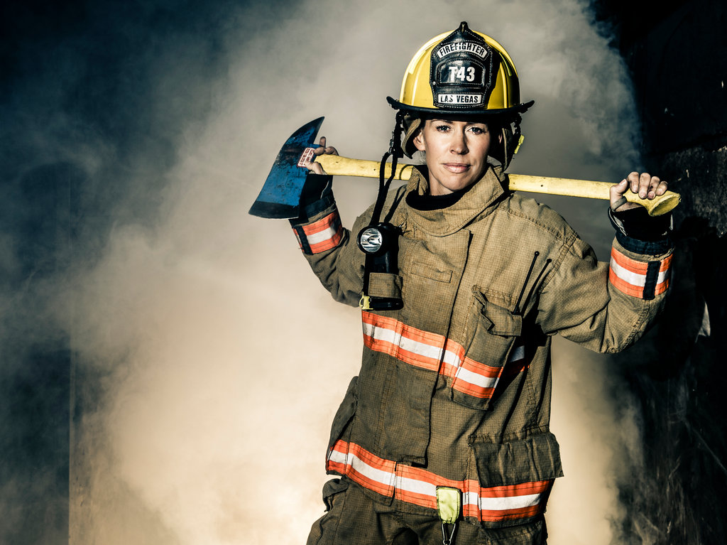

Slide 11
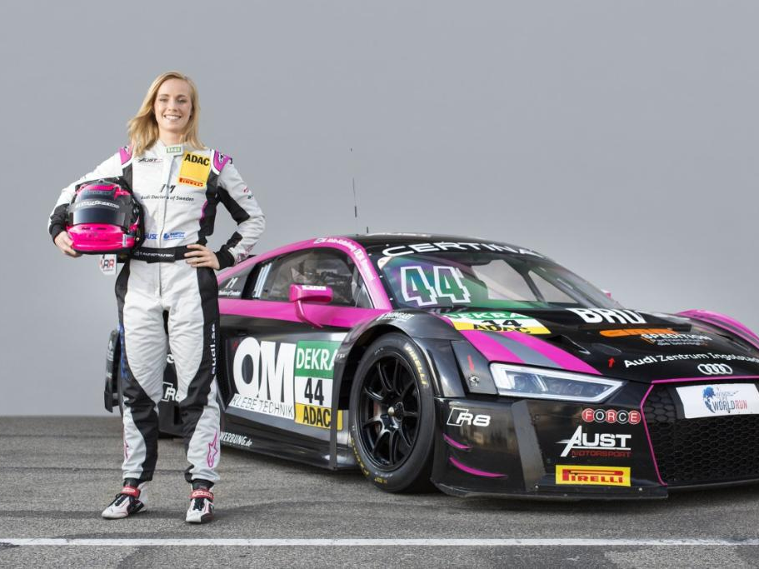

Slide 12
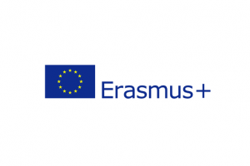
The European Commission support for production of this publication does not constitute an endorsement of the contents which reflects the views only of the authors, and the Commission cannot be held responsi­ble for any use which may be made of the information contained therein.”
MADE BY:
Maciej Hemlich

