Slide 1
PBL- environment project
How can we reuse our garbage?

Slide 2
Curriculum
Core Content
Language and communication
Discuss, listen, ask questions and express their own thoughts, opinions and arguments
Discuss the content of and message in different types of texts
Creative and aesthetic forms of expression
Create through play, drawing and painting, music, dance, drama and other aesthetic forms of expression.
Different materials, tools and technologies for creating and expressing oneself.
Natur, technology and society
How different everyday choices people make can contribute to sustainable development.
Design and construction using different materials, tools and techniques.
Different ways to explore phenomena and relationships in nature, technology and society, for example through observations, measurements and discussions of findings. How pupil relevant phenomena and relationships can be described, for example with words and pictures or simpler tables and diagrams.

Slide 3
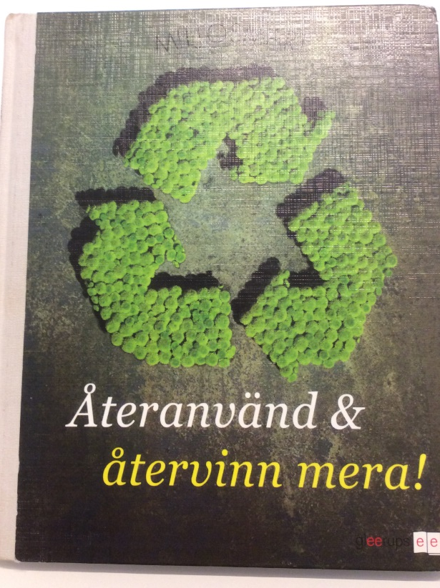
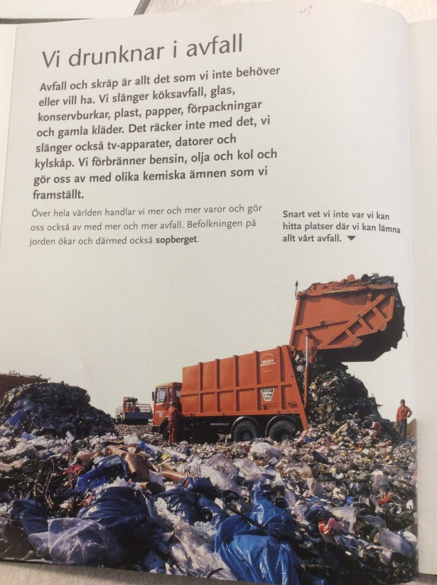
we read about how much debris there is in the world.

Slide 4
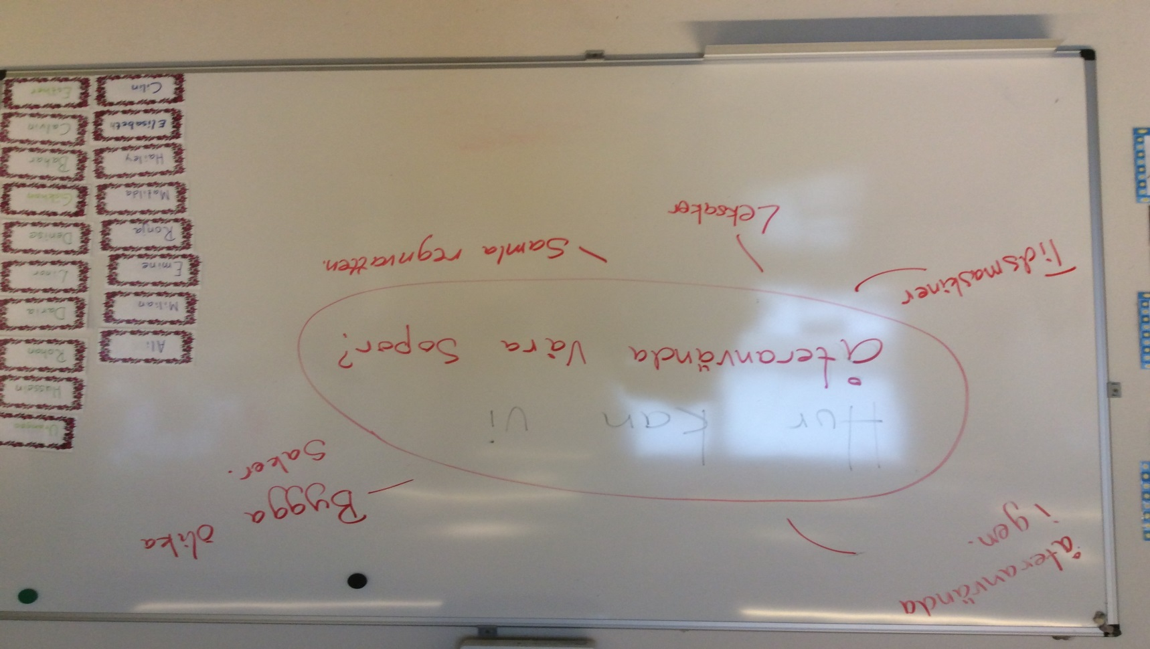
Mind map on how we can reuse our garbage

Slide 5
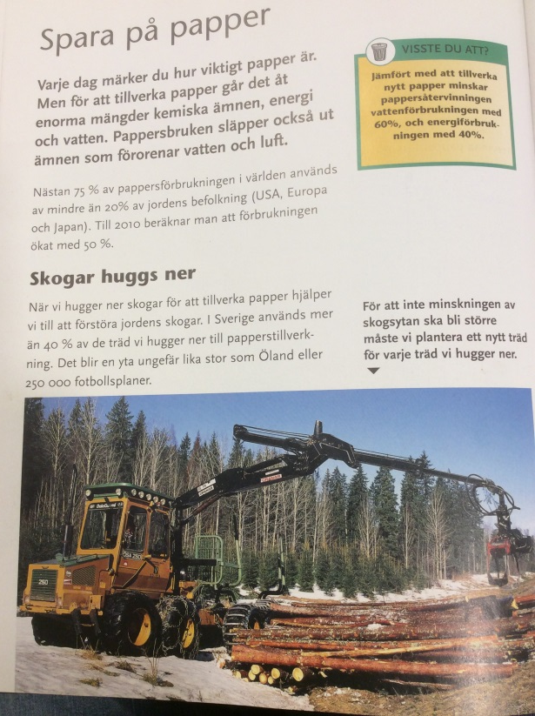
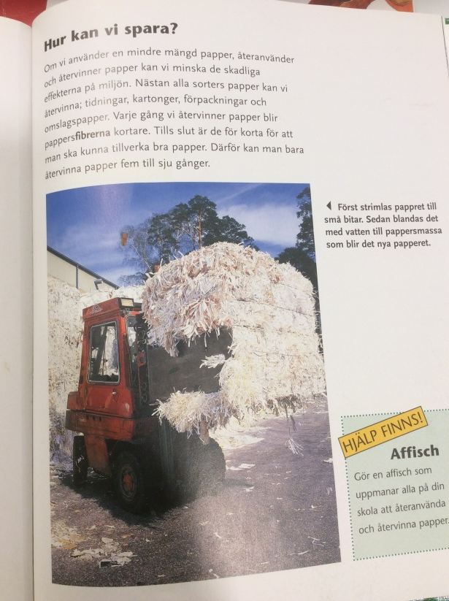
We read about papper making.

Slide 6
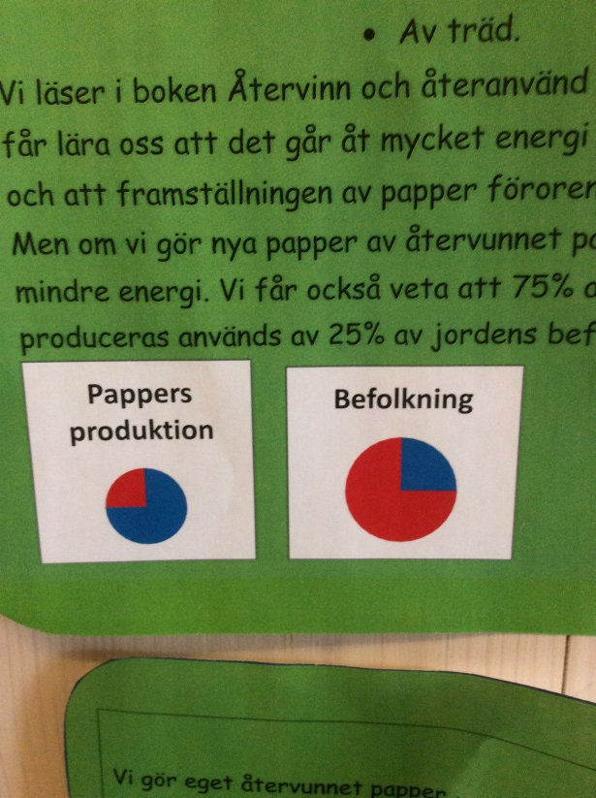
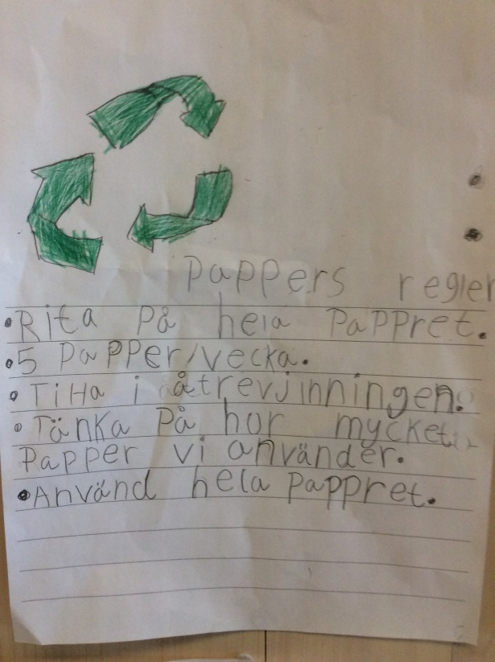

Slide 7
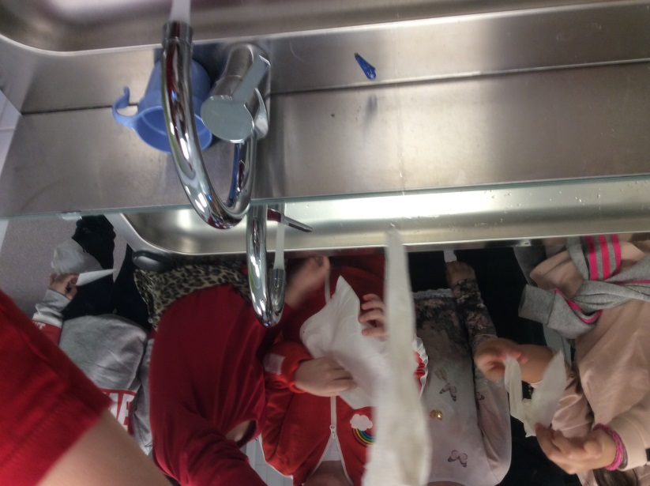
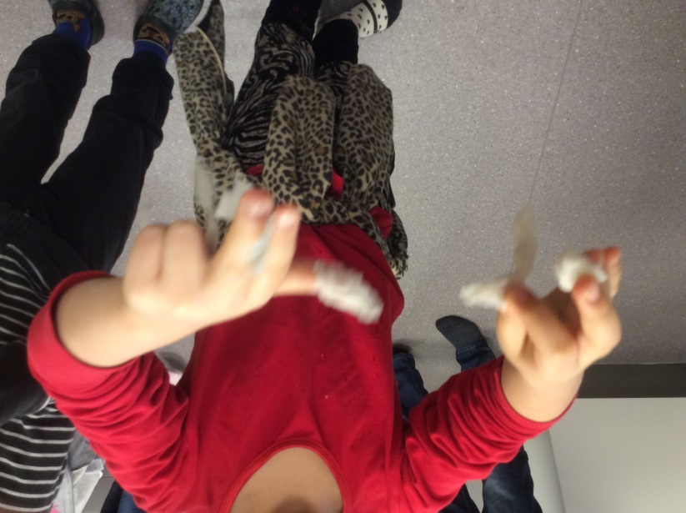
Explores different types of paper

Slide 8
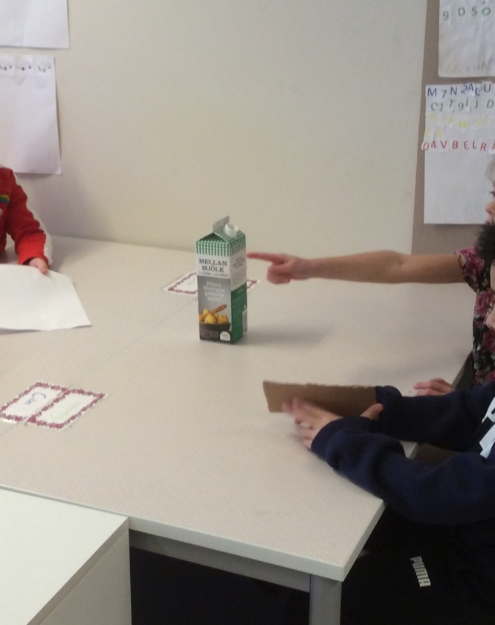
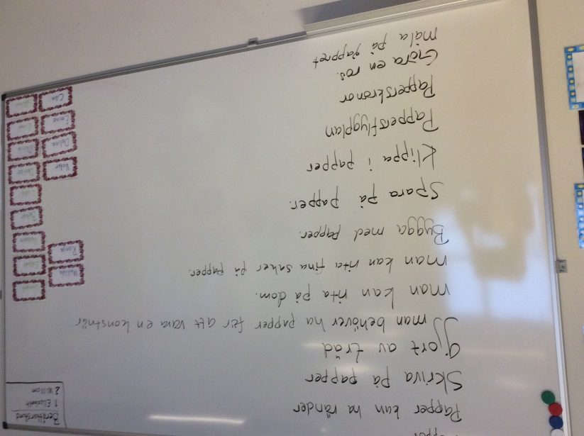

Slide 9
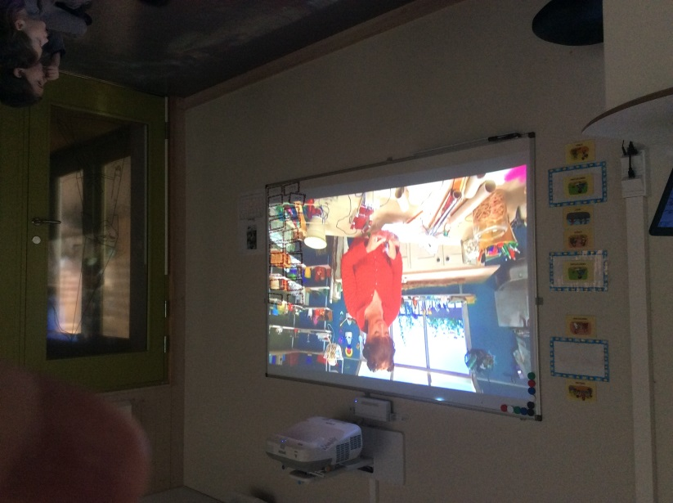

Slide 10
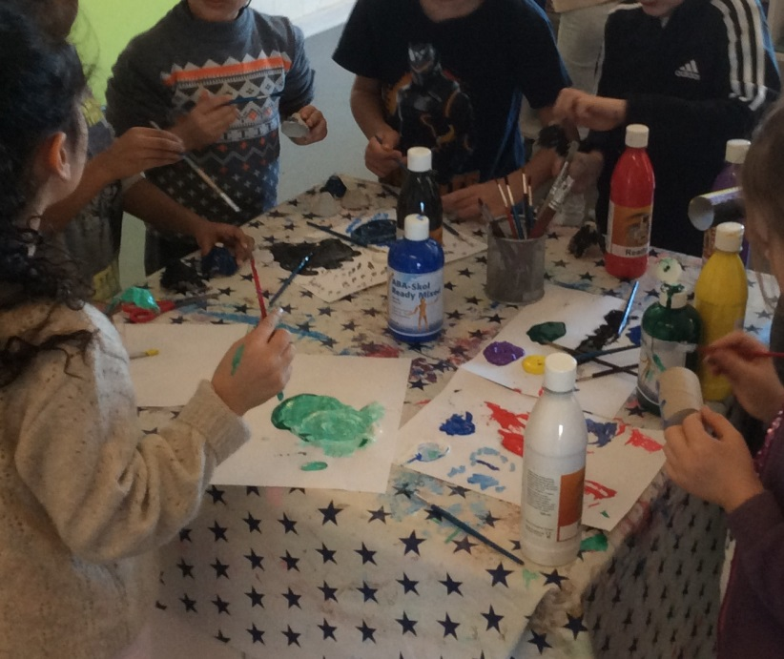
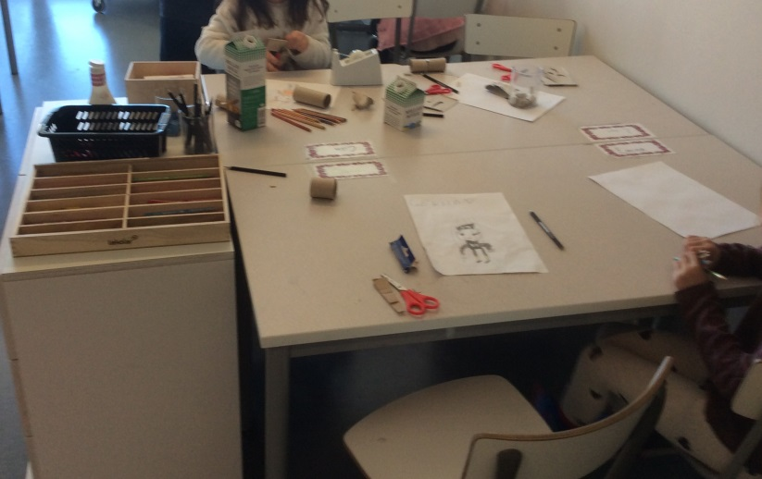
Puppet making

Slide 11
