Slide 1
In what way do we want our district to grow?
Year 4 and year 5

Slide 2
The curriculum of the swedish schoolsystem regarding syllabuses in swedish language, maths, geography, technology

Slide 3
Syllabuses
Math:
Strategies for mathematical problem-solving in everyday situations
Swedish:
Using arguments in different discussion situations and decision processes.
Oral presentations and storytelling for different audiences, on topics drawn from daily life and school. Key words, images, digital media and tools, as well as other aids for planning and performing an oral presentation. How gestures and body language can influence a presentation.

Slide 4
Syllabuses
Geography:
How choices and priorities in everyday life can impact the environment and contribute to sustainable development.
Technology:
Documentation in the form of sketches with explanatory words and terms, symbols and measurements, as well as physical and digital models.

Slide 5
Pre knowledge
History of the district
An update about the district up to now
The vision of the district from the municipality

Slide 6
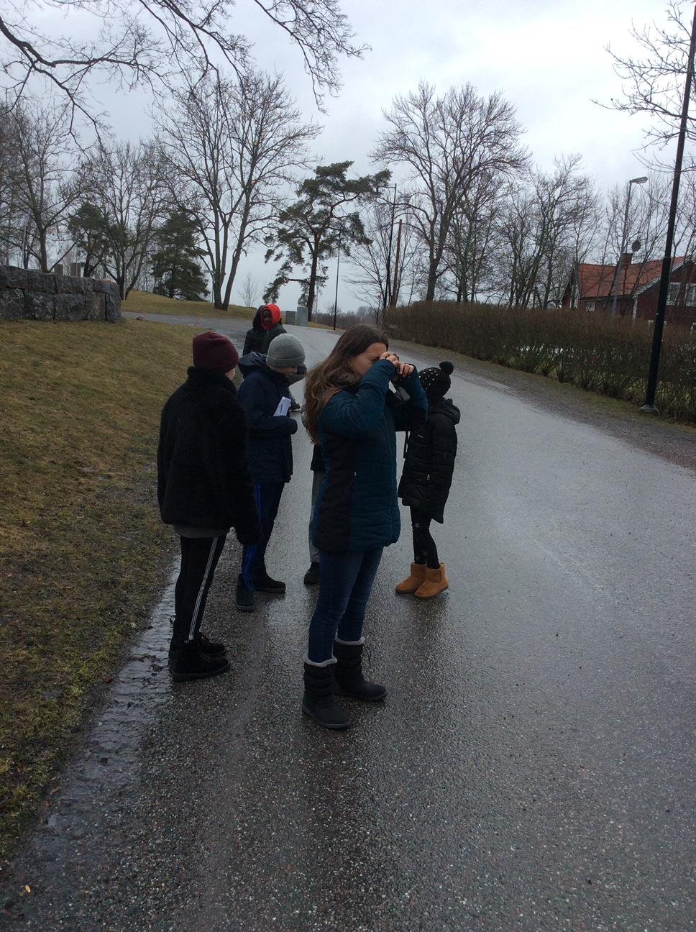
History facts
The pupils are attending a photoproject where they learn about the history of the district while they photograph.

Slide 7
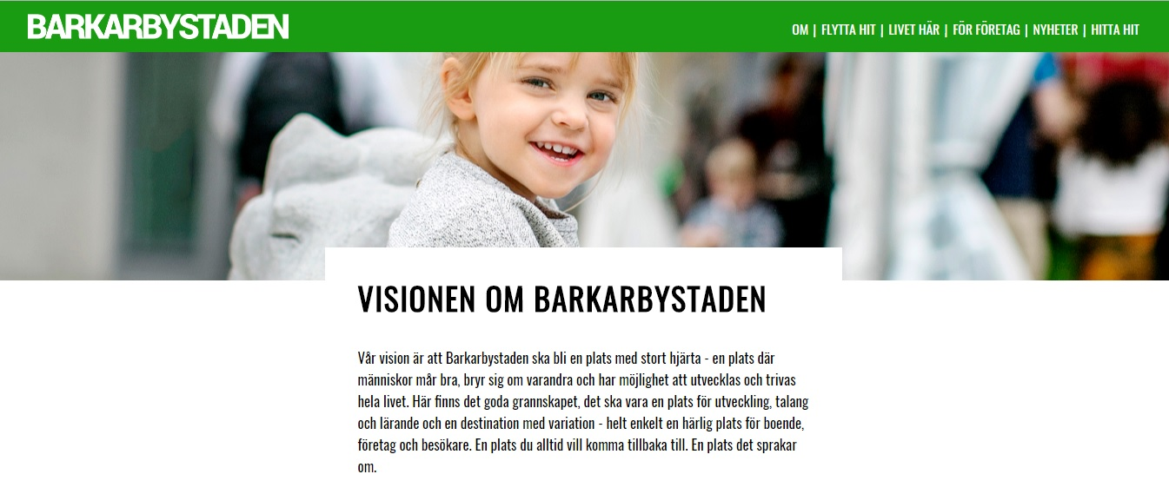
Update about the district
The pupils have read texts about the district, it´s resources, the active life, attractions, shopping inhabitants etc

Slide 8
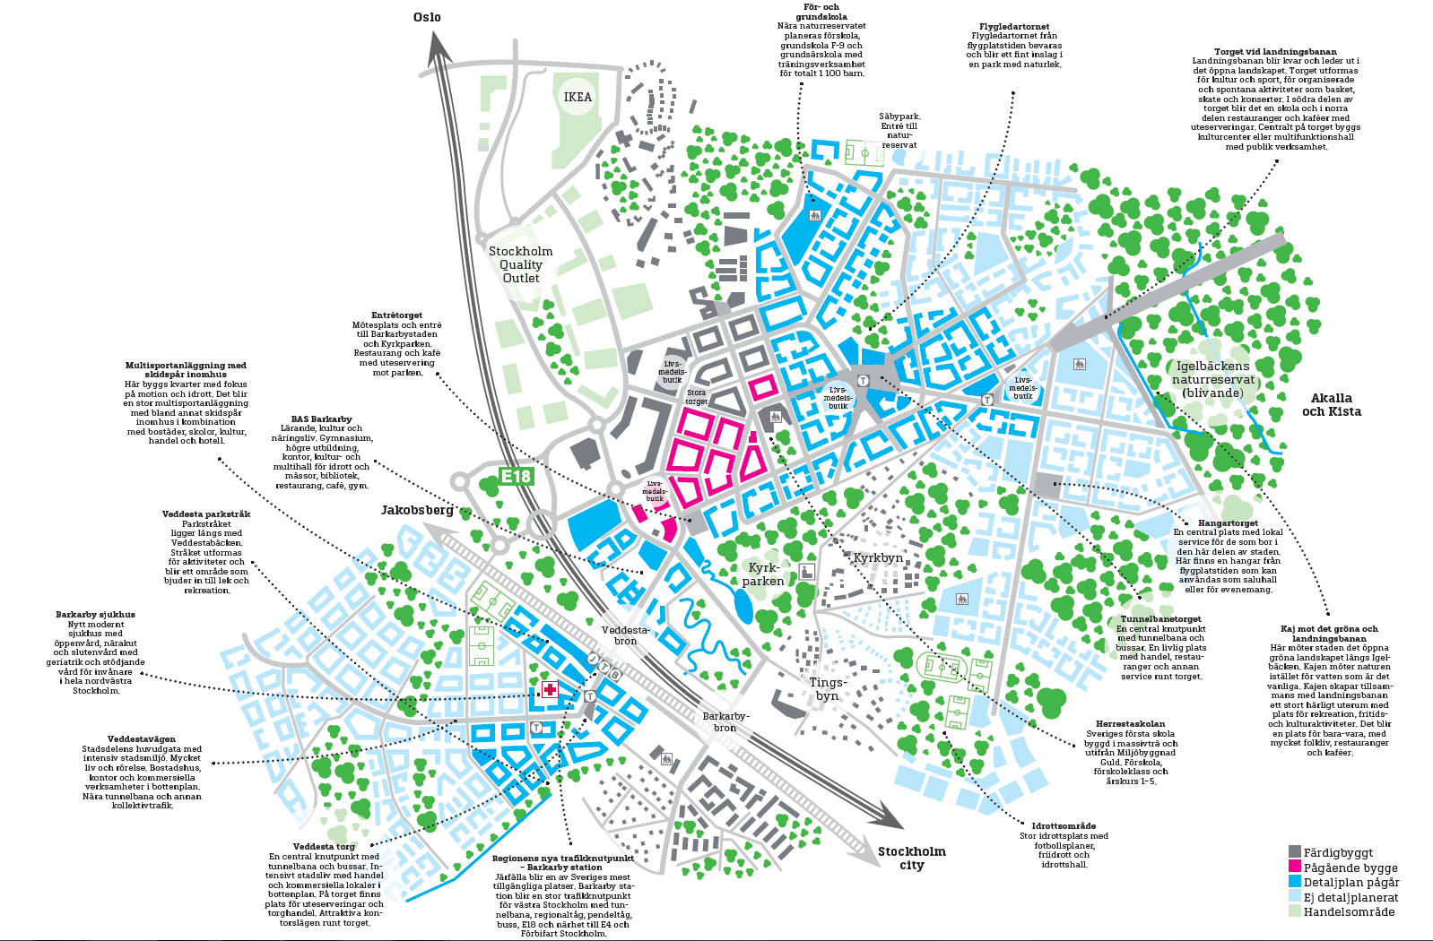
The vision of the town from the municipality
We had a look at a map of the vision that the municipality have of the town and also read a text about it.

Slide 9
Methods
Read texts together in a wider group and individually
Discussions about the map of the district
Watch movies about different districts and cities
Observations in the nearby area
Work in groups to plan the district
Work in pairs to do a digital visual presentation about the district

Slide 10
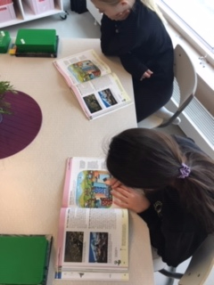
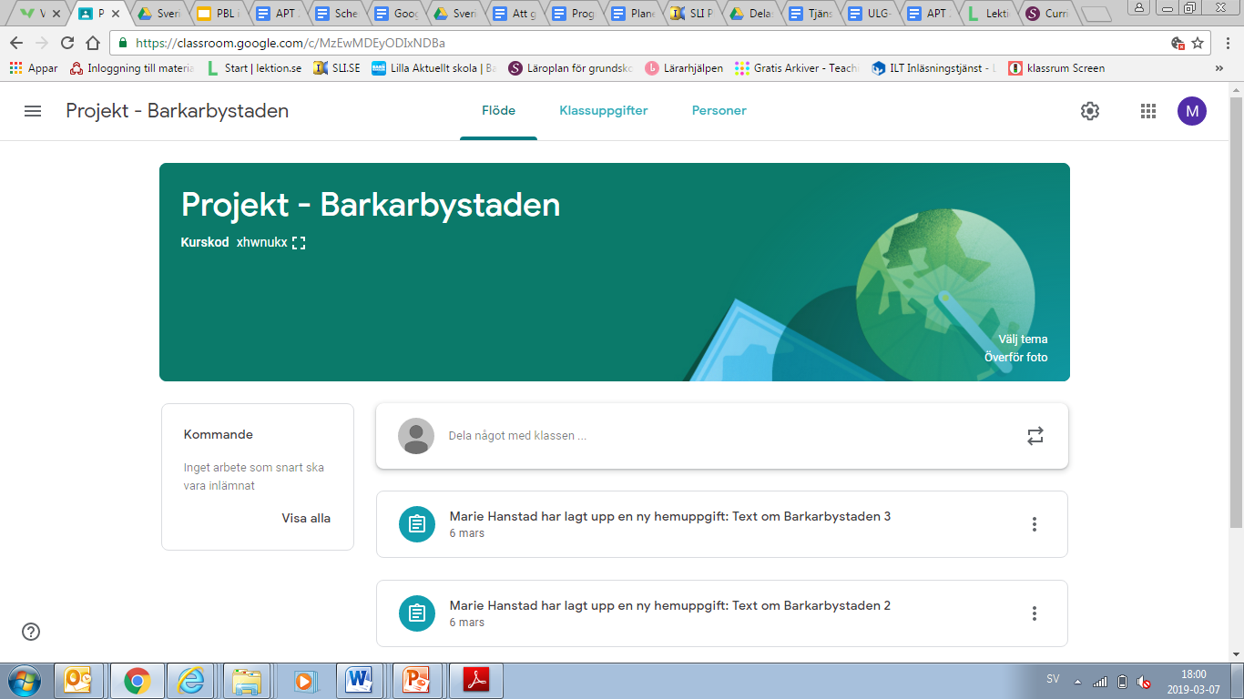
Read texts
We shared all the texts using Google classroom and also read texts about how a city is constructed

Slide 11
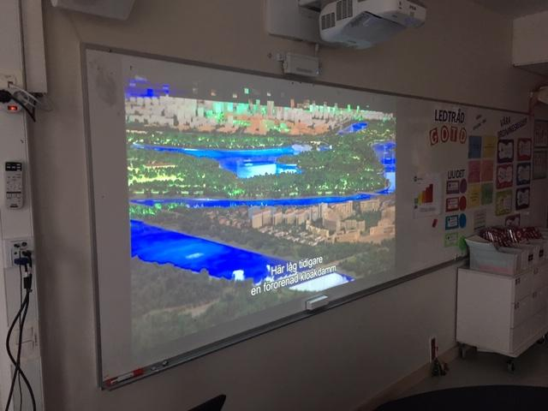
Watch movies about different towns
The pupils got some facts and information by looking at some short educational movies that involved what to think about when planning a new district/city, environmental thoughts about building a city and what is needed in a city.
In our municipality we have free access to a range of different media, educational and socially to listen to and to watch.

Slide 12
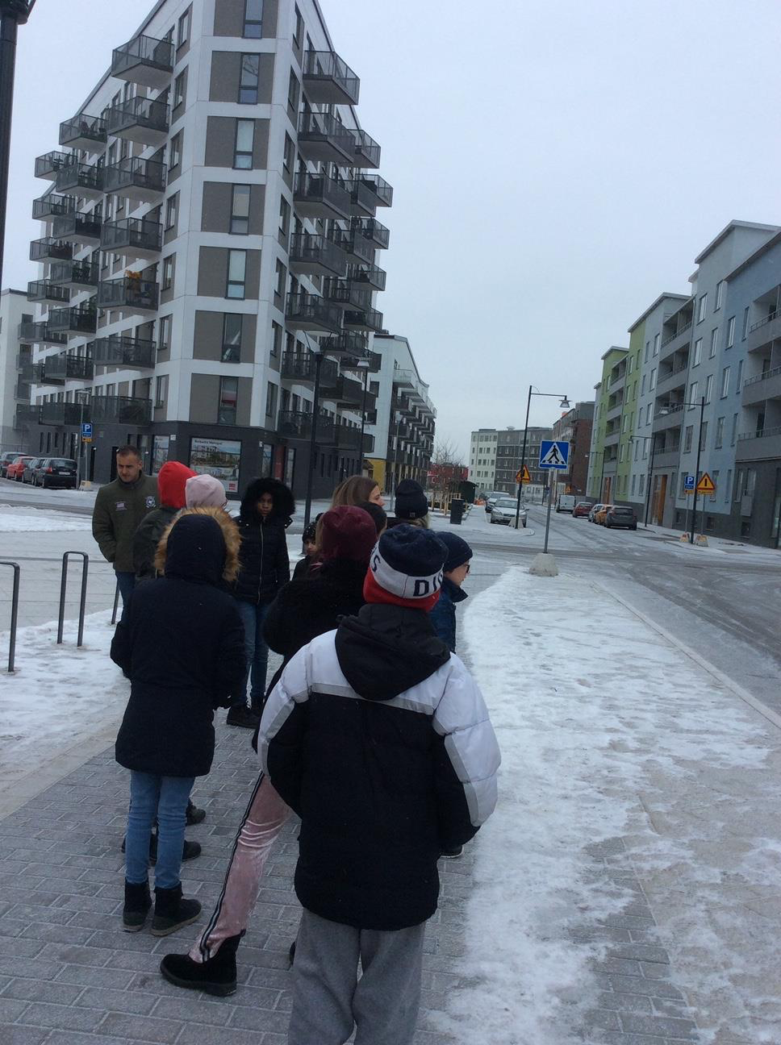
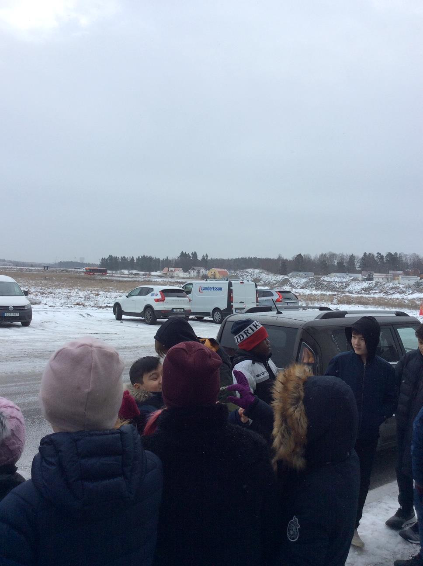
Observations
Before the children got the time to sit in their groups we all went outside to do observations of the area around the school and the field that is going to be a part of the district.

Slide 13
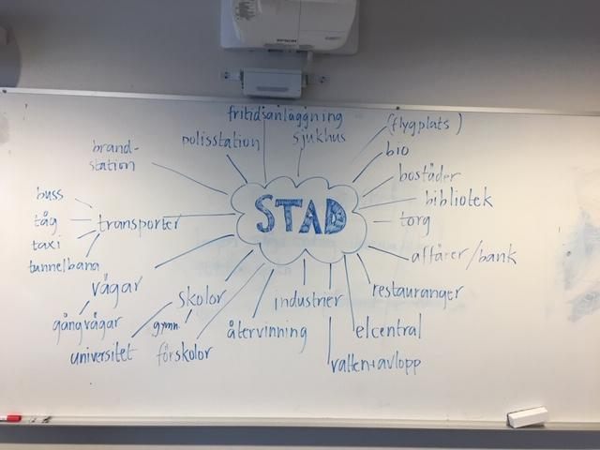
Mind map

Slide 14
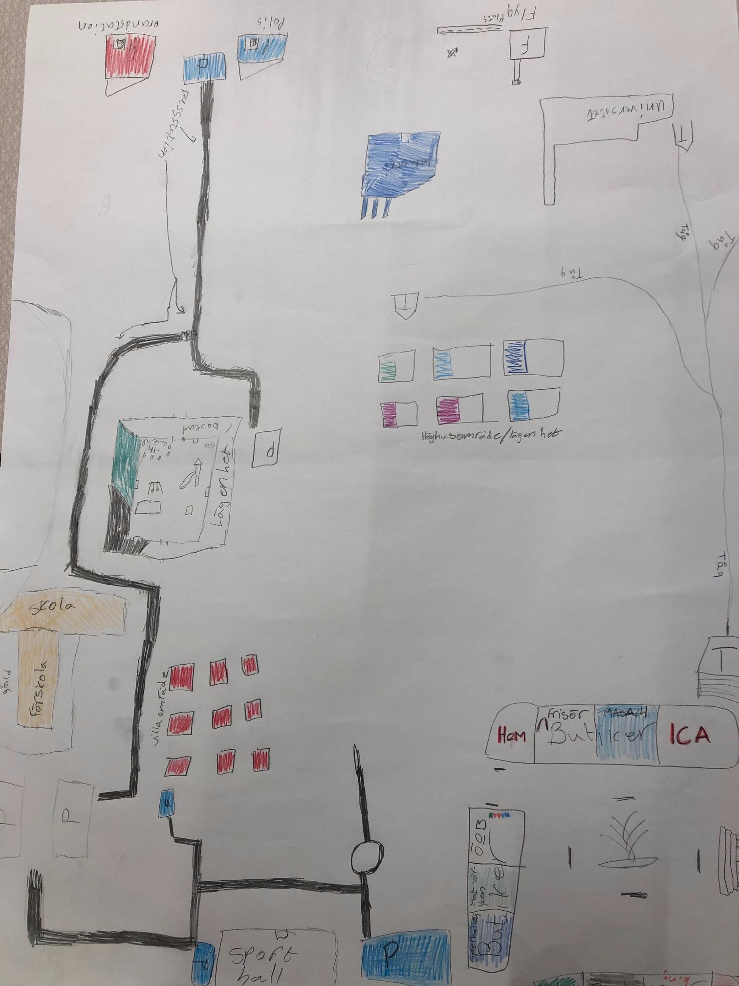
Work in groups
The pupils had to discuss in groups what they thought is important in a city and also if they could come up with some thoughts of different things they would like to implement in the district.
They also had to keep in mind the knowledge that they had received from the texts and short movies as well as the vision and facts that the municipality has.

Slide 15
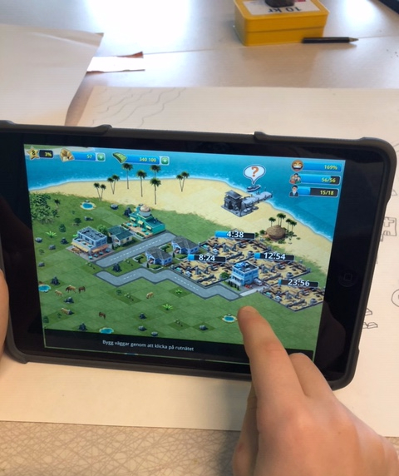
Work in pairs/individually
The pupils worked in pairs using the sketch as a foundation building their digital district.

Slide 16
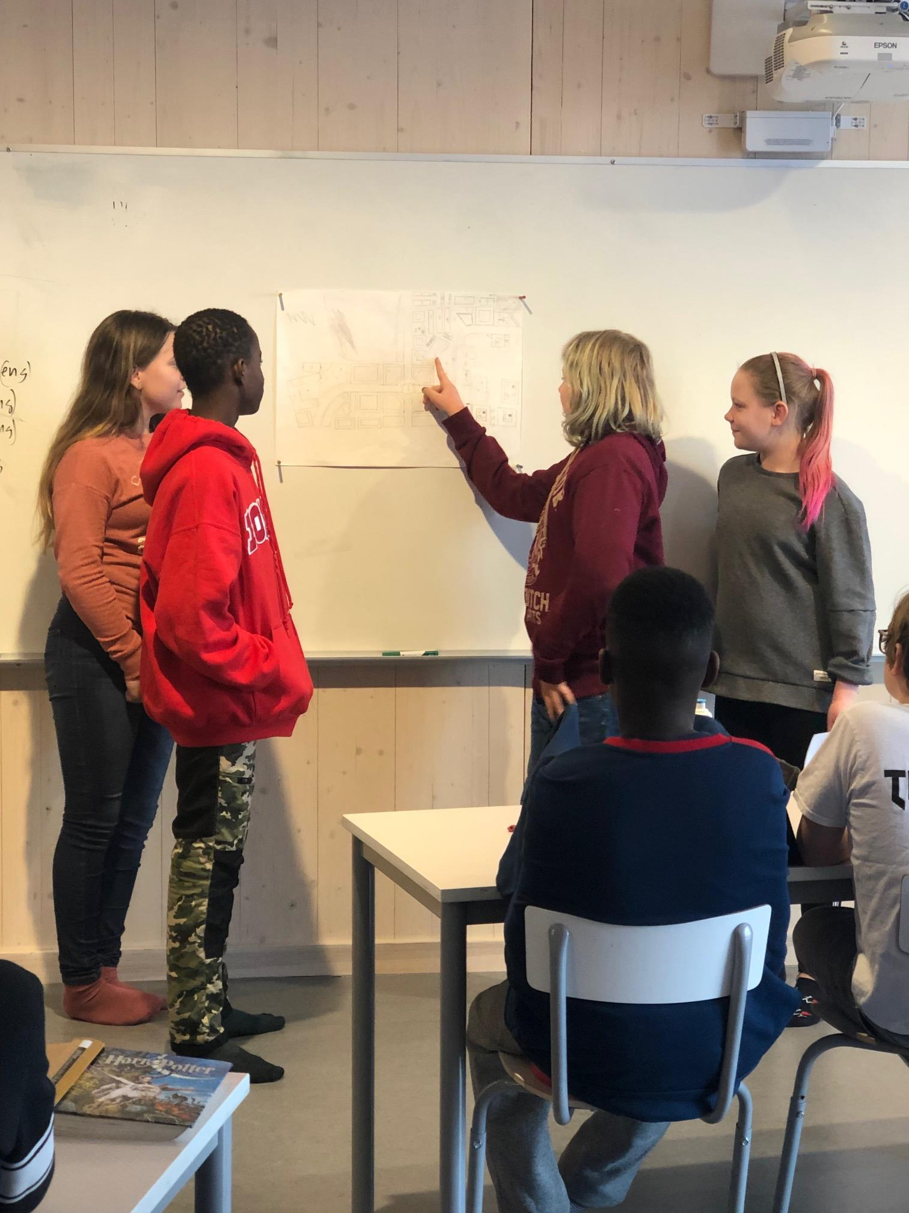
Pupils presentations
The pupils finished the project by giving the class a presentation of their plans of the district and they also had to explain their thoughts connecting to the facts that they had learned throughout the project.

Slide 17
The results of the project
PBLwise
The pupils thought this was a great project and they thought that they have learned alot about the district and what it takes to plan a city or a district. They also thought that it was easier to learn the different things while doing it hand on.
We had a lack of time doing this project because of the timeframe involving the PBL project. Some classes still have some work left to do with the virtual design of the district
Syllabuses
We saw that the pupils reached the goals of the syllabuses as they sat in their group reflecting on the preknowledge they had received and also as they were planning and creating the district.

