Slide 1
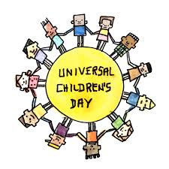
How are-we connected ?
Les Droits de l’enfant
Children’s Rights

Slide 2
How are-we connected ? Children’s Rights
In the classroom, the pupils decided that « we » must be all the chidren in the World.
And so, they searched together what could connect all of them :
«In the World, we all have the same body. »
Or, « We all have emotions. » « We have the same origins in Africa. »
And « We have desires end needs. »

Slide 3
How are-we connected ? Children’s Rights
Anne-Laure and I (Valérie) decided to stay on the terms : desires and needs and to work about them.
With us, pupils defined « needs » and « desires ».
Pupils kept « Needs » and decided to work on : Children’s Rights.

Slide 4
How are-we connected ? Children’s Rights
On different lessons and at home, they readed several texts and books.
They worked on documents (analysis) :
- Evolution of the child’s status in the history
- Children’s rights history

Slide 5
How are-we connected ? Children’s Rights
In Geography, pupils studed :
- Continents and oceans
- Chidren’s rights respect in the World

Slide 6
How are-we connected ? Children’s Rights
Pupils found alone several rights and then they discovered the others and main rights (10).

Slide 7
How are-we connected ? Children’s Rights
We worked about the Children’s Rights history and Convention on the Rights of the Child (1989).
The 20th November , the Convention celebrated the 30th Anniversary.

Slide 8
Exhibition : 19th November 2019
Pupils were happy and proud to show their work to parents.

Slide 9
How are-we connected ? Children’s Rights
Extensions :
Geography : rich/poor countries
Civic Education : Childrens labor in the World, Humanitarian Aid
Projet Enfants Reporters, Visa pour l’Image Exposition

