Slide 1
What the Greeks left us ? The Greek legacy
ULIS : from year 2 to year 6

Slide 2
Support : Le feuilleton d’Hermès in 100 episodes from Muriel Szac. This book traces the adventures of Greek god Hermes and of the others Olympus’ Gods.
Teacher reading : one episode per day.

Slide 3
Pupils follow Hermes’ adventures on a quest to answer some existential questions :
Where do we come from?
Why is there hatred, violence, and beside love and beauty?
What happens after death ?
To answer all the questions Hermes travels, observes and thinks.
This book allows children to face with pleasure and lightness the questions that are the basis of human spirit.

Slide 4
Why this project ?
My pupils, (with cognitive function disorders) face
real difficulties of understanding.
My goal is to allow special needs children to enter into learning through mythology.
Mythology is a rich cultural mediator that will allow
to learn vocabulary skills.

Slide 5
The project : creation of an inventory of words and expressions borrowed from Greek
Daily reading : pick up throughout the reading words or expressions of Greek origin still used today.
Understanding the meaning of these words, their origin.
Explaining and presenting the words : drawing, text, poster, model, photo, sketch (chosen by pupils)...
Presenting works to other classes and to families.

Slide 6
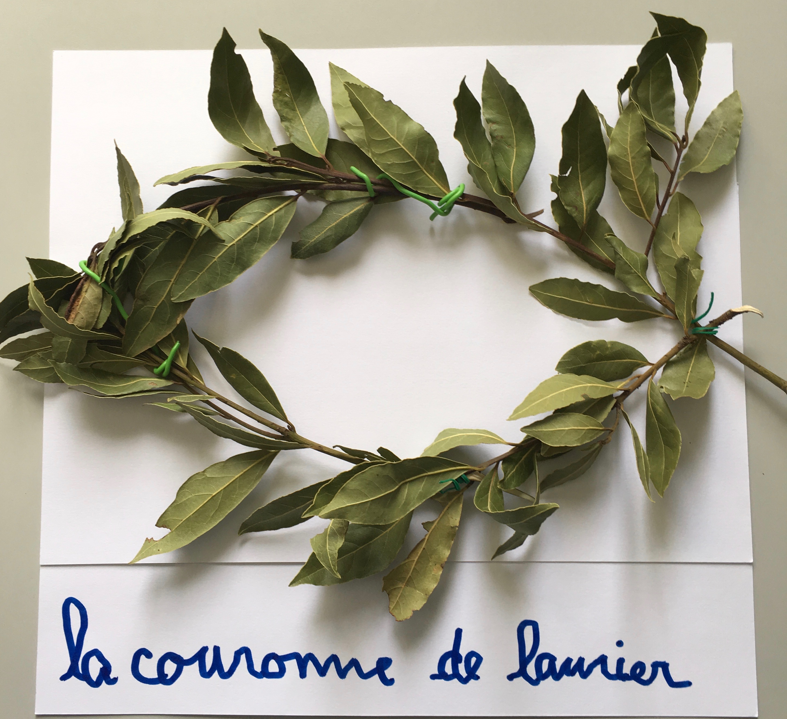
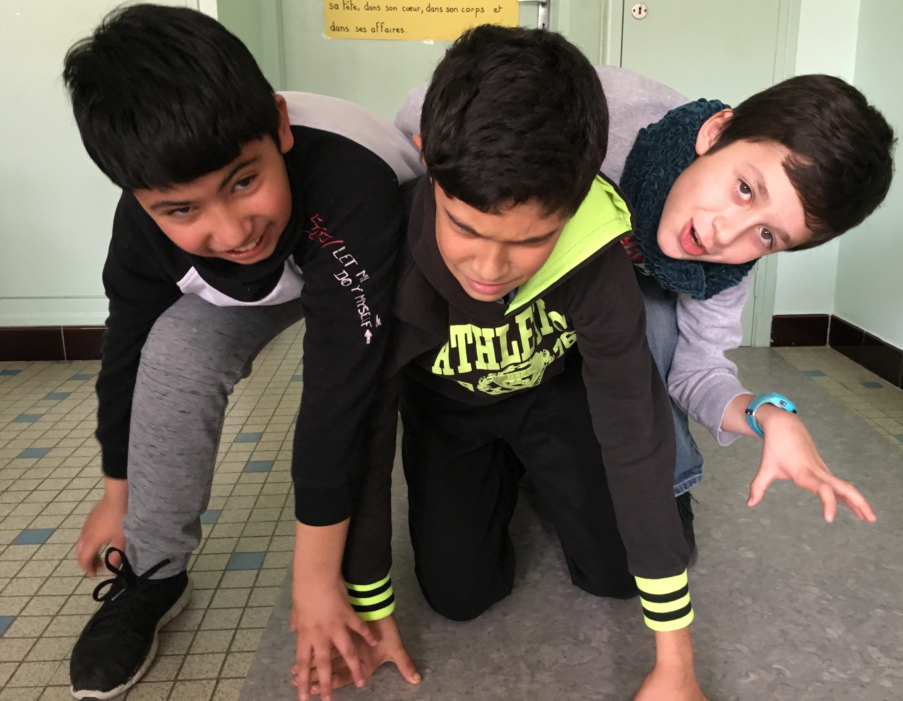
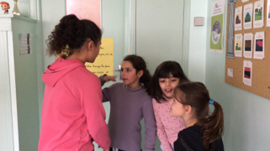
Examples of words or expressions
a cerber
A cerber
Caduceus
The laurel wreath
An Apollo

Slide 7
Relevant disciplines
What the Greeks left us?
Vocabulary
Oral expression
ICT
Arts
Literature

Slide 8
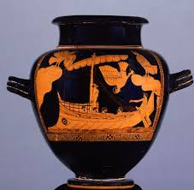
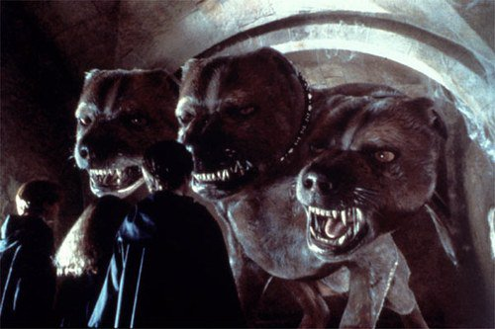
To be continued
Artistic antic’s legacy : students will create a Stamnos.
Staging : playing The twelve labors of Hercules.
Cultural references : the myths provide essential references for the understanding many artistic works : for example Fluffy in Harry Potter.

Slide 9
Answer to the question
The pupils reflected on our cultural legacy.
It helped them understand the world they live in :
There were people on earth before us,
There will be people after us,
We are the inheritors of a common past.

