Slide 1
Welcome to Herrestaskolan in Järfälla kommun

Slide 2
Herrestaskolan Swedens first school in solid wood
Bild: Lilljewall arkitektkontor

Slide 3
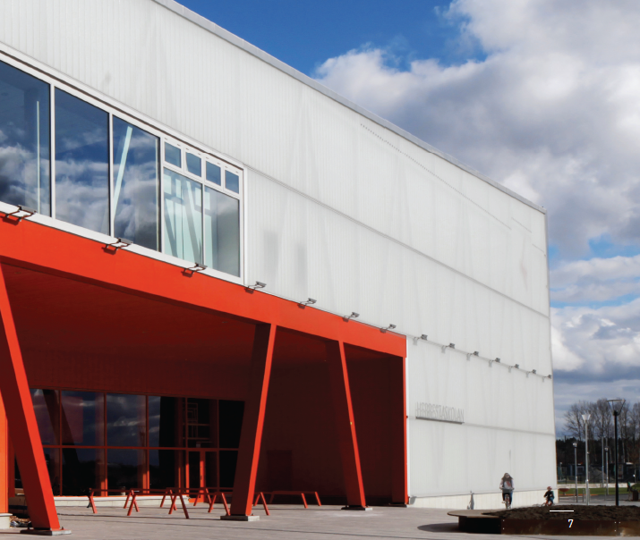
About Herrestaskolan
The building is approximately 8000 m²
The building started in 2014
Opened in January 2016
Bild: Lilljewall arkitektkontor

Slide 4
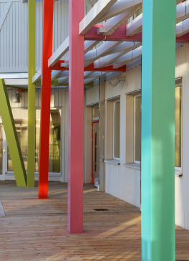
Architectural competition
Architectural competition 2011
”The school in the middle of the village”
Preschool for 100 children
Preschool class- year 5
Public library
Sports center
Aktivity park
Bild: Lilljewall arkitektkontor

Slide 5
” The village school-Byskolan” by Liljewall arkitekter in Gothenburg
Bild: Liljewall arkitektkontor

Slide 6
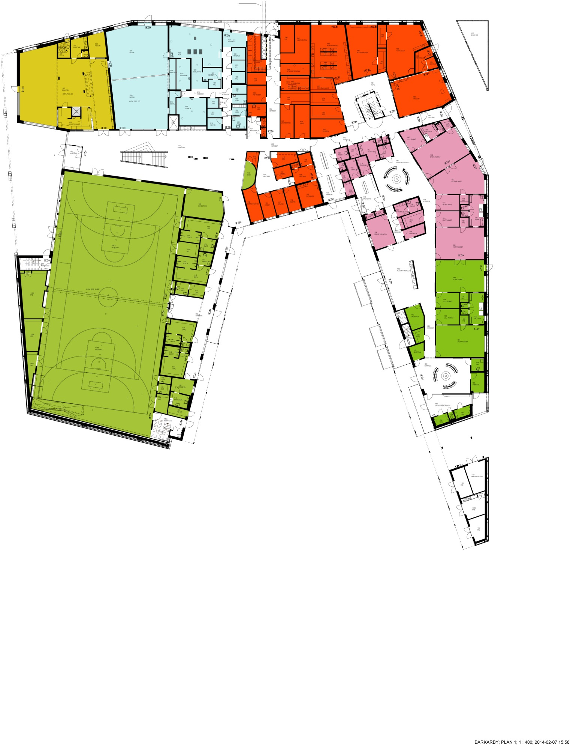
Herrestaskolan
A compulsury comprehensive school for pupils 6-11 y
Bild: Liljewall arkitektkontor

Slide 7
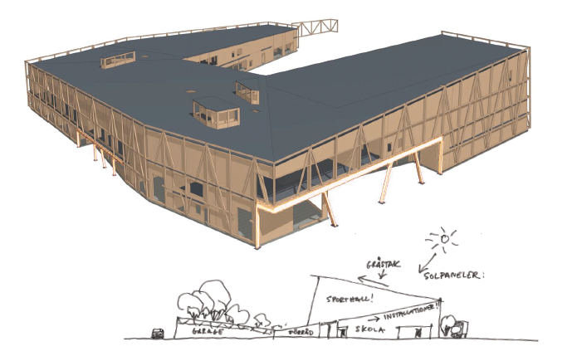
Bild: Lilljewall arkitektkontor

Slide 8
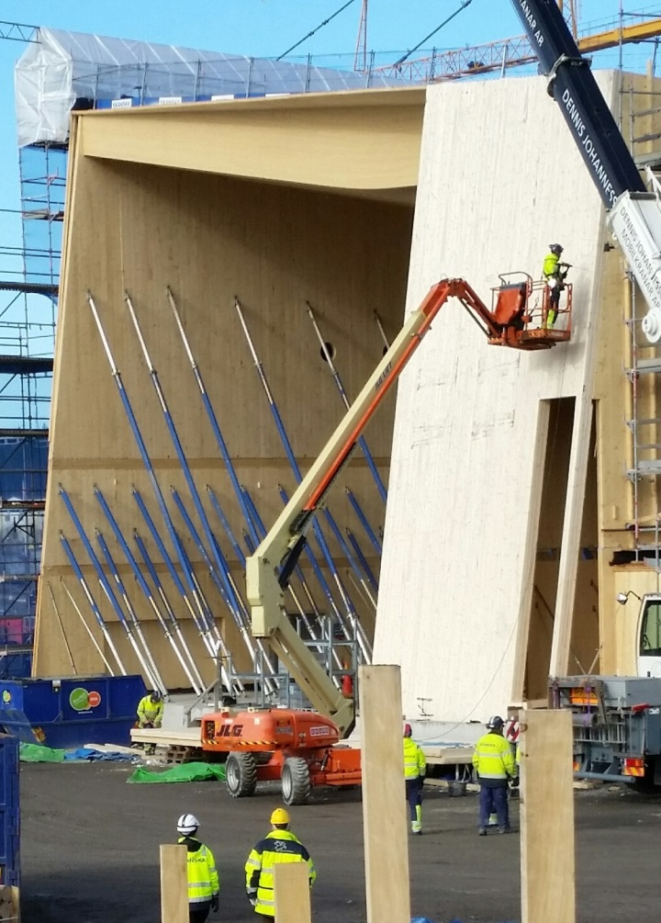
About Herrestaskolan
Was awarded as a sustainabel buildning gold i Barcelona in 2014
Made of massiv/solid wood -14 weeks shorter productiontime.
1400 m² of photovoltaics /
solar cells at the roof

Slide 9
Referens project, Norwich

Slide 12
World Sustainable Building
Bild: Liljewall arkitektkontor

Slide 13
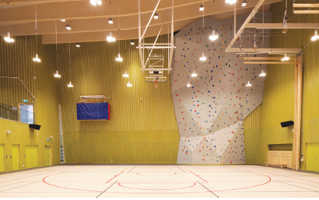
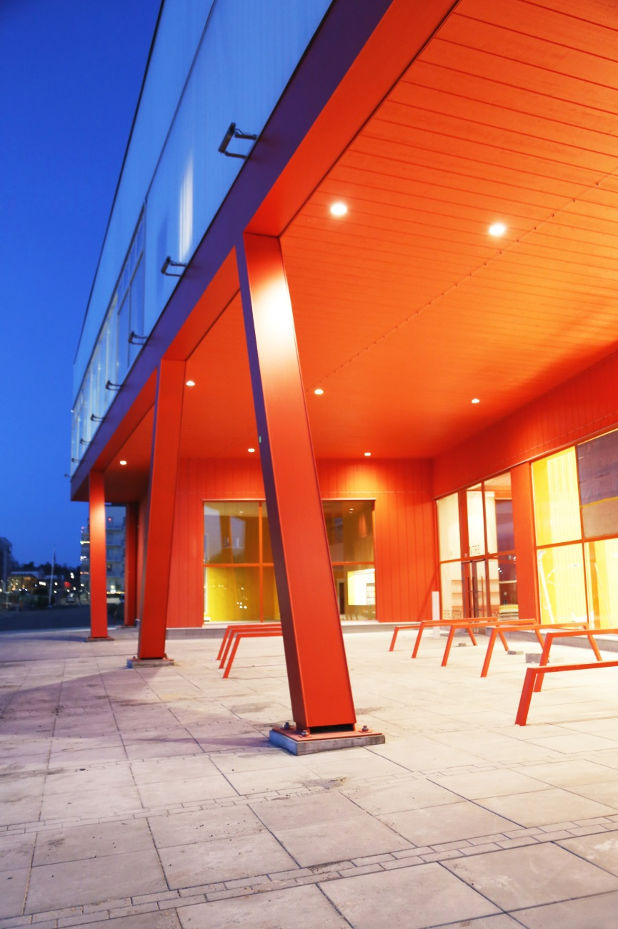
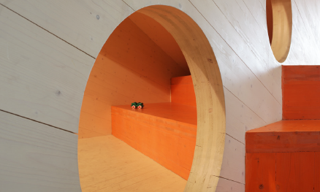
Bild: Lilljewall arkitektkontor
Bild: Lilljewall arkitektkontor
Bild: Lilljewall arkitektkontor

Slide 14
A school that focus on the environment and sustainability
Environmental studies
Ecological food
Chemical free cleaning
No shoe –school
Recycling
Take care of and cherish
Cooperation with the community

Slide 15
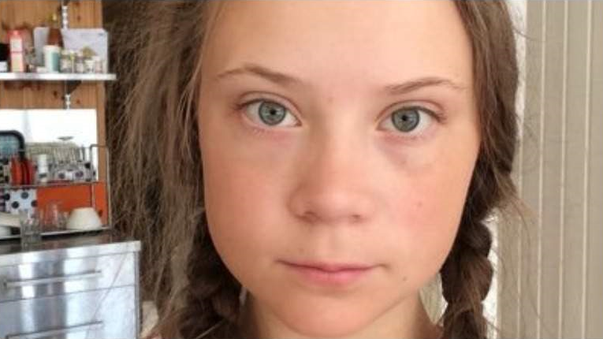
Greta Thunberg
https://www.youtube.com/watch?v=zmcNss6Bozg

Slide 16
The Swedish education system
For more information about the education structure in Sweden compared to other countries (Page 20-21 in this report). (PDF-dokument, 2 kB)

Slide 17
The Swedish education system in brief
Preschool -Your child can attend preschool from the time he or she is 1 year old. Play is an important element of preschool.
It is compulsory for children to begin in a preschool class from the age of 6.
Preschool class is a separate type of school that involves a large component of creative work and play. Preschool class is free of charge.
All children attend comprehensive school from about the age of 7. Comprehensive school is compulsory, and compulsory schooling applies for years Preschool class- year 9.
Most young people then attend upper secondary school for three years. Upper secondary school prepares pupils for university or university college, or for going on to employment without further education

Slide 18
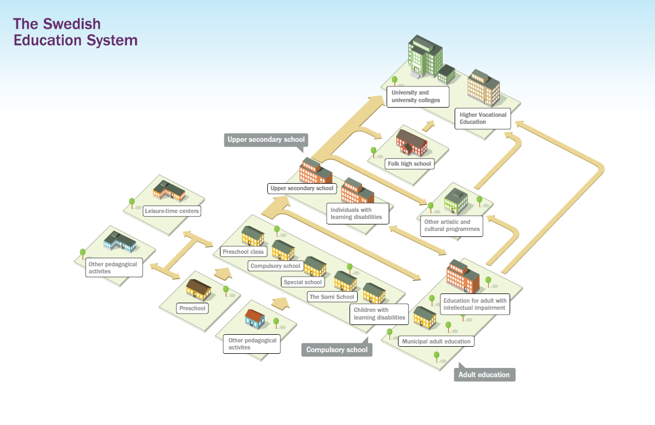

Slide 19
The Swedish education system
The Swedish education system includes compulsory and non-compulsory education.
Most Swedish schools are public, run by the municipalities, but an increasing number of schools are independent.
Local authorities have to provide a number of basic services for exampel compulsory education, upper secondary education, pre-school and child care.
Municipalities are free to use collected taxes and state funding for whatever services and systems are judged to be best for their respective areas. Many municipalities delegate budgets directly to individual schools.
An amount of money is granted and follows each pupil to whatever school they choose, either municipal or independent. A school that receives grants from the municipality is not entitled to collect school fees. (So independent schools are also financed by taxes and state funding!)

Slide 20
Inclusive Education
https://youtu.be/0I_kbX-3SmQ
Inclusive education is a democratic process based on human rights and human equality, striving for cherish diversity and differences.
All children in preschools and pupils in schools shall be given equivalent and high quality education.

Slide 21
Inclusive Education for participation in a democratic society
Equivalent education
availability
inclusive
participation

Slide 22
Inclusive Education at Herrestaskolan Availability- to give acces to learning
Means that the school develops knowledge about the terms for learning for each pupil and that know-how shows in the shools pedagogical, social and physical environment. (clean/empty walls, earmuffs, picture-schedule, smaller groups, customized tasks, technical aids)
We identify and remove obstacles and actively work for developing the learning environment in every aspect for every childs development regardless of disability.
The schools ability to create availability effects the pupils possibilities to take active part in their learning and to be a part of the community.
Inclusive education requires availability for the student.

