Slide 1
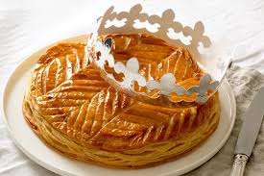
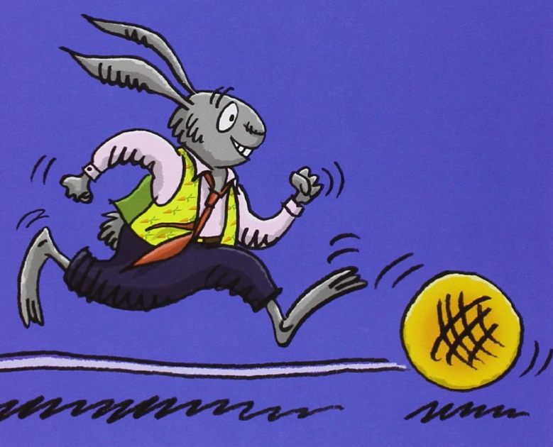
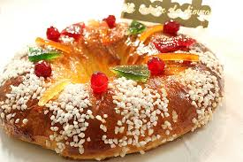
La galette Twelfth night cake Trettondag Jul Roscon de Reyes

Slide 2
12th night cake: a classic theme in Reception classes
in my class (year 2) → literature, cooking and animated movie
→ 7 weeks (with 6 ipads)
→ an exhibition and projection for parents at the end

Slide 3
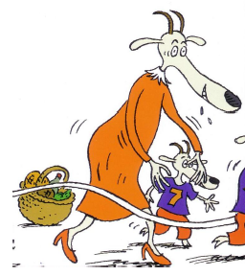
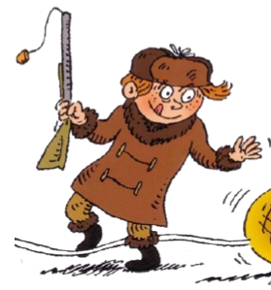
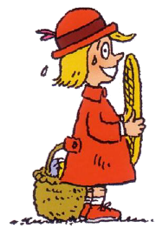
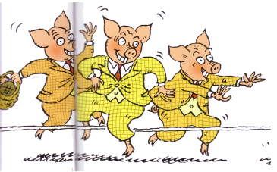
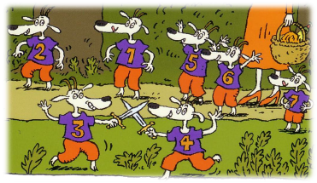
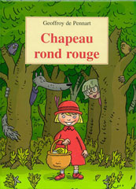
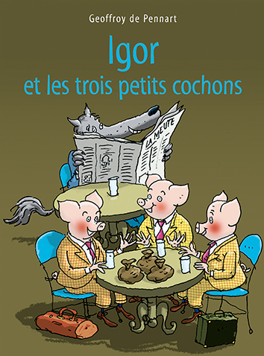
LITERATURE
Roule galette: a great classic, every child heard it in reception.
La galette à l’escampette (a great french author: Geoffroy de Pennard)
→ the same story as « roule galette » but hijacked: the running cake meets
classic tales caracters

Slide 4
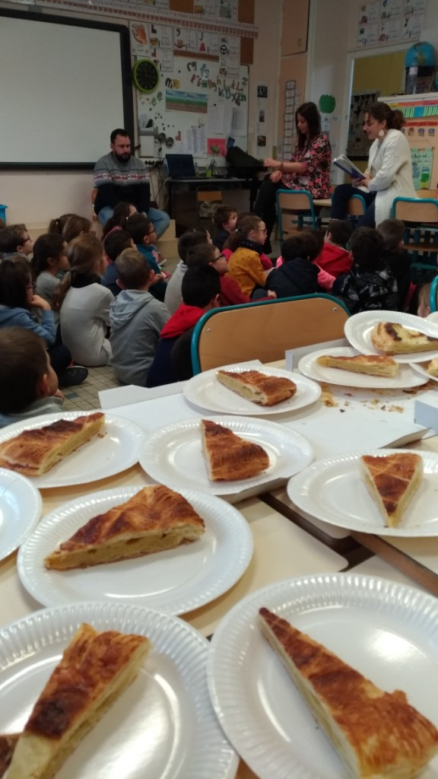
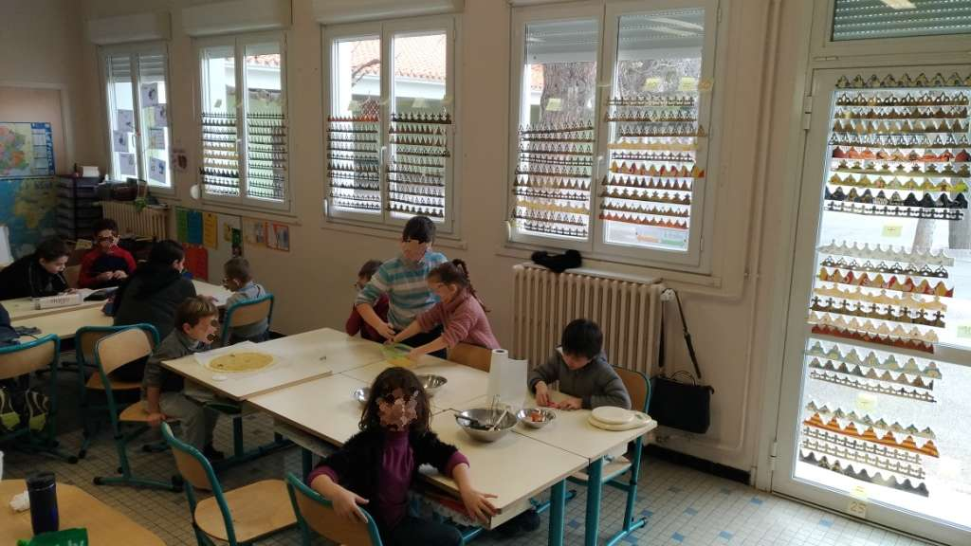
COOKING: our 12th night cakes
We had to:
- invite our penpals
- challenge them with the crowns
- look for a recipe (cooking books, internet)
- calculate the ingredients for 4 cakes
- write the shopping list
- cook
- take some pictures while cooking time
- have good time with penpals, eating the cakes and
counting the crowns…

Slide 5
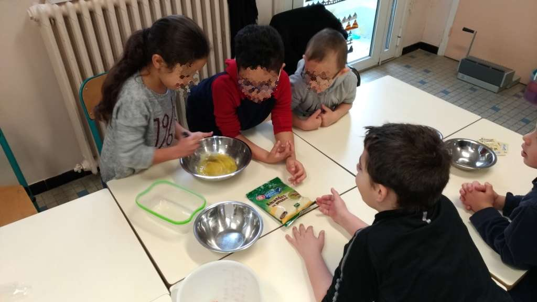
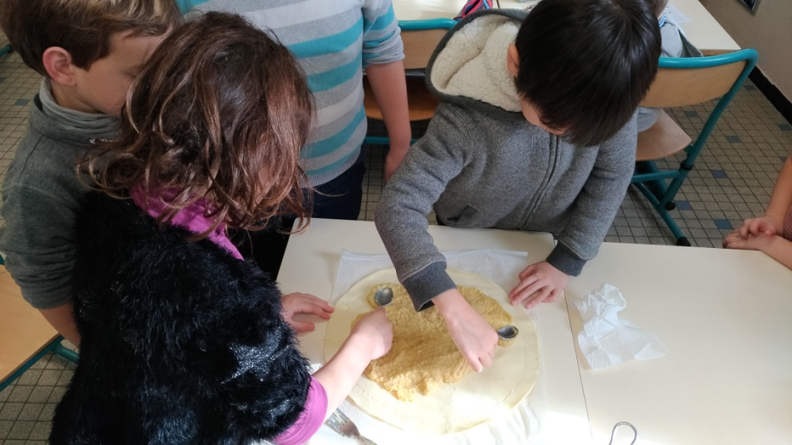
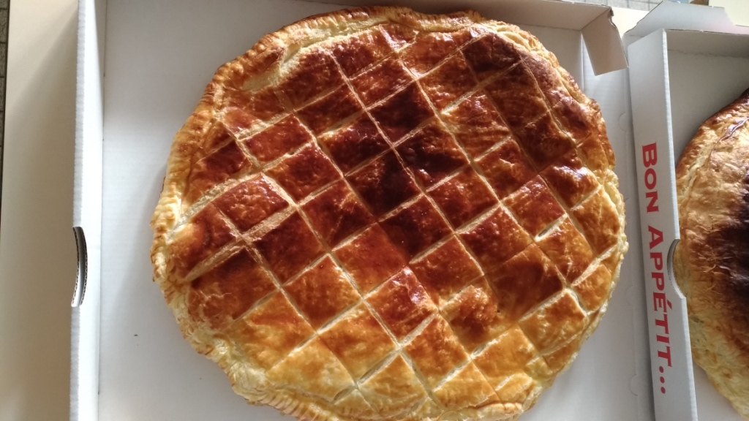
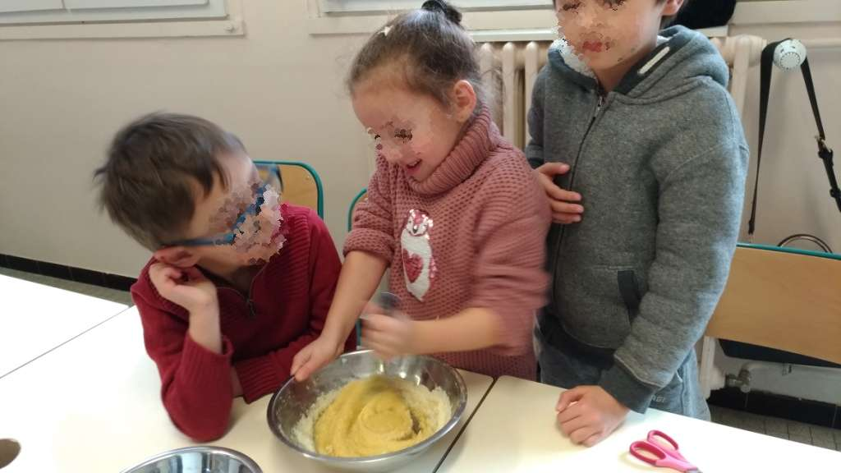

Slide 6
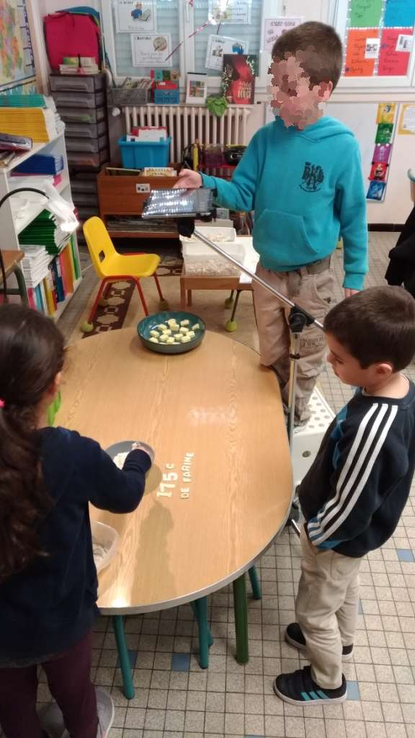
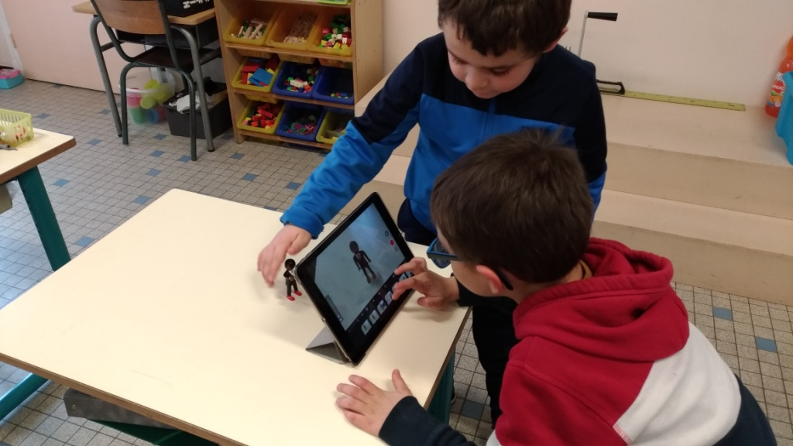
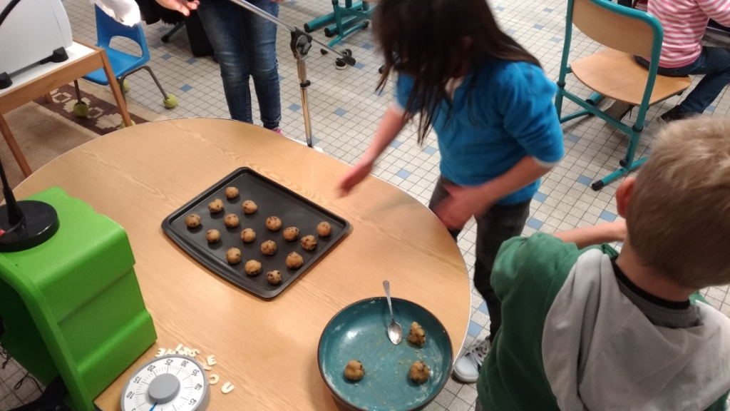
ANIMATED FILM: a stop motion recipe
We :
- looked at stopmotion recipes
- decided to change the recipe (no more 12th night cakes, but cookies!)
- tried the stopmotion app on ipads
- decided what to do for our film
- cooked during 1 day!
- took 654 pictures
added some music,
and our names on the
movie

Slide 7
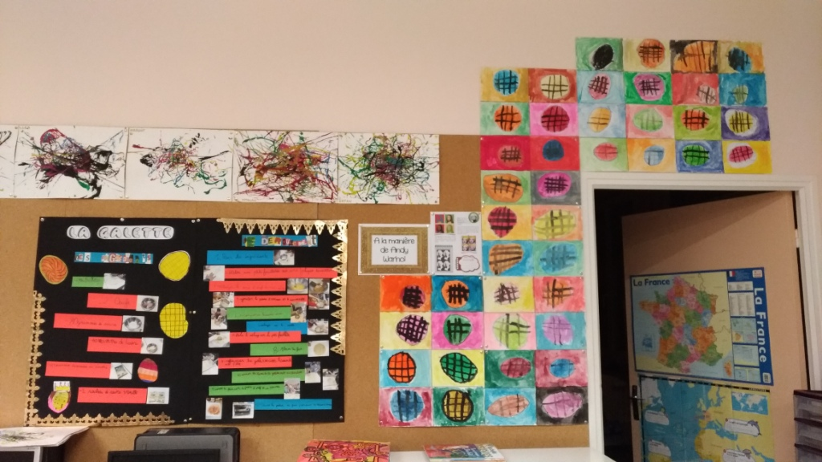
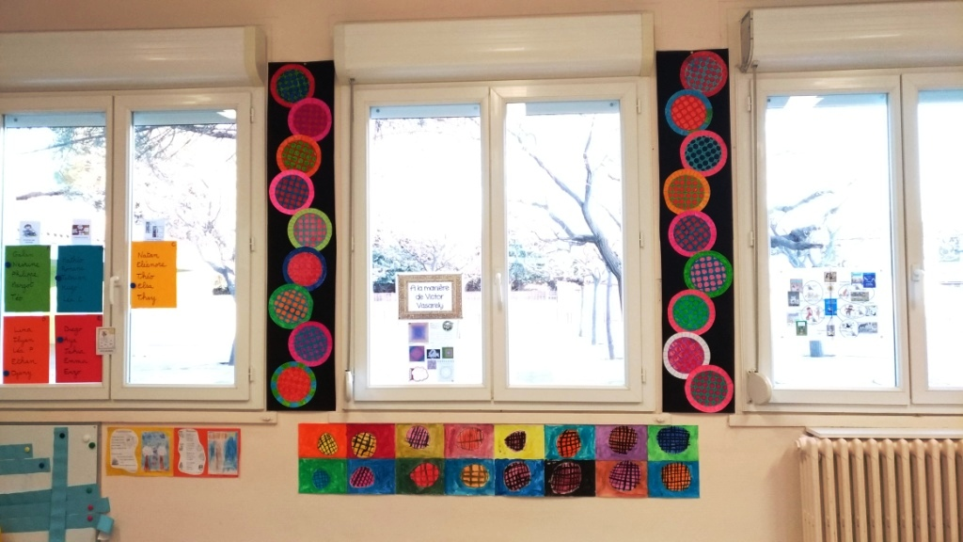
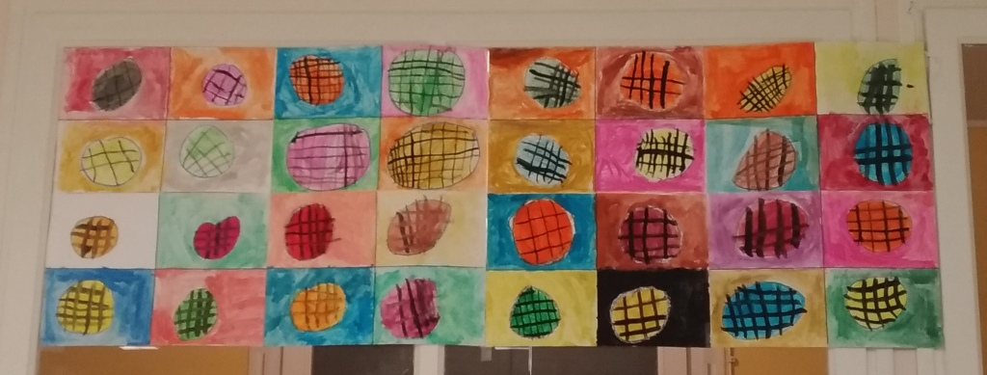
artistic activities

Slide 8
The areas of the french program worked through this project:
CIVIC AND MORAL EDUCATION
LITERATURE
ICT
READING
La galette
MATHEMATICS
WRITING
SCIENCE
ORAL LANGUAGE
ARTS
VOCABULARY

Slide 9
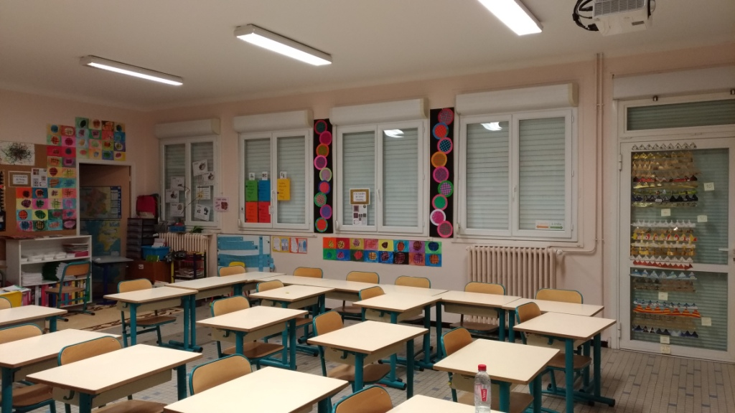
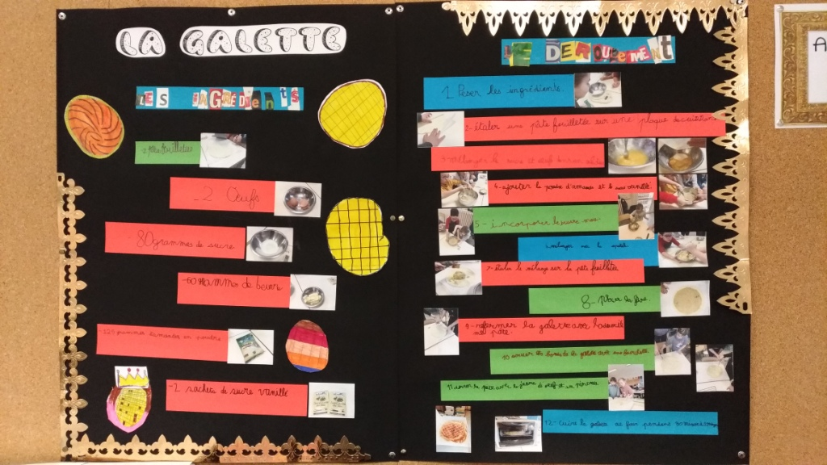
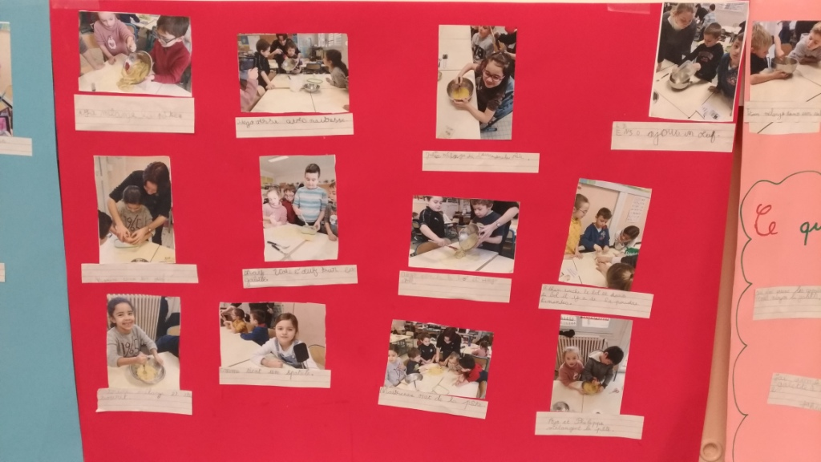
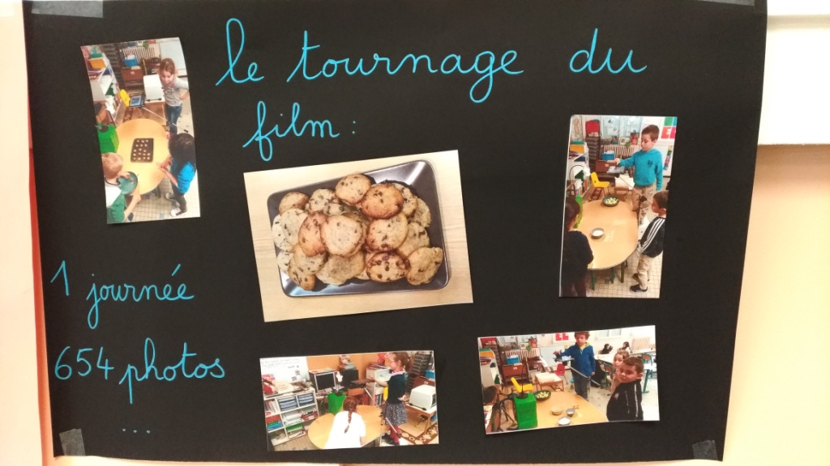
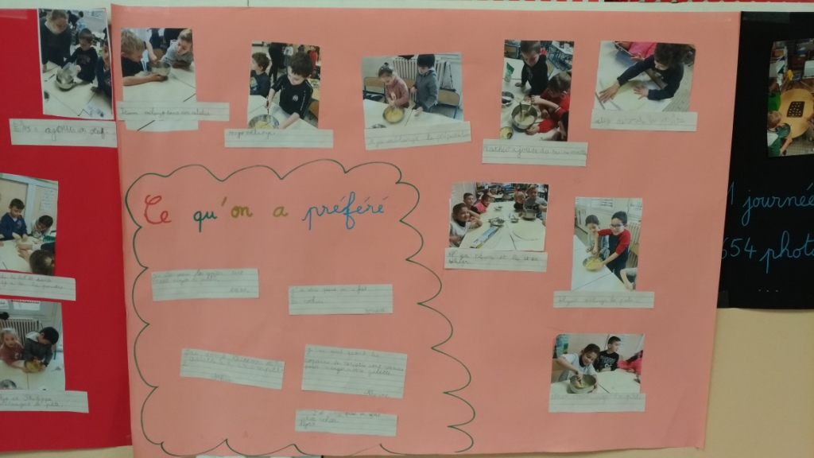
parents exhibition

Slide 10
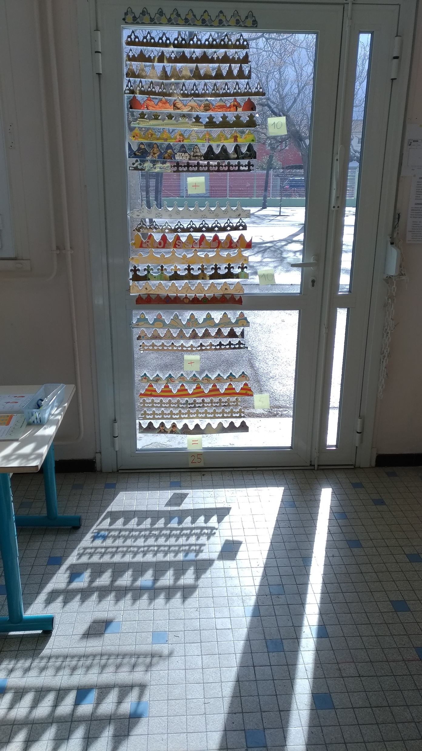
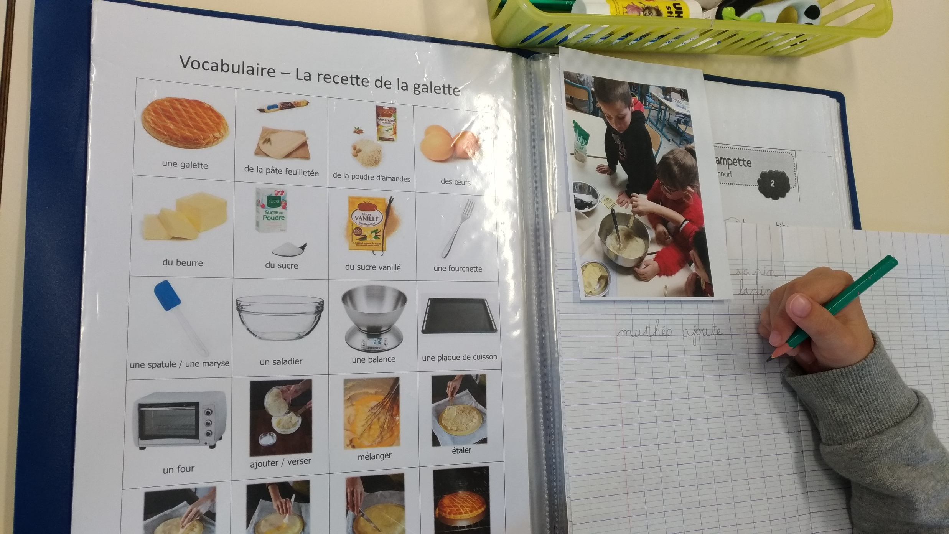
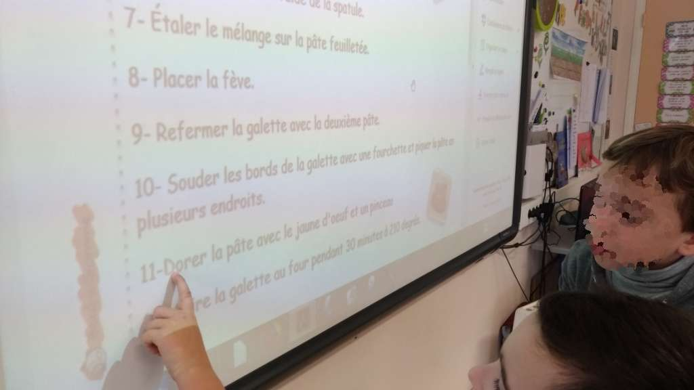
PBL creates sense while learning
We need to read the recipe while cooking.
We had to write sentences for parents
exhibition.
We had to count our crowns
(with dozens, it’s better!)

Slide 11
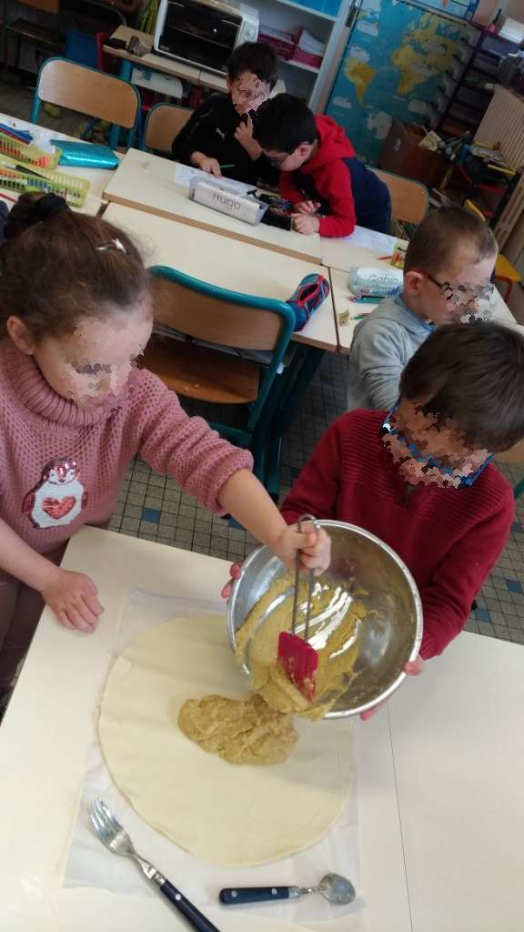
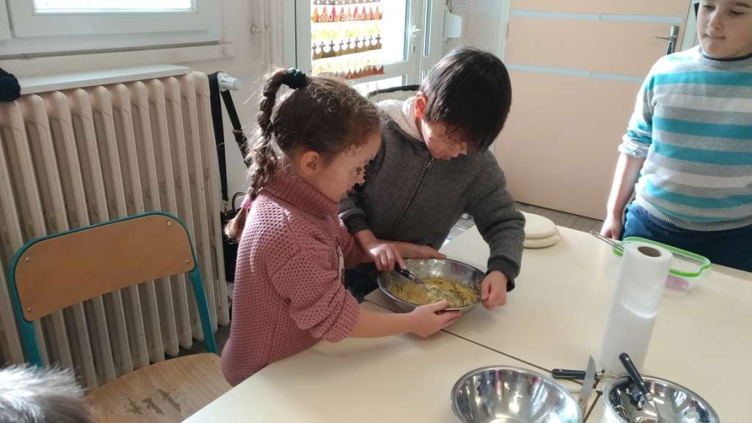
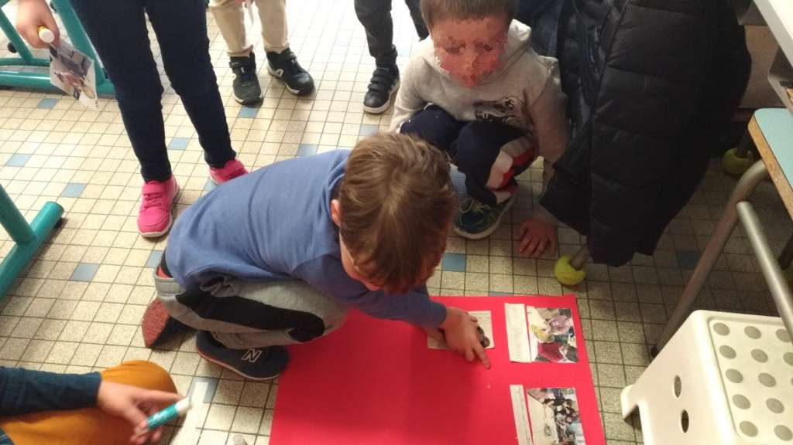
Get involved, cooperate, help each other.

