Slide 1
THE LONDON CONTEXT

Slide 2
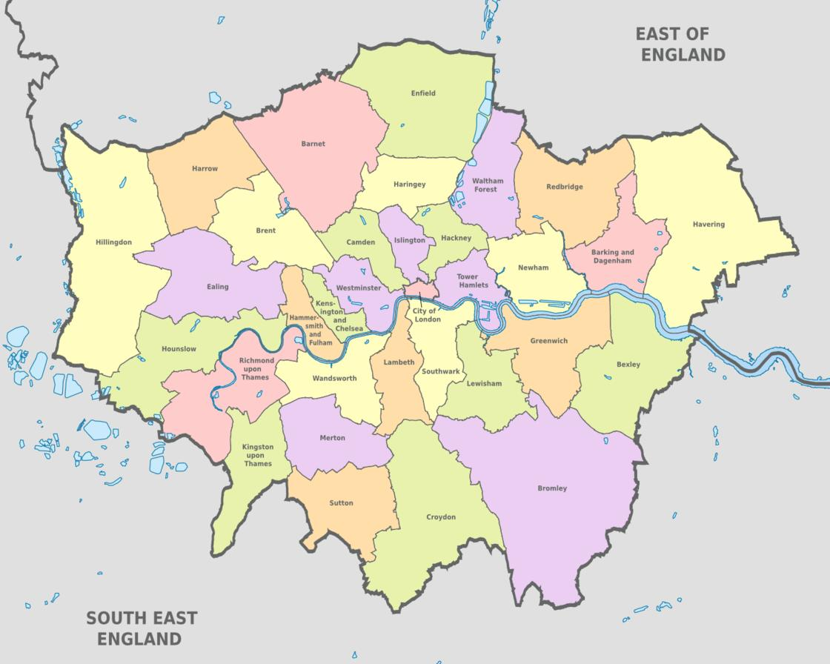
32 boroughs in London
12 inner London boroughs
20 outer London boroughs

Slide 3
London school details
3,149 schools in London
  1,816 Primary schools
  498 Secondary schools
  145 Special schools
  61 Alternate placements
  549 Independent schools
Total 1,412,050 children

Slide 4

London- wonderfully diverse

Slide 6

National Funding Formula

Slide 7


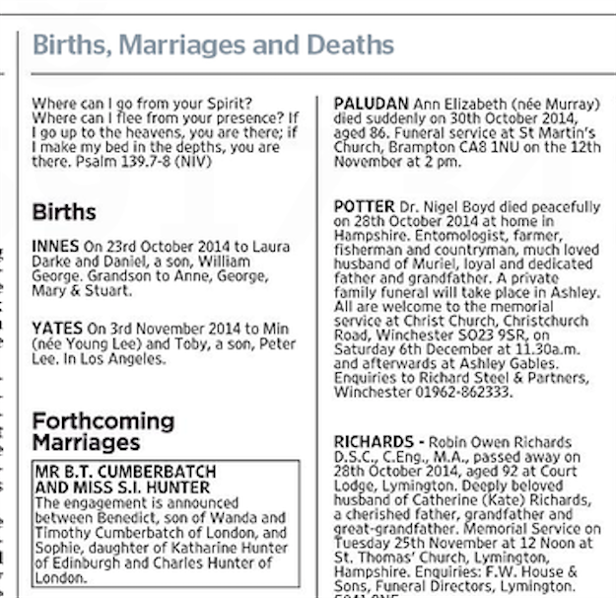

Teacher recruitment and retention

Slide 8

LONDON IS GREAT!

