Slide 1
Project Based Learning at Goose Green Primary

Slide 2
Strengths
End of term showcases are varied and embedded across the school as a way to celebrate the projects and children’s learning.
Immersions are increasingly exciting and diverse in nature
Literacy, reading, history, geography, art and design technology are taught consistently and successfully through a project based learning approach.
Teacher understanding and awareness of PBL has improved and the approach has been accepted as good practice.

Slide 3
Whole school implementation
Organisational changes:
Change from literacy books to learning books to allow flow between subjects
Dedicated project planning time has been allocated for each half term in order for staff to respond to children’s initial ideas
Curriculum letter and medium term plans are then sent after this planning with children so they are a genuine reflection of each classes’ interests
Curriculum teams have been re-designed to allow for more collaborative approaches between teaching staff.
Summer carnival project has been adapted to be a whole school PBL project
In 2018 – 19 the emphasis of this project was centred on developing design and technology skills. We used recycled materials to create a banner or float for our procession about a country that reflected the diversity of our children.

Slide 4
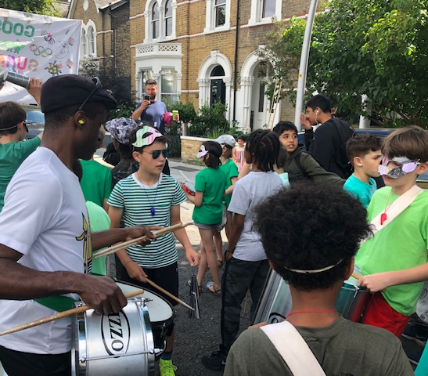
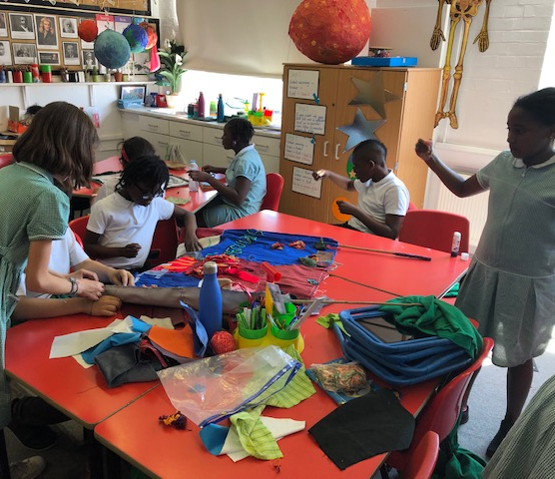

Slide 5
Whole school implementation
Summer 2020 carnival project will have an environmental focus which will allow us to teach STEM subjects through a PBL approach. This is something we have previously found tricky
Goose Green are committed to becoming more environmentally conscious and teaching children about sustainability in their future lives. The PTA also feel strongly about this and we intend to use PBL as a means of promoting these values throughout our school.
This project will include real maths and science investigations with an authentic purpose.
We will use this as another opportunity to highlight PBL as an approach at Goose Green

Slide 6
Ofsted Framework
Ofsted (the inspection body in the UK) have changed the framework through which they inspect schools and they have placed an increased emphasis on the whole curriculum.
Previously, priority was given to Reading, Writing and Maths.
PBL is a valuable strategy for demonstrating our commitment to the whole primary curriculum.

