Slide 1
PBL Year 6
« CAN WE CONNECT PEOPLE WITH WALLS? »

Slide 2
HISTORY – GEOGRAPHY
Famous walls in the world
History of them
Location on a map
CIVIC EDUCATION
Communicate with each other
Lead a project together
Exchange ideas
LITERATURE
- Create a poem
THE WALLS
ARTS
- Build a model of their wall
LANGUAGE
Proverbs’ interpretations
Presentation of their work

Slide 3
1/ CITATIONS AND PROVERBS
What do you think about these proverbs?
« Le langage, un autre mur »
« Un ami, c’est une route,
Un ennemi, c’est un mur. »
« Le mur est plus important
que la brique. »
« We build so many walls,
And not enough bridges. »

Slide 4
« The language, another wall »
Language to communicate,
to understand each other.
People who don’t have the same language.
People who don’t understand each other
(different vocabulary, ideas…).

Slide 5
« The wall is more important than the brick »
We need several bricks to build a wall.
All is more important than the details.
To be several of them is more important than to be alone.

Slide 6
«A friend, it’s a road
An enemy, it’s a wall. »
In life, a friend is a way,
An enemy is a barricade.
We progress with a friend,
We can’t with a enemy.
With a friend,
We can do lot of things.
A road is better than a barricade.

Slide 7
« We build so many walls,
And not enough bridges. » (I. Newton)
We create too much problems,
And not enough solutions.
We stay too much in our mind,
We don’t create enough links.
Too much difficulties to communicate.
It’s easier to create enemies, boarders,
than friends.

Slide 8
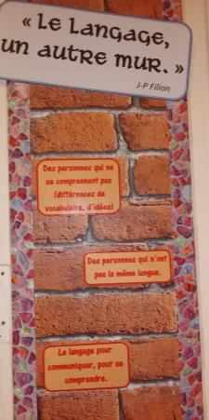
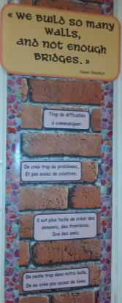
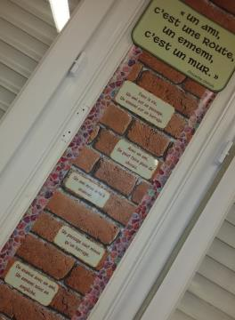
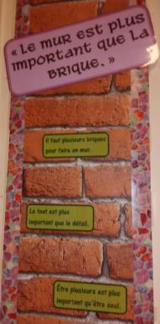

Slide 9
2/ What do you think about the word « wall »?
house
plastic
model
branches
USA / Mexique
carton
building
cement
paper
barricades
WALL
wood
Isolate
foam
iron
jail
stones
ramparts
cinder blocks

Slide 10
3/ What is a wall made for ?
TO PROTECT
Against bad weather
Against thieves
With fortifications, ramparts
TO LOCK
TO ISOLATE
TO LIMIT
TO HIDE
TO LIVE, TO WORK
Houses, buildings
Companies

Slide 11
TO HAVE FUN
Climbing
Play with a ball
TO SEPARATE
Partitions
Boarders
Fortified wall
TO EXPRESS
Artists
Display (publicités, messages, …)
To draw

Slide 12
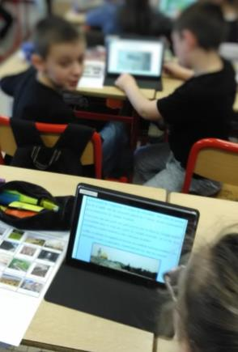
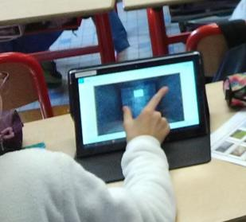
Using computers, they had to classify several walls in categories.

Slide 13
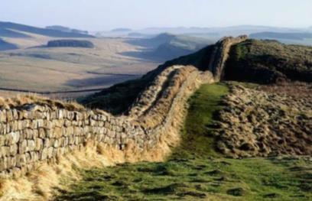
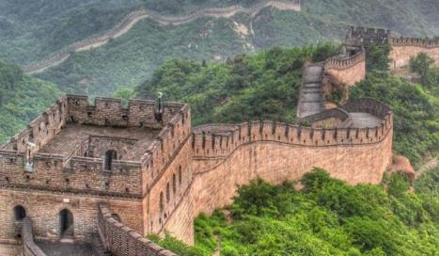
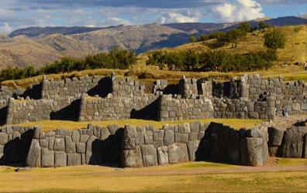
PROTECT
HADRIAN’S WALL
GREAT WALL OF CHINA
SACSAYHUAMAN

Slide 14
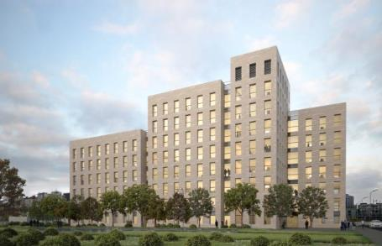
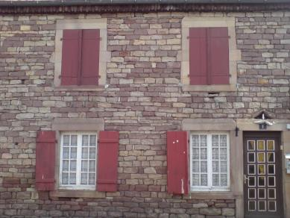
LIVE,
WORK
BUILDING
HOUSE

Slide 15
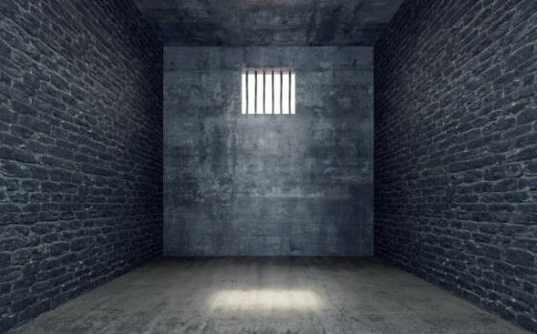
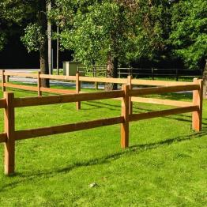
LOCK
ISOLATE
LIMIT
HIDE
A JAIL
HADRIAN’S WALL

Slide 16
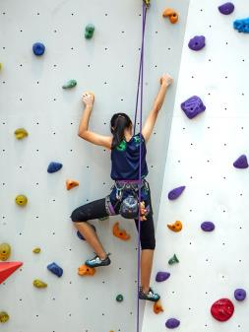
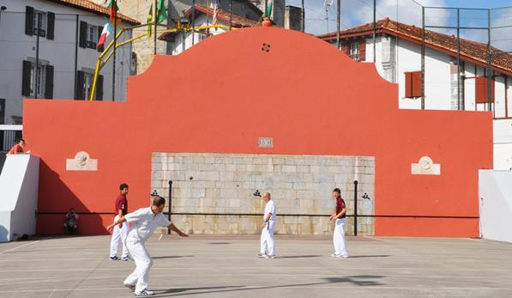
HAVE FUN
CLIMBING
PLAYING WALL: Basque pelota

Slide 17
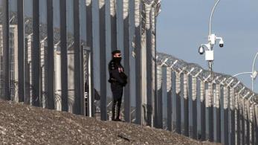
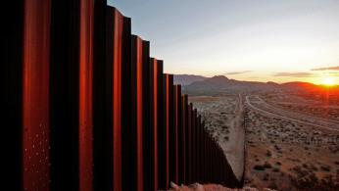
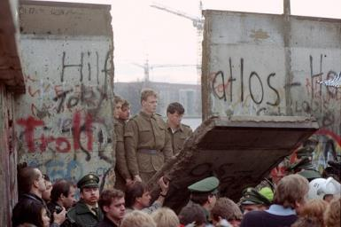
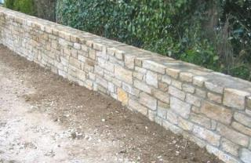
SEPARATE
CALAIS WALL
BOARDER USA/MEXICO
BERLIN WALL
A LOW WALL

Slide 18
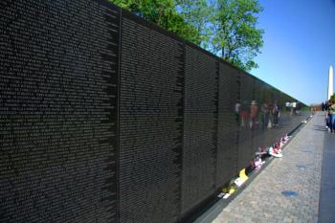
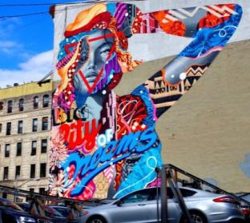
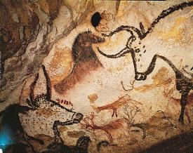
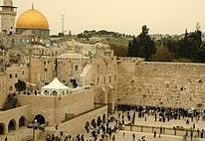
VIETNAM VETERANS MEMORIAL
EXPRESS
LASCAUX CAVE
STREET ART
WAILING WALL

Slide 19
OUR WALL !!!

Slide 20
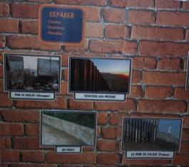
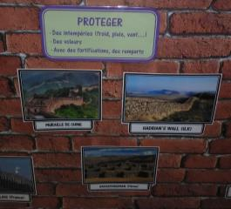
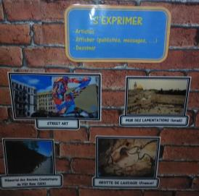
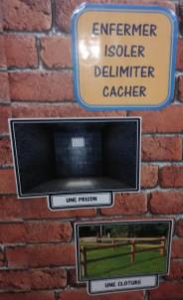
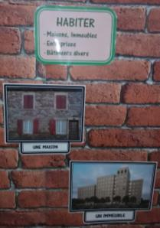
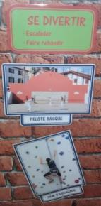

Slide 21
4/ Where are located those walls?
Using Internet, they had to replace some walls on a map.
In a next time, by groups, they will prepare a description of them.
It will be presented to families at the end of the project.

Slide 22
5/ « How can we connect people with walls? »
As we’ve seen before, in general, walls are made to separate people.
- Your mission is to create a wall for connecting people, helping them be closer.
- You need to draw and explain your project.
- You can work alone or in groups.
- You will build a model of your project.

Slide 23
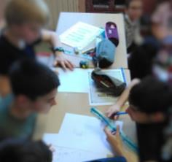
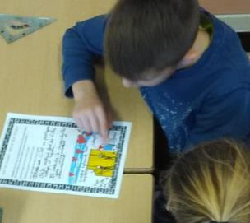
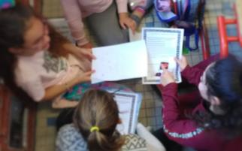
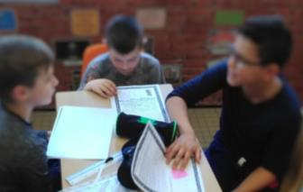
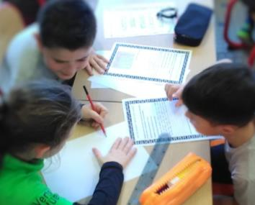
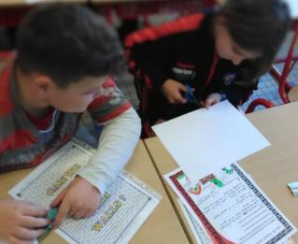

Slide 24
To be continued…
poems: caligrams, haïkus.
presentation to parents.

