Slide 1
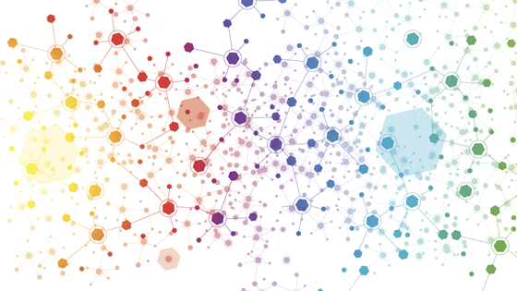
HOW ARE WE CONNECTED ?
PBL in action
Event 3
Ecole élémentaire
Pau Casals
Saint-Estève

Slide 2
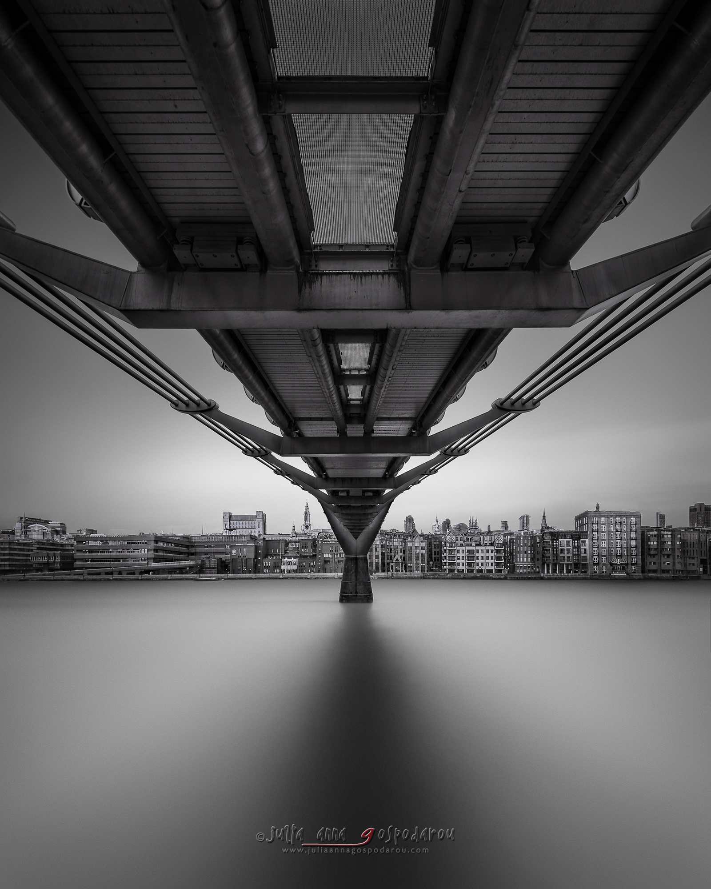
YEAR 6 – CM2
Laurent

Slide 3
How are we connected ?
We decided to study the links between our countries…
Is there a little bit of England, Sweden and Spain where we live?
And is there a little bit of France in your countries?

Slide 4
What we did ?
Researches
Posters
Survey
Exhibition

Slide 5
RESEARCHES
Informations on each country.
Links between countries.
Conclusions

Slide 6
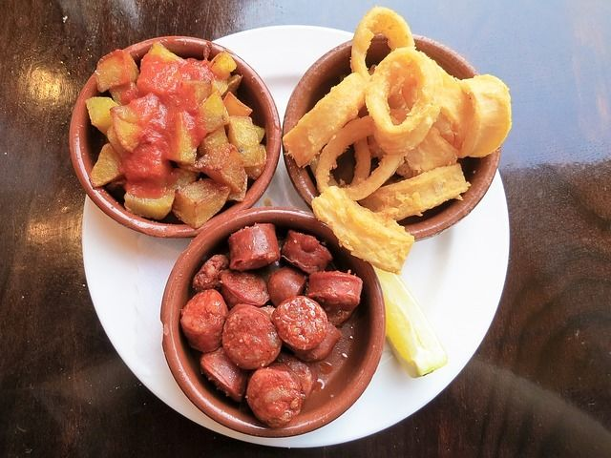
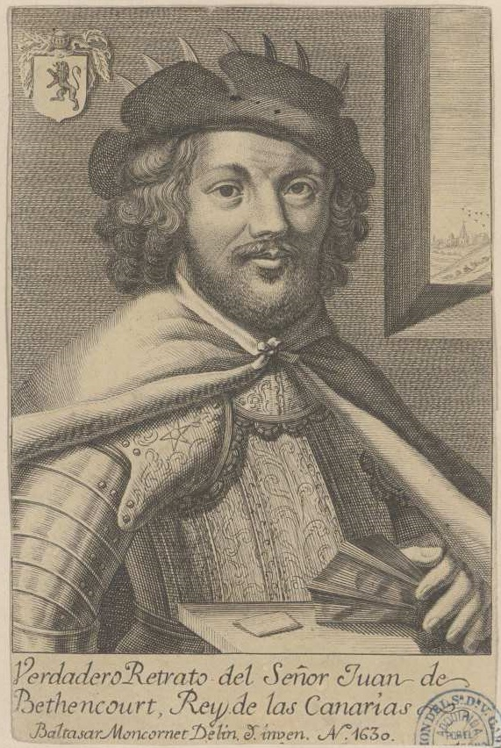
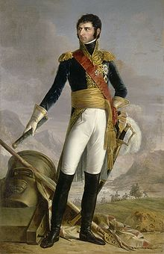
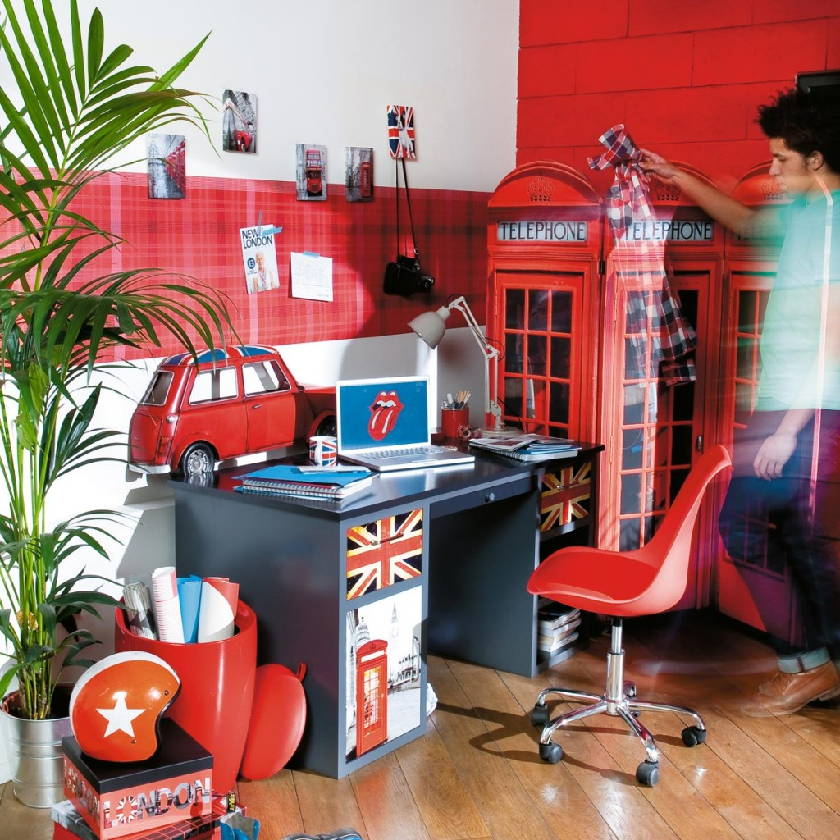
CONCLUSIONS

Slide 7
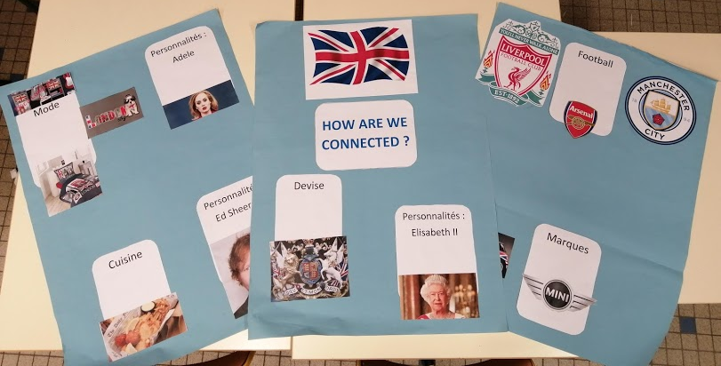
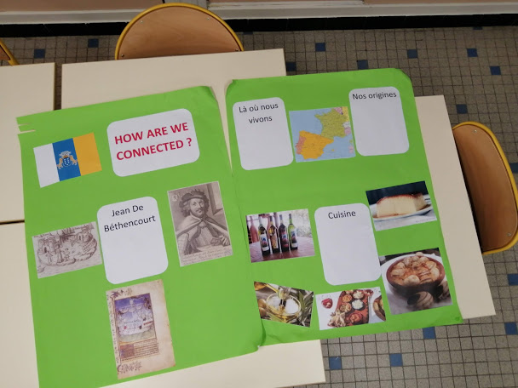
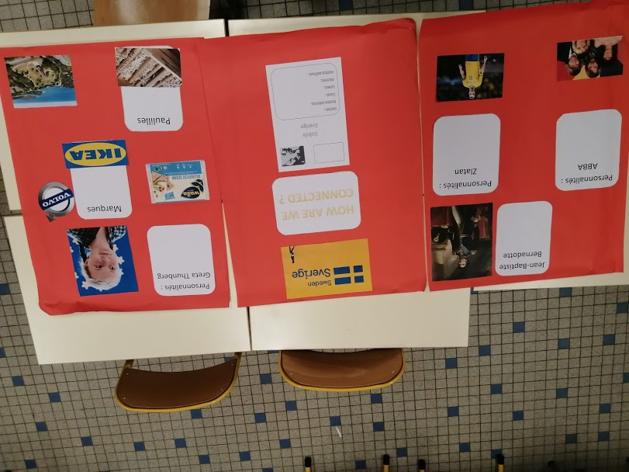
POSTERS

Slide 8
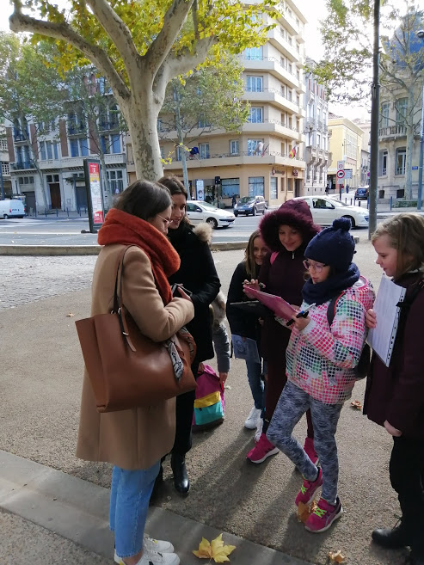
SURVEY
First three words that come to you when I say : Sweden, Spain or UK.
Do you think those countries are connected?
Booklet

Slide 9
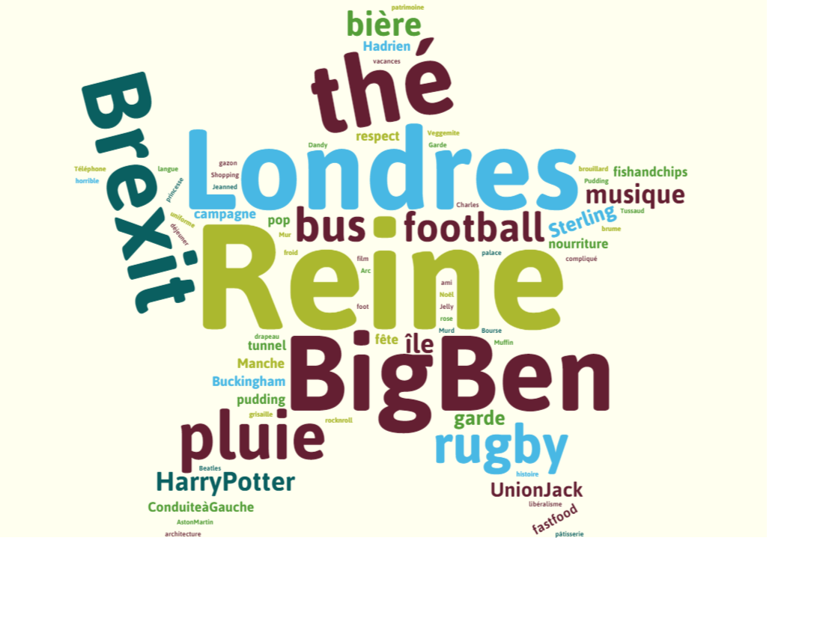
EXHIBITION

Slide 10
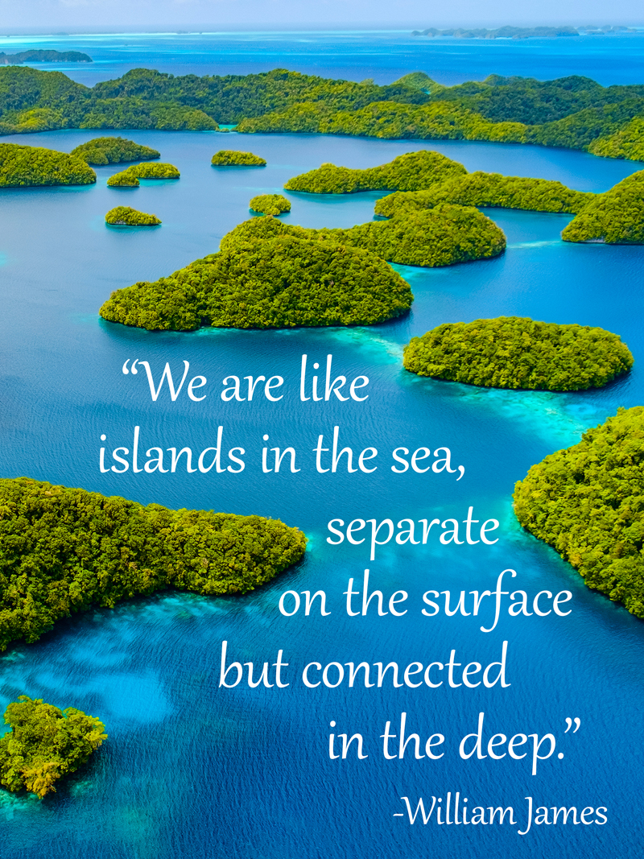
TO FINISH
What the pupils (I hope) will remember…

Slide 11
YEAR 6 – CM2
Caroline

Slide 12
How are we connected ?

Slide 13
Students exchanged together to give a sense at this topic.
They lead their ideas on a geographic way and chose to research what connect us to other european countries.
They selected 2 main ideas :
What are the means of transports that connect us ?
What cultural elements from other countries do we know and share ?

Slide 14
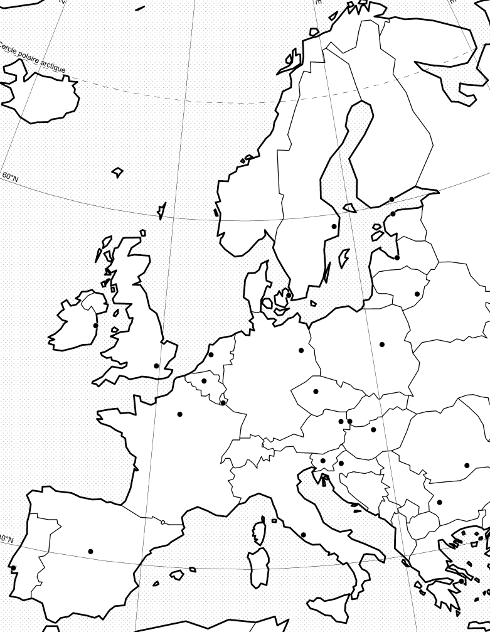
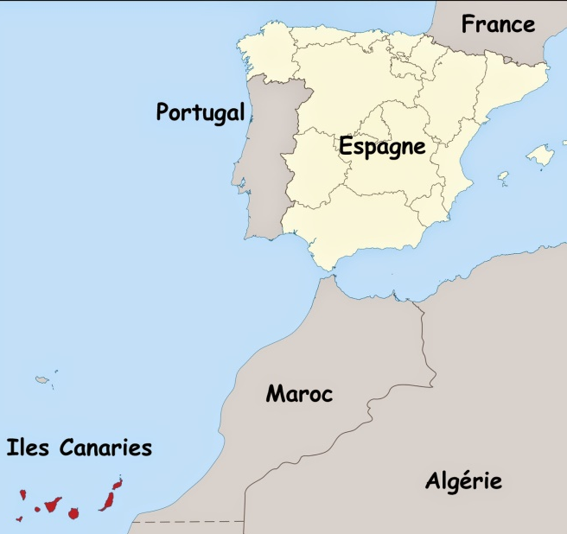
Erasmo and his friends want to visit Europ and discover what
connects them. They will have some missions to do. Can you help them ?
ERASMO
ERASTOCKHOLM
MADRILA
BERLINO
CANARMUS
PEPEROMUS

Slide 15
1st Mission
Which means of transport connect us ?
Students made researches on maps and on internet to find how, from Perpignan, we can go to european cities (London, Stockholm, Berlin, Roma and Gran Canaria).
They had to complete maps to illustrate their answers.

Slide 16
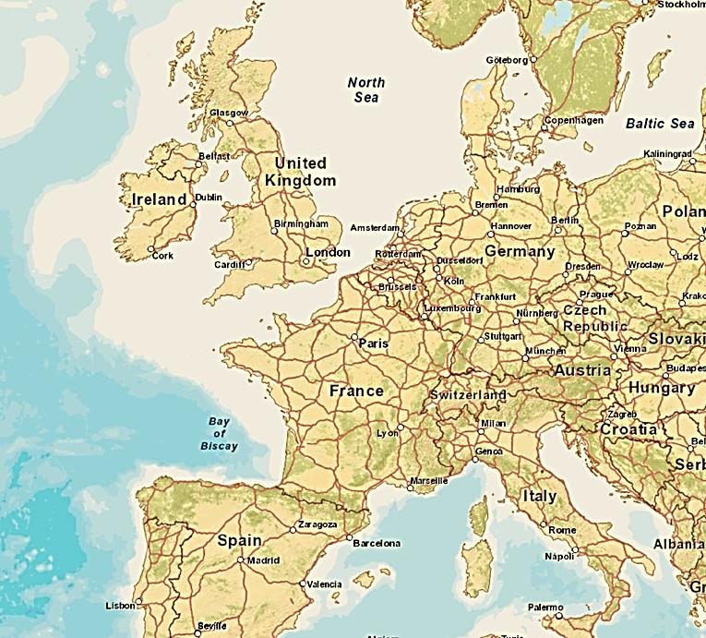
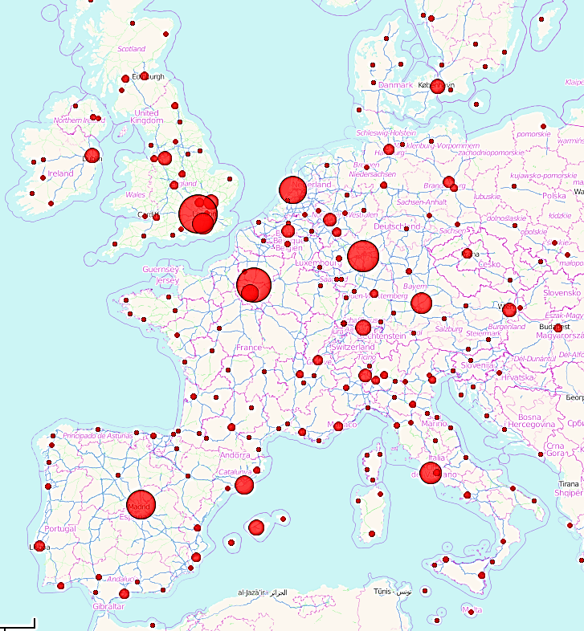
Main roads and airports in Europe.

Slide 17
2nd Mission
Which cultural elements come from Europe ?
They had to associate pictures to their original country.
It was interesting for them to realise that they were convinced that some of these elements were french, but no…

Slide 18
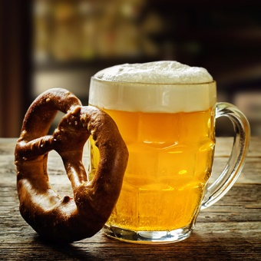
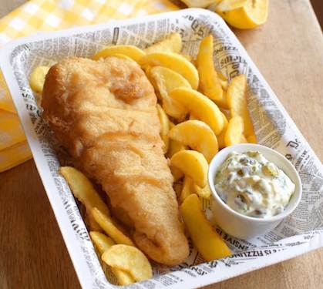
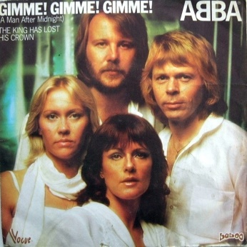
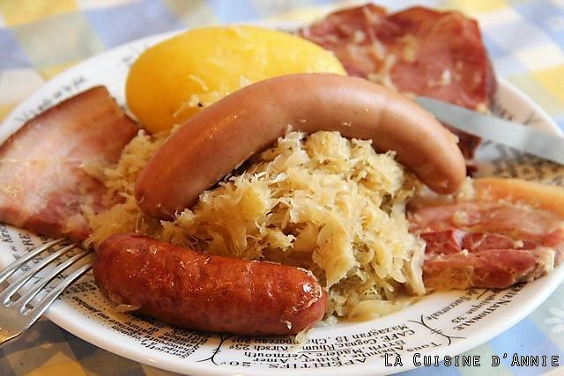
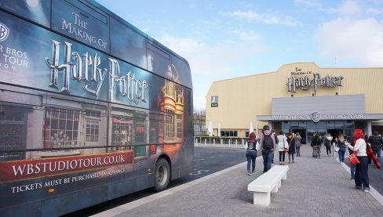
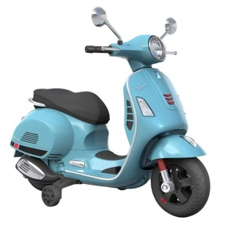
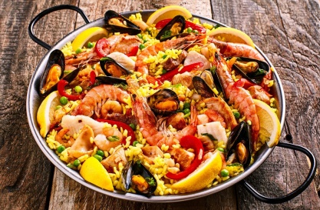
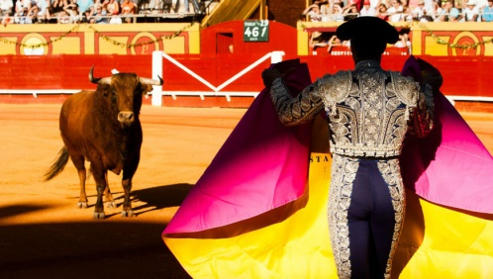
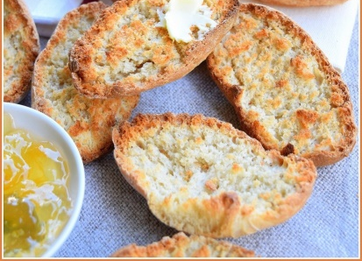
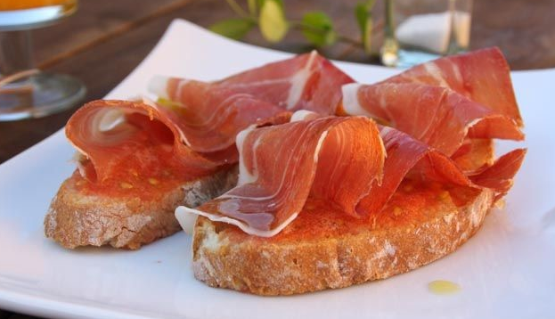

Slide 19
3rd Mission
And us, from Perpignan, what connects us to Europe ?
They cared about an international logistic platform located in Perpignan. It’s a site that organise import and export of fruits and vegetables.
Doing researches on the website and on aerial views, they learned about the european connection of this site.

Slide 20
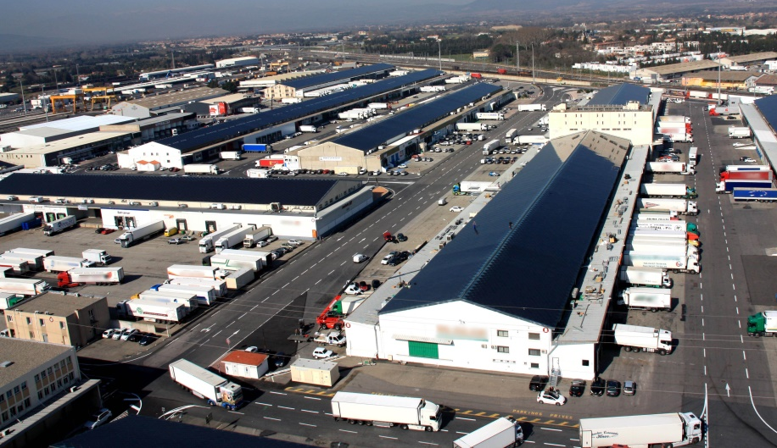
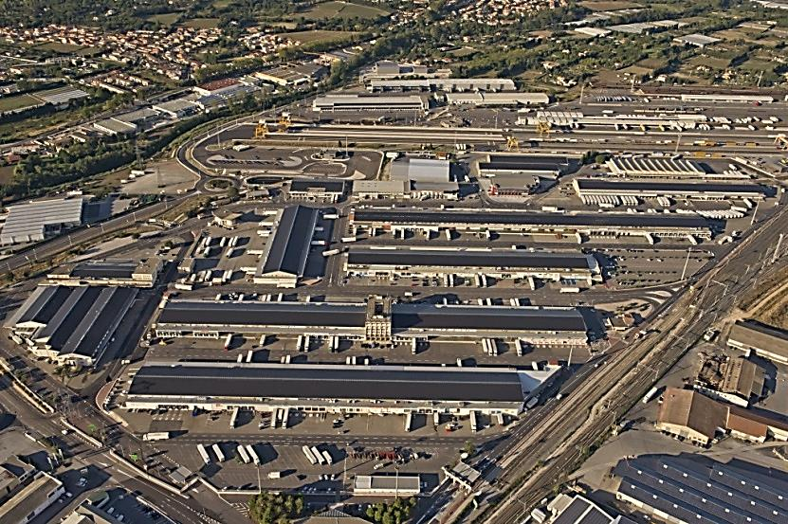
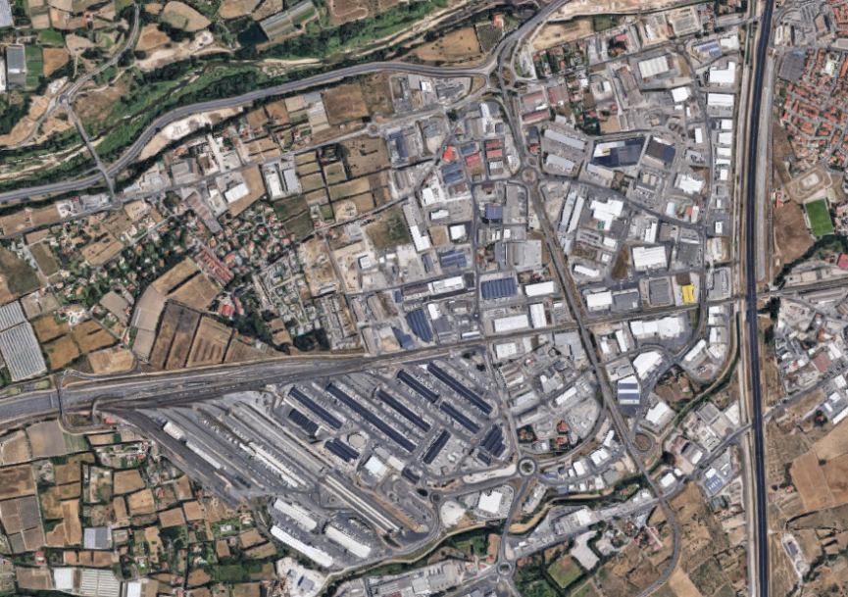
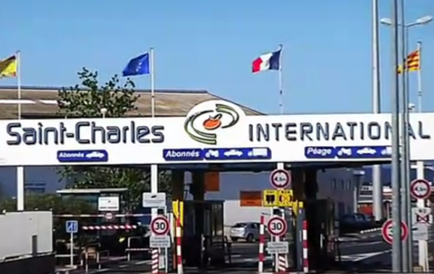

Slide 21
