Slide 1
How are we connected?
A whole-school Project at Goose Green Primary School.

Slide 2
How are we connected at goose green
We interpreted the project as an opportunity to establish our new classes at the start of this academic year. As we were unable to change our existing topics, we created a whole school ‘mini project’ which lasted for one week.
We have already carried out a whole school project at the end of the academic year 2018-19 based around our carnival, and are planning another for the end of this academic year too.
For this project, each year group was given the same set of expectations, but after that it was up to the class teachers and children to determine which direction their projects would take.
We did, however, pre-determine one final outcome of the project which was a shared art project across the school.

Slide 3
Setting up the project (From the document sent to teachers)
How are we connected? (Four day PBL project 2nd -6th September)
Each class/ year group is open to interpret the shared question in whichever way that group of children want. Please try to allow the children to lead the project as much as possible, as pupil voice and choice is important to PBL.
There will be a copy of ‘Everything is connected’ by Jason Gruhl available for each class which can serve as a stimulus. We would like each class to carry out at least one P4C lesson reflecting on this book.
This week is off timetable, though as we are focussed on finding and celebrating connections across our school, it would be a good opportunity to establish buddy reading with a partner year group.
Remember, we will have some time to plan in new year groups teams on the INSET in September.

Slide 4
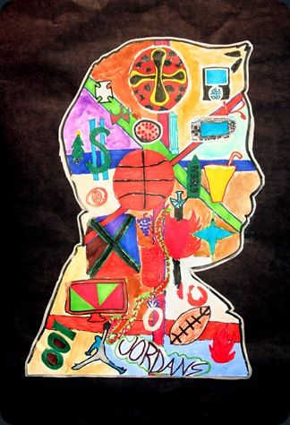
Shared art project
We also need to produce a piece of art work for each child which will then go up on display in the halls on Friday 6th of September. Please ensure art is ready for display and backed onto black A4 card by Friday after school.
Every child needs to produce a silhouette portrait filled with personal interests/ information. We will then mix up children from different year groups and classes on the display boards. We will then ask each class to use coloured wool to find connections across the portraits.

Slide 5
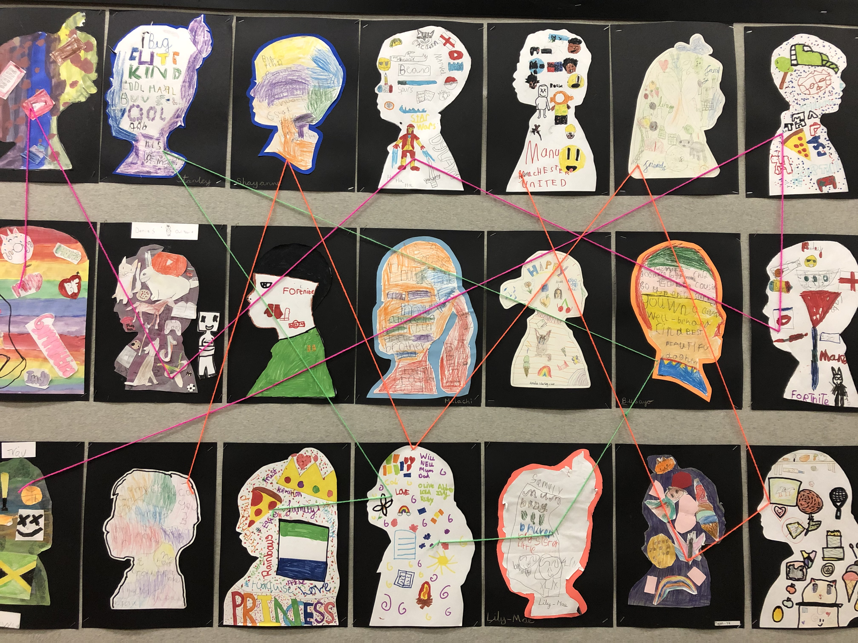
The children used coloured wool to find and show the connections between the different portraits.

Slide 6
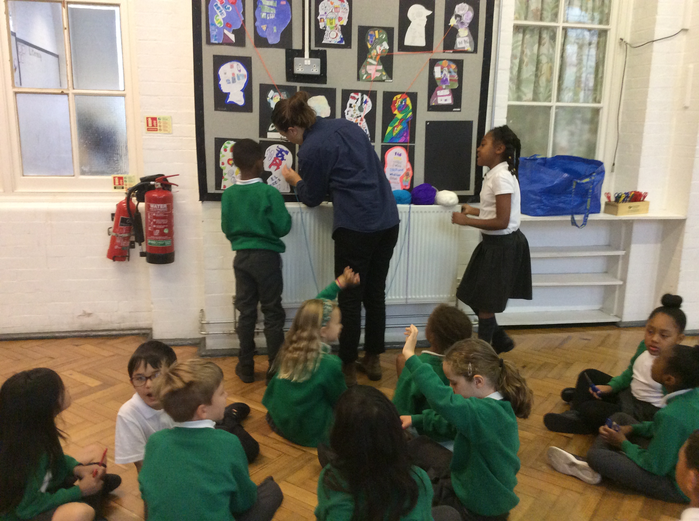
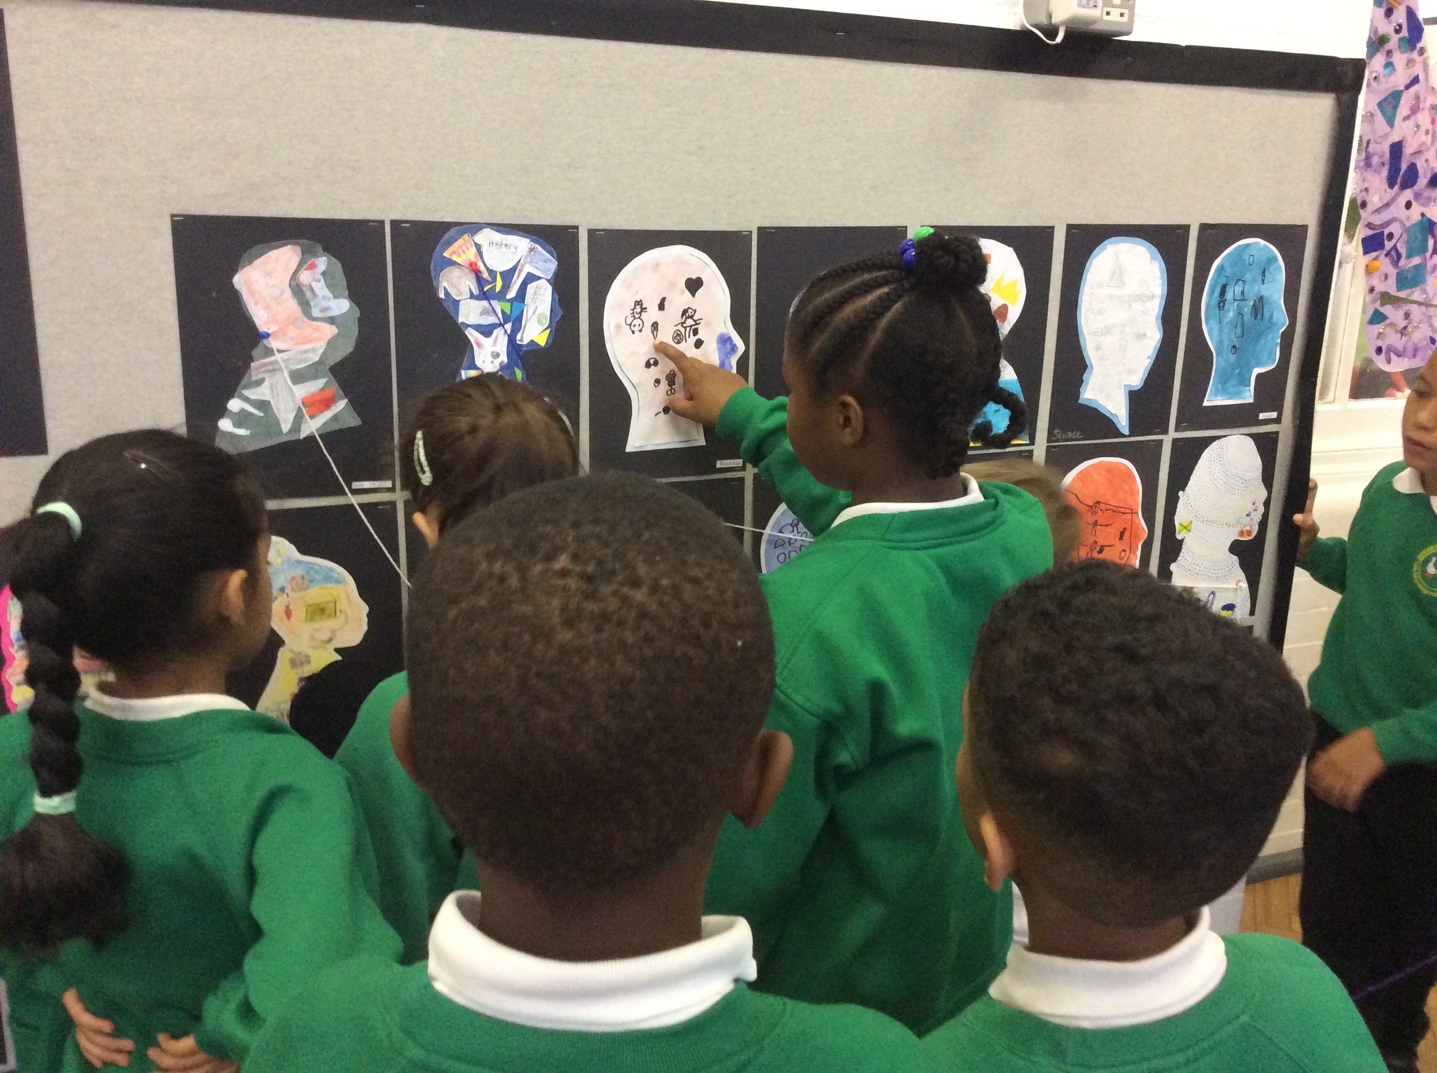
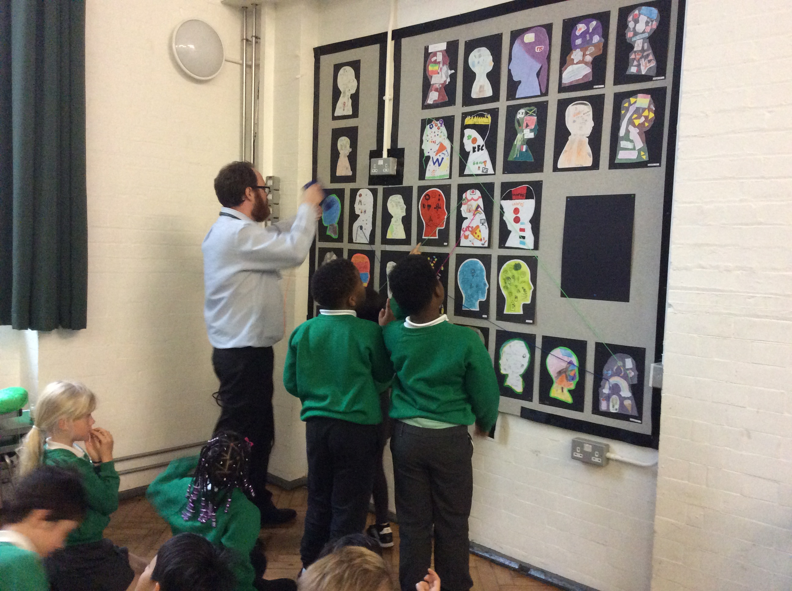

Slide 7
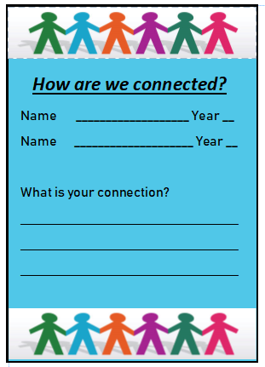
Connections cards
The children also attempted to find their own, personal connections with children across the school. If they found their portrait had been connected with another child they tried to find that child and discuss what they had in common. They filled in these cards and shared them with their classes. As our lunch and break times are staggered across the morning some of our children do not get much of an opportunity to meet.

Slide 8
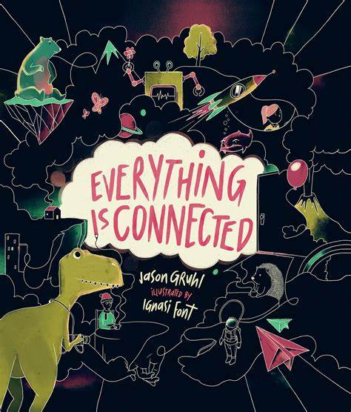
Key text
At Goose Green we use a key text as part of every project that takes place. The children are used to exploring these high quality texts as part of the project and it allows us to connect literacy and PBL in meaningful ways.
We found this text and ordered a copy for each class to use for the project.
As part of our instructions to teaching staff, we asked that the book be used as a stimulus for teaching P4C (philosophy for children) at some point throughout the project.

Slide 9
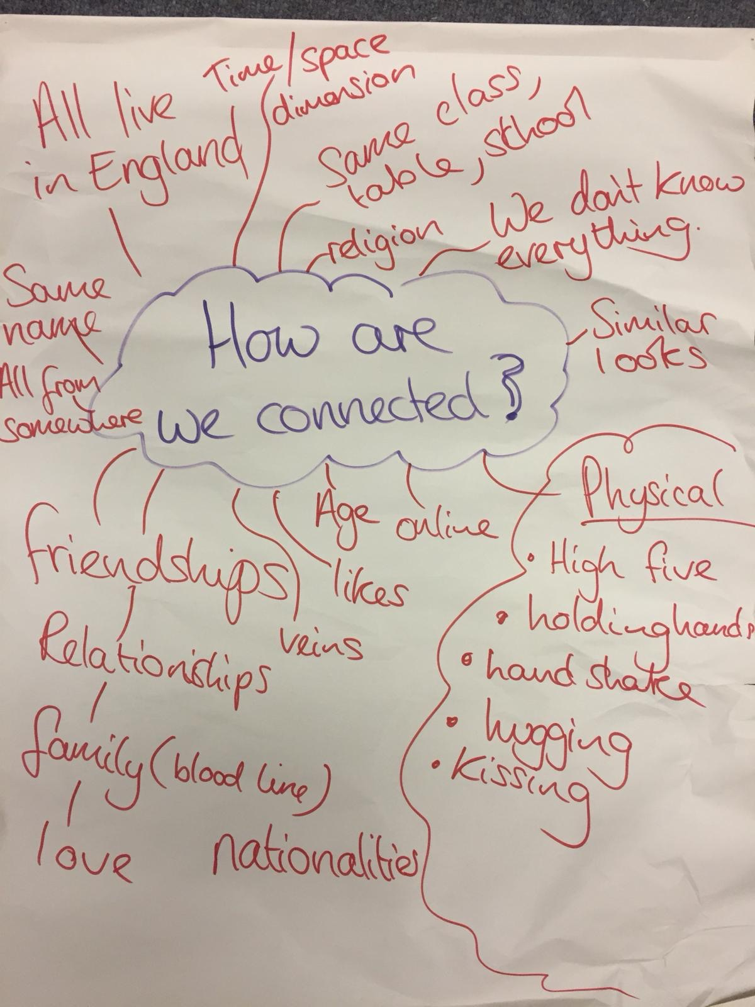
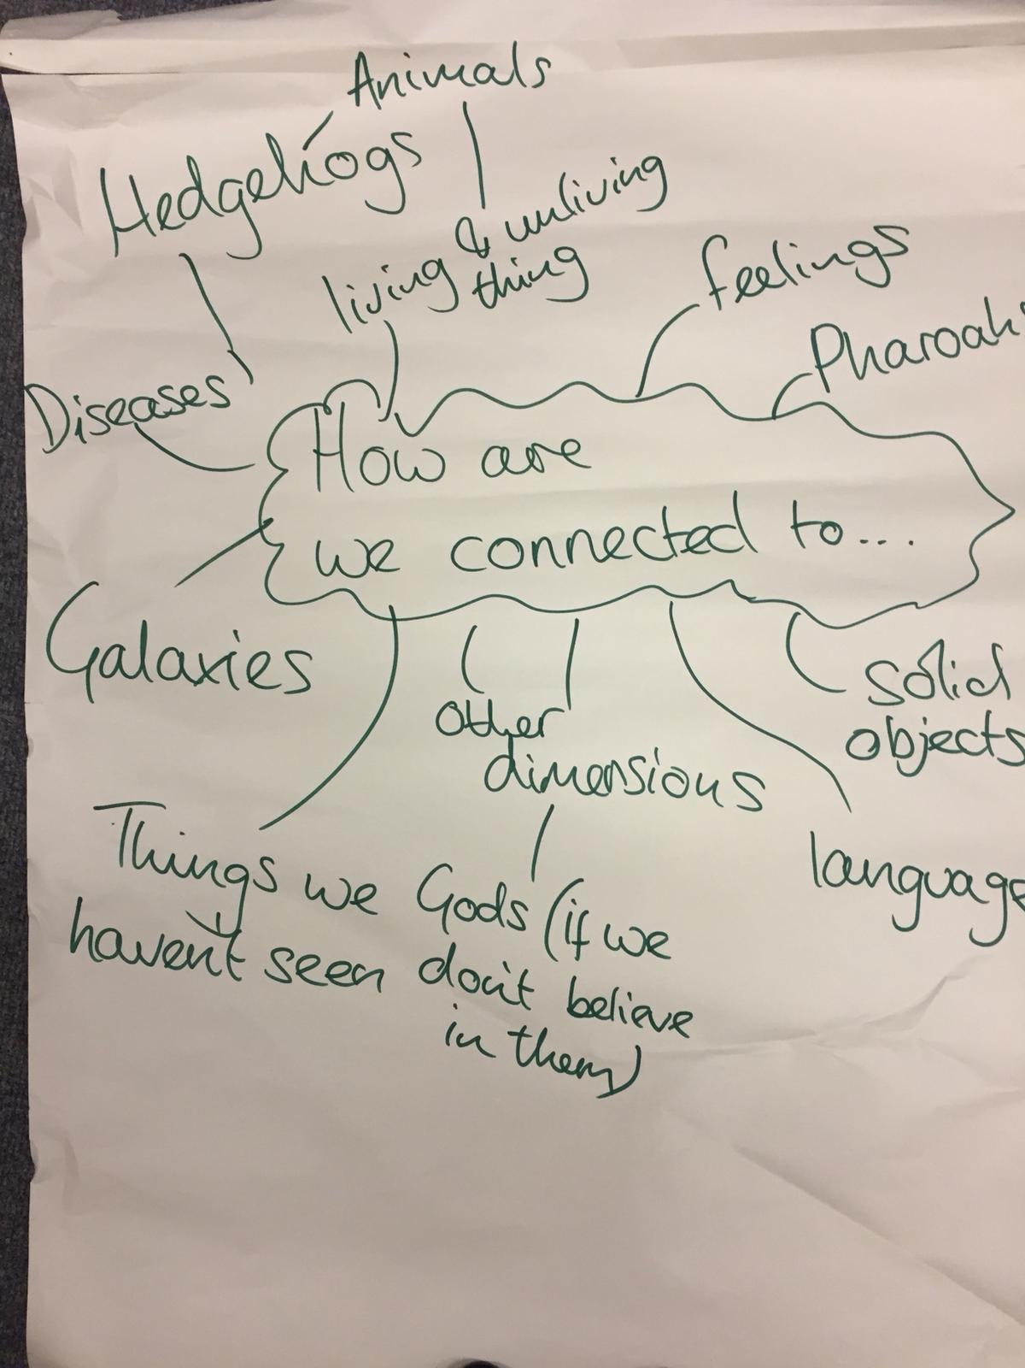
Before reading the book.
Questions after reading the book.

Slide 10
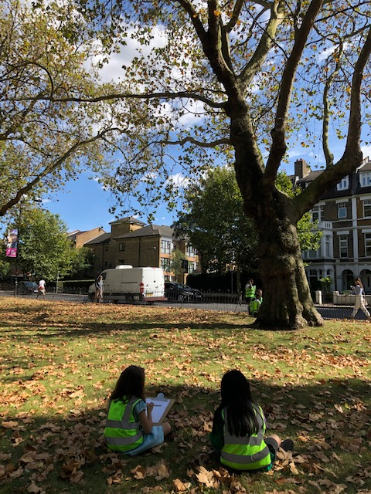
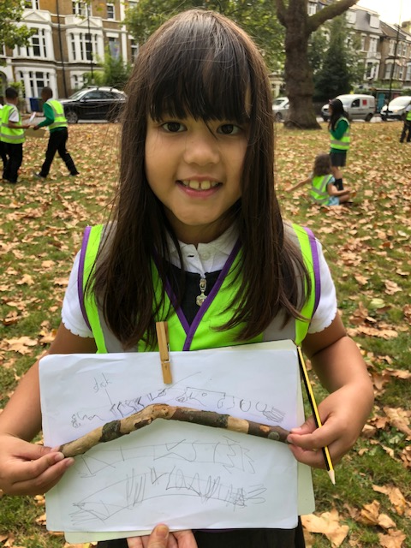
Year 3: how are we connected to our local area?
Year 3 children wanted to go out and explore their local area after reading ‘Everything is Connected.’ We drew observational drawings of the trees in our closest park as well as the buildings and cars around us. Many of our children live very close to school and could tell each other about their local knowledge.
A local woman also told us about the process through which trees in the park absorb pollution and shed their bark.

Slide 11
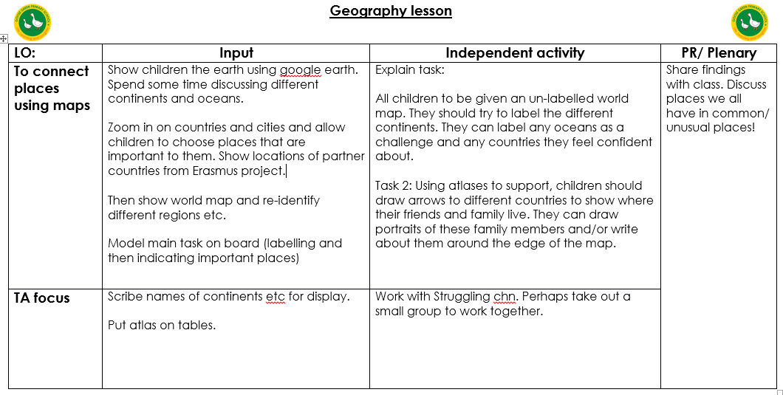
Geography skills/ PBL

