Slide 1
‘Topic based learning’ at goose green primary school

Slide 2
Goose Green is a two form entry primary in East Dulwich, South East London. We have a very diverse set of children from a wide range of cultural and socio-economic backgrounds. Goose Green joined Communitas Education trust in September 2017.

Slide 3
Curriculum
Goose Green have spent the last few years developing our curriculum to ensure that it is inclusive, relevant to the needs of our children, exciting and allows for progression across the different key stages.
Each year group explores a topic focus for a half term (or longer). This topic will be framed in the form of a question, such as: ‘How have the Victorians impacted our lives today?’ This starting question will then be used a stimulus for the children, and the rest of the half term should be spent exploring the themes that emerge in response to it in cross-curricular learning. We are moving towards an increasingly child-led approach and want to continue to develop our teaching and learning practice to reflect this.

Slide 4
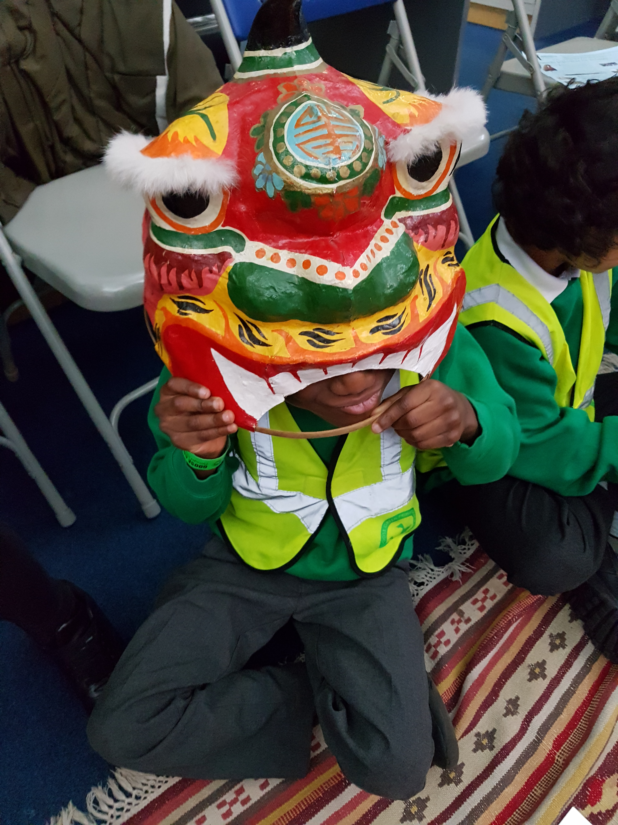
Immersion activities
At Goose Green we find that many of our children need to have some kind of experience of a new topic to be able to place it within a context. We provide this by ensuring that each new topic begins with an immersion activity. This may take be in the form of an excursion, a visitor to school, or a set of activities to frame the new topic and allow all children, regardless of background or past experience, to access and engage with the new learning about to take place.

Slide 5
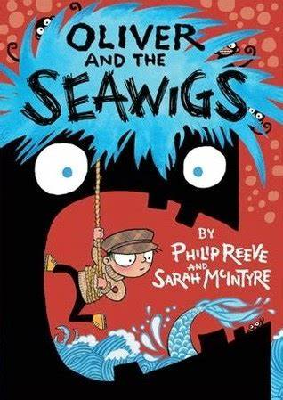
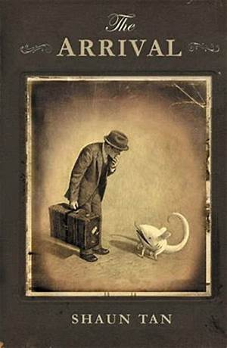
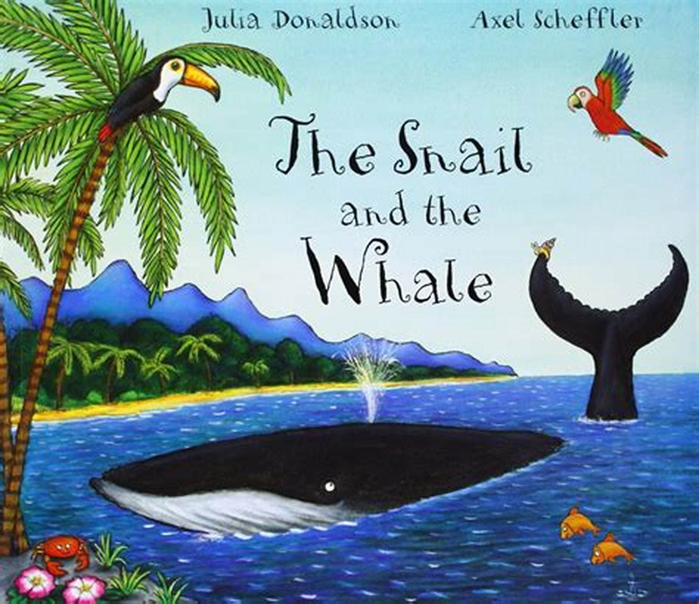
Key texts
Goose Green also uses a key text as a main stimulus alongside the original starting question. We use a variety of age appropriate, high quality texts (stories, picture books, poetry) at the heart of our literacy teaching.

Slide 6
End of topic celebration
At the end of each half term, our children will have worked towards some kind of final outcome which reflects the learning journey that has taken place. We always share this celebration with the families of our children and past celebrations have taken many different forms. Some examples include:
- Reception children have organised a café for parents and carers to attend.
- Year 5 children have planned, written and performed a debate.
- Year 4 children set up an Ancient Egyptian museum to display artifacts they had produced.
- Year 3 shared work

Slide 7
End of topic celebrations
Work from Year 2

Slide 8
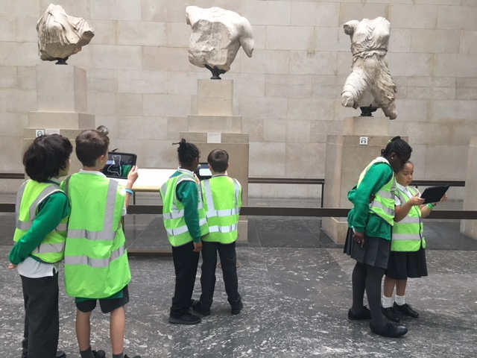
Work from Year 5

Slide 9
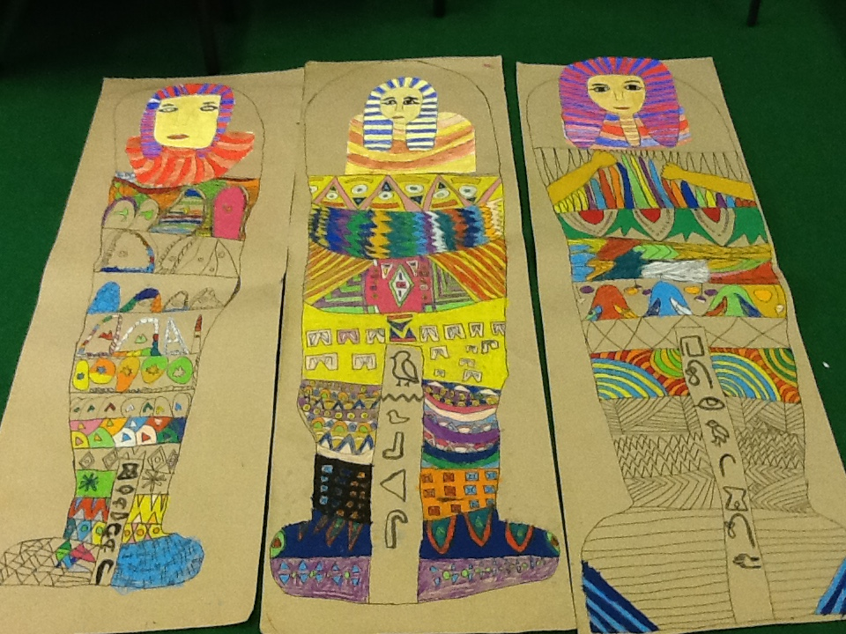
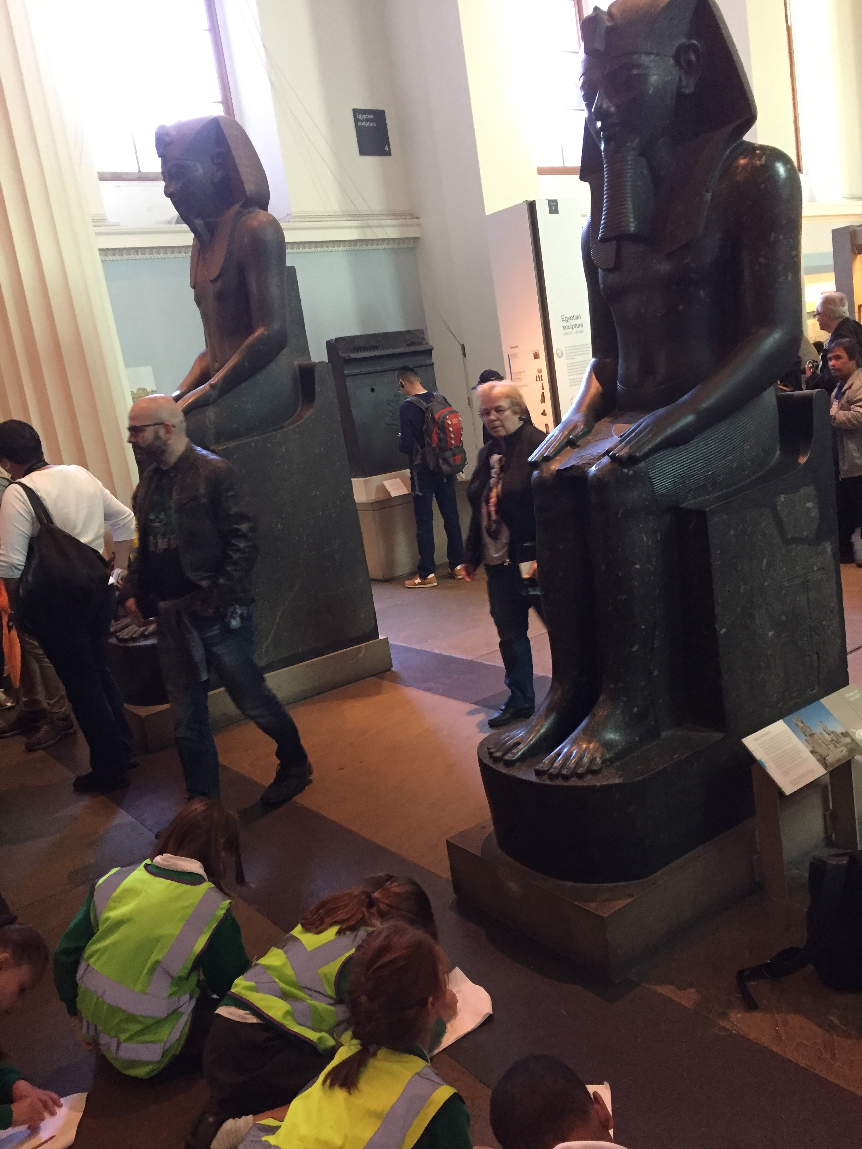
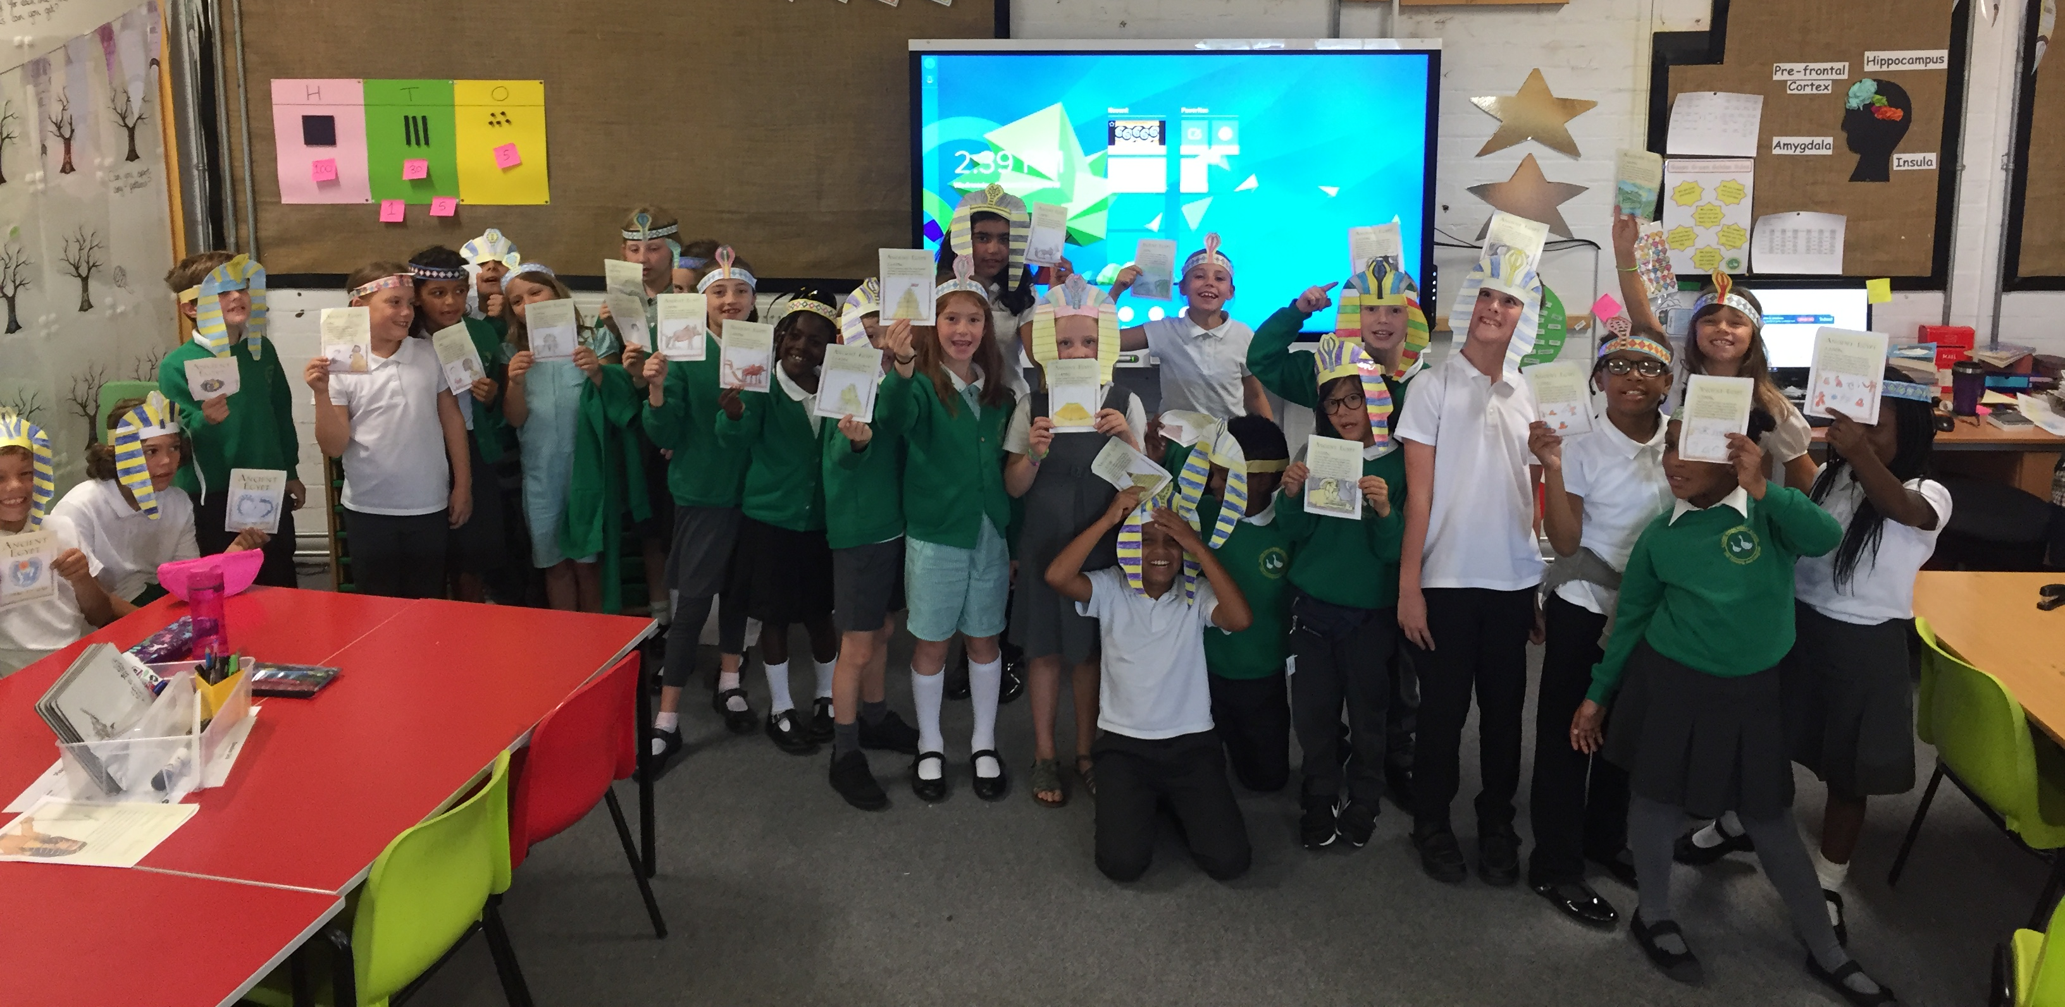
Work from Year 4

Slide 10
What does PBL mean at goose green?
At Goose Green, our curriculum has been designed to our topic-led approach already utilises many aspects of PBL. Throughout the course of this project, we are hoping to continue to develop our understanding of PBL in addition to the journey that we are on as a school and to enhance our existing curriculum.

