Slide 1
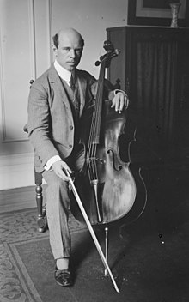
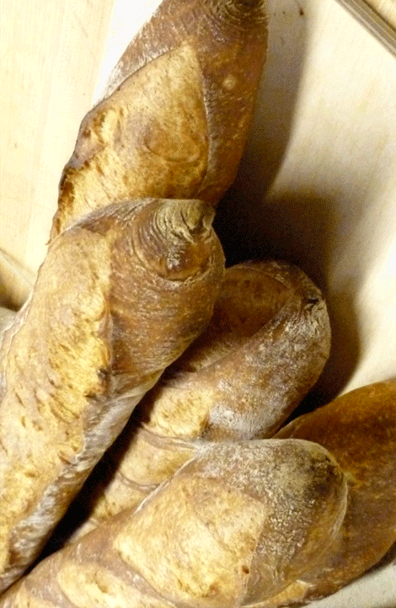
Ecole élémentaire Pau Casals

Slide 2
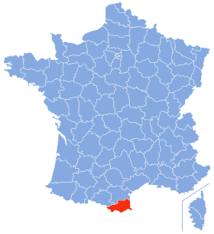
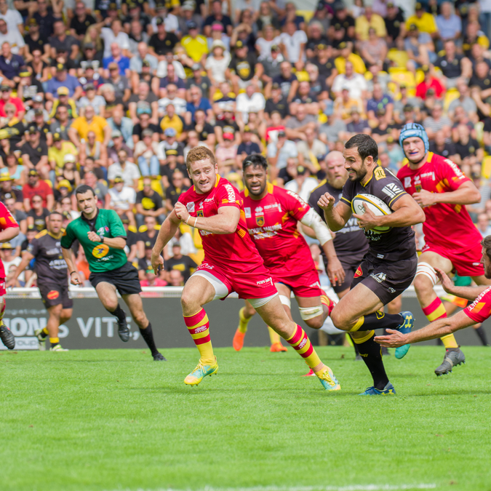
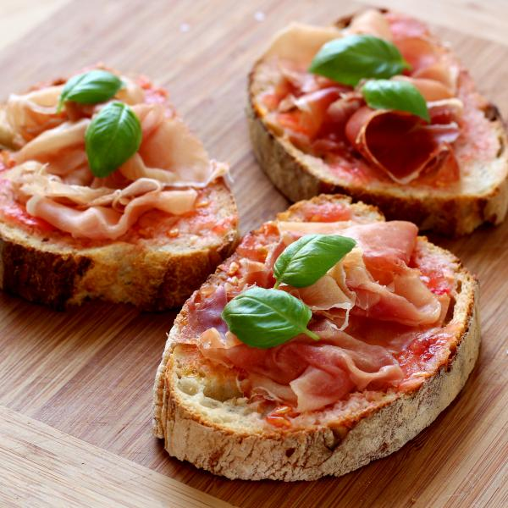
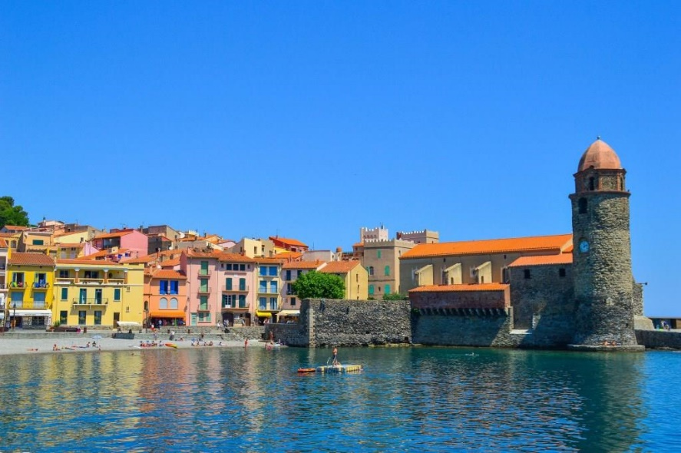
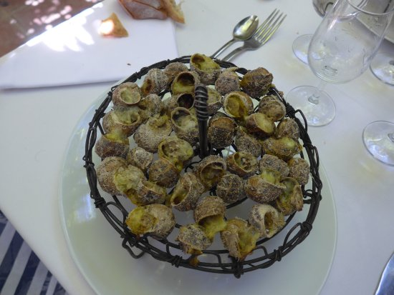
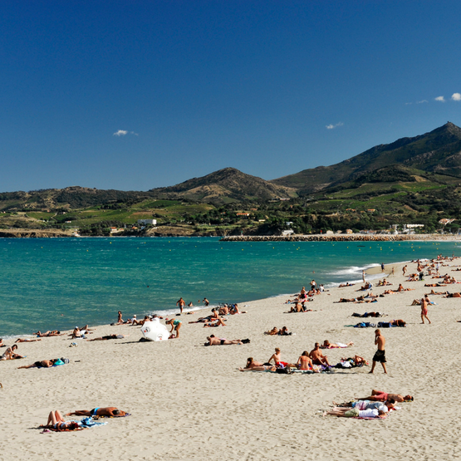
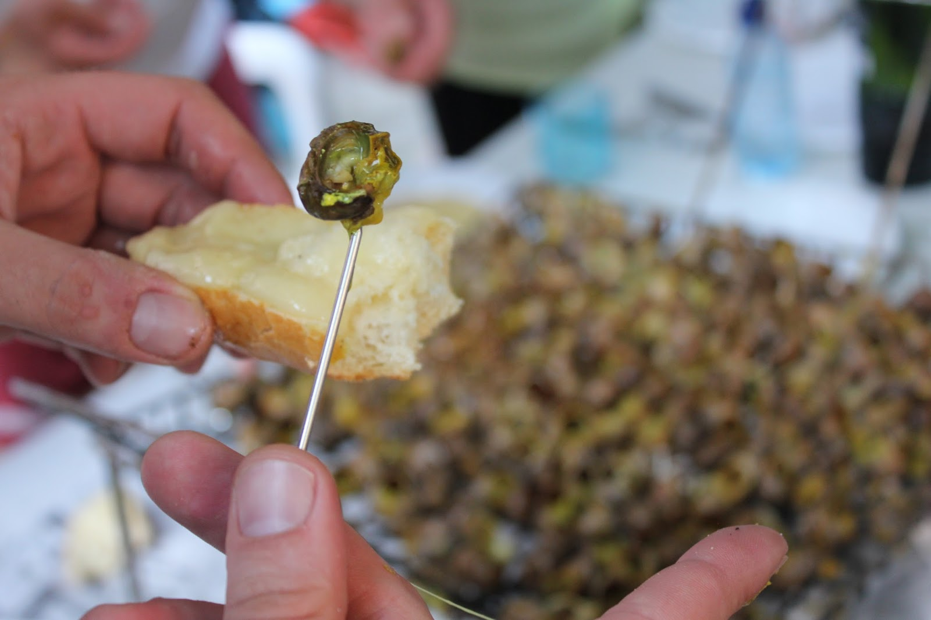
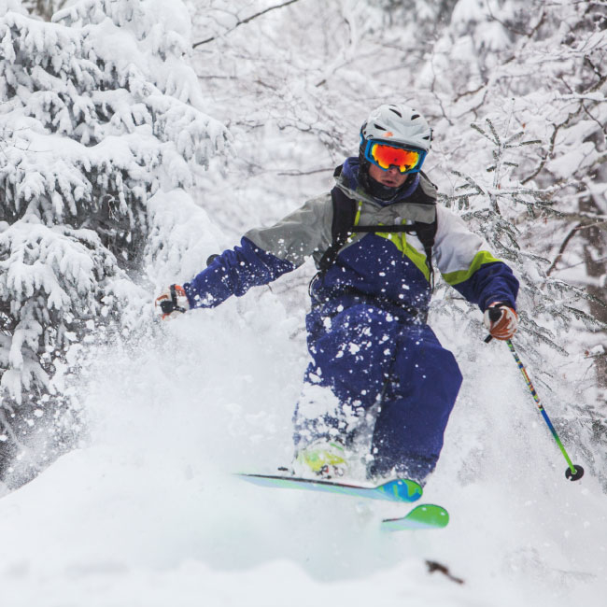
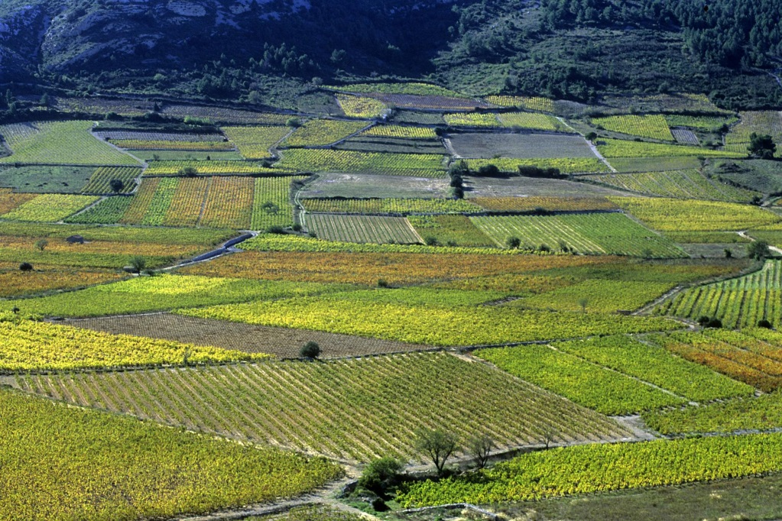
The Pyrénées Orientales

Slide 3
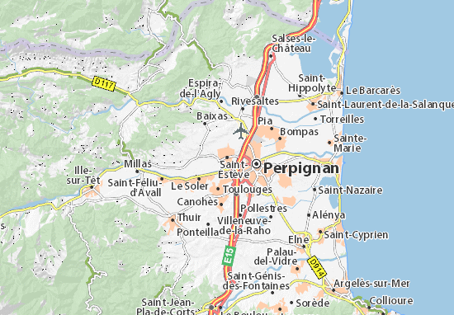
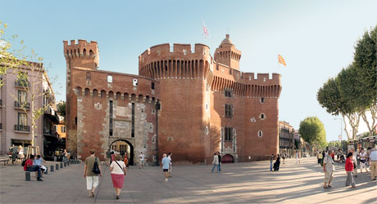
Where is Saint-Estève ?
Five kilometers (3,10686 miles) from Perpignan : our BIG city…

Slide 4
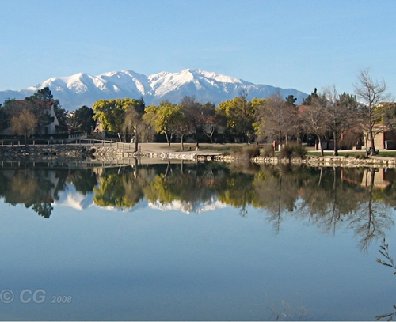
Saint-Estève
Saint-Estève can be considered as a district of Perpignan (a really quiet one).

Slide 5
The school
12 classes :
2 CP : 6 y/o
1CP/CE1 : 6 & 7 y/o
1 CE1 : 7 y/o
1 CE1/CE2 : 7 & 8 y/o
2 CE2 : 8 y/o
2 CM1 : 9 y/o
2 CM2 : 10 y/o
1 ULIS for special needs pupils
300 pupils

Slide 6
Some pictures of the school

Slide 13
What is P.B.L. for us?
P.B.L. is for us :
Pupils will have to produce something
Many subjects must be involved (mathematics, sciences, ICT…)
Pupils will learn a lot without realizing it

Slide 14
Do we use P.B.L.?
P.B.L. is used almost in kindergarten and in challenging schools : in fact where it’s needed to involve pupils.
10 years ago it was really requested by our inspectors.
Nowadays, we are asked to work each subject for itself.
For many families having fun at school or taking part in projects is not seen as really working…

Slide 15
What do we do?
We have many projects involving from one class to the whole school…
…but most of them can’t be described as P.B.L.
We work using themes (Christmas, autumn, Africa…) and during a month many activities are related to the same theme.

Slide 16
One example : Les Poilus
This project took place in october and november and the topic was to make some researches on the soldiers from Saint-Estève who died during WW1.
Pupils had to make some researches on each soldier and write what they found with a short message to this soldier on a sheet of paper.
Those sheets of paper were attached to balloons.

Slide 17
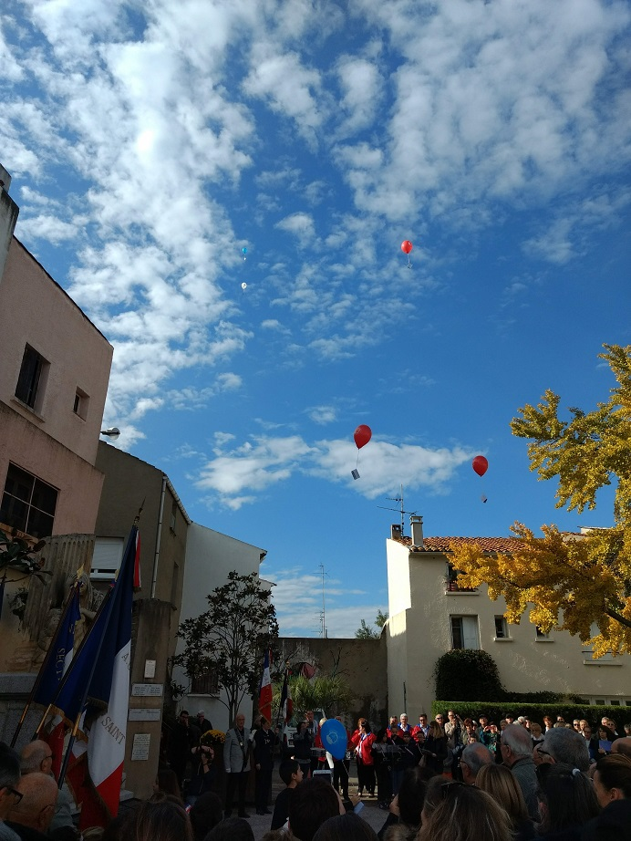
And on Sunday november 11th, a century after the end of WW1, the balloons were released during a ceremony next to the war memorial of Saint-Estève.

Slide 18
Subjects :
History : We studied the WW1
ICT: the researches were made on the website :
http://www.memoiredeshommes.sga.defense.gouv.fr/
Citizenship education and remembrance
Language skills

