Slide 1
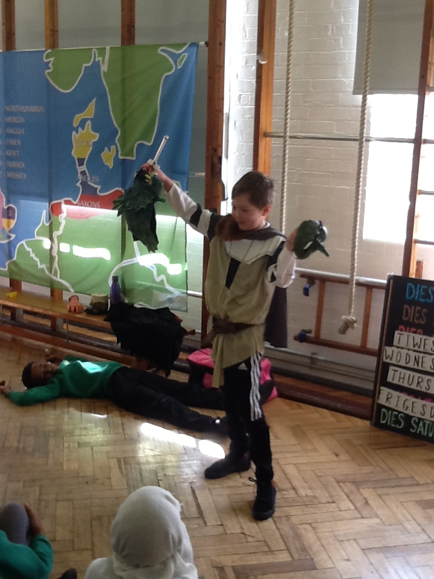
PBL at Goose Green
Spring term 2018-19

Slide 2
Successes
● Some year groups across the school starting to incorporate PBL more holistically.
● End of term celebrations have been really successful and structured to allow for extended problem solving.
●A really good variety of different outcomes are starting to develop.
● Parent engagement with topics is becoming stronger through home learning as well as invitations into school.
●As a school, we are already working using PBL in some way or another and every year group has embraced the aspects adopted so far.
●Children show high awareness of topics and questions.

Slide 3
strengths
● Beginning to include more D&T as part of our existing projects.
Art and drama already whole-school strengths to be utilised further as part of PBL approach.
Specialist teachers are very skilled and enrich our curriculum a great deal already.
● Continued use of key texts which relate to our topics have very high levels of engagement for Goose Green children, which in turn supports literacy teaching. This is a target area for Goose Green.
●Immersion activities and trips are very successful and children are highly engaged.

Slide 4
Challenges
● Some topic questions may need to be adjusted to allow for a wider range of projects to evolve
● Different approaches to planning and structuring each half-termly topic needs to be considered and shared with all staff
● Subject knowledge about PBL as well as D&T needs to be improved throughout staff.
●Some texts lend themselves better to projects and cross-curricular learning than others.

Slide 5
challenges
● Children’s level of engagement with topics varies. Accessibility and inclusivity is an ongoing challenge.
● Levels of resources and equipment for teaching D&T.
● Sometimes inconsistency across year groups in terms of immersion activities/ end of topic outcomes. More support needed for planning, as well as developing approaches to planning.
● Sharing of planning and division of planning can inhibit ‘flow’ and links between subjects. Need for planning meetings more explicit.
●Funding

Slide 6
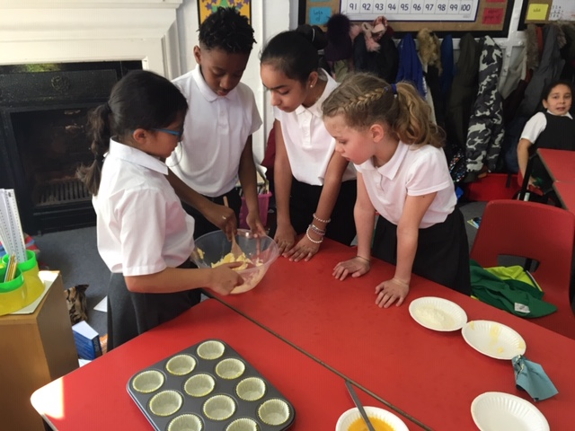
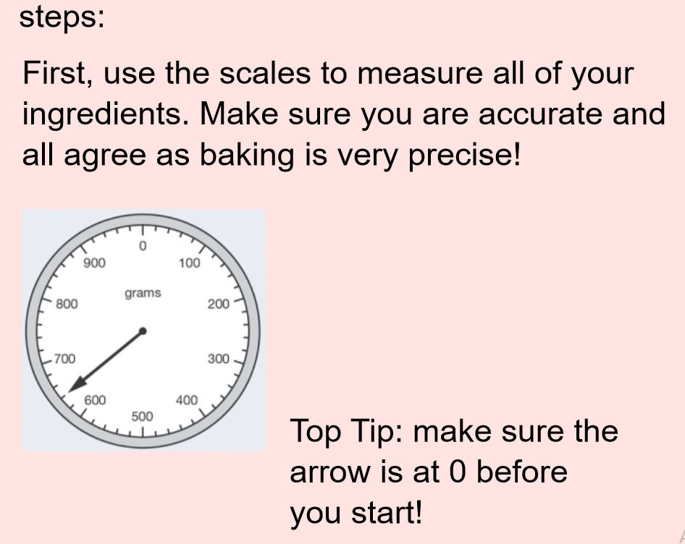
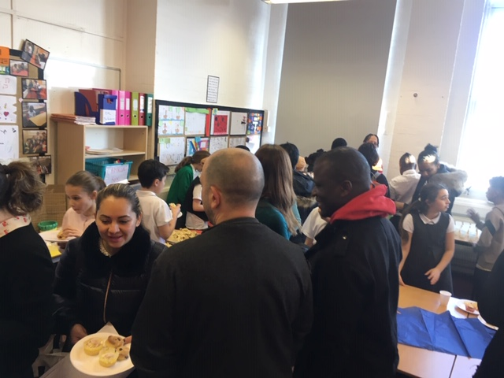
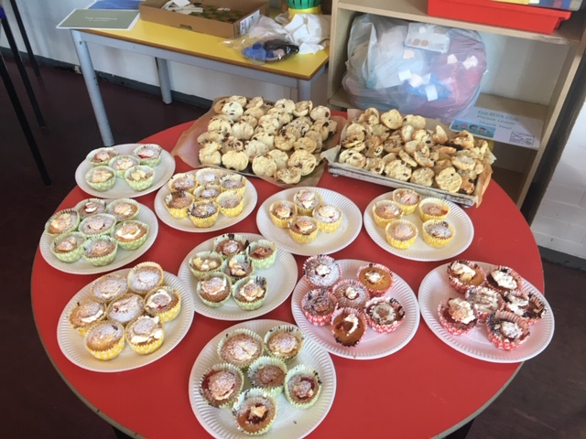
Year 5
Year 5 have been studying the Victorians and their influence on modern British life. The children were interested in the food Victorians ate, so we researched this as a class. We then spent some of our maths lessons figuring out the finances for an imaginary café. We allowed the children to design menus, and finished the topic by actually baking cakes and scones which we then served to the children’s families while they looked through their children’s writing from the half term. We covered a wide range of the curriculum including; measure, money, fractions, percentages, reading, history and following instructions as well as the cooking itself.

Slide 7
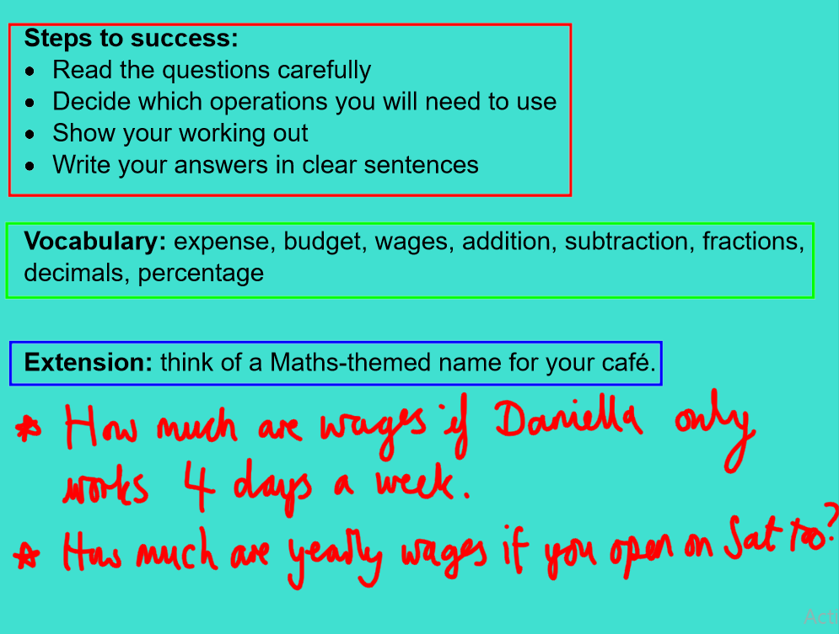
PBL and maths
Year 5 used an imaginary café as a basis for consolidating previous maths skills, whilst also establishing links to our topic and D&T. We planned a week’s worth of problem solving around our topic, which we used for our higher ability children. They engaged really well at first, and were really invested in the idea of a café which is something we could have capitalised upon more.

Slide 8
KS2 History objective overview
Pupils should continue to develop a chronologically secure knowledge and understanding of British, local and world history, establishing clear narratives within and across the periods they study. They should note connections, contrasts and trends over time and develop the appropriate use of historical terms. They should regularly address and sometimes devise historically valid questions about change, cause, similarity and difference, and significance. They should construct informed responses that involve thoughtful selection and organisation of relevant historical information. They should understand how our knowledge of the past is constructed from a range of sources.

Slide 9
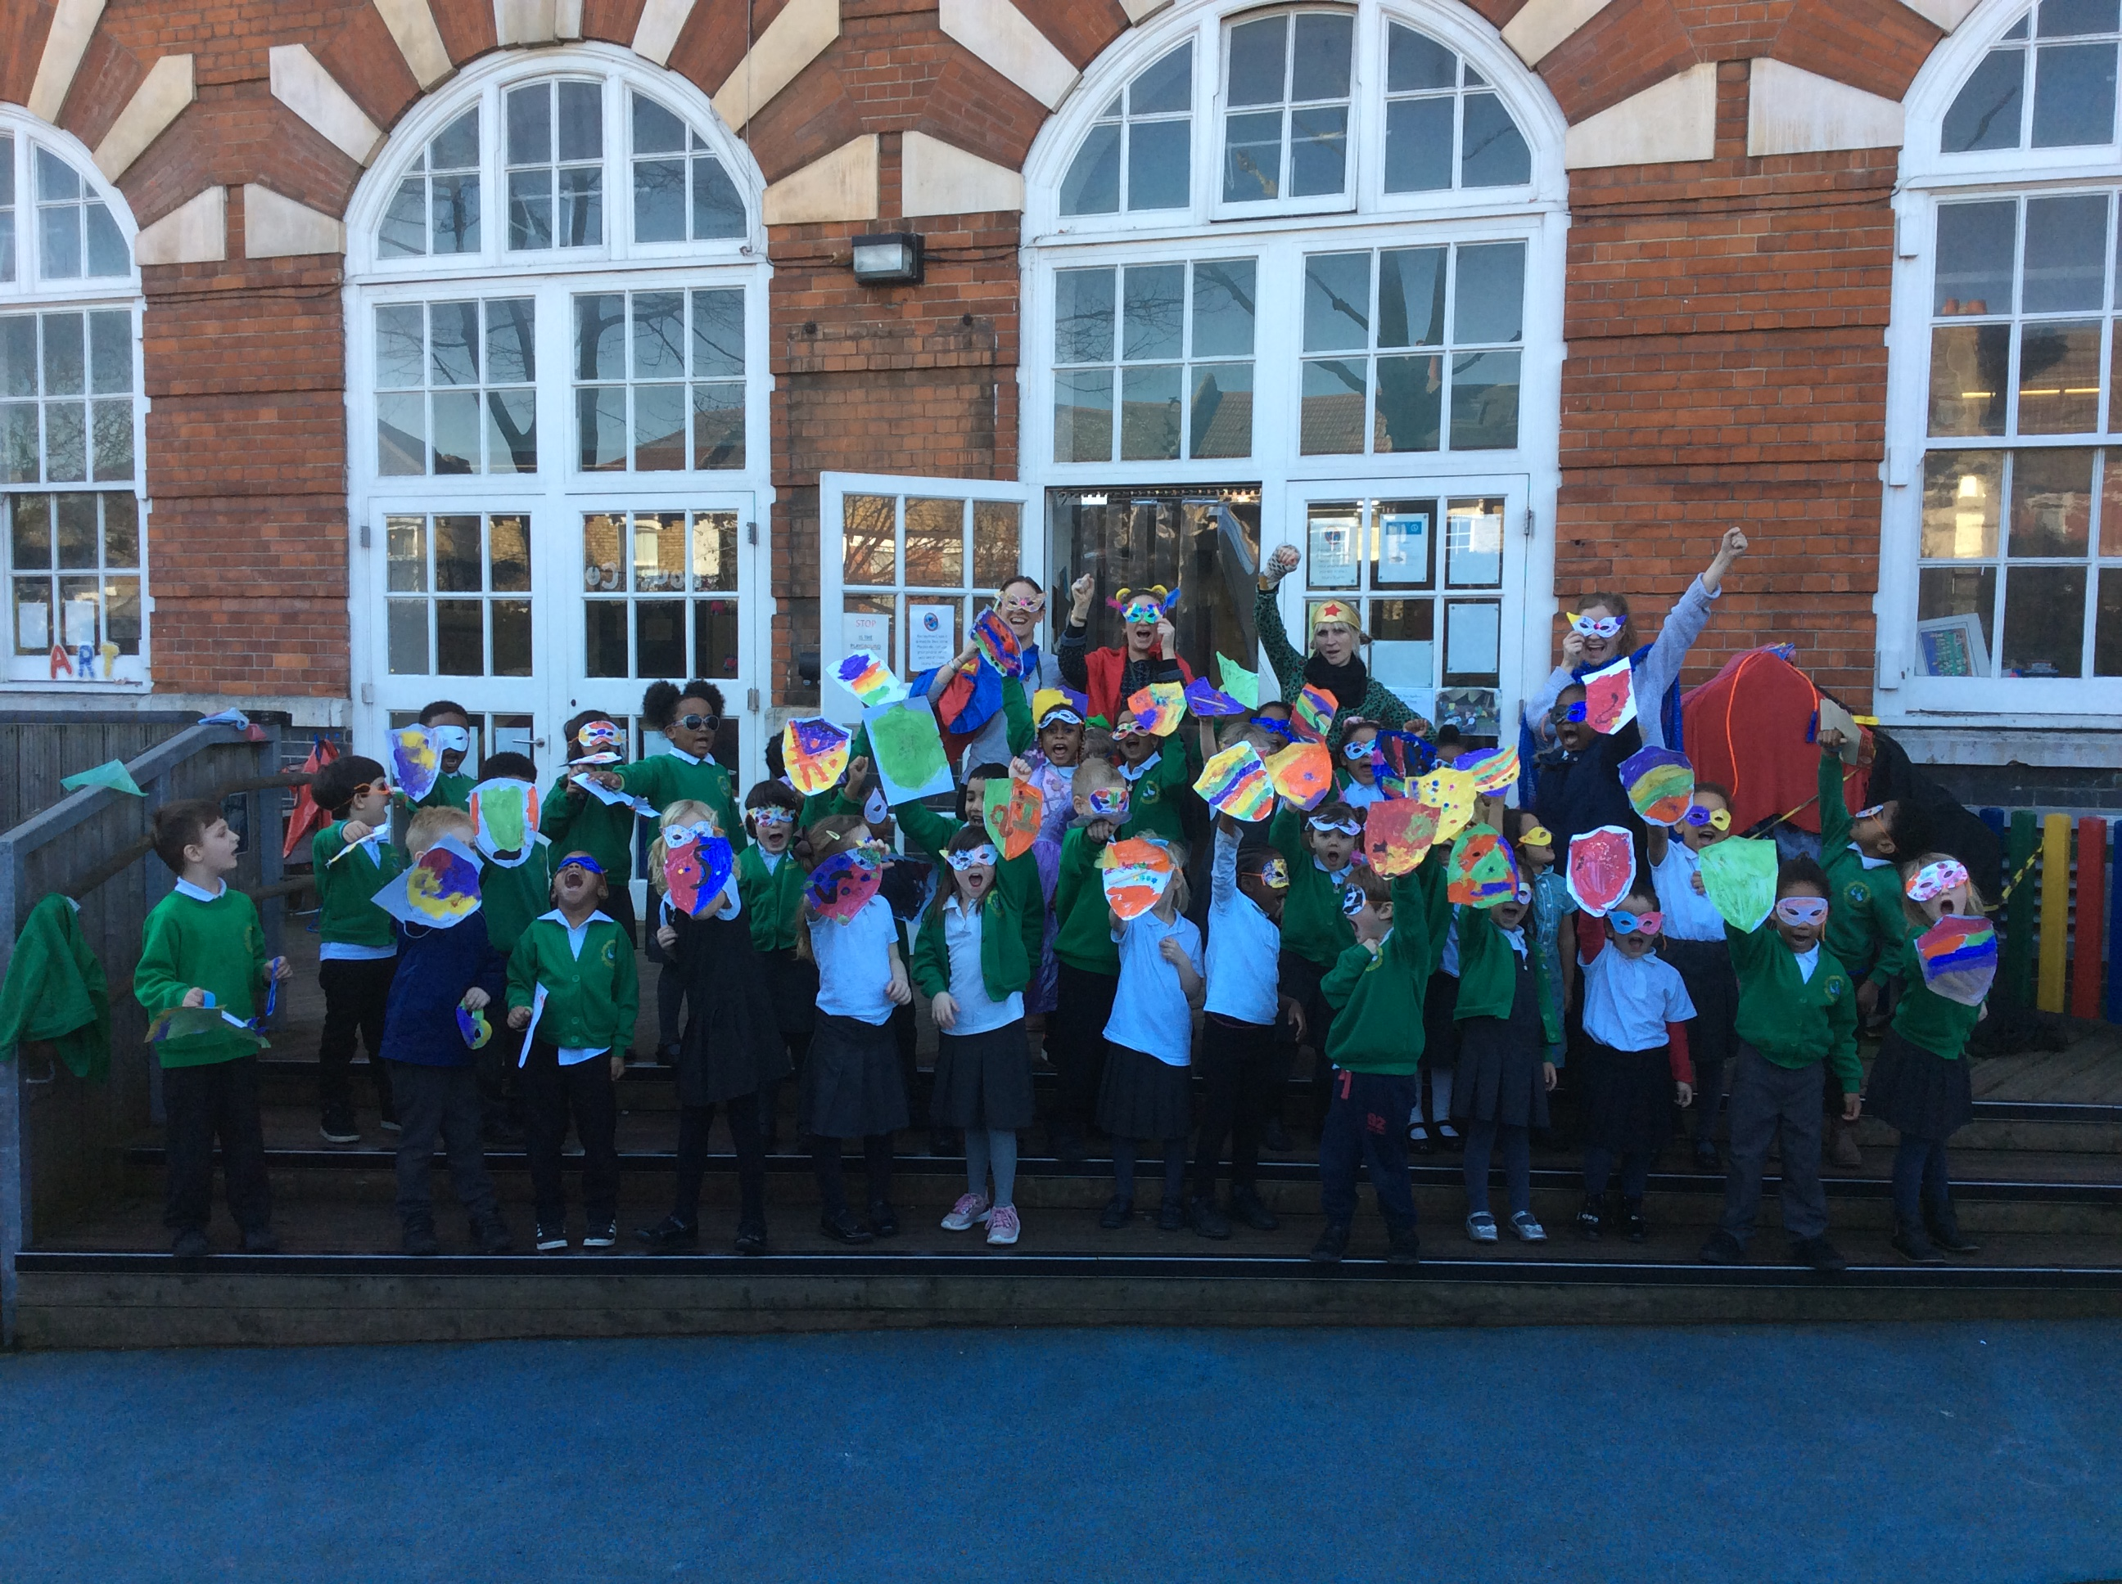
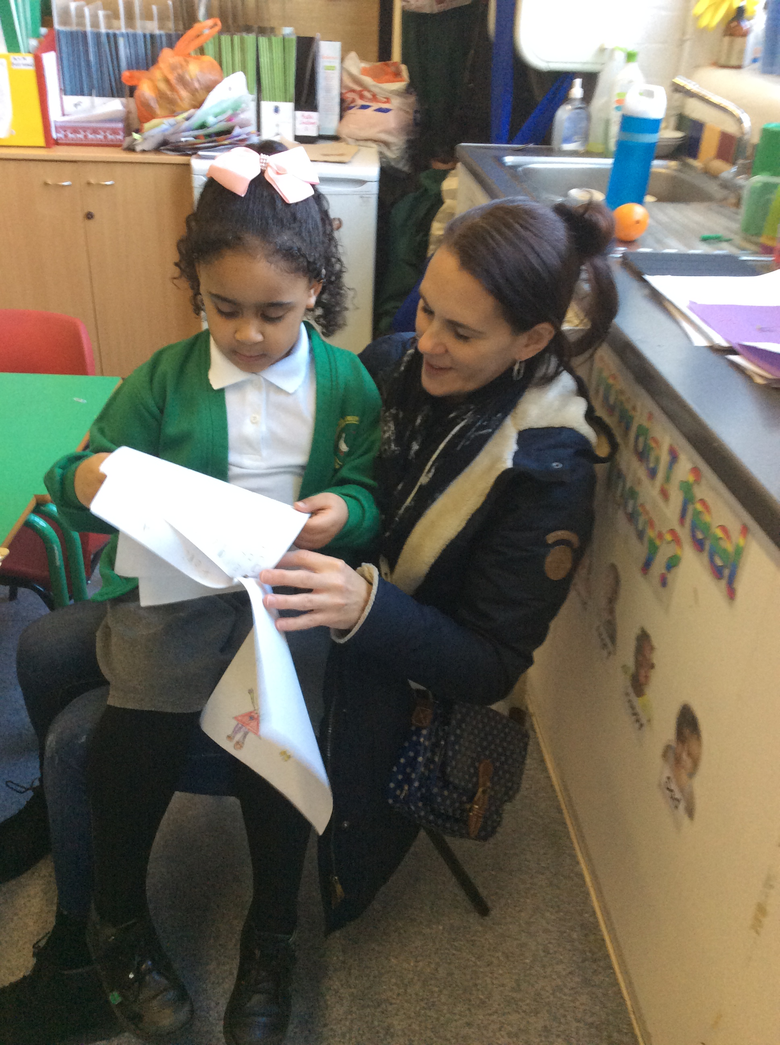
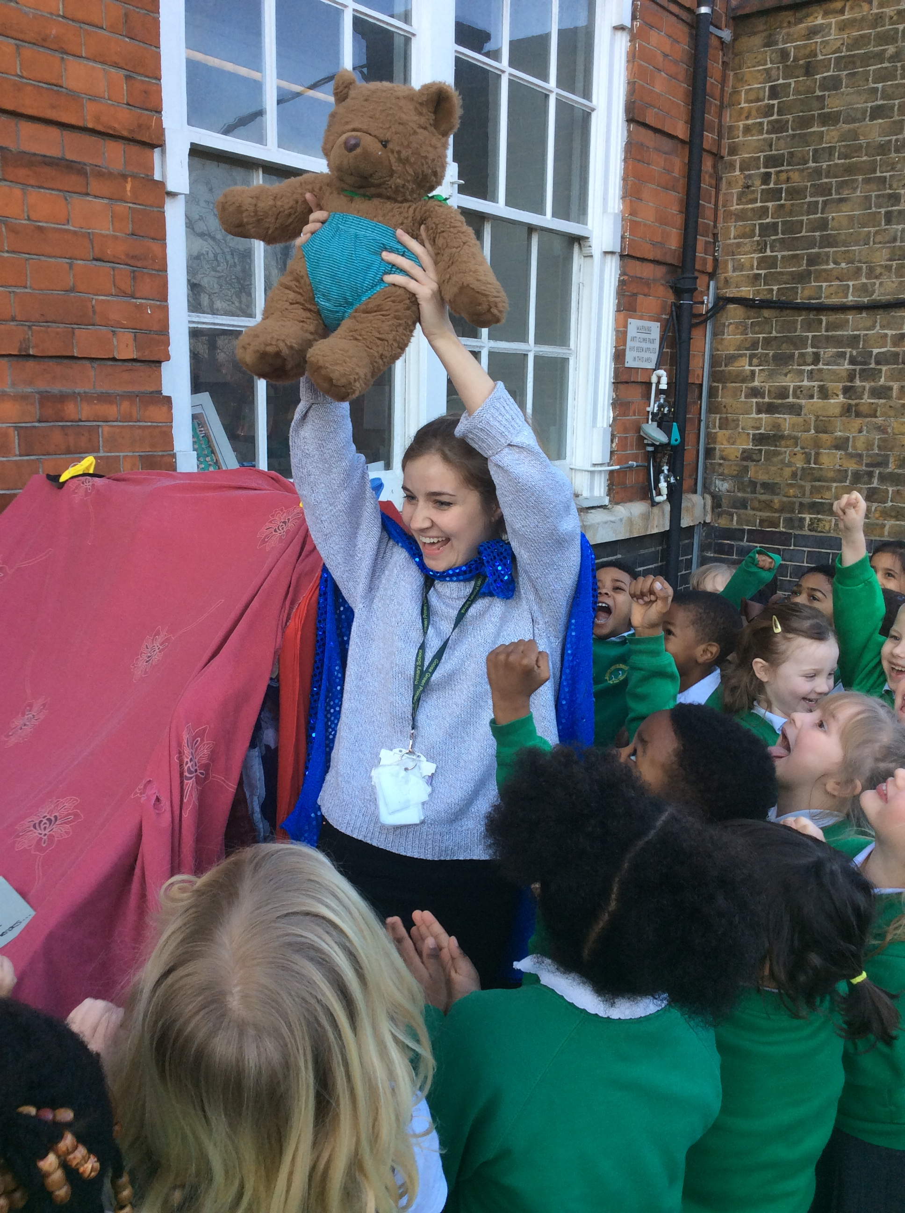
Reception
"What is possible in a fantasy world?". Our immersion activity was a trip to the theatre to watch Room on the Broom - this was also our first key text. We then created our own theatre in the classroom in which children were able to re enact the story as well as create their own on the stage. The children then came up with, and wrote their own fantasy stories over three weeks, and at the end of the half term they shared these stories with their parents/carers. Then in the final week of term we had superhero week. An supervillain called Evil Pant Man stole the class bear, and the children had to become superheroes to win him back.
The whole topic was a lot of fun and we were able to engage all the children (particularly boys).

Slide 10
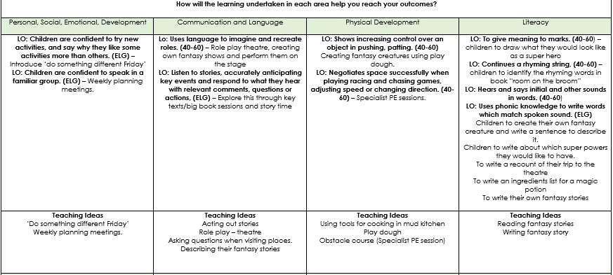
Reception planning
Our reception planning allows for clear links to be made across different areas of learning whilst covering a wide range of the required learning objectives.

Slide 11
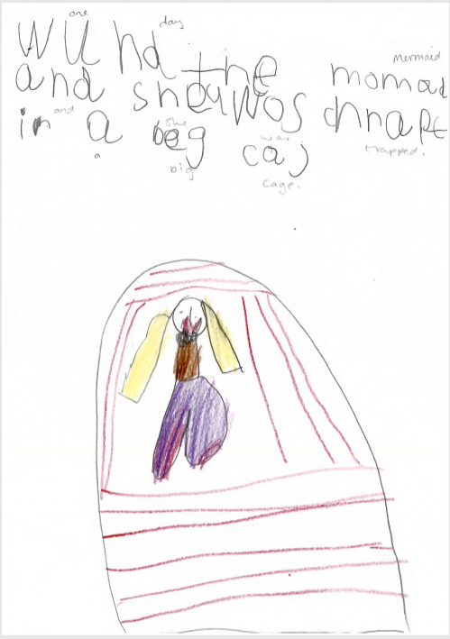
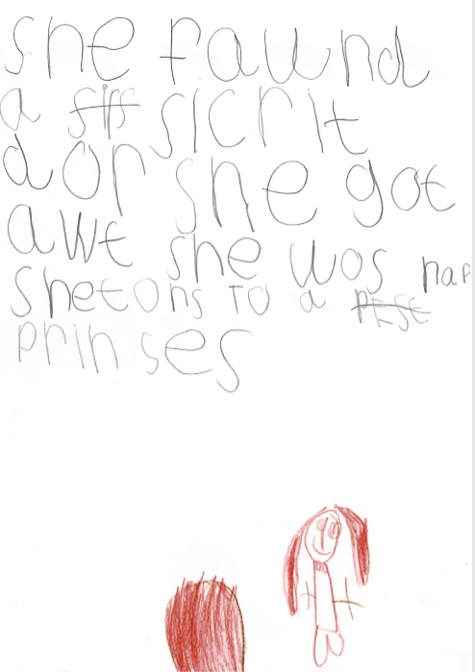

Slide 12
Year 2
'What is special about China?‘
Our core text was 'The magic paintbrush' which we used as a stimulus for the children's own dragon story writing - with the idea that they created and named their own dragon (the dragon heads made out of shoe boxes), they decided on their type of dragon (water, fire etc) and created their own published story books.

Slide 13
The showcase for parents included a traditional Chinese dragon dance followed by an opportunity to look at the children's work and also to make some arts and crafts such as Chinese lanterns with their parents.

Slide 14
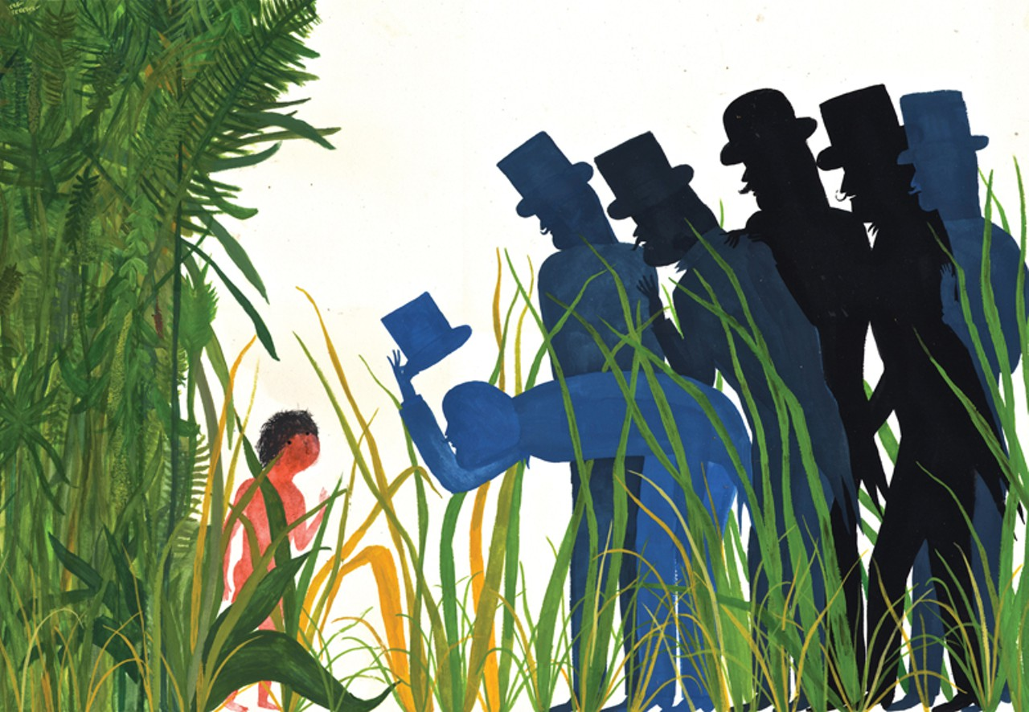
Year 4 Autumn 2
Autumn Term 2:
Book: Jemmy Button
Topic: What makes me unique?
We followed a CLP scheme of work in literacy which had ideas for foundation subjects within. We could not use the book for reading comprehension skills because it had very few words although we did look at related poetry. We also used non subject related books and did small group leveled reading.
This term was a little disjointed as the parallel teacher was on jury service yet putting the literacy plan into our planning format. This topic had PSHE (emotions and feelings) and historical links with the Victorian times. We did a lot of P4C around immigration, slavery and rainforest destruction. We covered some geography (rainforests) along with our science which was animals and habitats. Our project aims and outcomes changed during the project. I felt we needed to work together as a year group a lot to keep an eye on the other class who had different adults looking after them. It also became clear that the children enjoyed some of the repetition and poetry in the book and as there was only a sentence on each page I often recapped from the beginning and there was lots of anticipation about what would come next. This meant the children were beginning to learn the story so I felt it would be great to make it into a performance. This is very much in the vain of Pie Corbett's 'Talk for Writing' which is all about learning and reciting a story. Then innovating it which helps children to learn new vocabulary as well as the grammatical structure of sentences. The parents and children really enjoyed the performance and the children have requested they do another performance in the future rather than an exhibition.

Slide 15
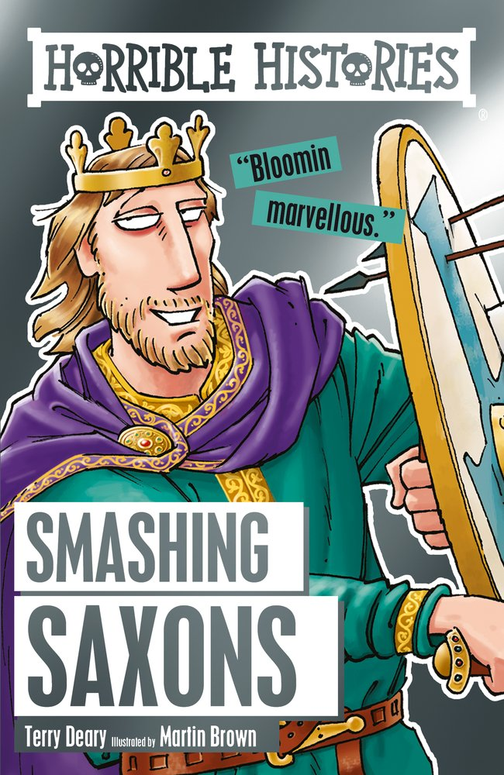
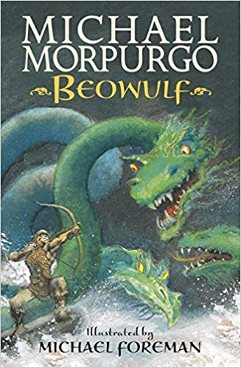
Year 4

Slide 16
