Slide 1
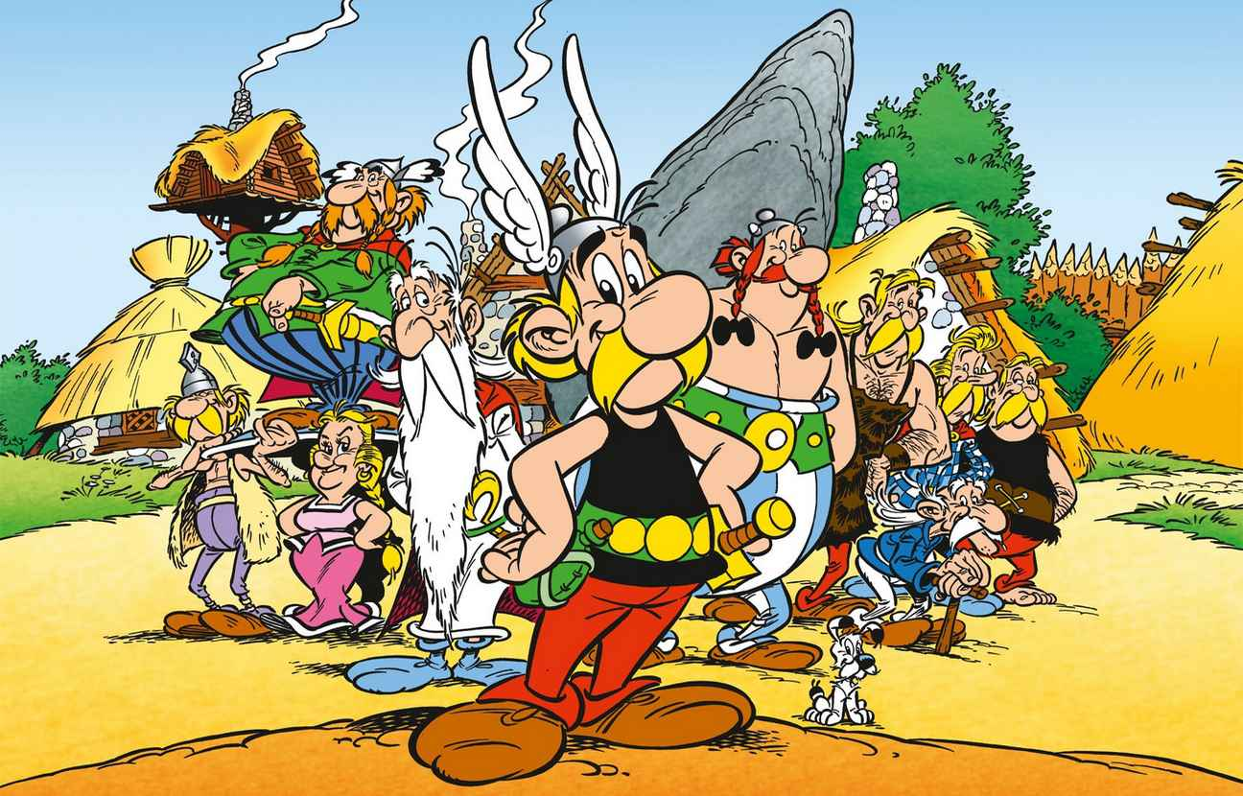
Who were « our ancestors » the Gauls?
Year 6

Slide 2
Who were « our ancestors » the Gauls?
History
Music
Literature
Arts and crafts
ICT
Arts and crafts
Writing
Using knowledges
At school

Slide 3
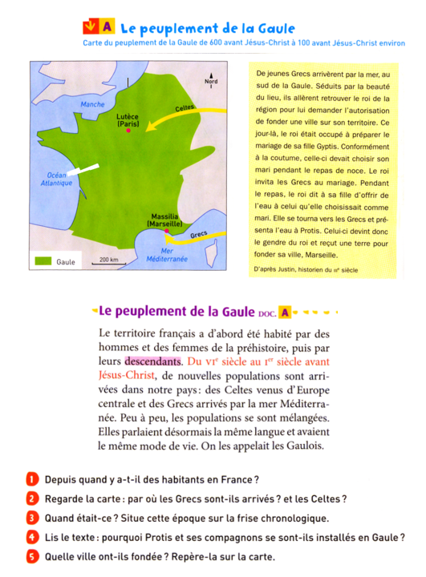
History
What children learnt about the Gauls :
Settlement
Society
Religion
Crafting
Vercingétorix and Julius Cesar

Slide 4
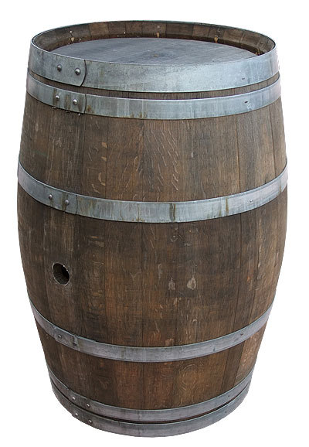
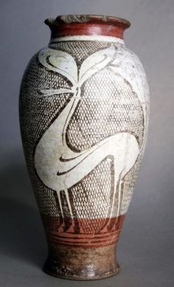
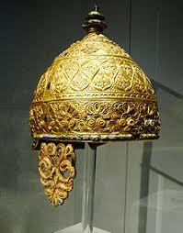
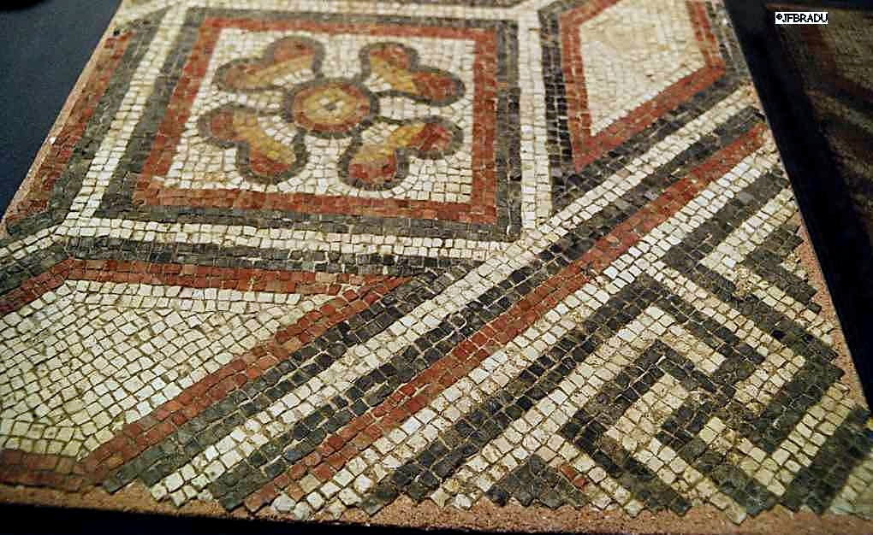
Arts and crafts

Slide 5
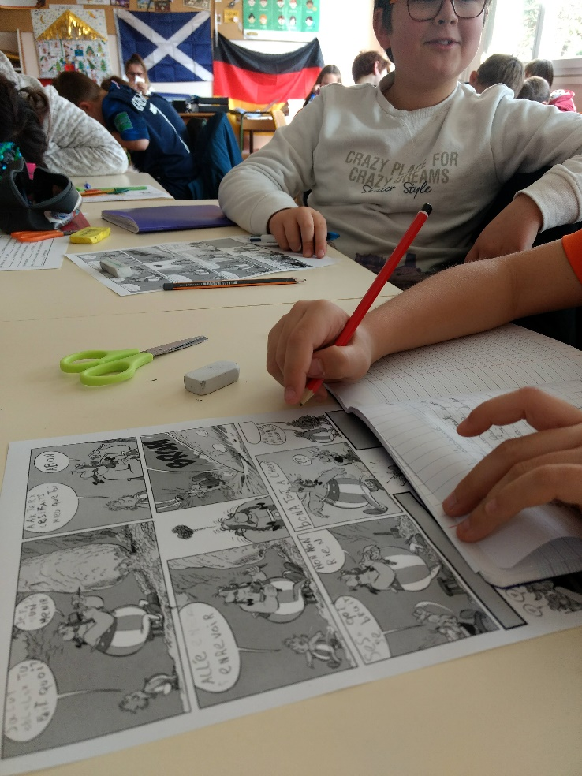
Literature

Slide 6
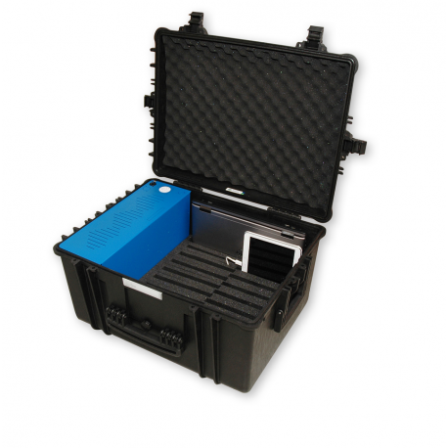
ICT
Researches
Creation of documents

Slide 7
Music
French rap song (not the best one…) based on a celtic fictionnal story

Slide 8
Personal work
Arts and crafts
Using knowledges
Writing

Slide 9
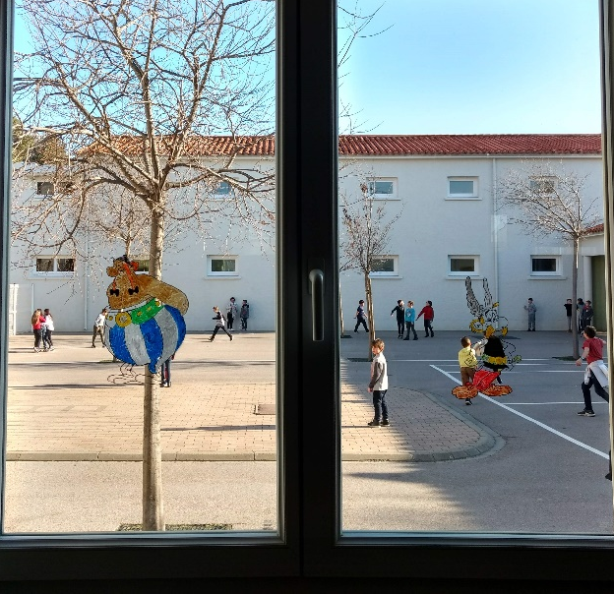
Exhibition
Arts and crafts
Reading or playing
Quizz for the parents
Explaining posters
Answer to the question
Many activities were suggested by the pupils

Slide 10
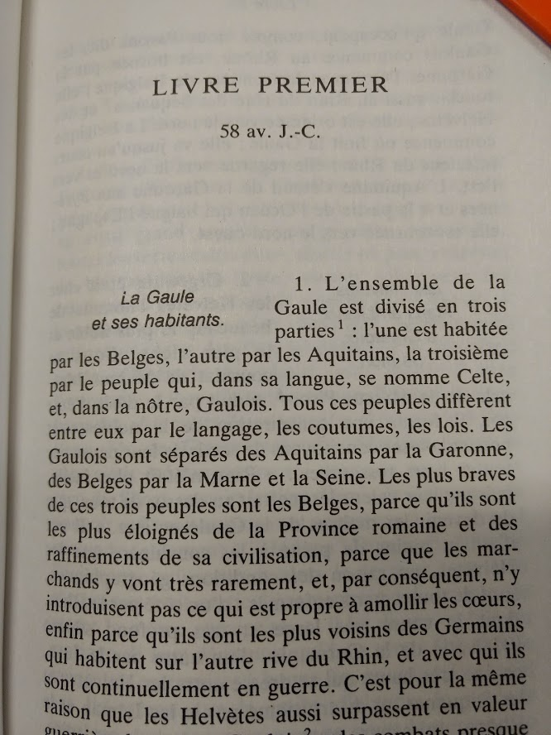
Answer to the question
« Nos ancêtres les Gaulois » is a really used phrase in France.
Pupils realized that we cannot really say that the Gauls were our ancestors :
The Gaul was a territory where many tribes lived : they were not unite and fought themselves.
The idea of Gaul nation comes from Julius Cesar when he invaded the Gaul.
We come from different places, we are not really sure that our ancestors were in Gaul.
The Gauls were the people living here 2000 years ago.
War of the Gauls
Julius Cesar

Slide 11
Benefits
For the pupils :
Involvement and interest
Collaboration
Reflection on french history
Reflection on their history
For the teacher :
New way of working
Requires time for preparation and reflection
Has a positive impact on the class

