Slide 1
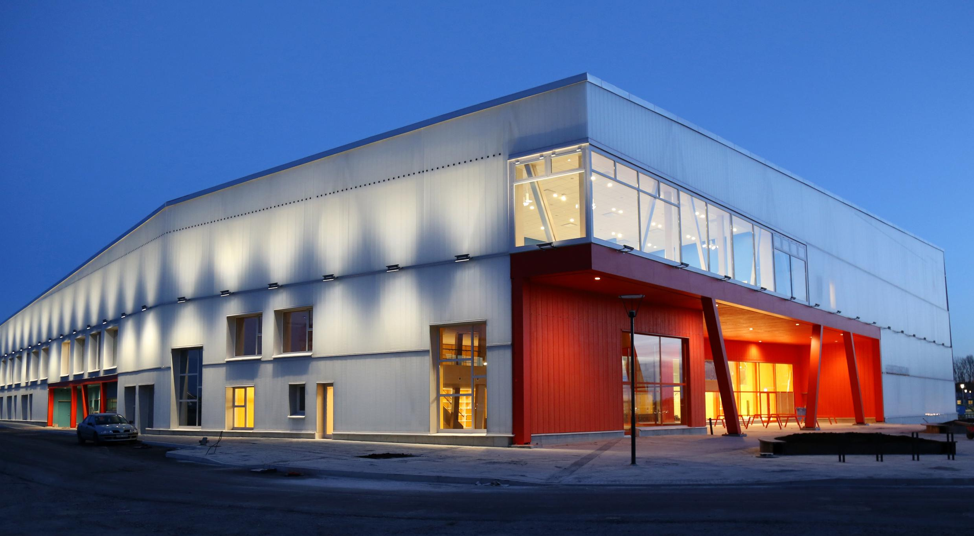
Herrestaskolan, presentation for PBL-meeting, London dec. 2018
Photo by Liljewall architects

Slide 2
About Herrestaskolan
Herrestaskolan is located in Järfälla municipality, on the outskirts of Stockholm.
It opened in 2016, and it has an environmental certification and is labelled as a sustainable building. Its structure is entirely made out of wood and there are solar panels on the roof that produces almost all of the electricity used in the building.
The school has about 320 students aged from six to eleven years old and there are around 40 members of staff. The community is diverse, for example there are about 25 languages represented in the school.

Slide 3
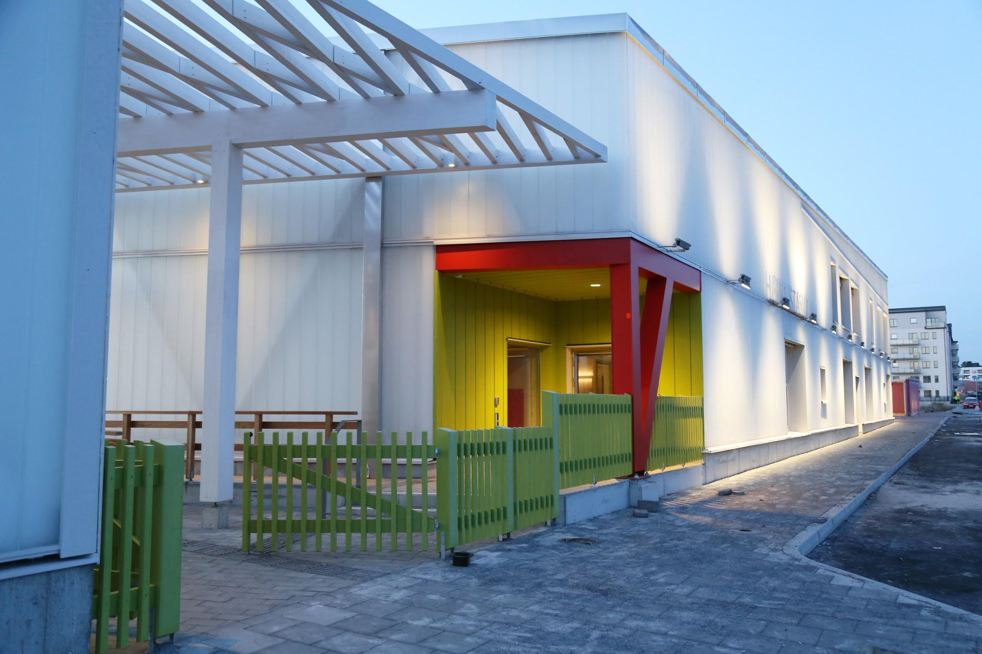
Photo by Liljewall architects

Slide 4
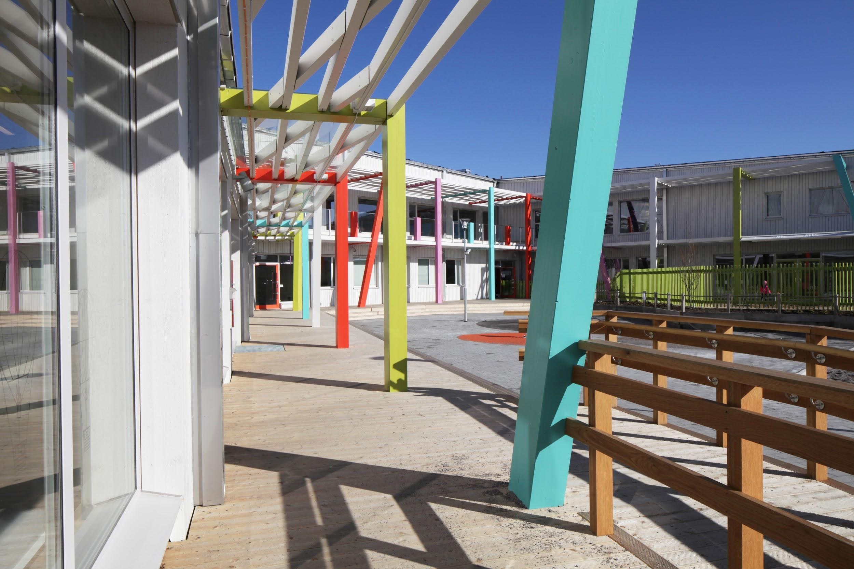
Photo by Liljewall architects

Slide 5
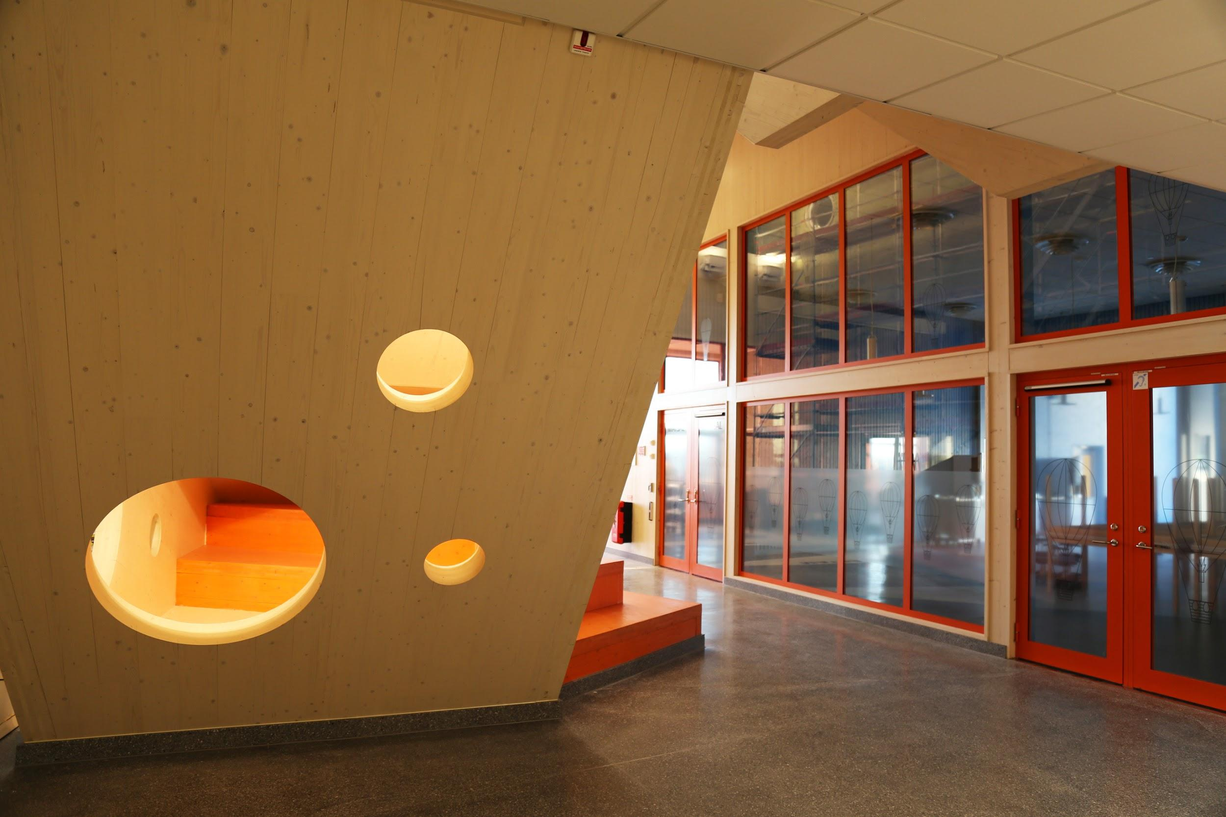
Photo by Liljewall architects

Slide 6
What is our context? We are interested in learning more about PBL to see if it is a method that we could use across the whole school. We have not had an international partnership before and this is something that really interests our staff and pupils and could bring about a lot of positive development for our school.
What does PBL mean to us? We would like to learn more about PBL as a method since some teachers have been working in a PBL-esque way with cross-curriculum projects, but not with PBL as the method.

