Slide 1
Android application T2E ver. 1.0
Šolski center Krško-Sevnica, Slovenia

Slide 2
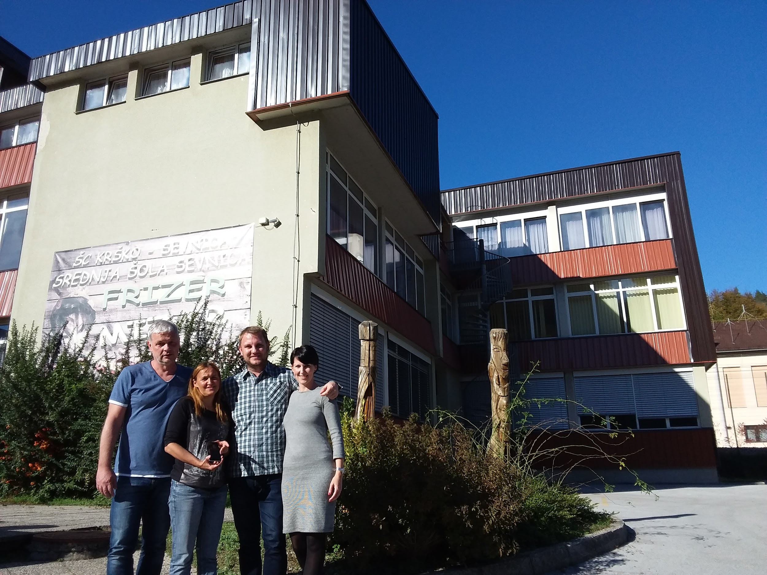
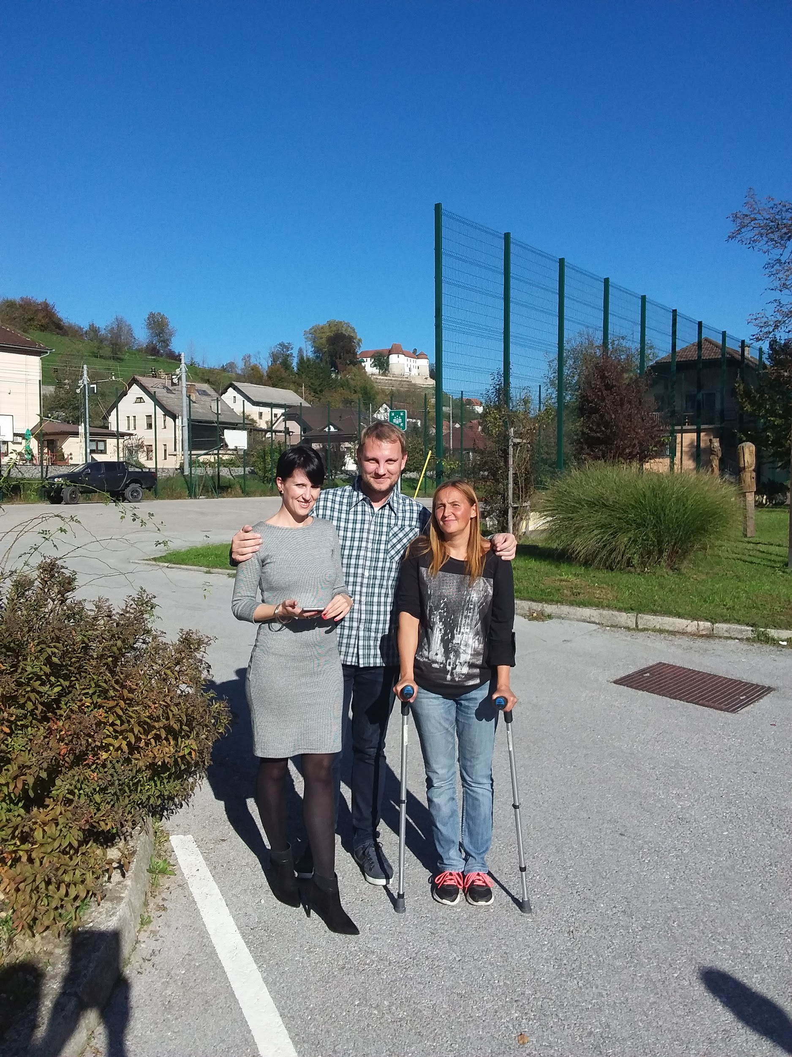
Greetings from slovenian team

Slide 3
About application
Development delay is caused by different reasons:
coordinator illness
agreement with outside help: cooperation with student

Slide 4
Accomplished tasks
cooperation with tourisem association and companies
workshops for students (content of the route and route planning)
public event
hiking (sports, cultural attractions)

Slide 5
Accomplished tasks
The first screenshot shows the launch activity, that shows all the participant's logos. The app quickly loads and continues to path selection.

Slide 6
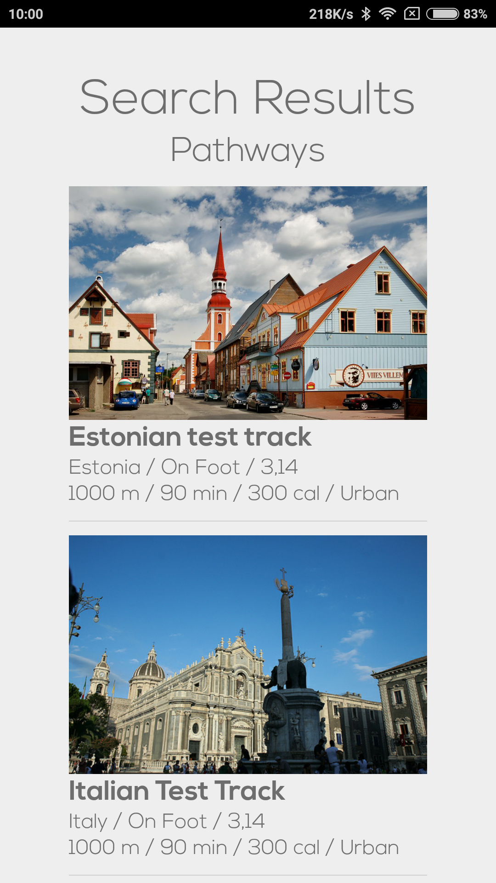
2. The second screen provides the path list the user can choose from. It currently has placeholder lables and pictures as we are yet to receive the json filed with the data.

Slide 7
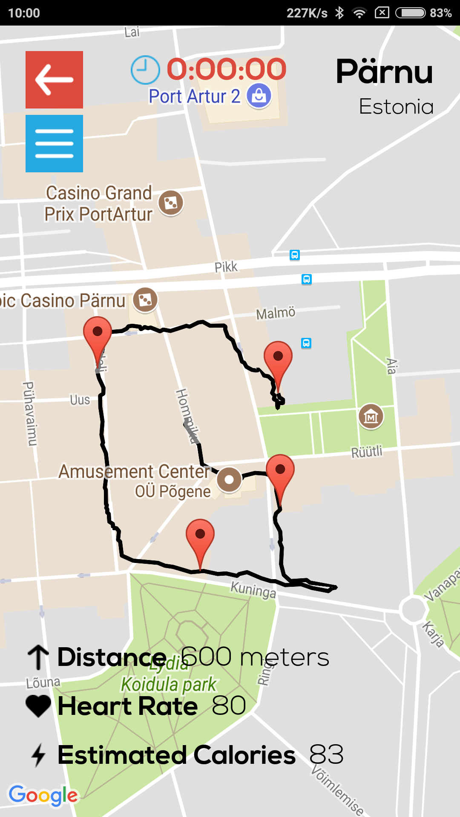
3. The third screen is the actual screen in which a user can walk the path and see the spots. We have implemented the provided json file.

Slide 8
Future tasks
The advice from future users: if app isn’t interesting enough after few seconds, app won’t be used
Screen adjustment for different devices
Suggestion: after launched app finds current location (country) and shows available pathways. (setting parameters for route selection can be too demanding for users?)

Slide 9
Future tasks
4. About routs:
Existing path in DB has too many points (Žiga suggests 50 to 100 points)
Export urban routes from Google Maps, data administrators should improve paths in nature (to be straight from point to point)
Improve keys (ID) for paths (more paths have the same ID)
5. About contents:
less is more
quality of contents is important

