Slide 1
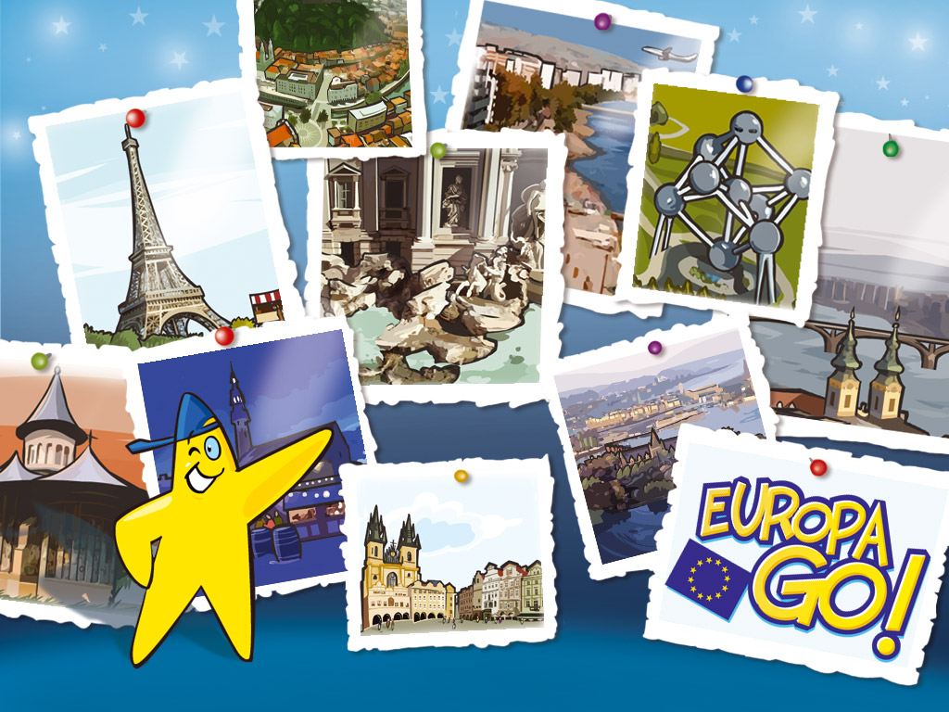
Tournament of Videorealia

Slide 2
Rules:
Your aim is to guess the videorealia – a thing, or a person, or a place, etc.
Every task has 3 stages
You get:
At the 1st stage – 3 points
At the 2nd stage – 2 points
At the 3rd stage – 1 point

Slide 3
Let’s start with some easy questions – two stages each!

Slide 4
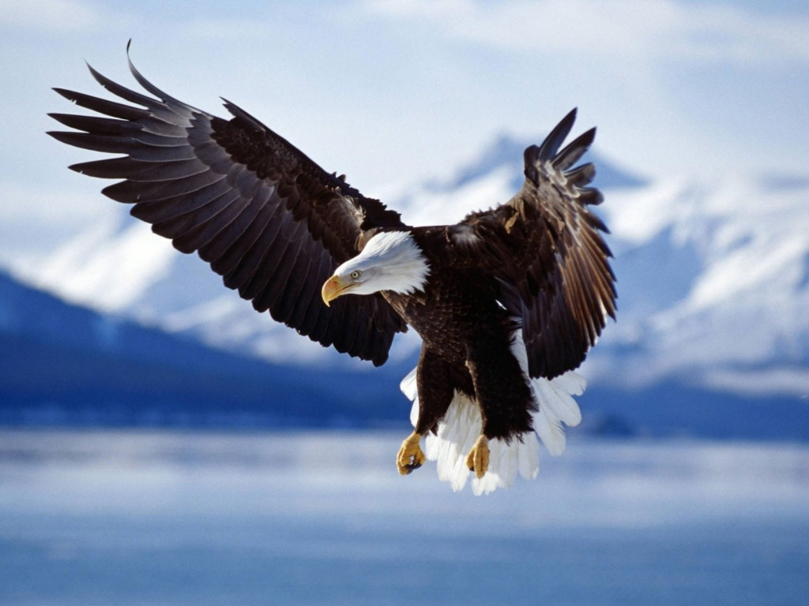
Country

Slide 5
The country: Poland

Slide 6
Piece of music

Slide 7
The piece of music: Ode of Joy

Slide 8
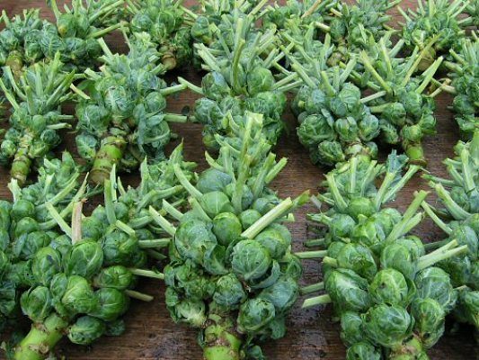
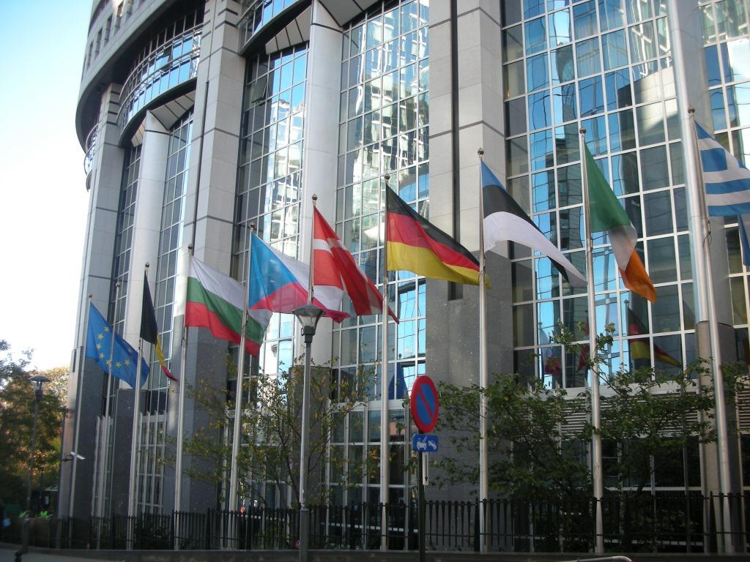
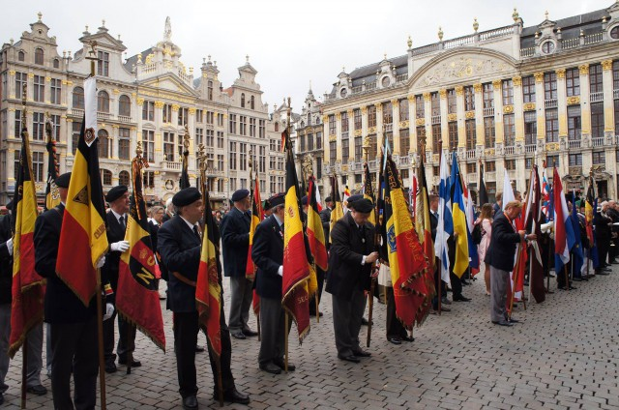
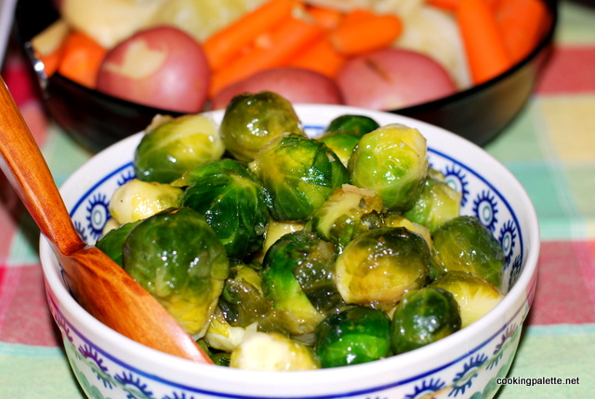
City

Slide 9
City: Brussels

Slide 10
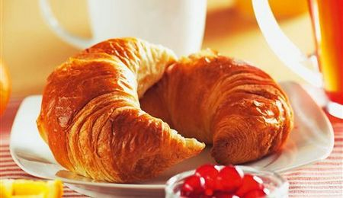
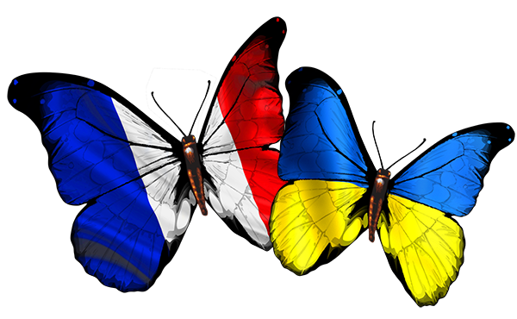
Dish

Slide 11
Dish: Croissant

Slide 12
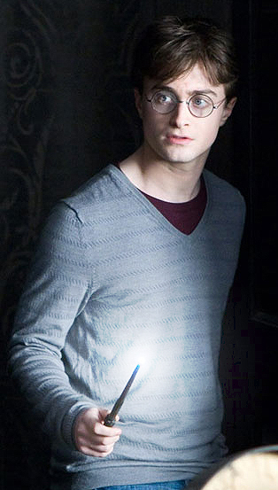
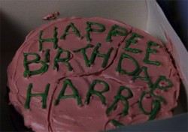
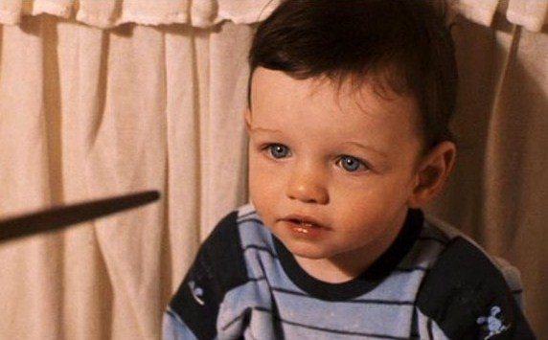
Book character

Slide 13
Book character: Harry Potter

Slide 14
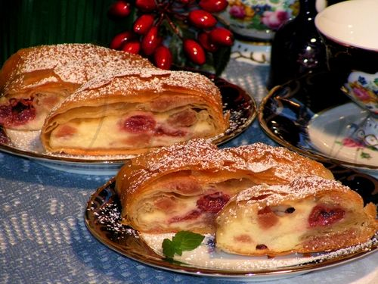
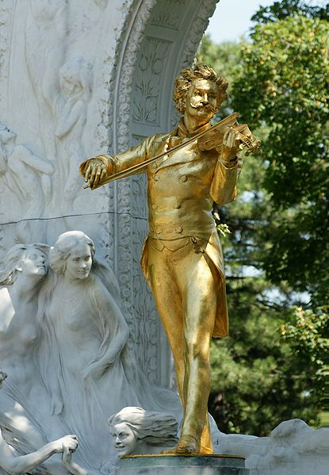
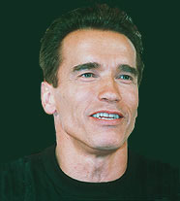
River

Slide 15
River: the Danube

Slide 16
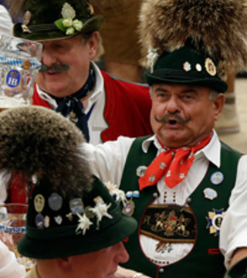
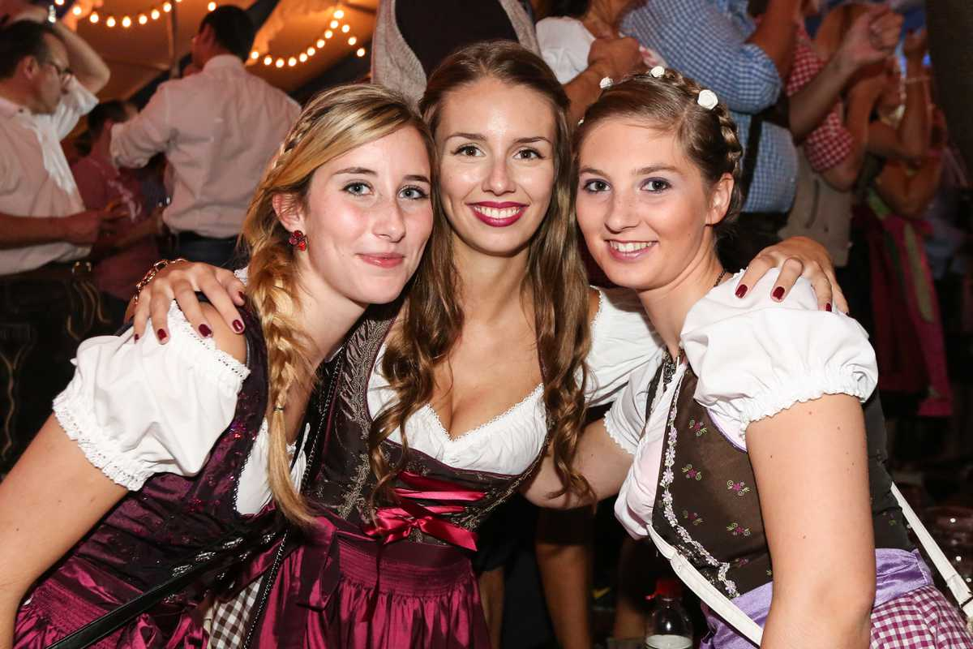
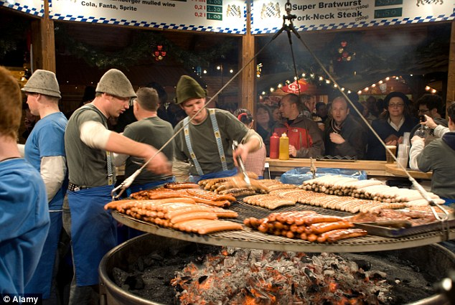
Festival

Slide 17
Festival: Oktoberfest

Slide 18
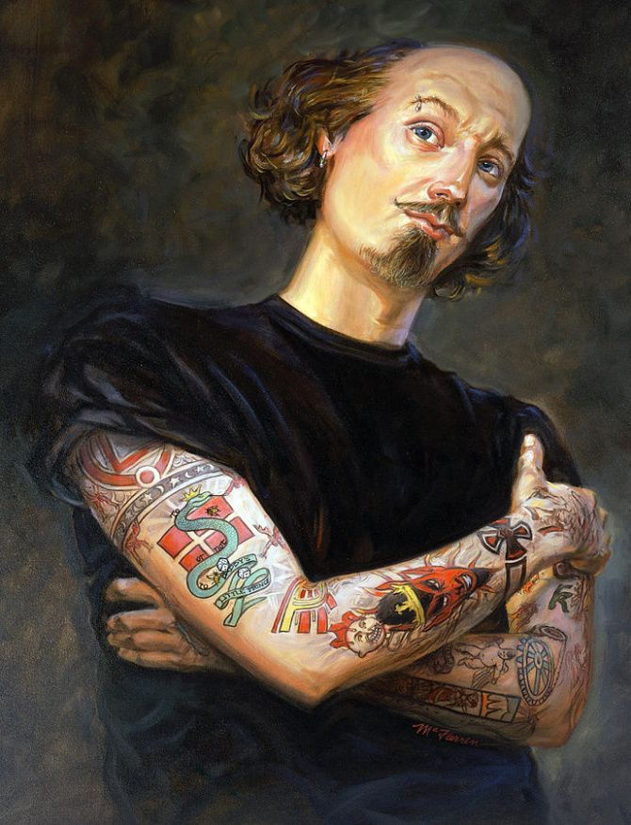
Writer

Slide 19
Writer: William Shakespeare

Slide 20
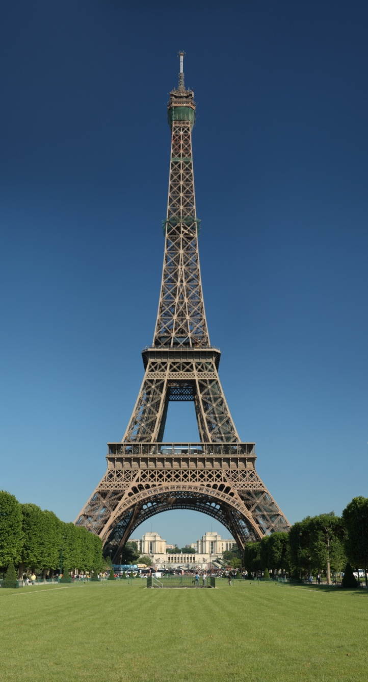
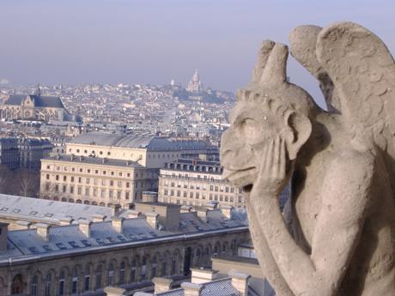
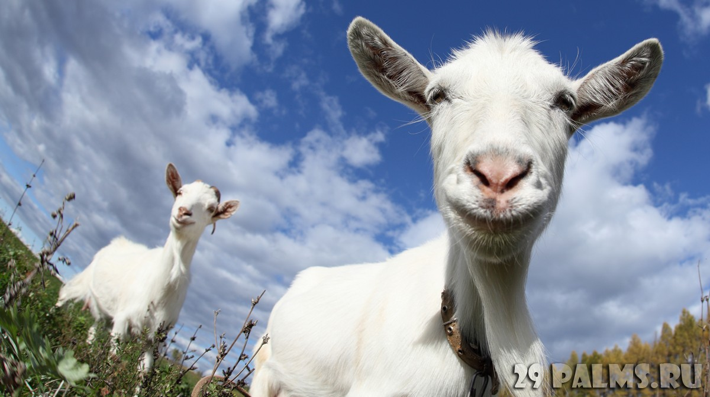
Building

Slide 21
Building: Notre Dam de Paris

Slide 22
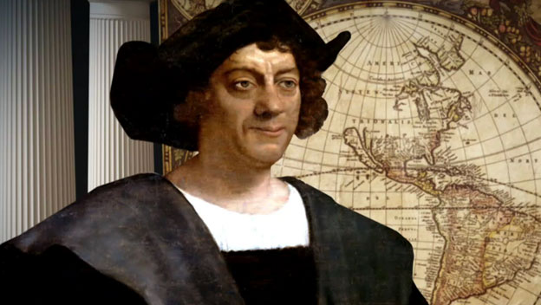
Holiday

Slide 23
Holiday: Hallowing

Slide 24
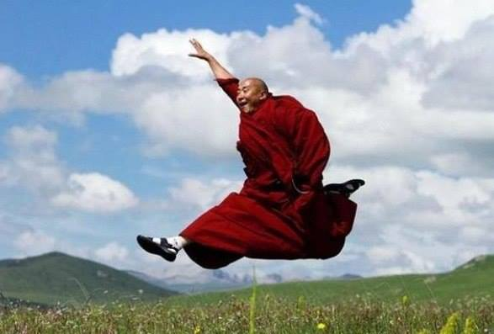
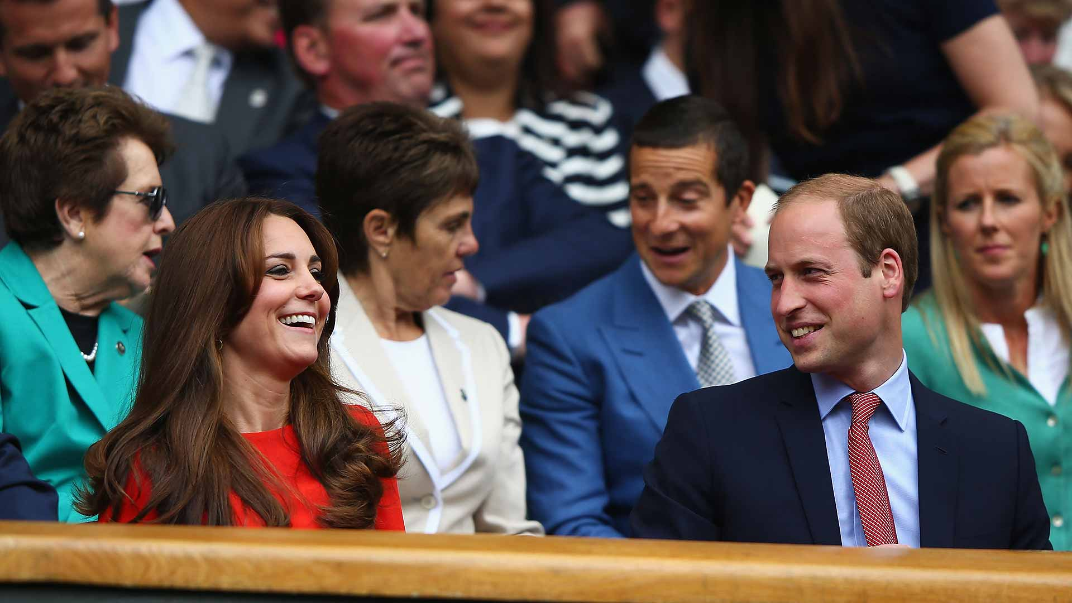
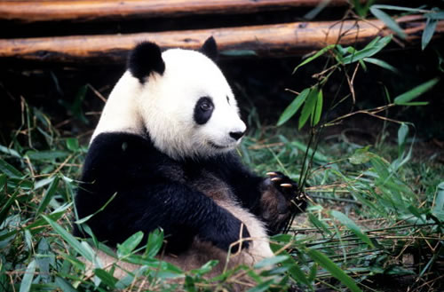
Drink

Slide 25
Drink: Tea

Slide 26
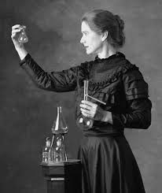
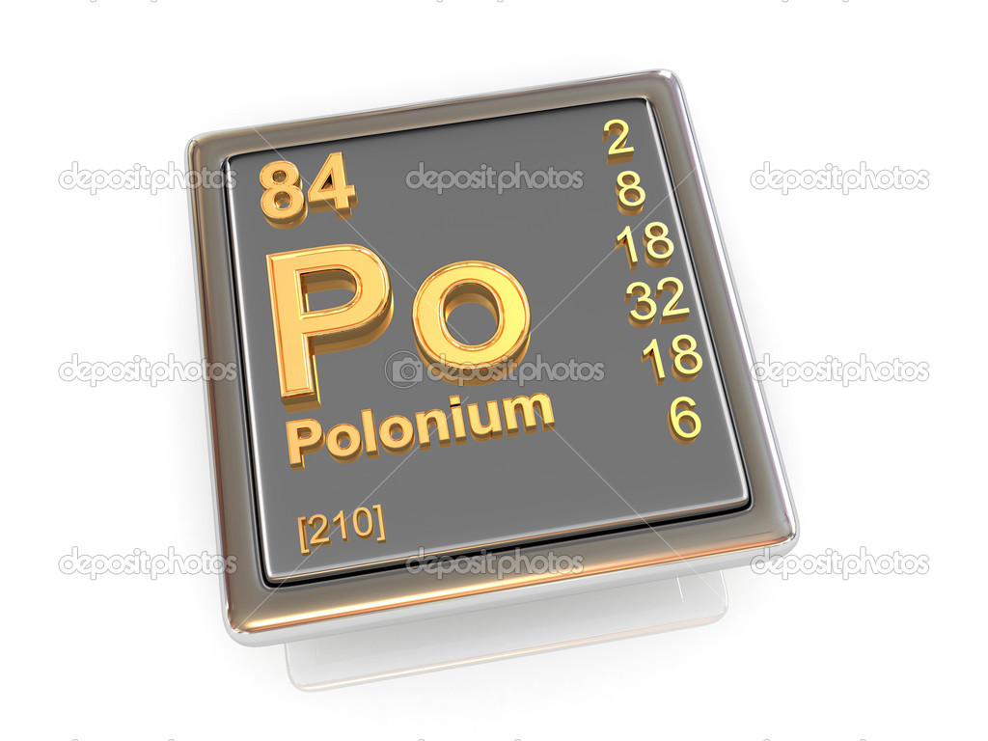
Chemical element

Slide 27
Chemical element: Polonium

