Slide 1



a ERASMUS+ KA229 PARTNERSHIP

Slide 2


DISCLAIMER:
The European Commission support for the production of this publication does not constitute an endorsement of the contents which reﬂects the views only of the
authors, and the National Agency and Commission cannot be held responsible for any use which may be made of the information contained therein.

Slide 3




SHORT- TERM
EEXXCHANGE
OF GROUPS
OF PUPILS

Slide 4
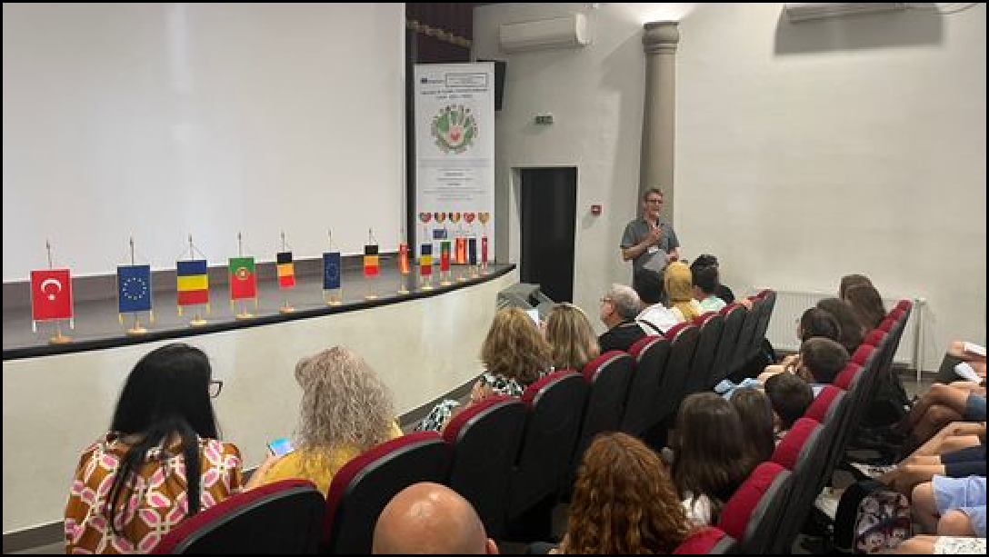
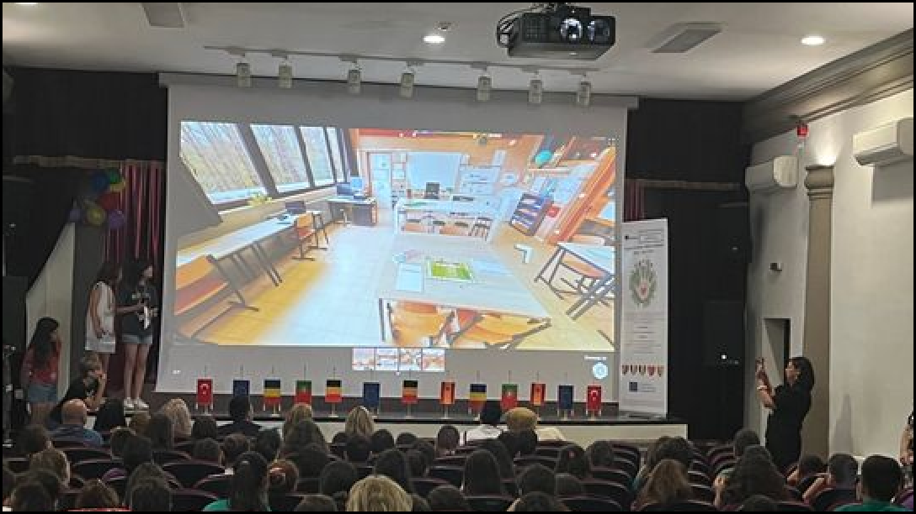
ROMANIA, BRANESTI, 06/06/2022-08/06/2022
“Drama against bullying”
Day 1
11:00-13:00 Visiting Branesti
•Walk tour
•Meeting the Mayor, and local representatives 14:00 Welcome by
Headmistress
14:30 School’s presentation made by Romanian students
-School tour in small mixed groups
15:00 Ice- breakers for
students and presentations of their own schools, region, country, traditions
16:00 Participating in
lessons by pupils ‘choice 17:00 Erasmus+ Stall

Slide 5
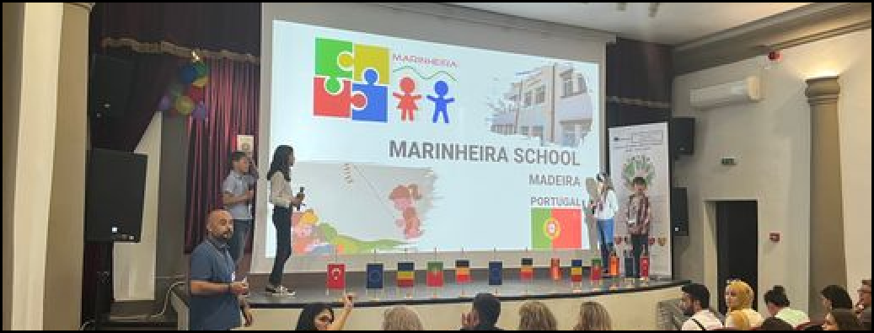
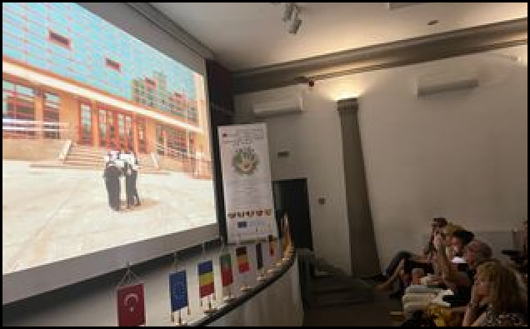
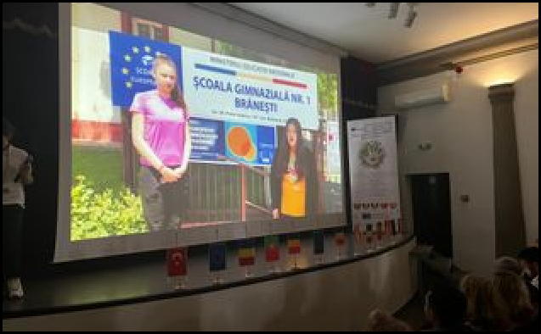
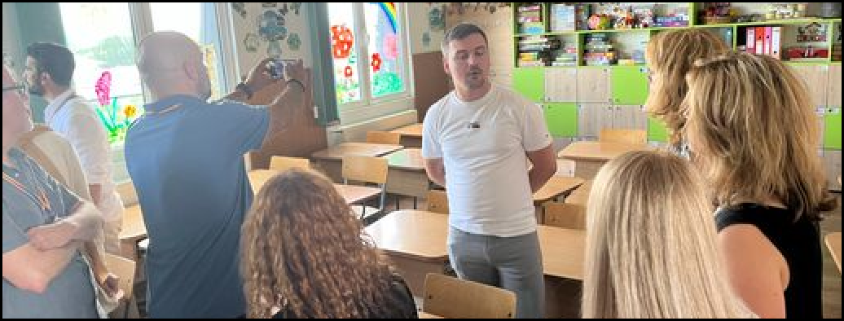
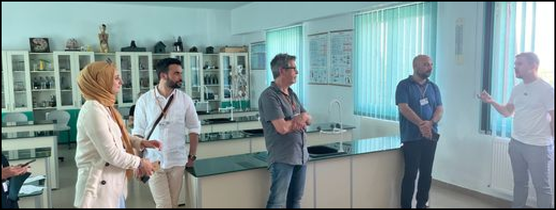
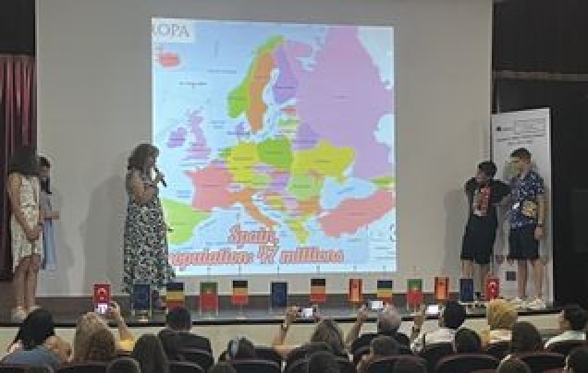

Slide 6
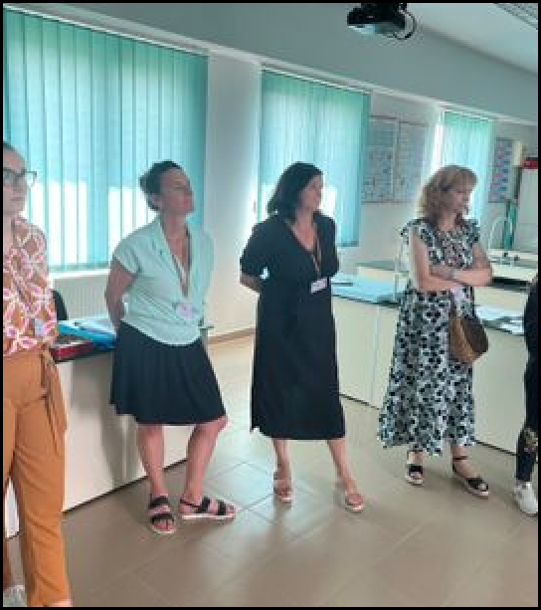
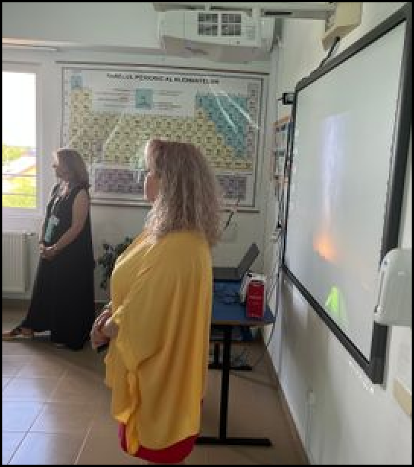
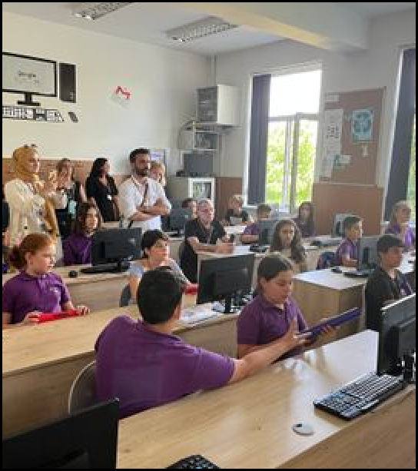
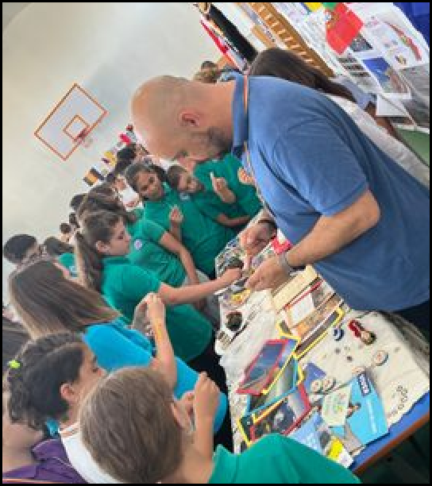
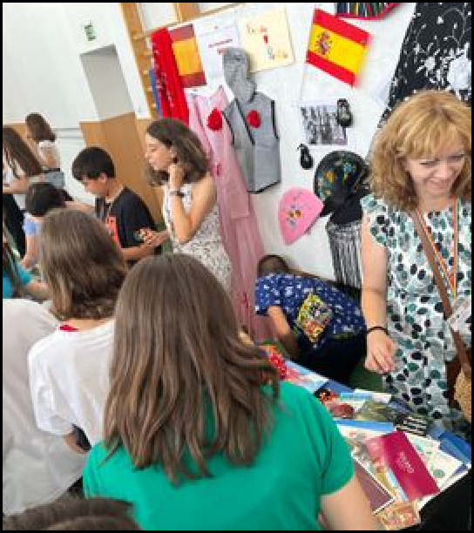
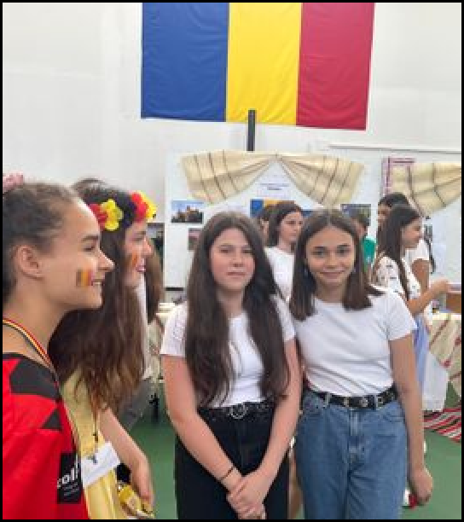

Slide 7
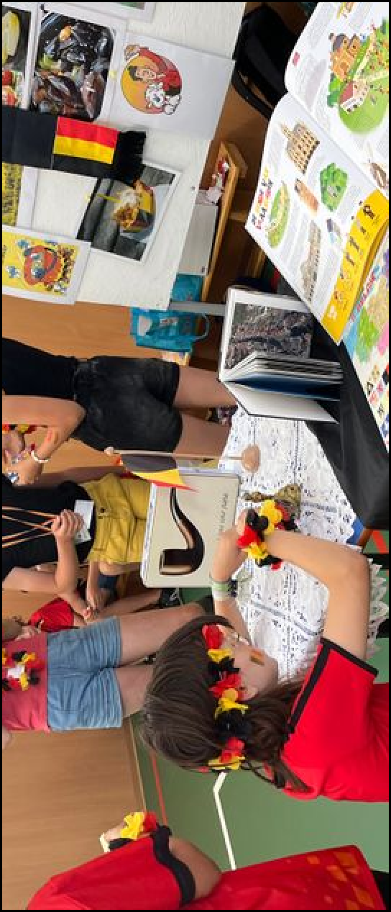
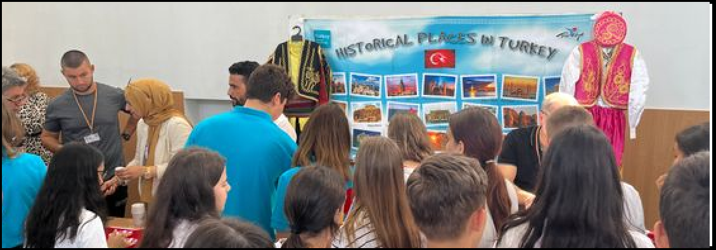
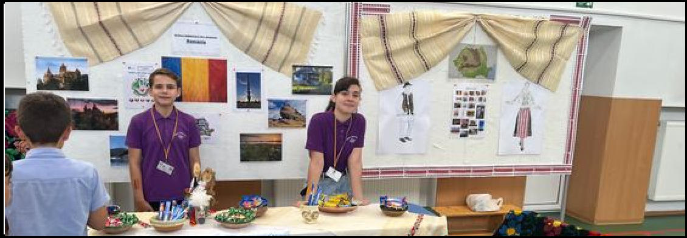
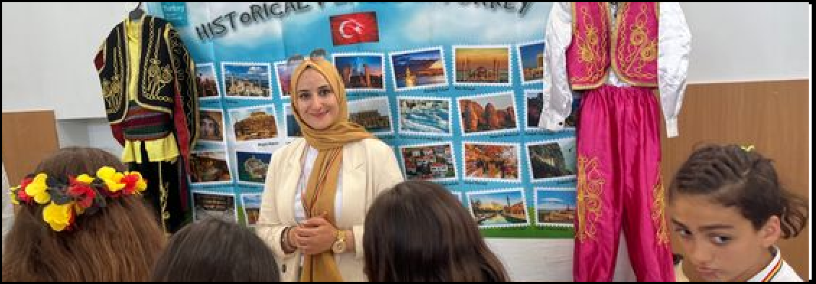

Slide 8
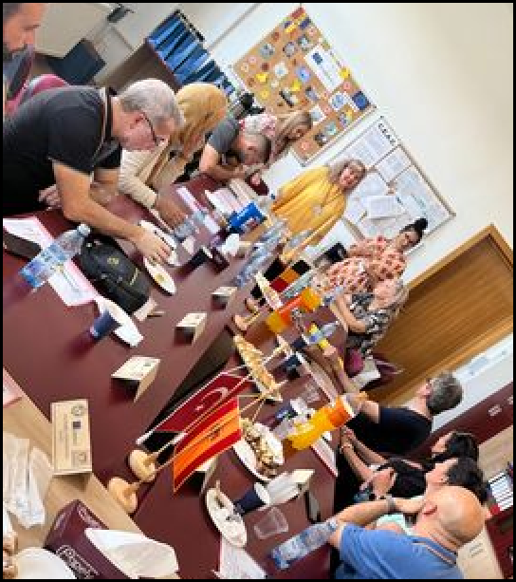
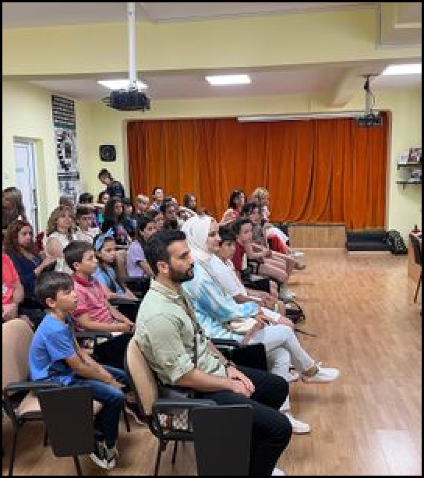
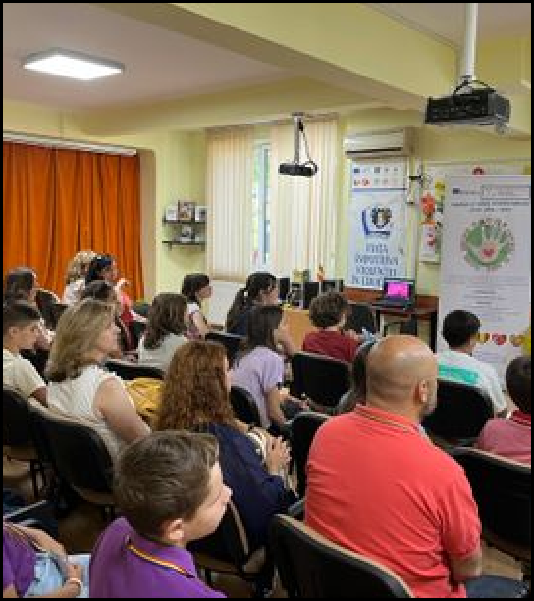
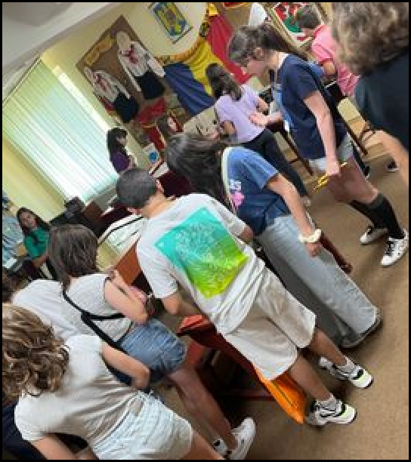
Day 2
10:00- 11:00 Visiting the House of Teachers; meeting local teachers, students and community
11:00-12:30 Seminar with a mentor teacher about bullying; the pupils received a Certiﬁcate of Participation
14:00-15:00 Course about forms of bullying, how to prevent it and how to stand up to it safely with a school counselor teacher from The County Center for Resource and Educational Assistance using non-formal educational methods; the
students received a Certiﬁcate of Active Participation
15:00-17:00 Students worked together on a script play named “Friends at home. Friends abroad” in English

Slide 9
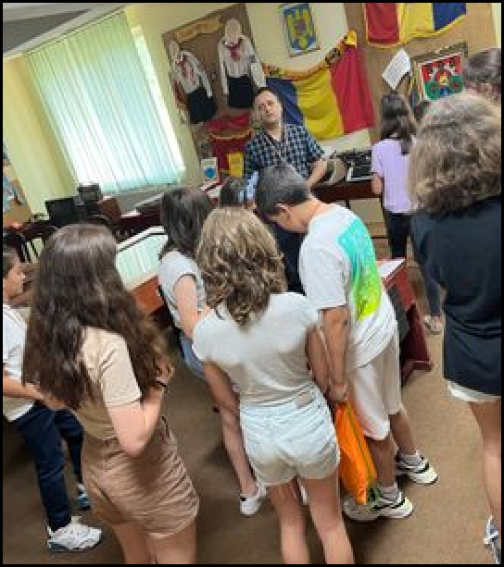
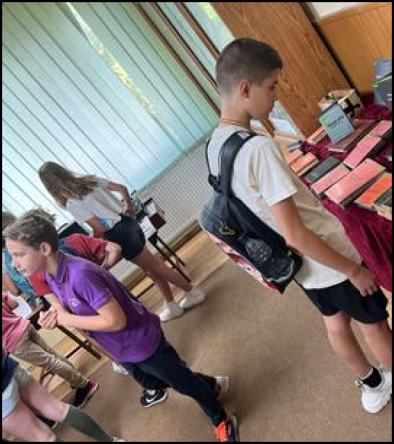
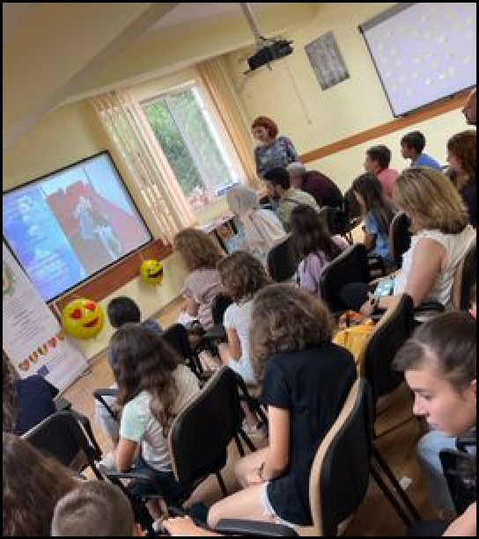
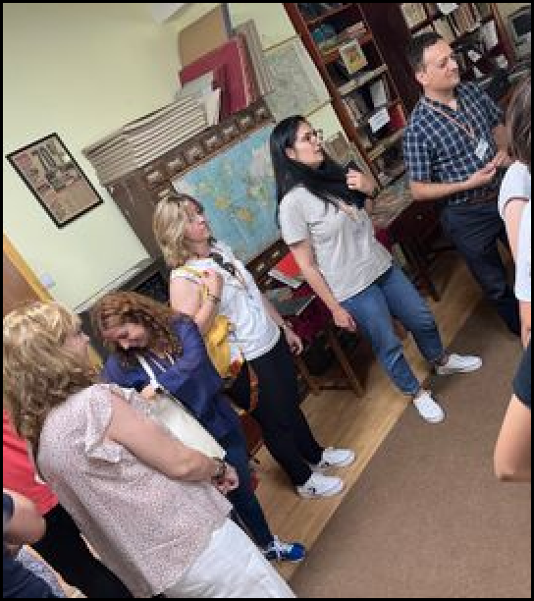
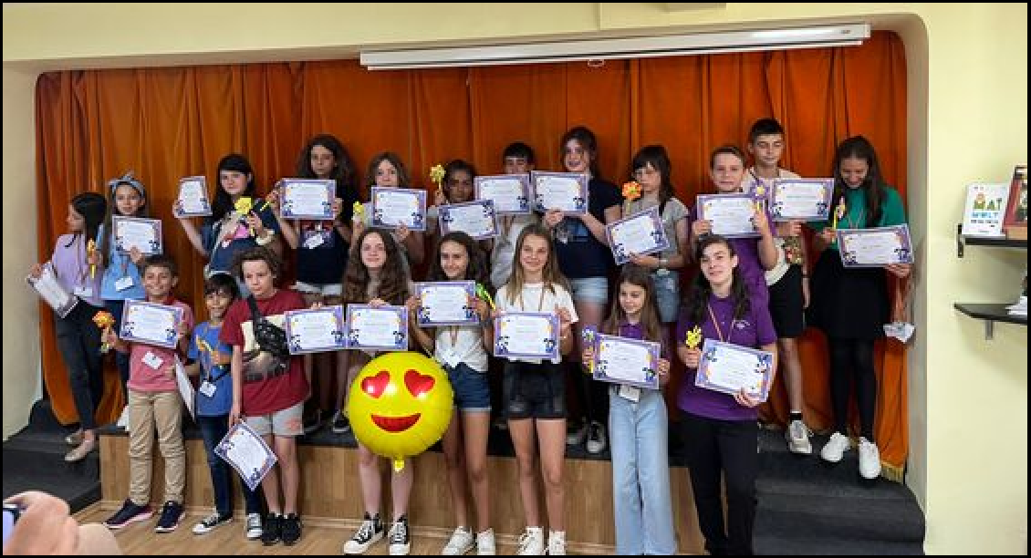

Slide 10
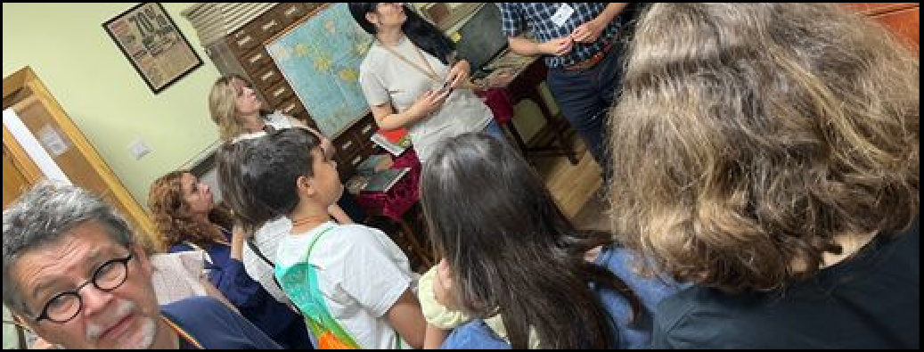
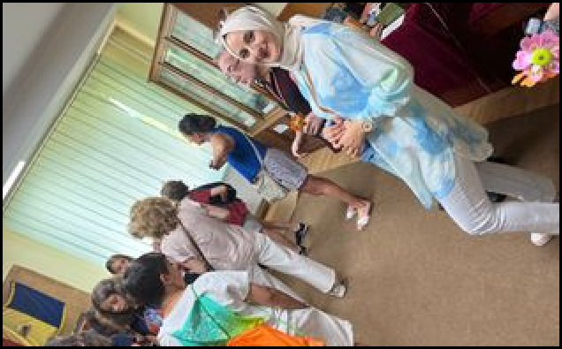
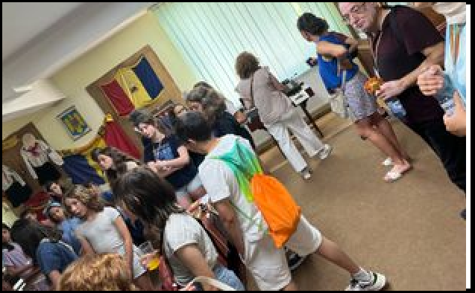
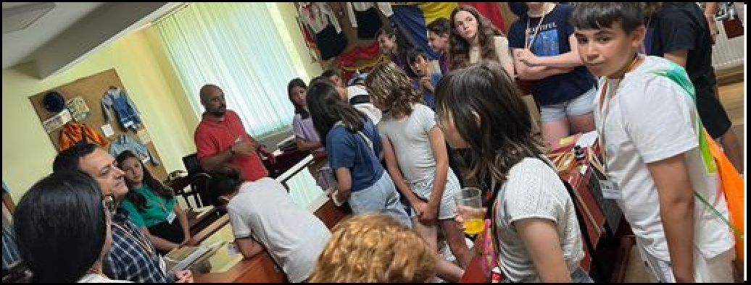
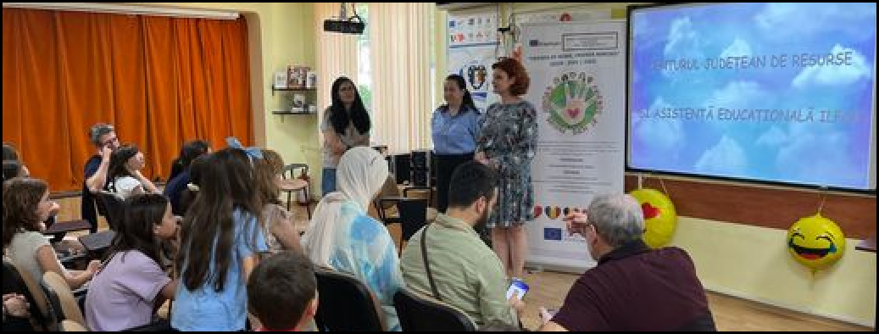
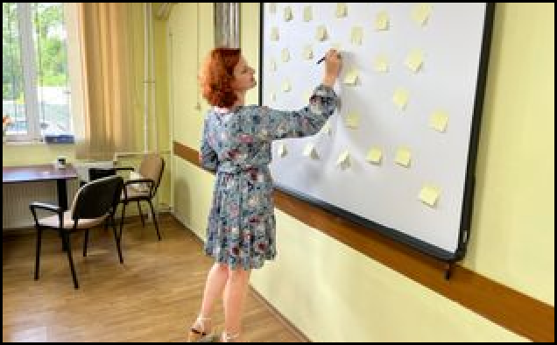

Slide 11
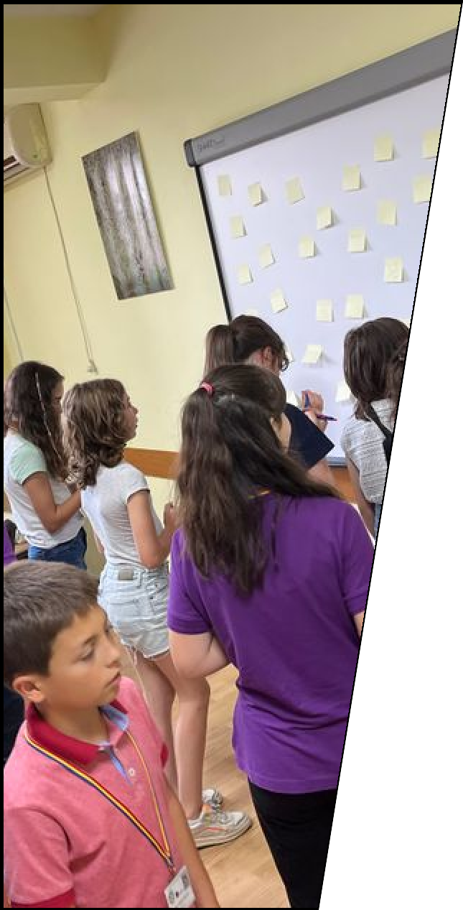
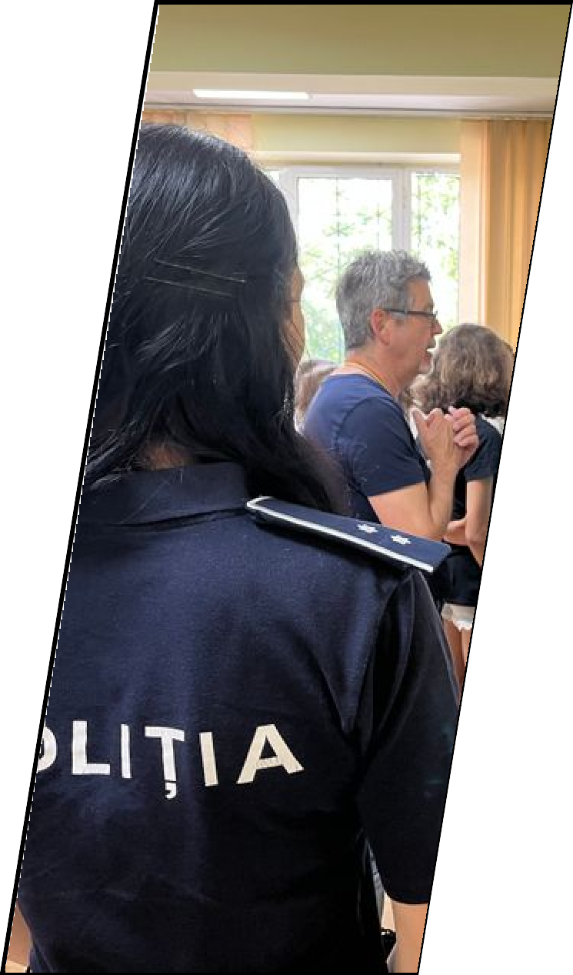
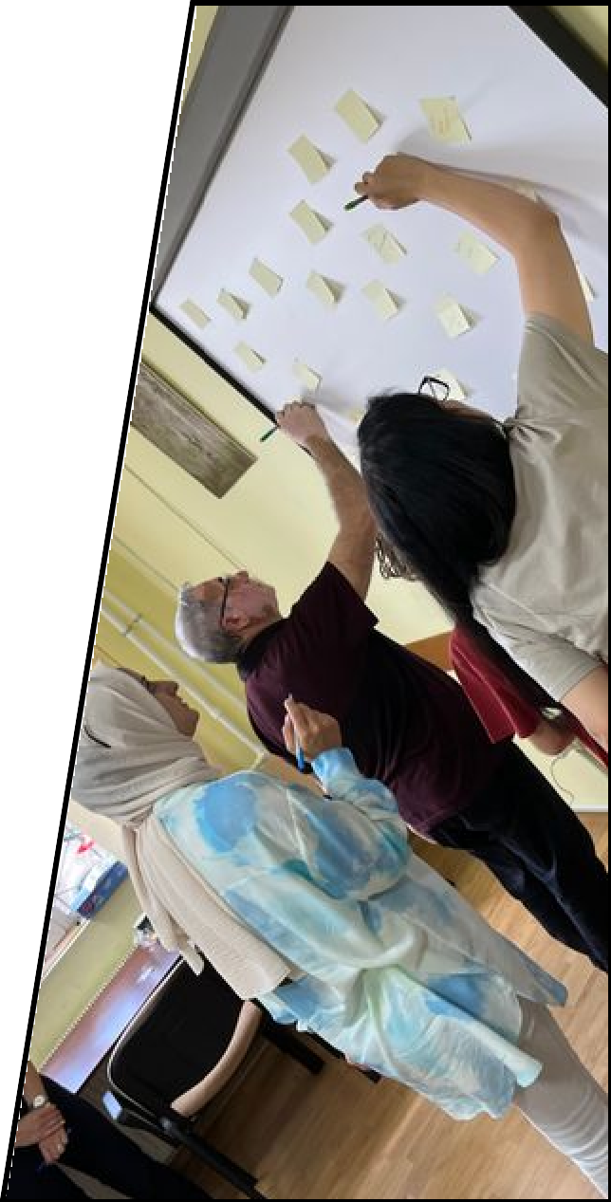

Slide 12
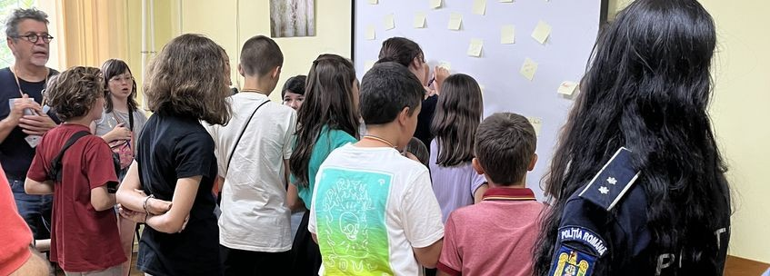
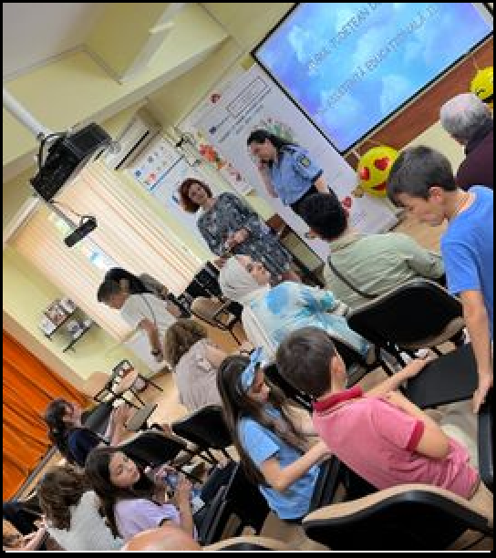
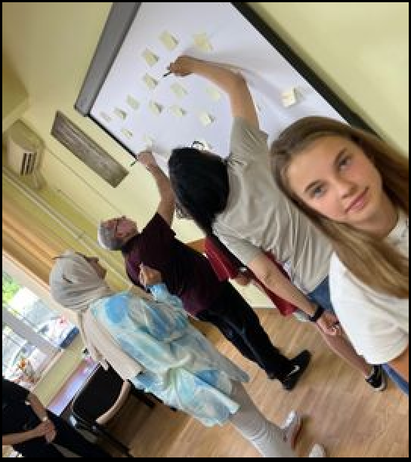
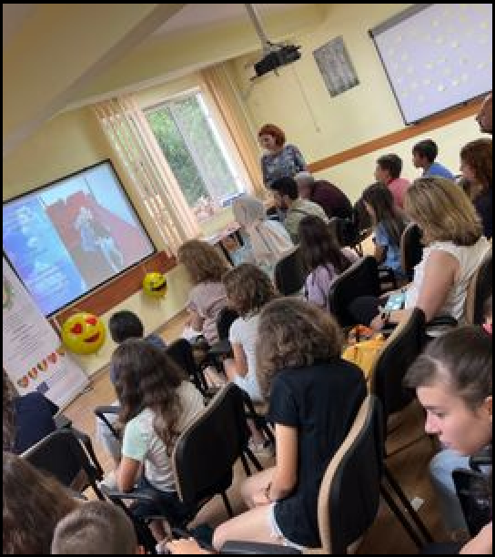

Slide 13
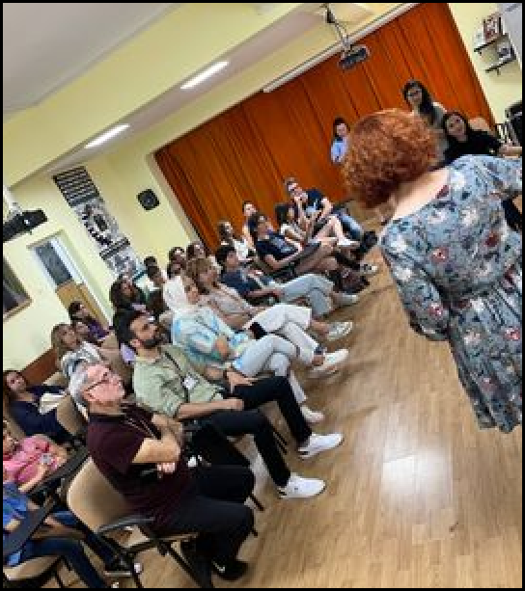
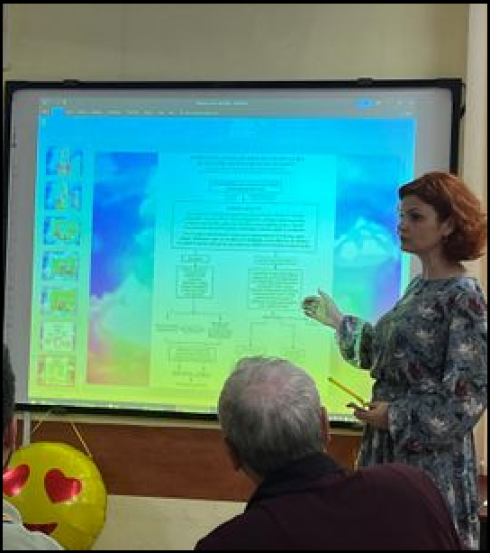
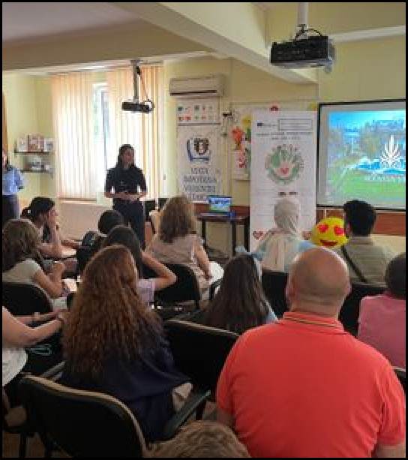
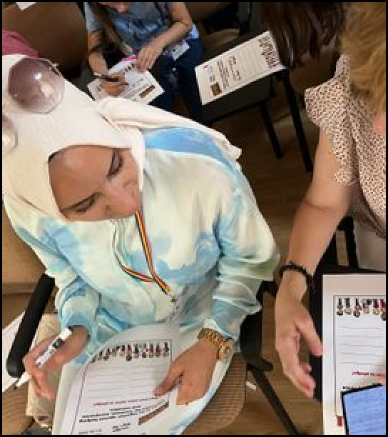
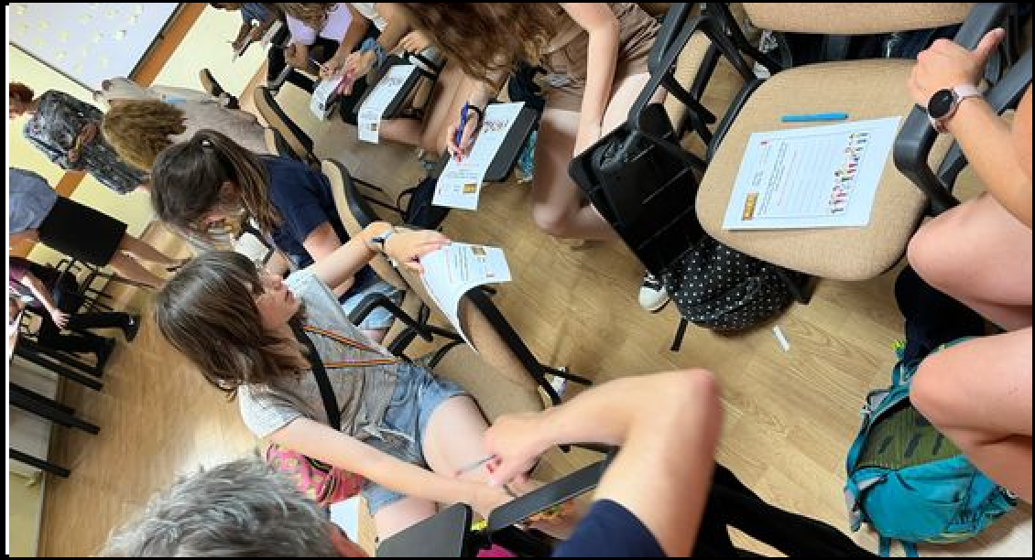

Slide 14
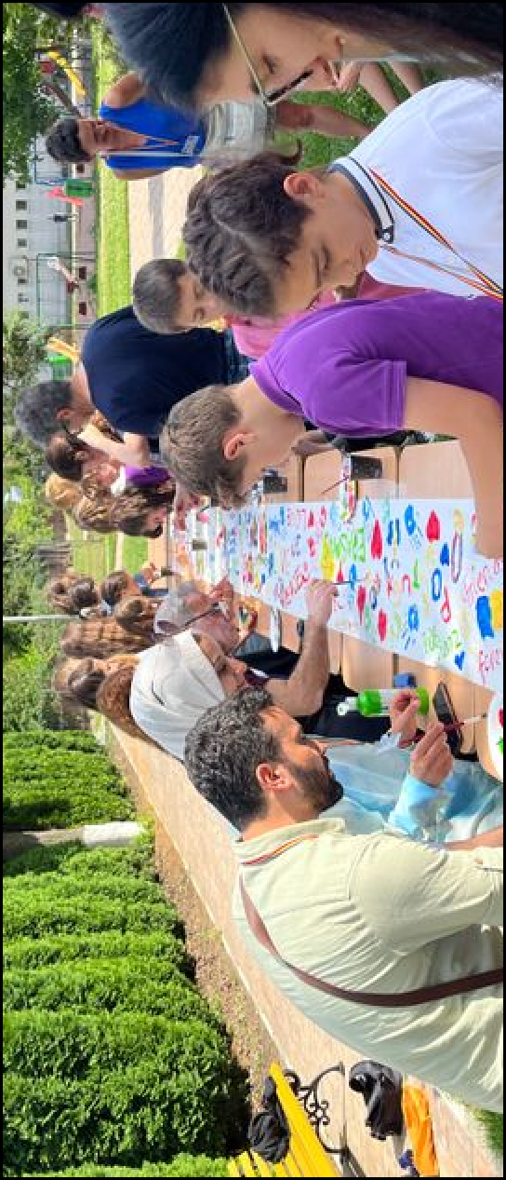
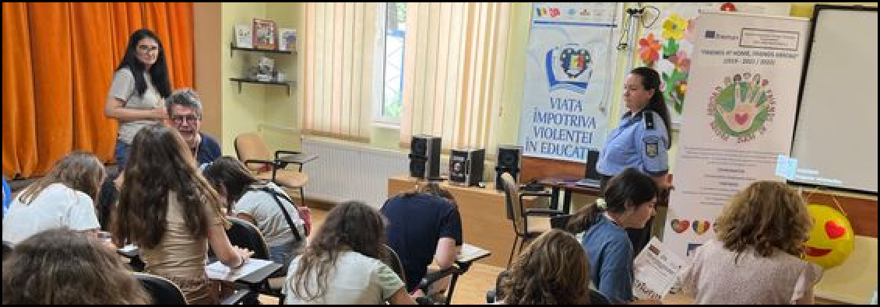
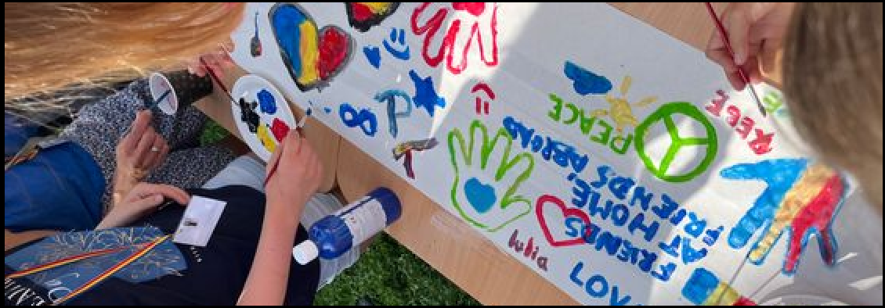
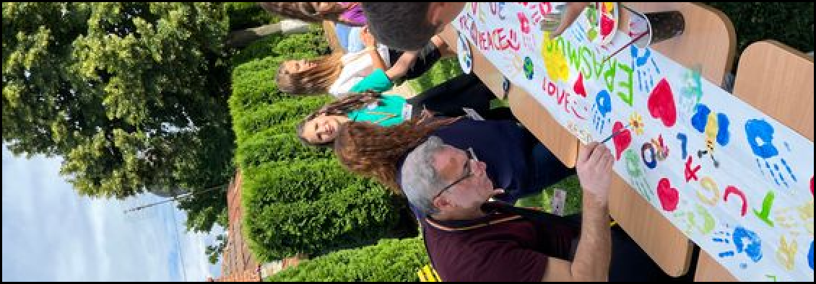

Slide 15
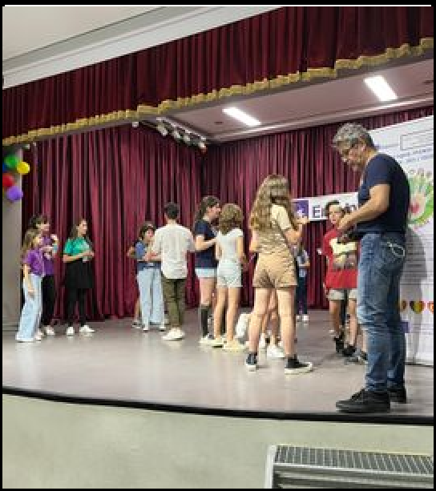





Slide 16

Day 3
10:00-12:30 Workshop with their peers from
local schools and high-schools involved in other Erasmus+ project about bullying and
befriending; Recording ﬂash mobs about
befriending ; the students received a Certiﬁcate of Active Participation. Students will upload the drama play and the ﬂash mobs
14:00-16:00 International festival- TEDx where all the students involved in the short-term exchanges of groups of pupils in Romania talked about bullying and befriending,
dramatized the script play, recorded it and translate it in their mother tongue ; we invited local newspapers, authorities, community;
students from other local schools were invited to participate
16:00-17:00 Preparing materials for Erasmus+ corner
17:00-17:30 Reﬂection of work. Evaluation of satisfaction.
18:00- 20:00 Certiﬁcates Ceremony. Farewell party

Slide 17







Slide 18






Slide 19






Thank you for all your letters!
Lots of love from romania!

Slide 20





Slide 21


THANK YOU FOR THIS AMAZING EXPERIENCE!

