Slide 1
ART IN SPAIN
Spanish art has been an important contributor to Western art and Spain has produced many famous and influential artists including Velázquez, Goya and Picasso.

Slide 2
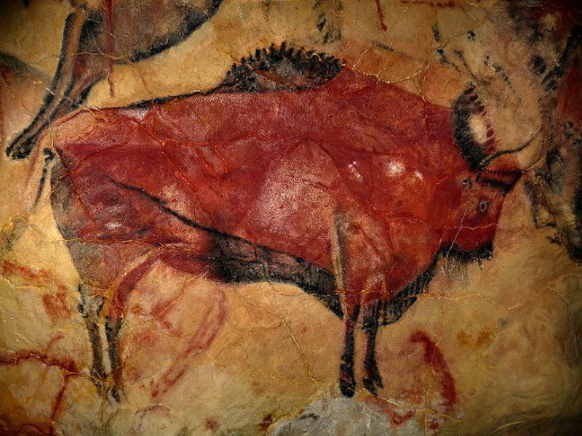
Prehistoric age
The prehistoric art of Spain had many important periods: it was one of the main centres of European Upper Paleolithic art and the rock art of the Spanish Levant in the subsequent periods.
Homo sapiens arrived in Spain 195,000 years ago and transmitted their artistic flow to the rest of Europe.
However, art evolved and gave way to the new artistic age.

Slide 3
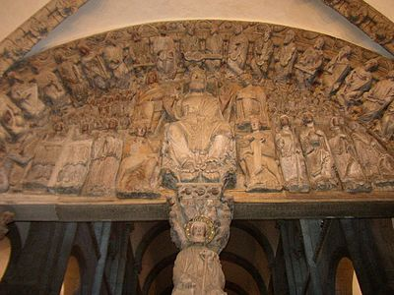
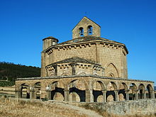
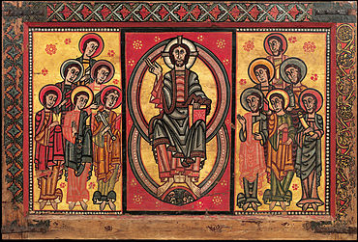
Romanesque
From the 11th century the European artistic influence was superimposed on local artistic traditions and lived with the so-called Mudéjar Romanesque.

Slide 4
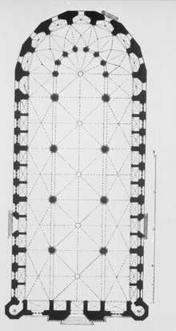
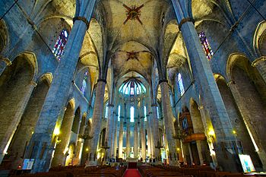
Gothic
Spanish Gothic architecture was important in the Late Medieval period.
The Gothic style was adopted by the Mudéjar architects, who created a hybrid style, employing European techniques and Spanish-Arab decorations. The most important post−thirteenth-century Gothic styles in Spain are the Levantino and the Isabelline Gothic.

Slide 5
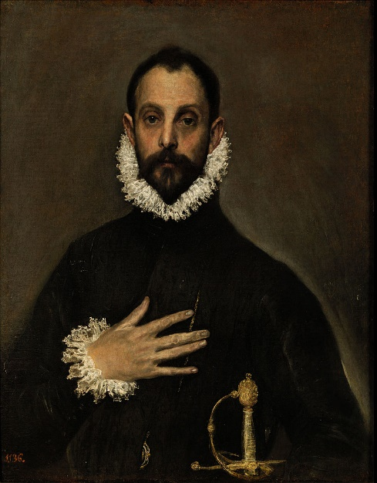
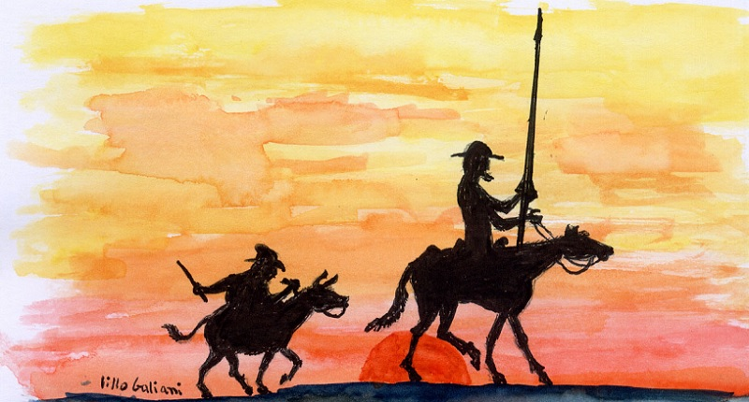
Renaissance
This new focus in art, literature and science is inspired by the Greco-Roman tradition of classical antiquity.
There are Spanish well-known writers as Cervantes with works such as "El Quijote" or painters such as "El Greco" with works such as "The Knight of the Hand in the Chest“

Slide 6
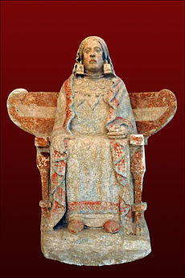
Specific art of Baza
In Baza, our city, the best known art is the Iberian, whose main work is the Lady of Baza

Slide 7
conclusion
Diego Limonchi Bujaldón
Carmen Fernández Pérez
In short, art is very important in Spain

