Slide 1
MY HIGH SCHOOL
I.E.S. ALCREBITE
José Antonio Martínez bordajandi
Silvia teresa hernandez diaz

Slide 2
THIS IS OUR BUILDING:

Slide 3
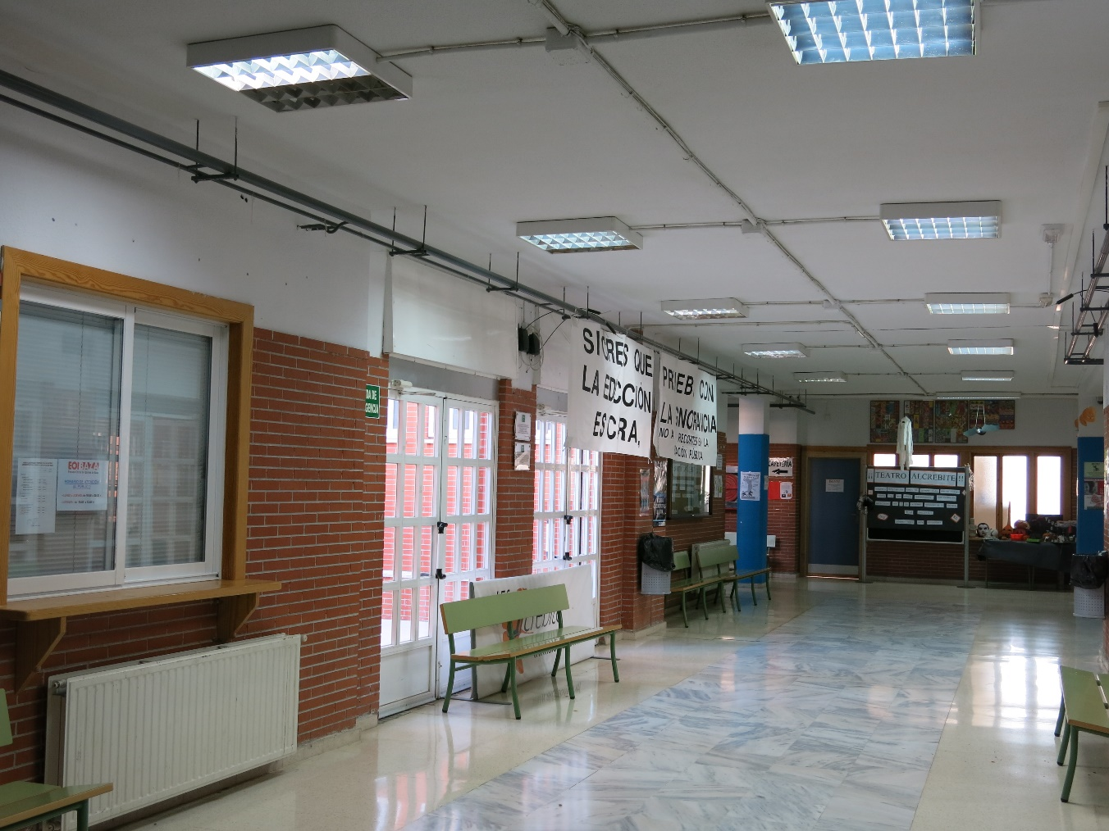
This is the hall of the high school, where we are in the breaks.

Slide 4
This is the playground where students spend their breaks, and where they do sports activities

Slide 5
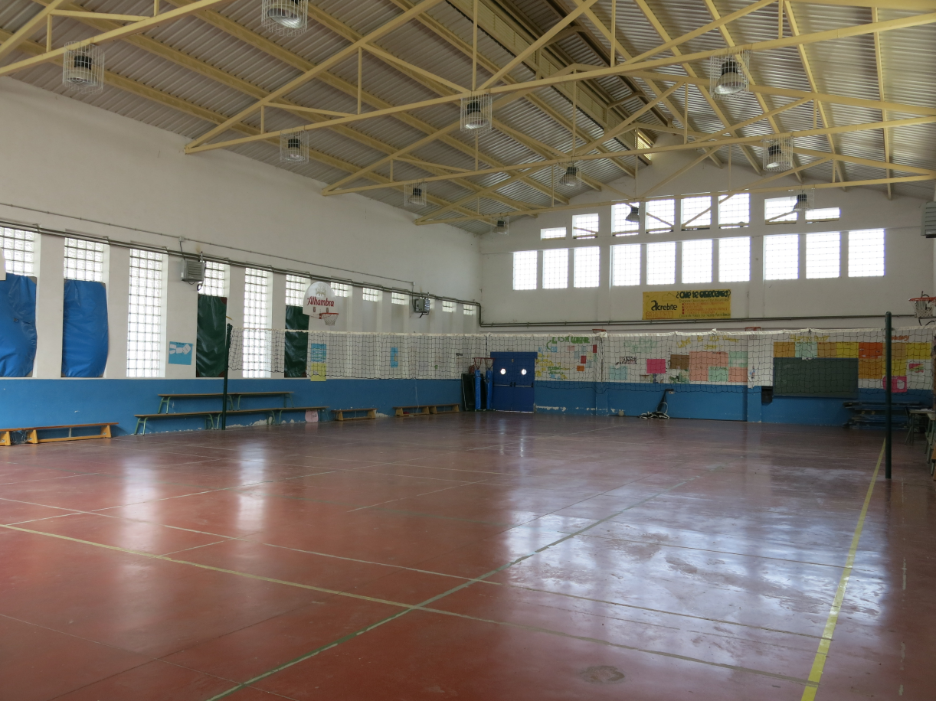
This is the large gym of the highschool, where Moises, our P.E teacher, does his job

Slide 6
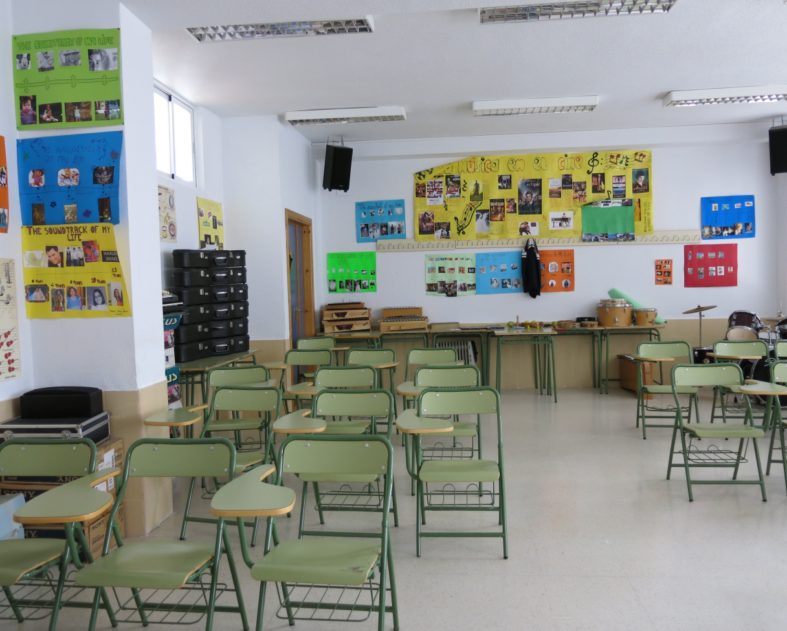
This is the music classroom, where we can see many instruments that children learn to play.

Slide 7
THE LIBRARY.
This is the library, where at can go to do their homework and it’s also used for meetings of importance. Some classes are also taken in the library because you can use the projector to watch presentations or movies.

Slide 8
PHOTOS OF THE LIBRARY:

