Slide 1
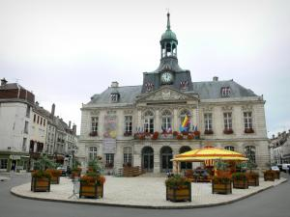
Chaumont city Haute-Marne Champagne-Bourgogne

Slide 2
Chaumont

Slide 3
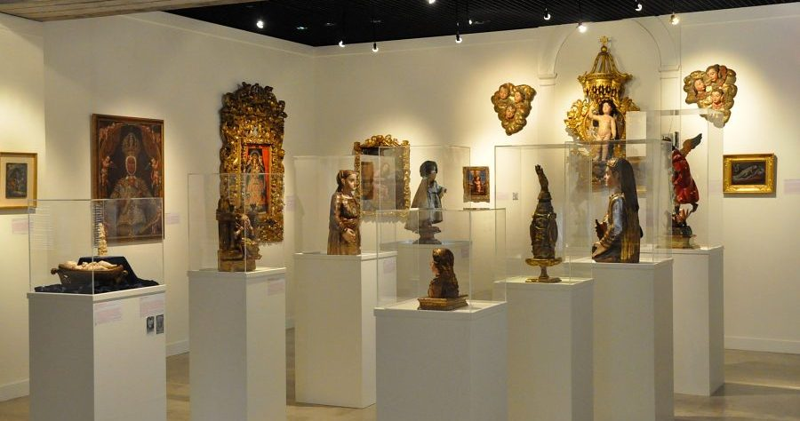
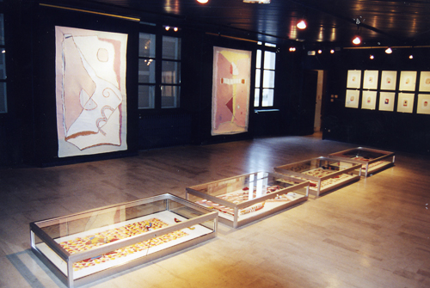
Museum of the creche
There are 2 museums
Museum of art and history

Slide 4
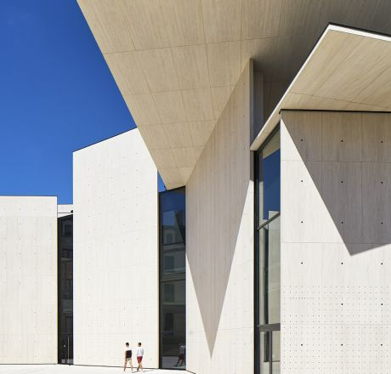
There is <<le signe, centre national du graphisme à Chaumont>>

Slide 5
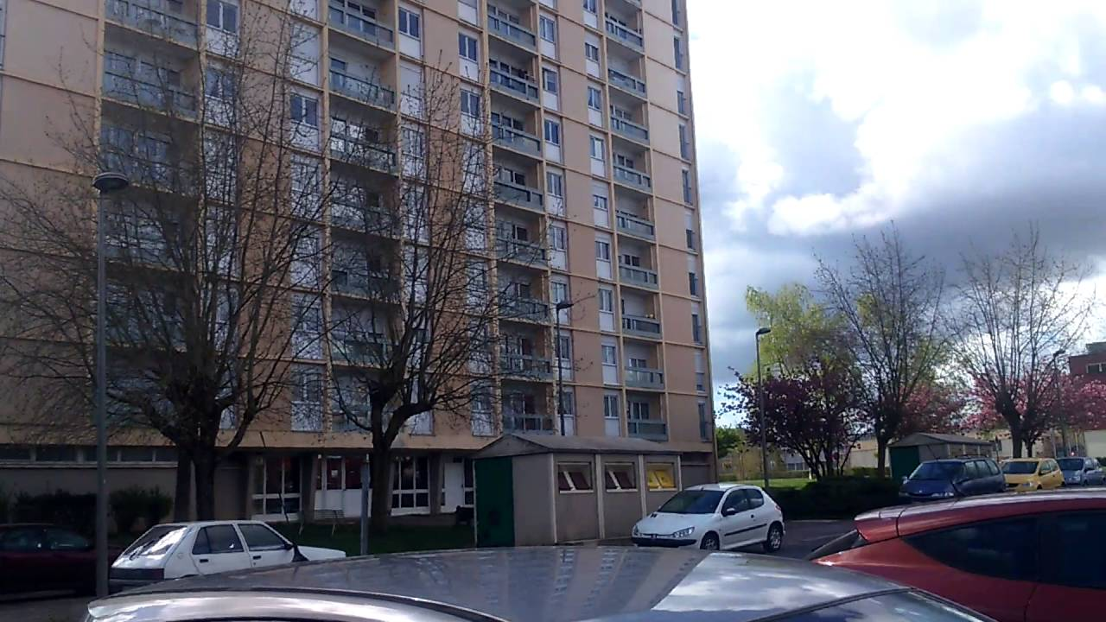
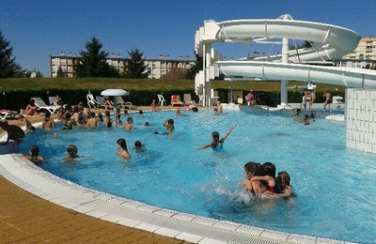
The <<Cavalier>> There is a summer swimming pool, a bakery and a commercial area.
There are 2 neighborhoods

Slide 6
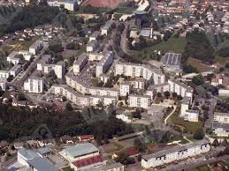
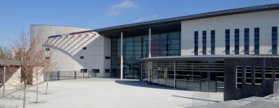
This is a middle school
The <<Rochotte>>

Slide 7
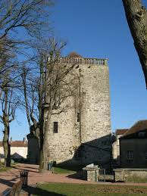
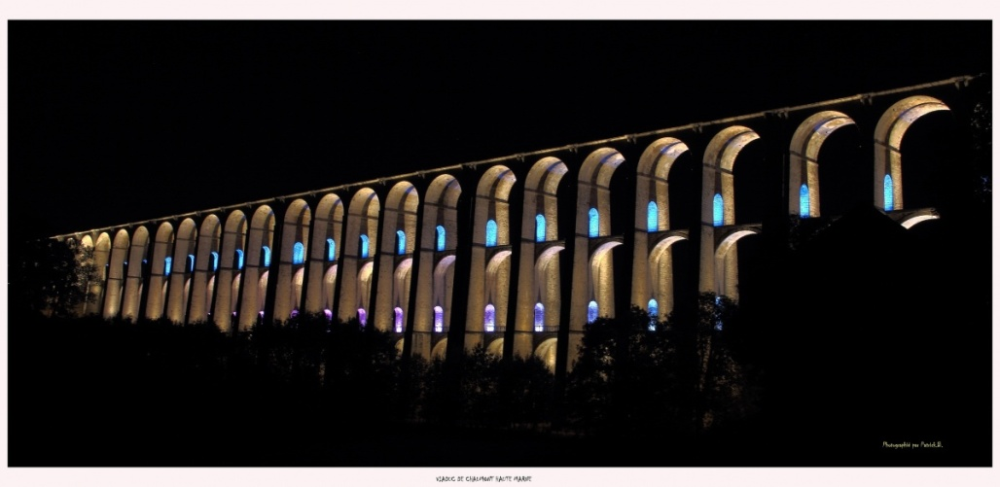
The dungeon
There is a dungeon and a viaduct
The viaduct at night

Slide 8
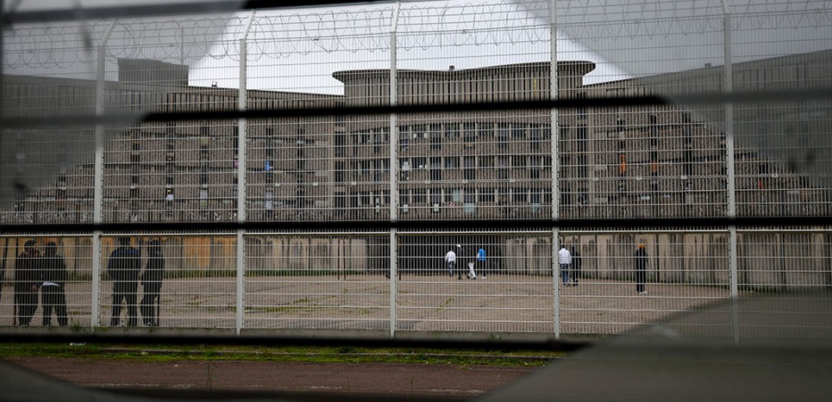
Here is the jail of Chaumont

Slide 9
There are 24 000 people in Chaumont
The city is not very dynamic for young people

