Slide 1
MY DAILY ROUTINE
ALEJANDRO SANCHEZ AND JESÚS GIL

Slide 2
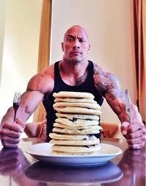
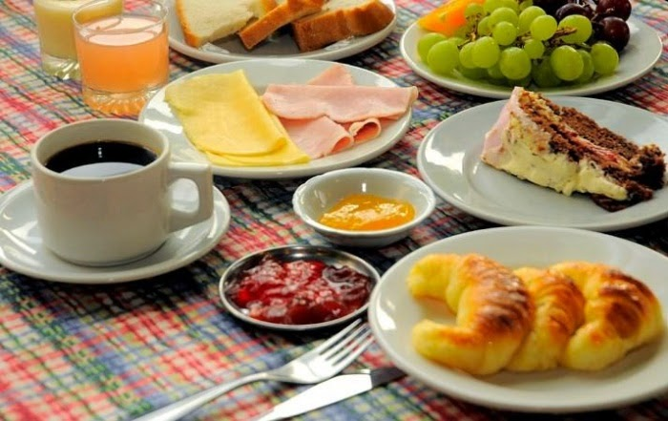
THE BREAKFAST
We get up and get ready to go to school, We get up dressed, we put on our clothes and we have breakfast.
We have breakfast at all.
When we finish, we go to the high school

Slide 3
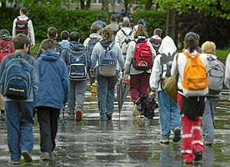
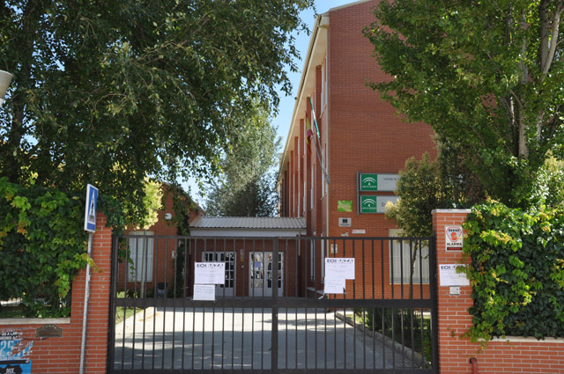
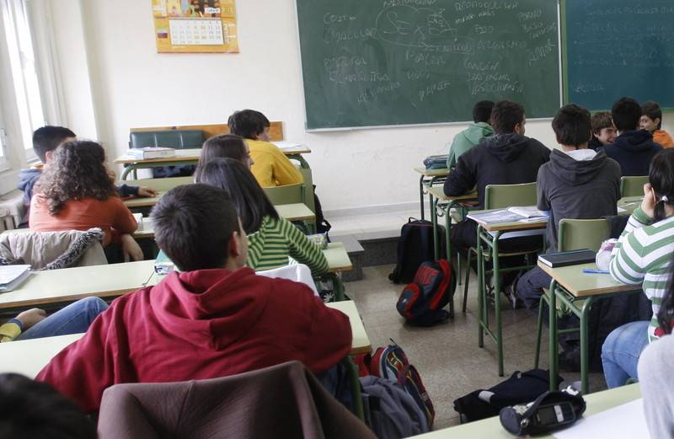
GO TO SCHOOL
We walk to the highschool and we spend 30 minutes to arrive there
We usually go a little early so we can spend some time with the classmates before starting the class.
At quarter past eight, we start the class, we have two breaks. We finish at quarter to three.
When we finish, we go home to have lunch.
.

Slide 4
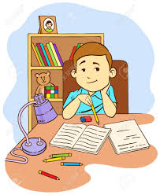
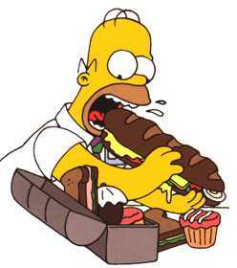
THE LUNCH AND HOMEWORK
When we got home, we start to have lunch, and when we finish, we help to pick up the table
When I finish , I start to do my class tasks and to study for the next exams.

Slide 5
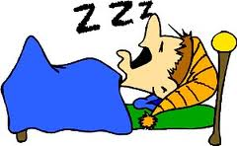
IN THE AFTERNOON…
When I finish all my duties, I usually do some kind of sport: riding a bicycle or playing basketball.
After doing sports, you have to recover your strength, and for this you deserve it.
After doing sports we have a snake to recover forces.
Later on, I usually read a book and we rest until dinner time.
After having dinner with my family, I watch a little TV and go to sleep.

