Slide 1
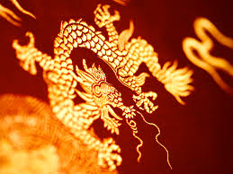
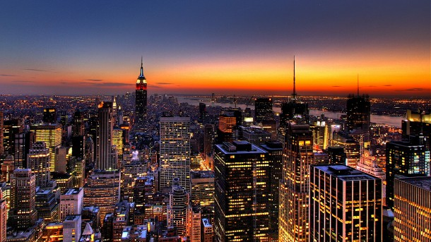
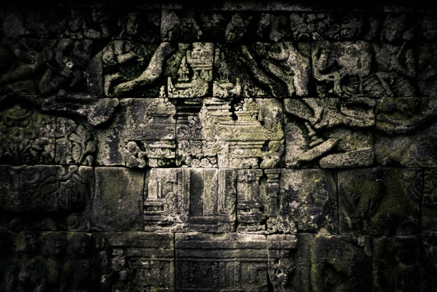
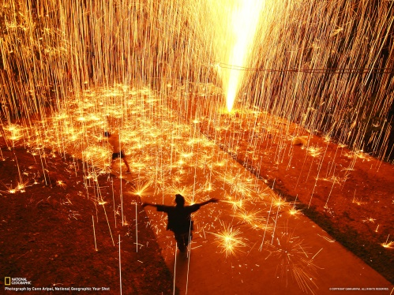
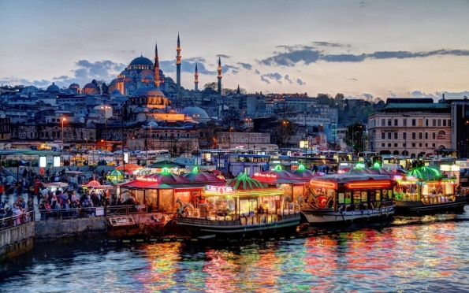
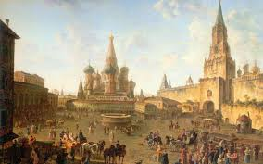
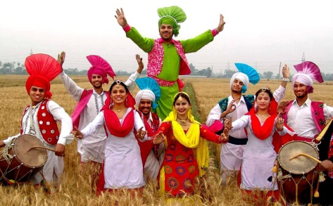
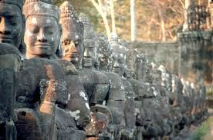
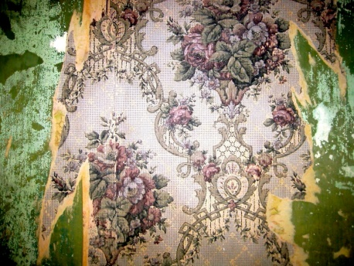
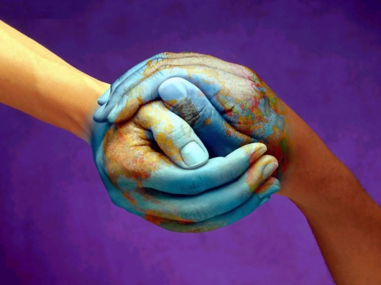
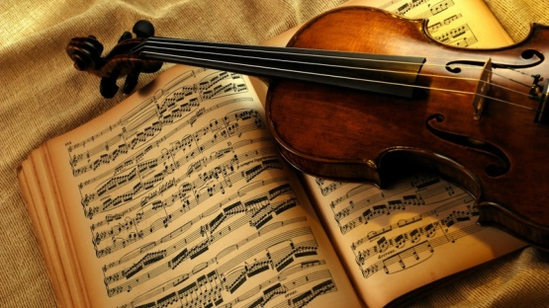
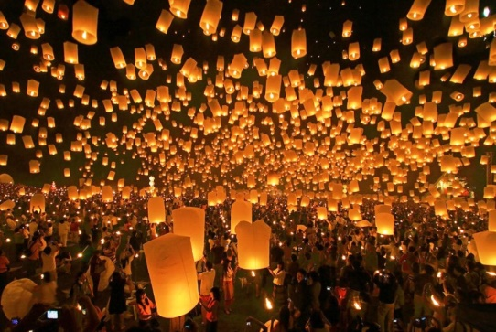
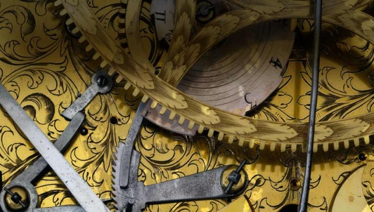

Slide 2
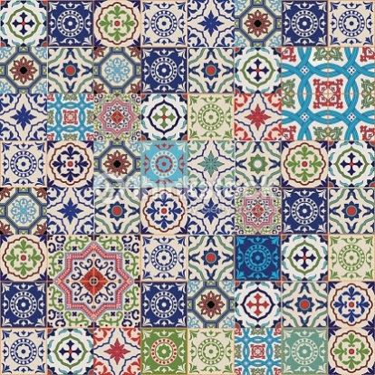
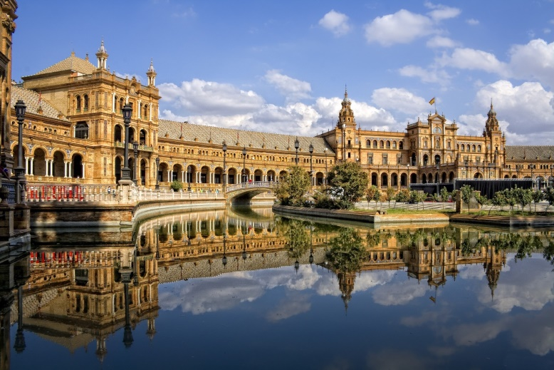
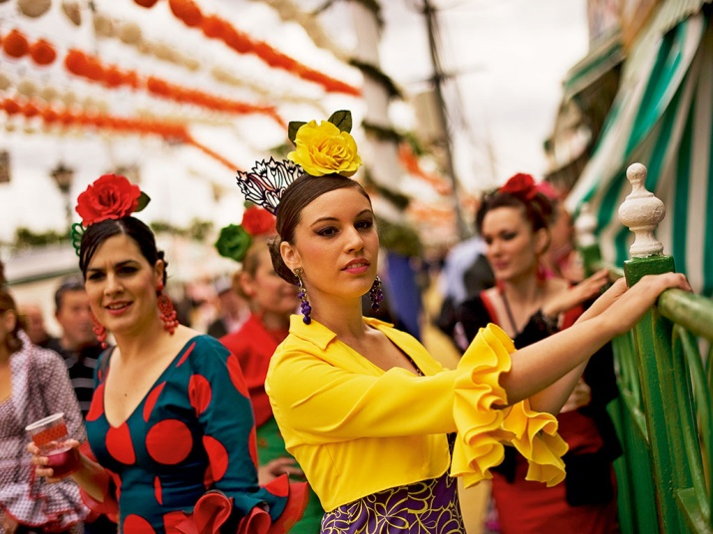
DEFINITION OF CULTURE
Culture are the characteristics and knowledge of a particular group of people, defined by everything from language, religion, cuisine, social habits, music and arts.

Slide 3
Literature
The term "Spanish literature" refers to literature written in the Spanish language, including literature composed by Spanish and Latin American writers. It may include Spanish poetry, prose, and novels.
Some of the most important Spanish writers are:-
-Miguel de Cervantes: He wrote: “El Quijote ”
Lope de Vega: He wrote: “Fuenteovejuna”, “ La Dorotea”…
Calderón de la Vega: “La vida es sueño” (Life is a Dream)
Federico García Lorca “Poet in New York”,…
Juan Ramón Jiménez: “Platero and Me”
Benito Pérez Galdos: “Fortunata and Jacinta”
Leopoldo Alas, Clarín: “La Regenta”

Slide 4
Architecture
During the Prehistoric period, the megalithic Iberian and Celtic architectures were developed.
The Aqueduct of Segovia belongs to the Roman Period.
After the pre-Romanesque period, we have the architecture from Al-Andalus,with important monuments such as the Great Mosque of Córdoba, La Giralda in Seville and the Alhambra ,and the Generalife in Granada.
We have Mudéjar style (the Alcázar of Seville), the Romanesque period (the Cathedral of Santiago de Compostela), the Gothic period (the Cathedrals of Burgos, León and Toledo), the Renaissance (Palace of Charles V in Granada), the Baroque period (Granada Cathedral), the Spanish colonial architecture, and Neoclassical style (ex. the Museo del Prado) are the most significant
In the 20th century, we have the Modernisme (La Sagrada Família by Gaudí),

Slide 5
Cinema
"Spanish cinema".
In recent years, Spanish cinema has achieved high marks of recognition as a result of its creative and technical excellence. Luis Buñuel was the first to achieve universal recognition, followed by Pedro Almodóvar in the 1980s. Spanish cinema has also seen international success over the years with films by directors like Luis García Berlanga, Carlos Saura, Julio Medem and Alejandro Amenábar.
There also relevant Spanish people as the actress Penélope Cruz and the actors Fernando Rey, Antonio Banderas, Javier Bardem and Fernando Fernán Gómez, who have obtained some recognition outside of Spain.

