Slide 1
Music in Spain
Serafín Fernández Noguera

Slide 2
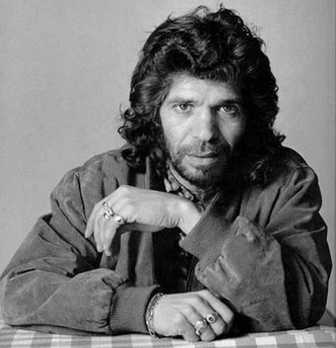
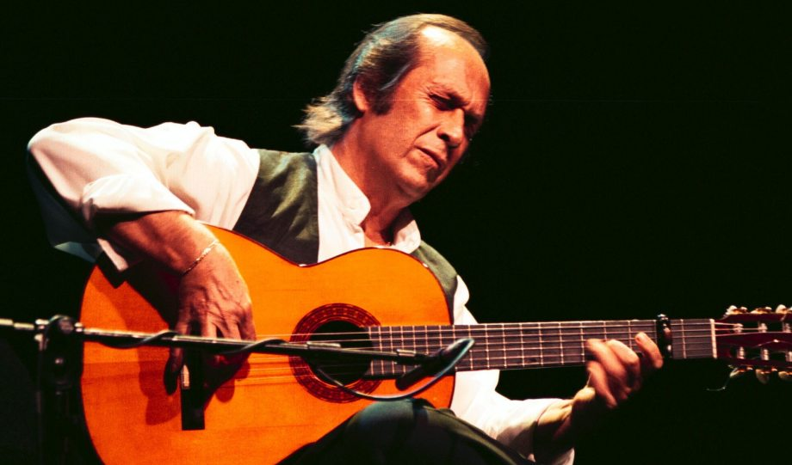
TYPES OF MUSIC IN SPAIN
Flamenco: This is the traditional folklore type of music in Andalusia. This kind of art is very admired by some citizens from Andalusia. Camaron de la Isla and Paco de Lucía are the most important flamenco singers and musicians.

Slide 3
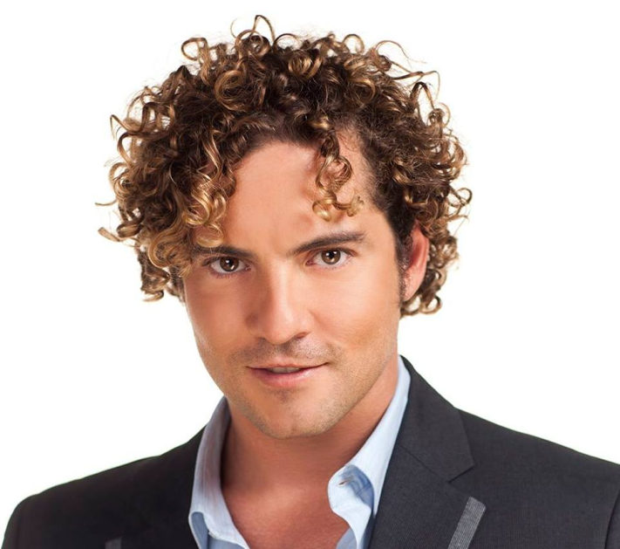
POP AND ROCK
Pop and rock are two types of music which are very important in Spain nowadays.
Alejandro Sanz, Julio Iglesias and David Bisbal are some artists which have a great international career.

