Slide 1
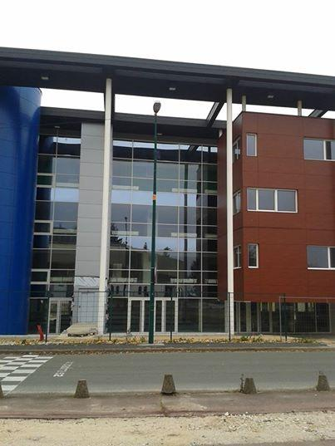
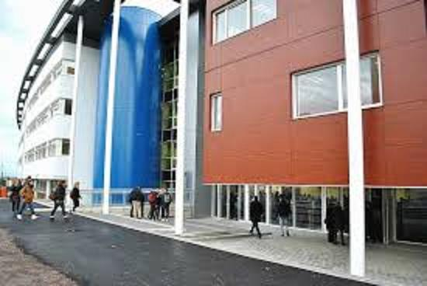
My High school
Lycée Edme Bouchardon

Slide 2
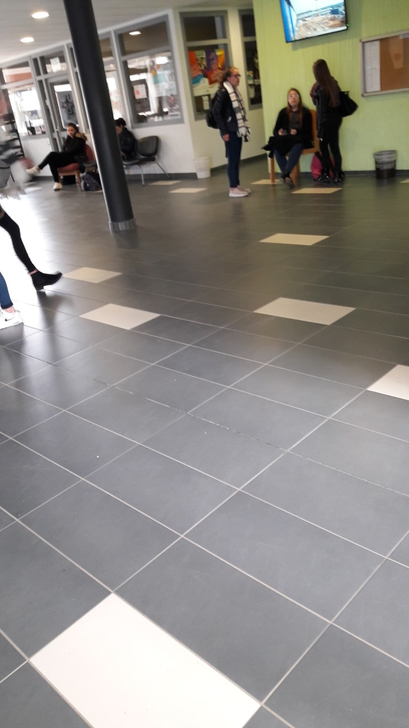
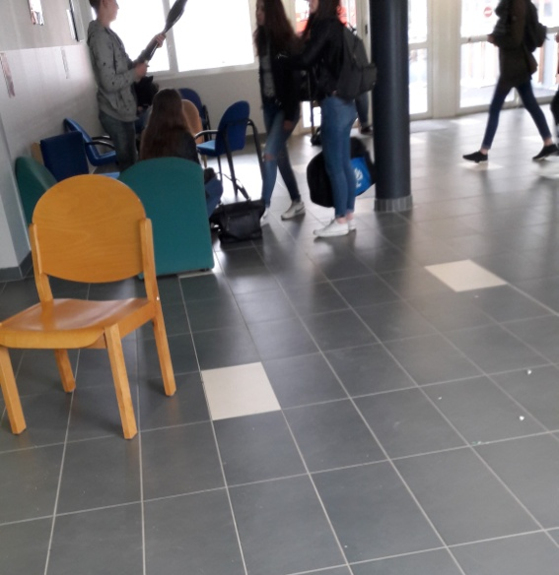
We have a entrance hall for the students That can use mobile phone, look the informations.

Slide 3
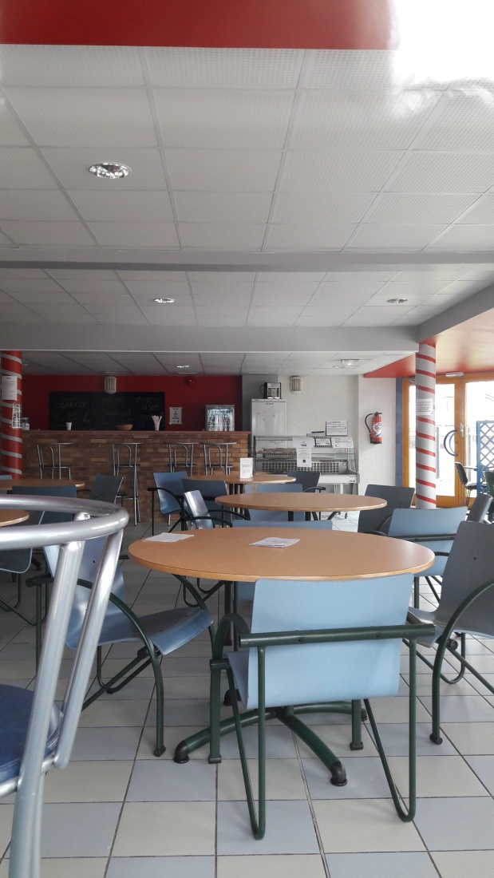
There is a cafeteria for the breaks,where We can buy to eat as the drinks, chocolate bread…

Slide 4
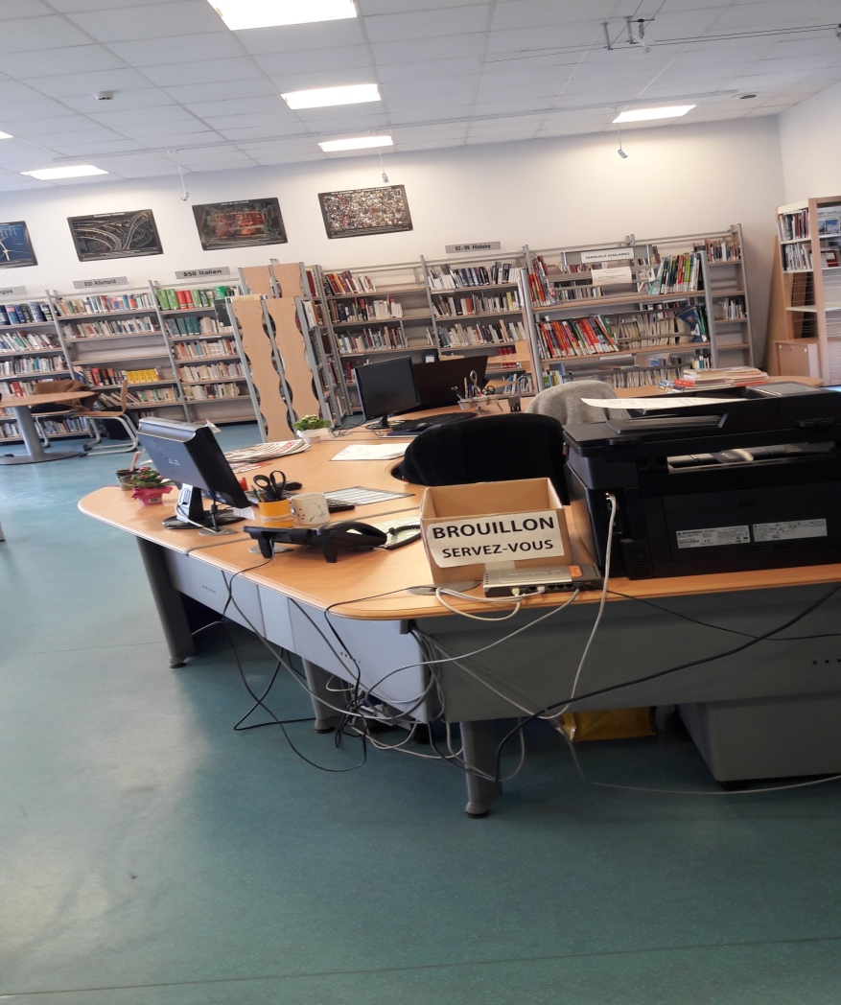
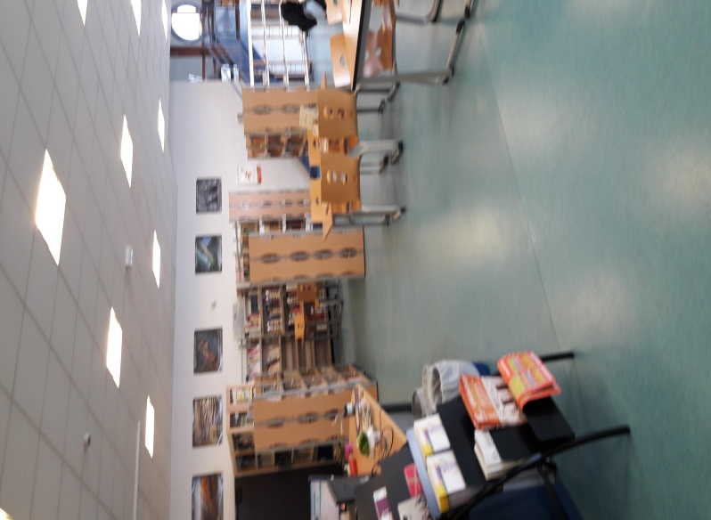
There is a CDI for read , do homework , go to computer .

Slide 5
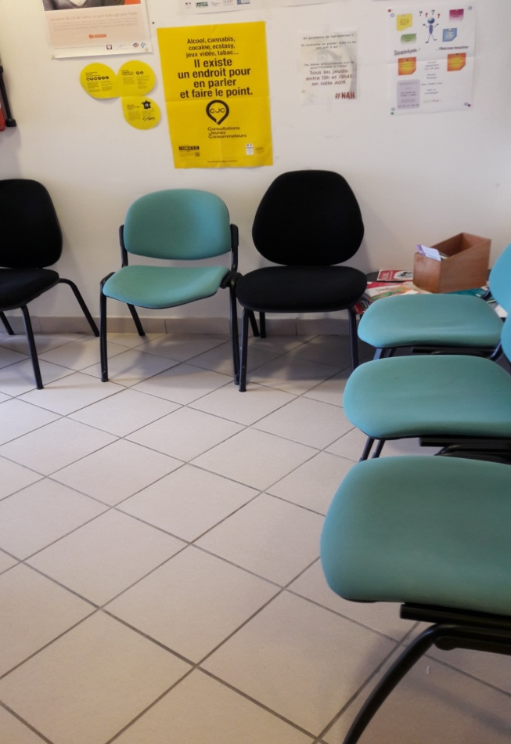
infirmary
We can go to infirmary when we are sick

Slide 6
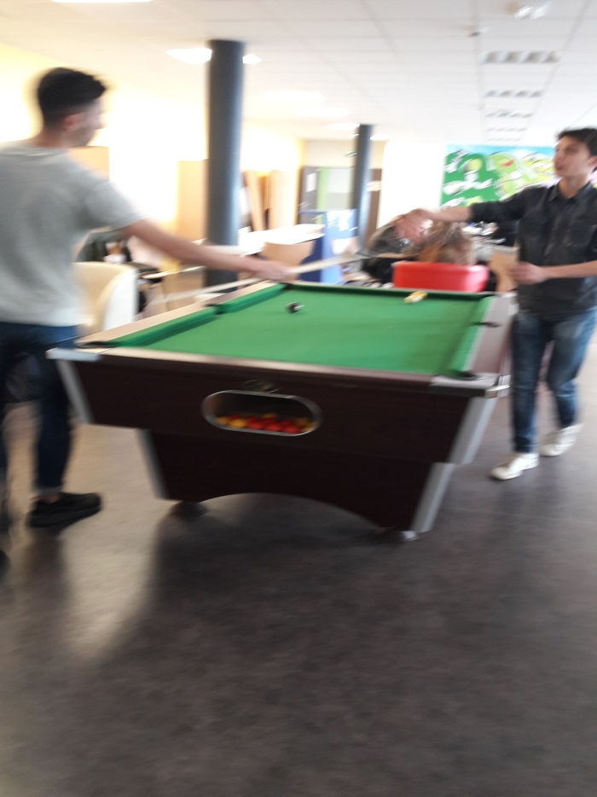
The home
We have a home , we can play billiards , talk with friends , read BD , play board games and use phone .

Slide 7
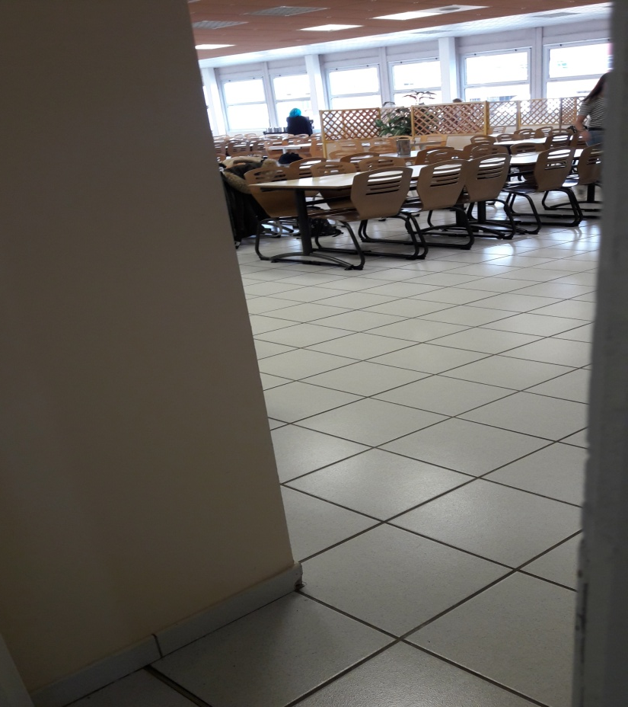
The school cafeteria
The school cafeteria is for the interns , the half boarders and the external . There are Two possible menus per day .

