Slide 1
GASTRONOMY IN SPAIN
MADE BY:
MARIO
AND
JOSE ANGEL

Slide 2
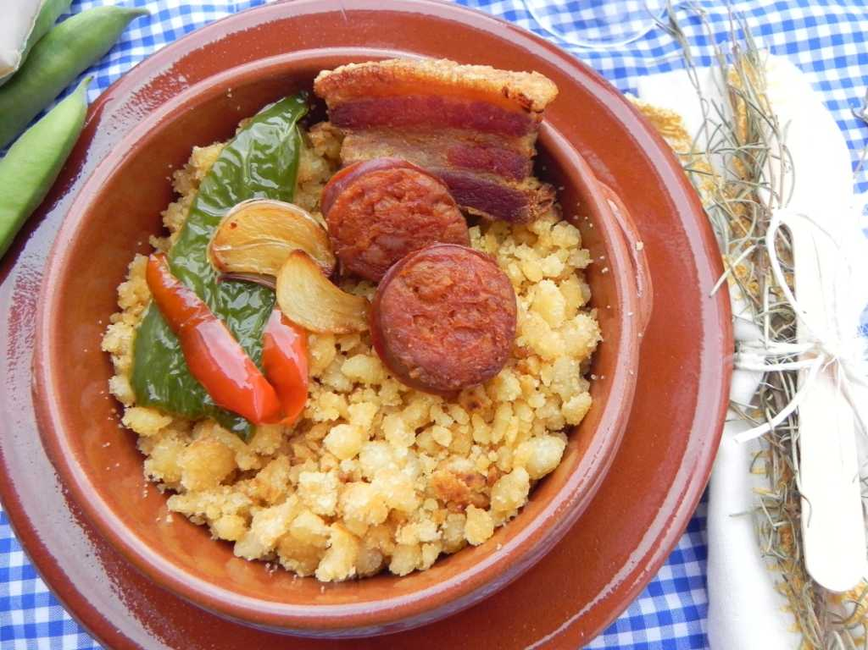
MIGAS
The crumbs in a famous typical dish, which is made of bread, chorizo, peppers, garlic, bacon, chicken and many other things

Slide 3
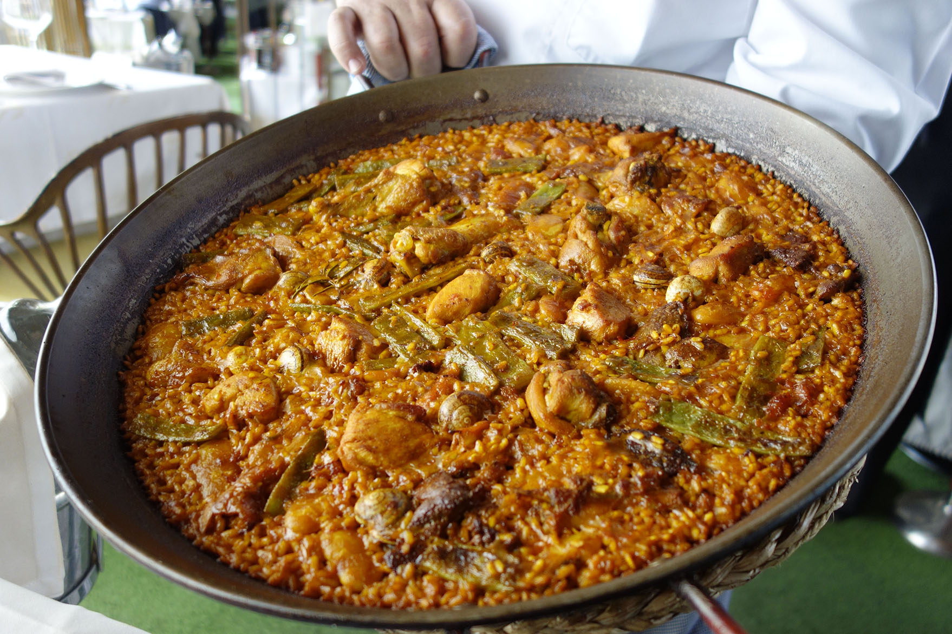
PAELLA
Paella is a typical dish in the Spanish gastronomy. It is made with rice, a sauce of vegetables and it can be made with meat (chicken, pork, rabbit) or seafood (prawns, squid, clams)

Slide 4
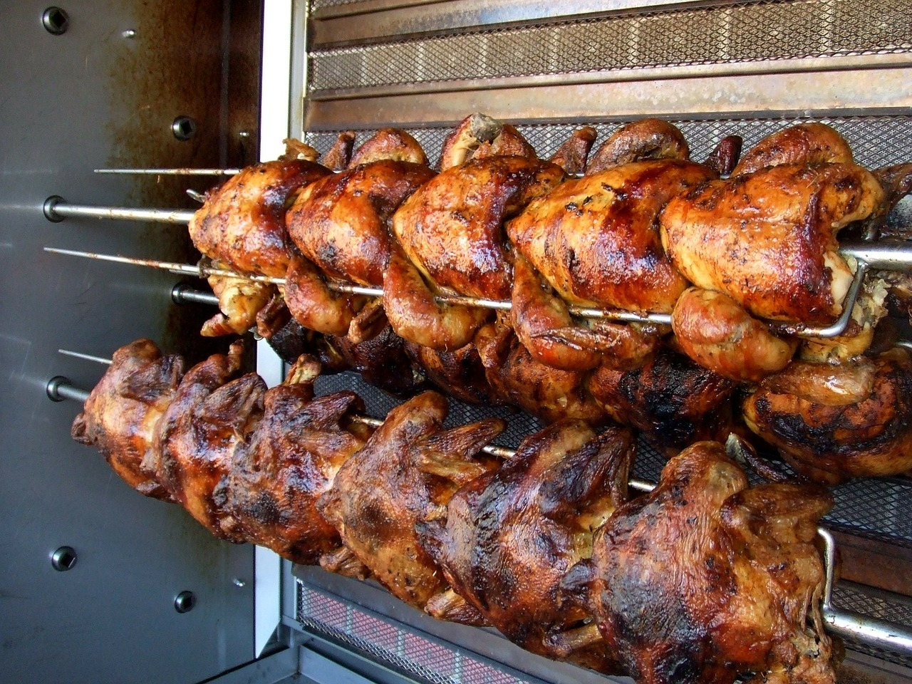
POLLO ASADO
The chicken is a typical Spanish dish. It is roasted in a barbecue where they are roasted in some bars about 5 or 6 chickens at a time per bar. The chicken is seasoned with many species and it remains very juicy

Slide 5
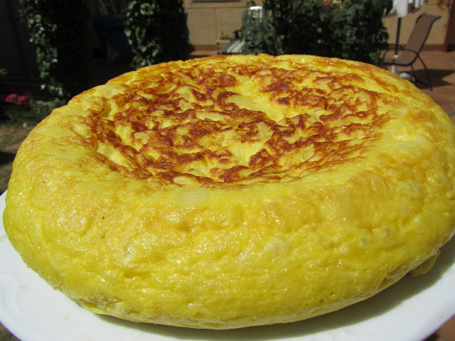
TORTILLA DE PAPATAS
The tortilla is a very famous dish, mainly in Andalusia. It consists of potatoes eggs and onions

Slide 6
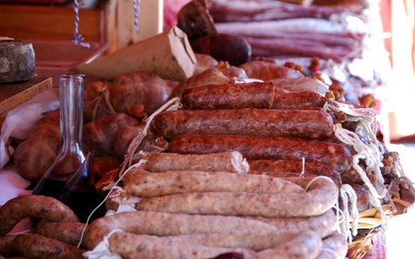
EMBUTIDOS
The sausages is a famous pickle that is made in all Spain there are many types and is usually pork, but there are also turkey, chicken ... Some examples of sausages are: sausage, blood sausage, salchichon, chistorra

Slide 7
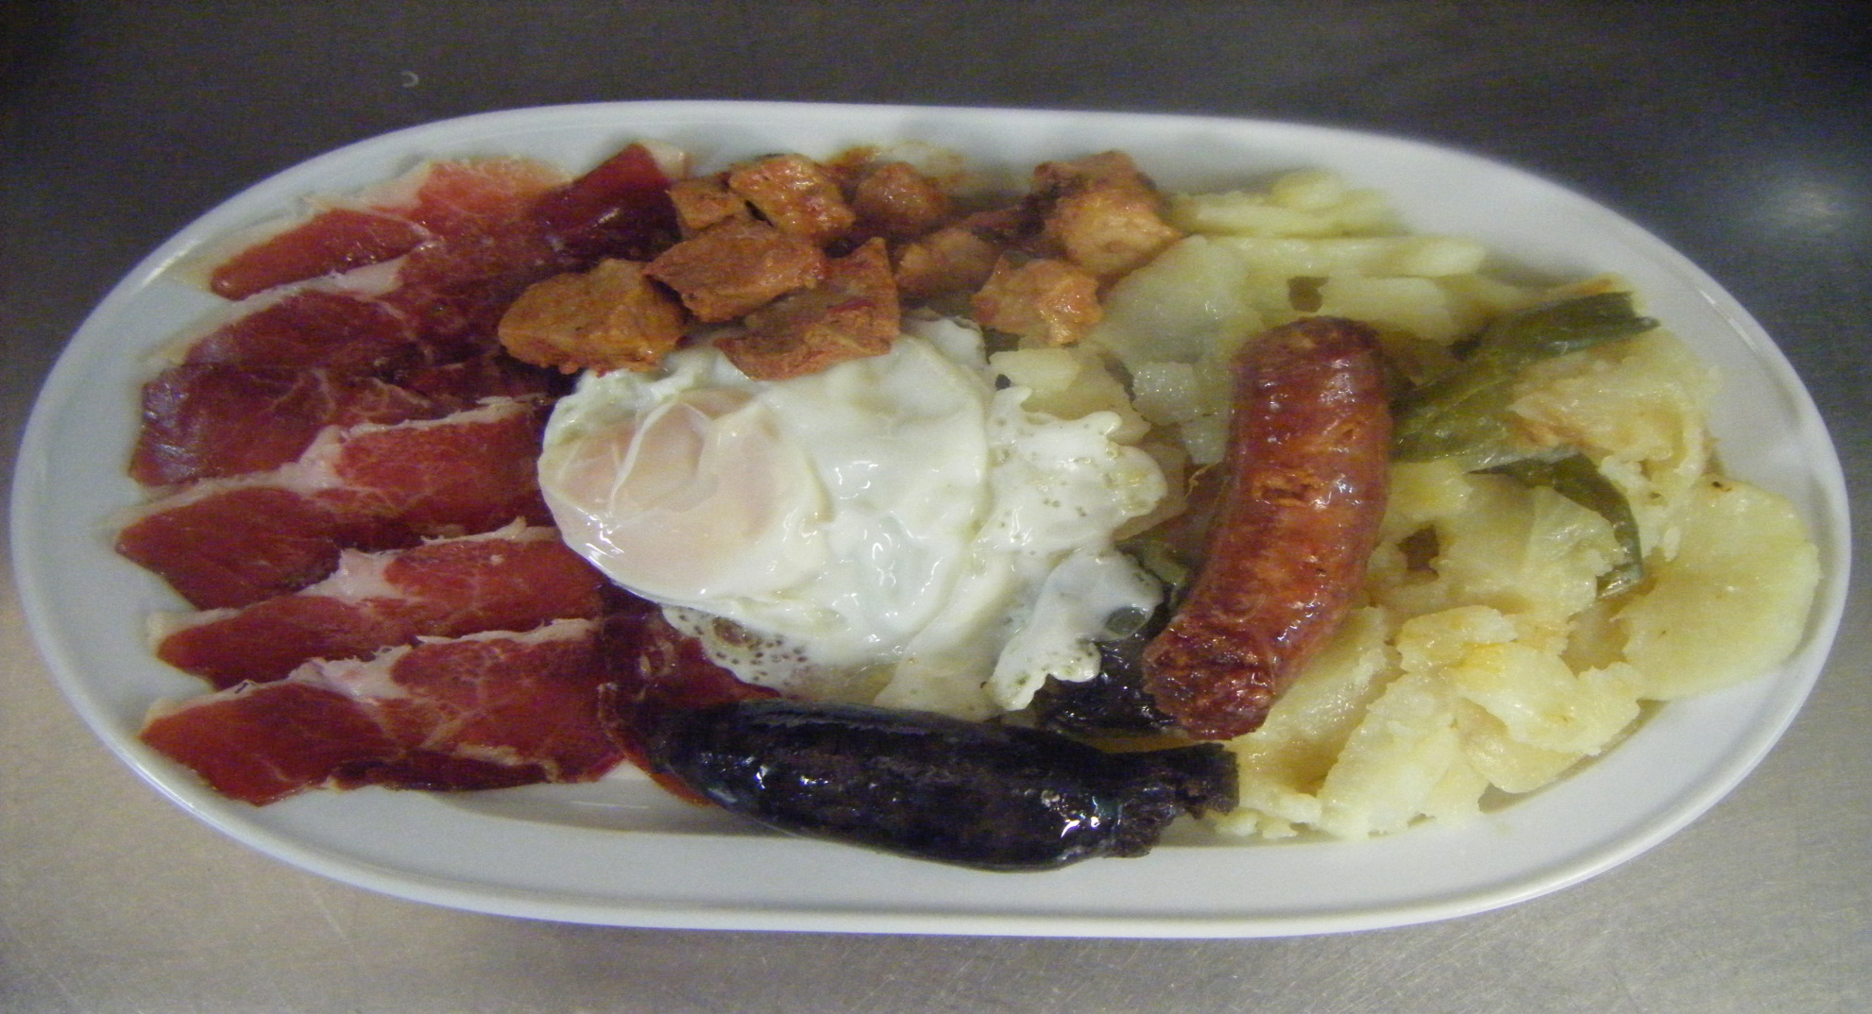
PLATO ALPUJARREÑO
“El Plato Alpujarreño”is a typical Spanish dish consisting of chorizo, eggs, pepper, black pudding, ham and potatoes

Slide 8
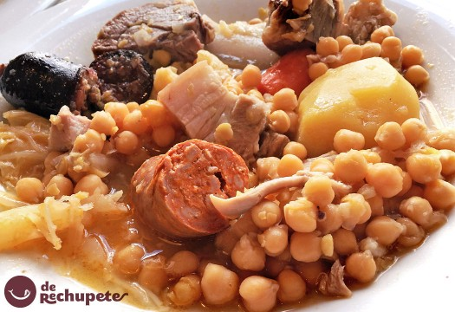
COCIDO
The stew is one of the most famous dishes in Spain is a meal consisting of potatoes and sausages that is cooked for hours

Slide 9
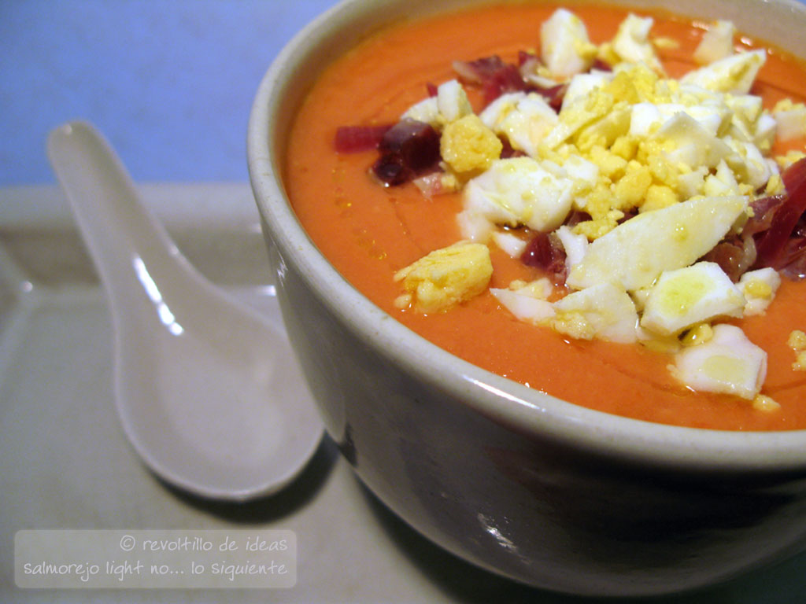
SALMOREJO
Salmorejo is a vegetable smoothie consisting of tomatoes, peppers, garlic, carrot ... and over toasted bread and boiled egg

