Slide 1
4 in 1
QUALITY LABEL GUIDENCE
by Çağrı DERE

Slide 2
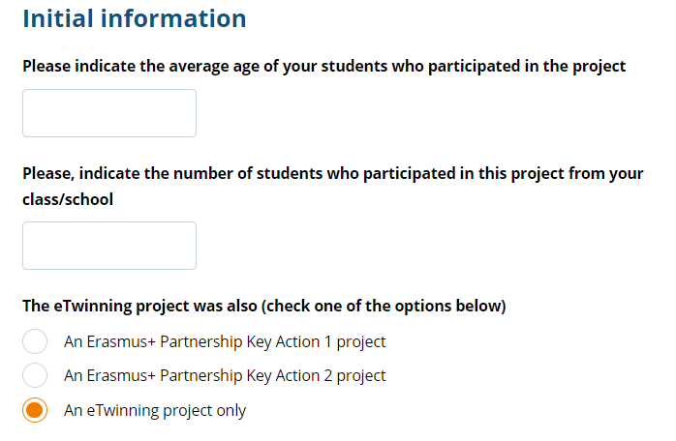
In the first question, write the age of your students in the project. In the second question, write how many students took part in the project. If you did the activities just with your class, write the number of class. If you included whole of your school or some of the students of your school, just write the average number of them.

Slide 3
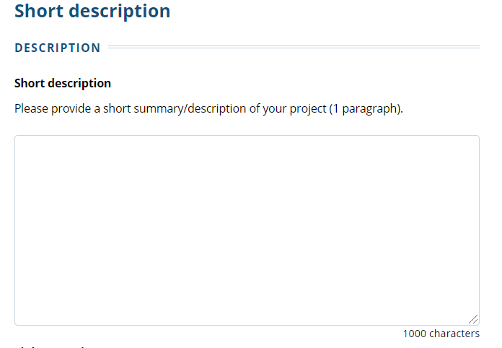
* Type the visitor username and password. With the visitor input to be created
by the project founder, NSS Evaluators will enter the project page and will see
your work concretely.
* What is your project about? With whom and how did you run your project? How
did you begin the project?
* What is your branch?
* How many countries have you run the project with participants?
* What are the results of your project? (generally)
* What are your common products?

Slide 4
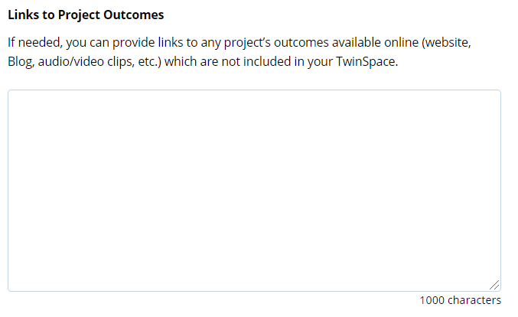
You should share all your links that are not in Twinspace here.
You can also share links below;
* Project twinspace page
* News links of our project
* Our project contact links
* Links to our project outputs
* Individual page links (padlets, etc.) you created for the project

Slide 5
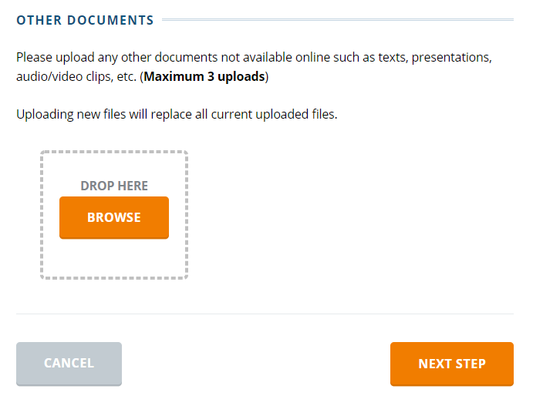
In this section, you can upload any document you prepared for the project.
For example, you can prepare your own project activities background and
upload it in the pdf format. It is not obligatory for you but if you can, it will
bring you bonus ☺

Slide 6
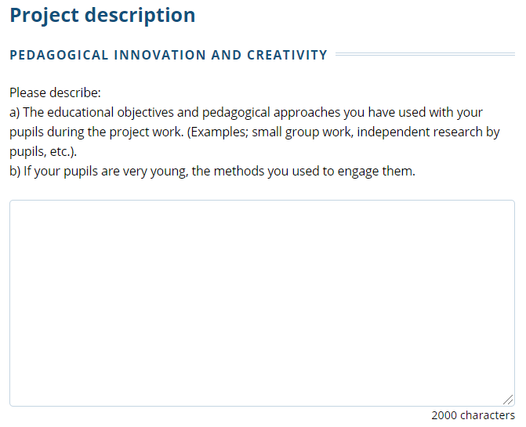
* What kind of innovative method did you use in your project? Have you used an original
method that others do not? Explain if you have creative works.
* Describe the age group and characteristics of your students.
* Was the project student-centered project? Have you registered students on Twinspace?
(Be sure to mention class and level situations)
* Did your students research and analyze? Did you give guidance while doing these?
* Do you have specific aspects of your project? (Give examples)
* Are your activities diverse? Did your students contact and work with partner schools in
these activities and did they come up with a common product?
* What learning methods did you use in the project?
* How did you attract your students?

Slide 7
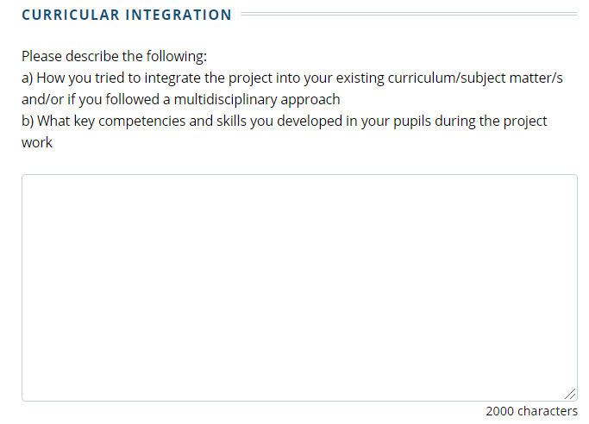
* How did you integrate your project activities with the curriculum? Which of your
activities were related to which gains?
* Is your project an interdisciplinary project? Did you carry out your project work in more
than one course?
* Where were the project activities carried out?
* What skills did your project develop?
* Have you been able to sustain your curriculum with the project?
* Were there activities related to the ability to use computers in your project? (Please
indicate the city and school conditions)
* Did you tell your students about the goals of the activities and made joint decisions?

Slide 8
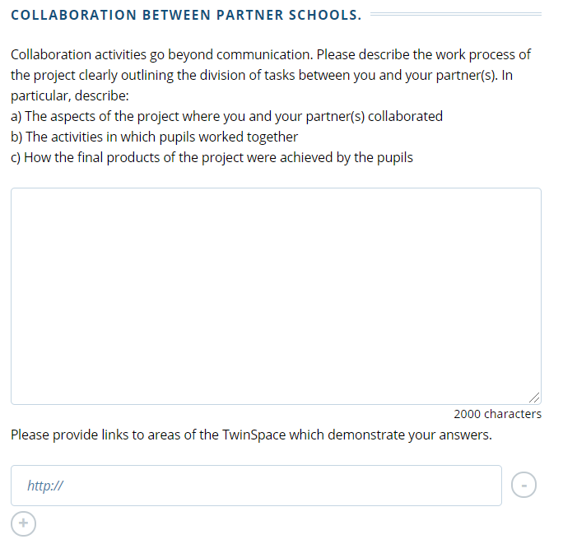
* All forms of communication with partners should be fully explained. (Twinmail, Twinspace, email, WhatsApp, facebook, blog ...)
* Was there communication between students? (webinars, twinspace ...)
* Have you actively used Twinspace forum? What is your students' contribution to the forum?
* Are your students registered on twinspace? Did they actively use it? Did they share their products on twinspace?
* Have online interviews been made?
* Does the project have collaborative products? Is it shared on Twinspace or other platforms?
* Is there a division of labor in the project? What tasks did you carry out?
* In which areas did you cooperate during the project?
* You can also talk about your project's joint work.
* In this section, also touch on your students' age group and school-environment physical conditions.
You can share the links here that pay attention to the collaboration.

Slide 9
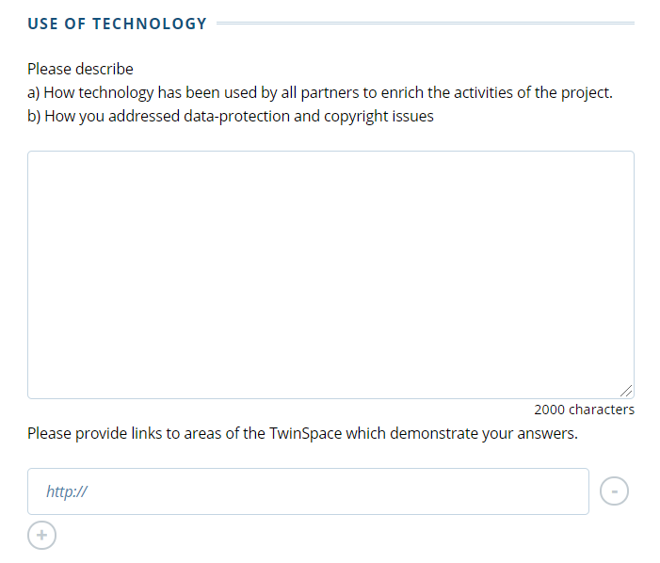
* You can especially mention your work on e-security. For example;
Faces are not clear,
- Permission of parents,
- Not to use copyrighted products.
*Which web2 tools or software did you use in your project? (Give examples.)
* In short, where and how did you use technology in your project?
* What did you do in the Safer Internet Day?
You can share the links here about the use of technology.

Slide 10
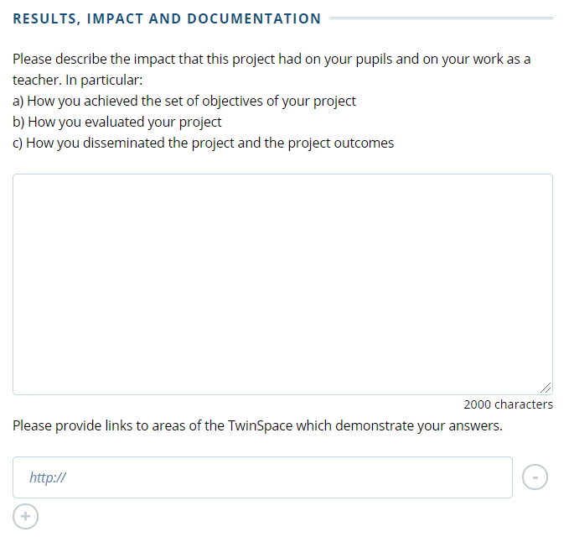
* What were the results and effects of the project? What did the project add to your students?
* What impact did the project have on co-teachers and students?
* Have joint evaluations been made for teachers and students at the end of the project?
* Are the project results visible? Have evaluation results been published online? (For example, conducting assessment surveys, studies where students express their opinions and forum pages etc.)
* Are there any unseen project results? For example; Did it have an impact on knowledge and skills or social or larger communities?
* Have you made the dissemination studies?
* Have the targets been reached?
* Did joining the project benefit you, your students and your school?
* What is the most beneficial result of the project for you?

Slide 11
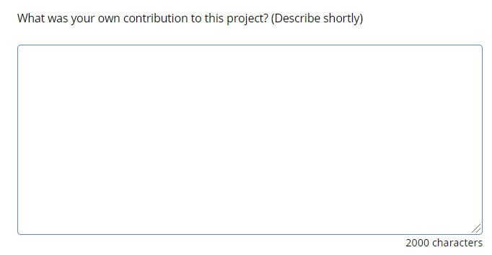
In this section, you will write what you did in the project.

Slide 12
CHECKLIST
Do you have a collaborative and common work?
Is Twinspace regular?
Are your studies complete?
Have you associated a project with the curriculum?
Did your project take place in a flow?
Have students contributed in the forums?
Are there simultaneous studies?
Have you applied the principles of safety?
Have you evaluated and published the survey results?
Is there a task distribution list in twinspace?
Have you shared dissemination links?
Have you done webinars? (At least two webinars are recommended)
Do you have a project plan?
Are the activities student-centered? Are the photos of the students loaded on twinspace while they are at work?
Do you have a blog and social media page?
Were different web2 tools used in the activities?
Did you pay attention to copyrights?
Do you have any contribution in the project?
Did you fill in your application text yourself? (Should be individual)
Did you mention your achievements in the application text?

Slide 13
Thank you ☺
Çağrı DERE

