Slide 1
4 IN 1
LAST SURVEY FOR PARENTS
BY Jelena Vukičević , Oš Vrpolje
June, 2021.

Slide 2
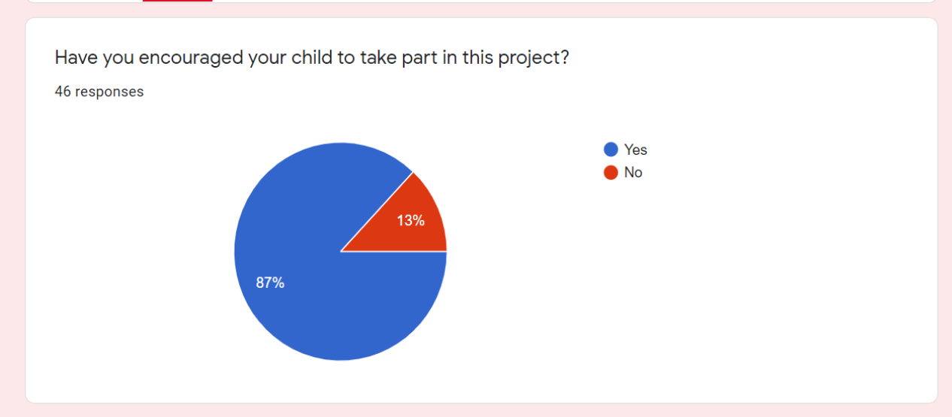
87 percent of parents support their children in participating in project by encouraging them to take part in the project, whereas only 13 percent of the parents do not encourage their children.

Slide 3
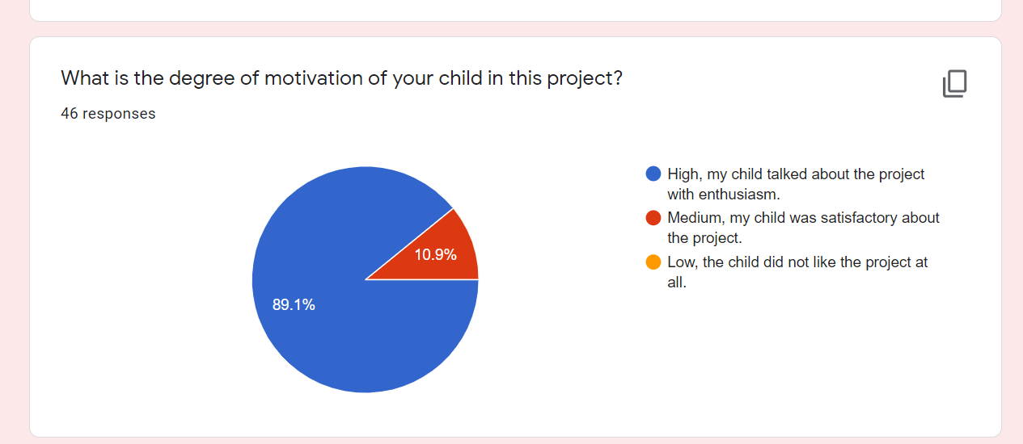

Slide 4
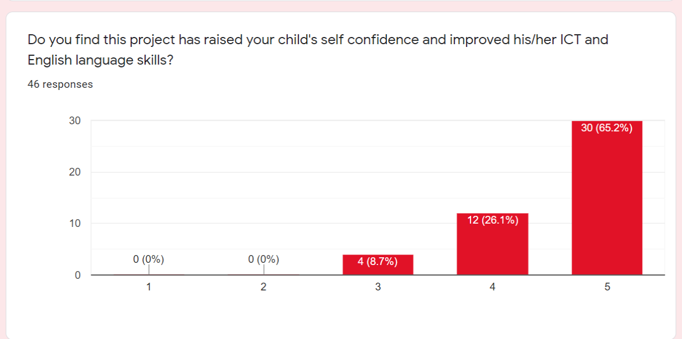

Slide 5
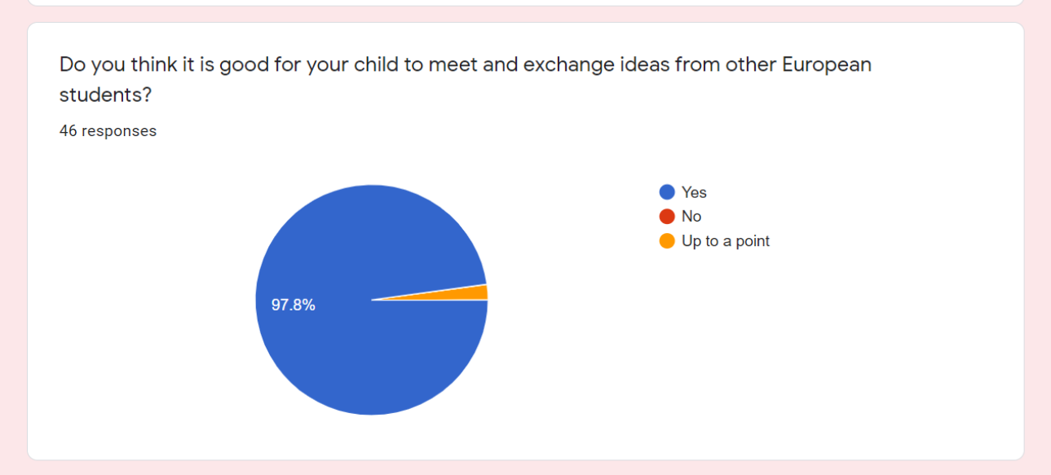

Slide 6
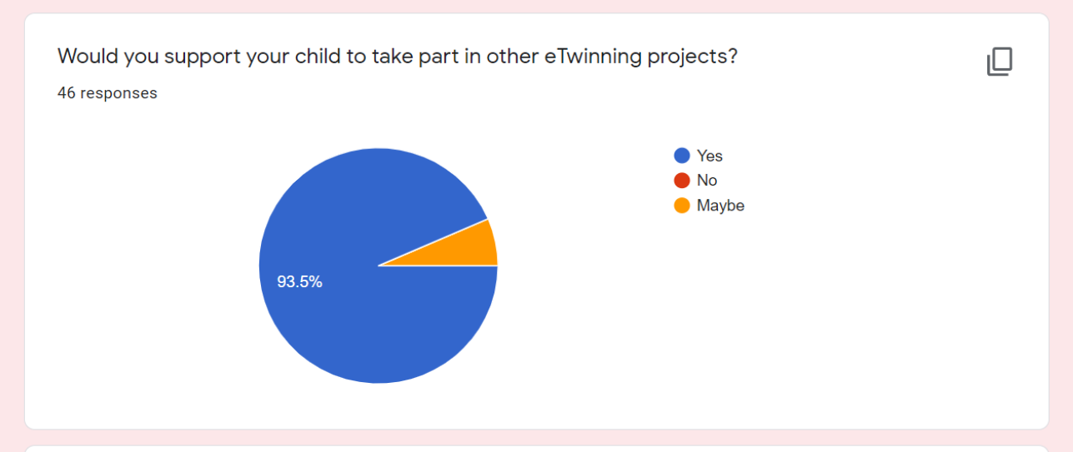

Slide 7
