Slide 1
An Old Finnish Tale:
A Fool’s Trade

Slide 2
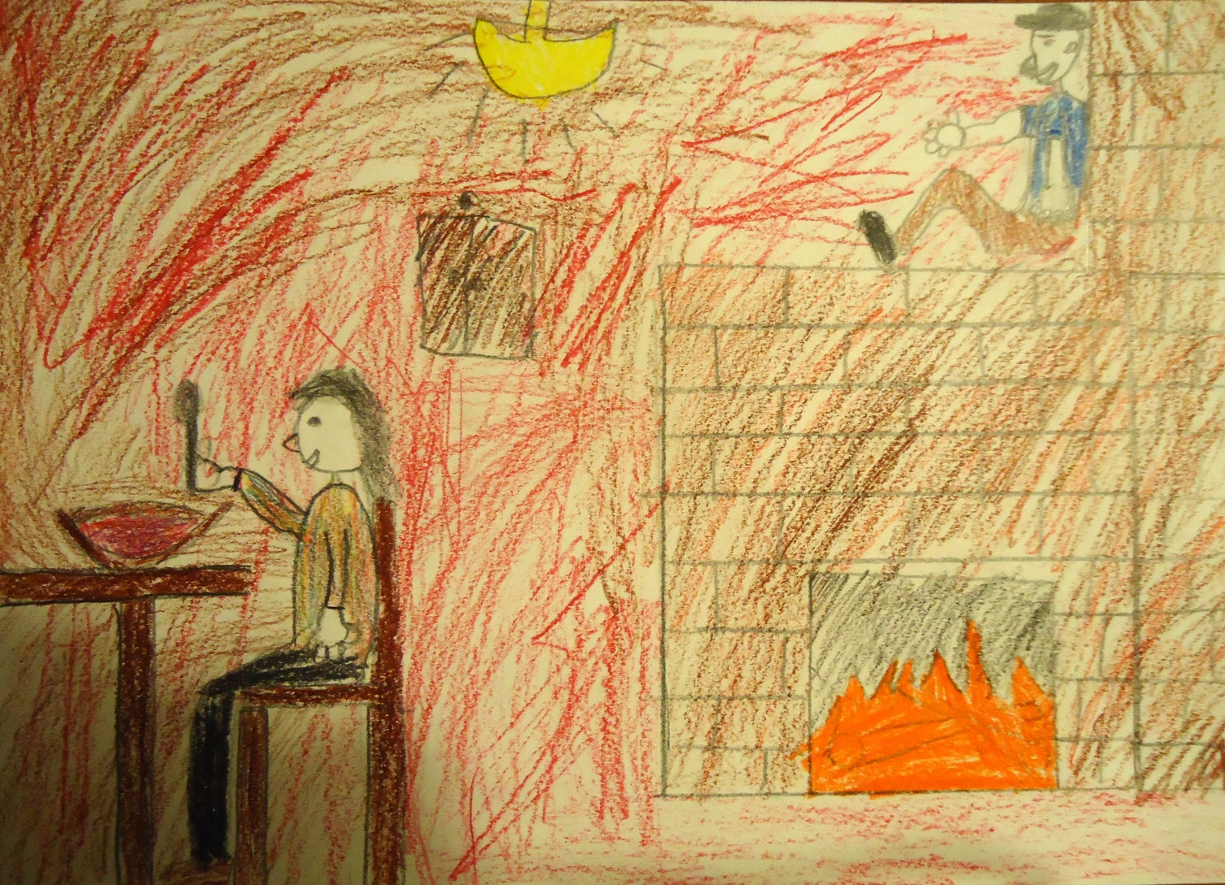
The Fool’s wife was worried about her husband who pondered all day long on the top of the furnace.

Slide 3
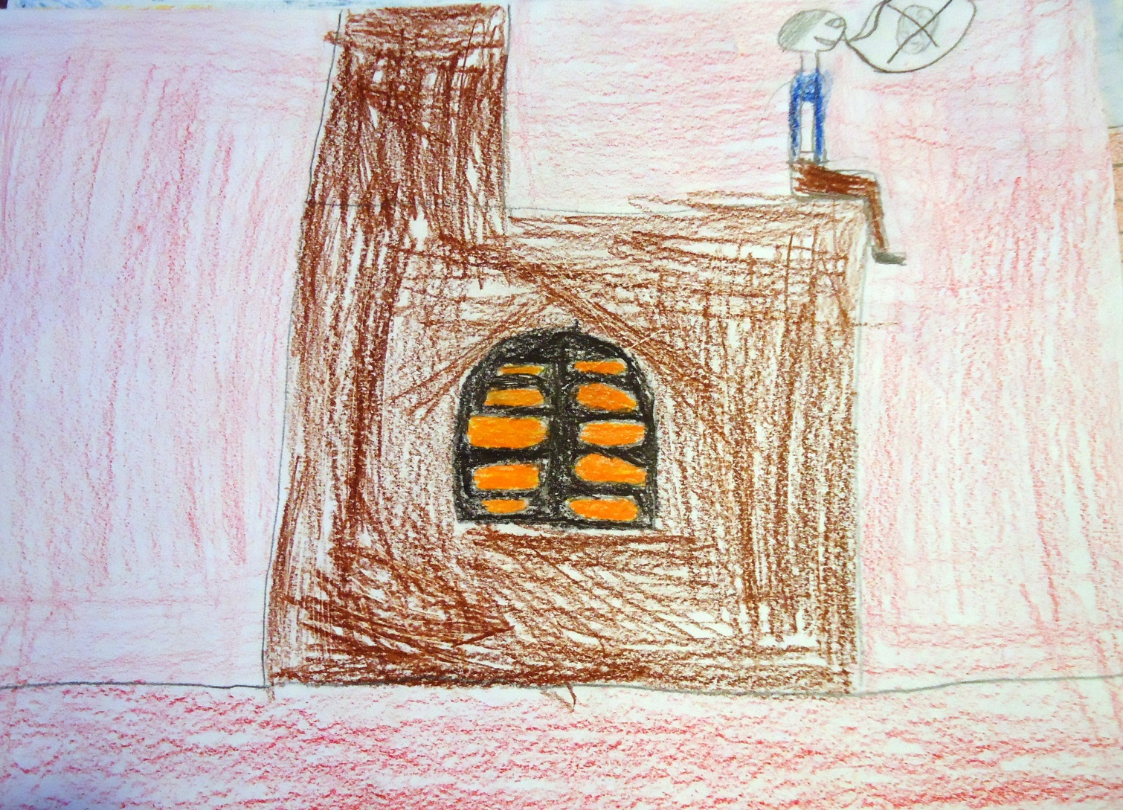
At last the Fool had pondered enough and stated that they were out of hay and had nothing to feed the horse.

Slide 4
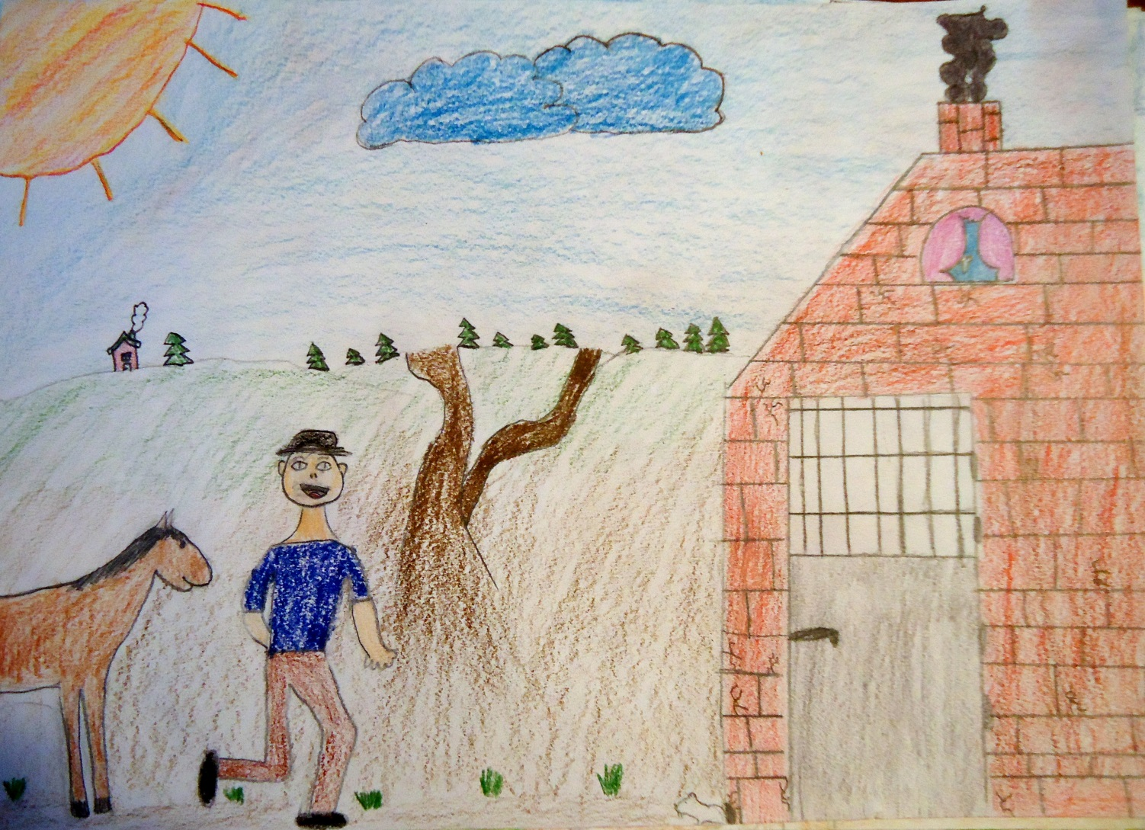
He said: ”The smartest thing to do, is to sell the horse and buy hay. Without hay the horse is going to die”.

Slide 5
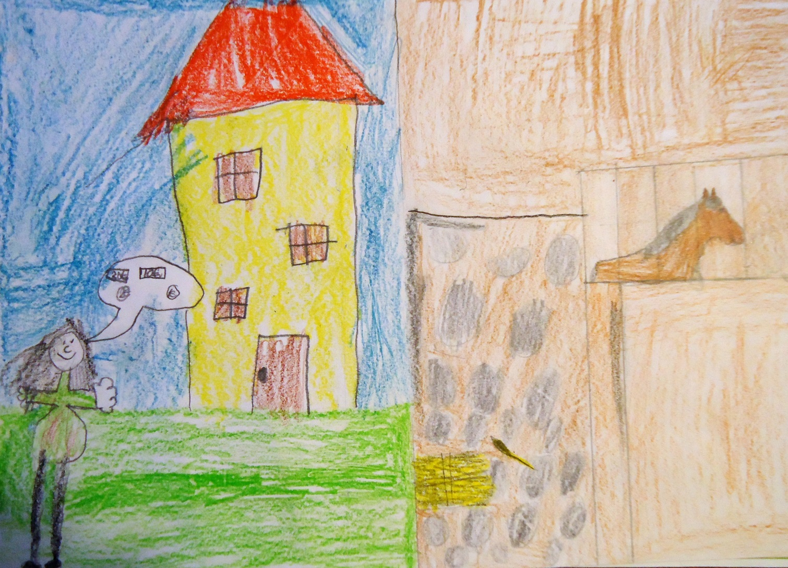
The Fools wife became happy and said:”You’re right. You always understand everything better than the others”.

Slide 6
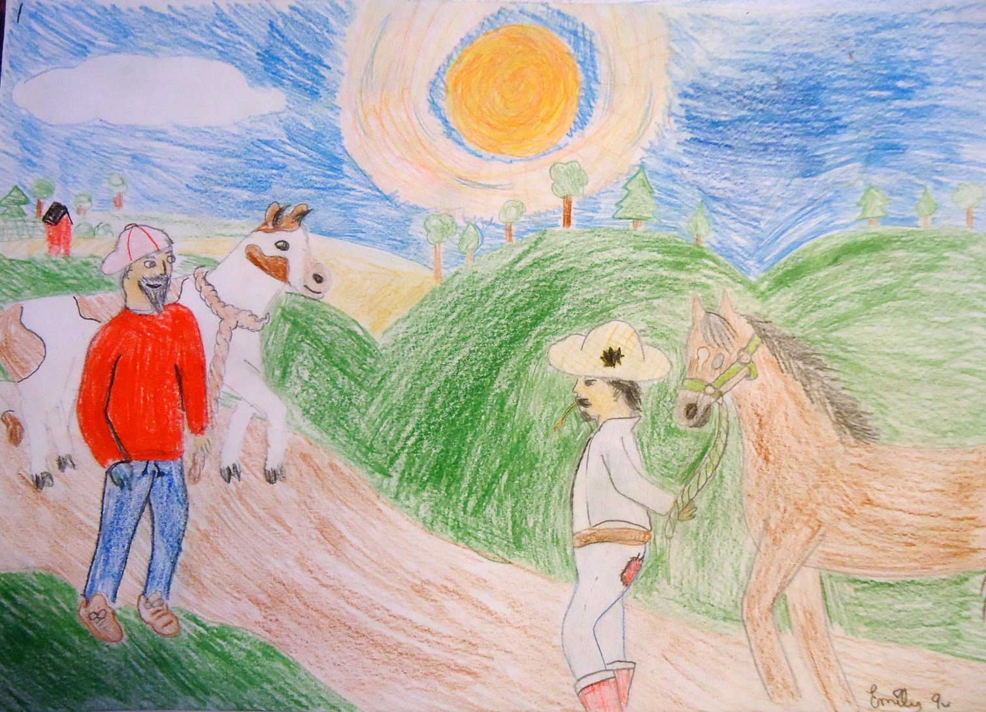
The Fool headed for the market. After a while he came across a man with a cow.

Slide 7
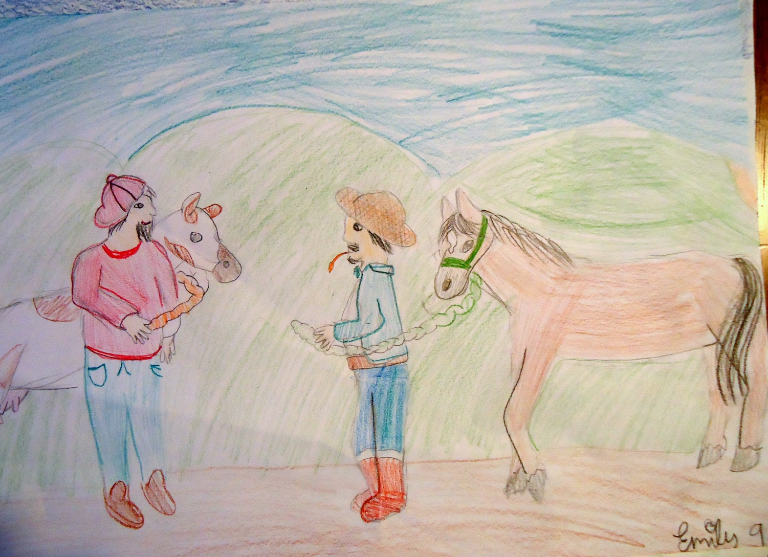
The Fool said:”Exchange your cow to my horse. I have no hay so I can’t keep my horse”.

Slide 8
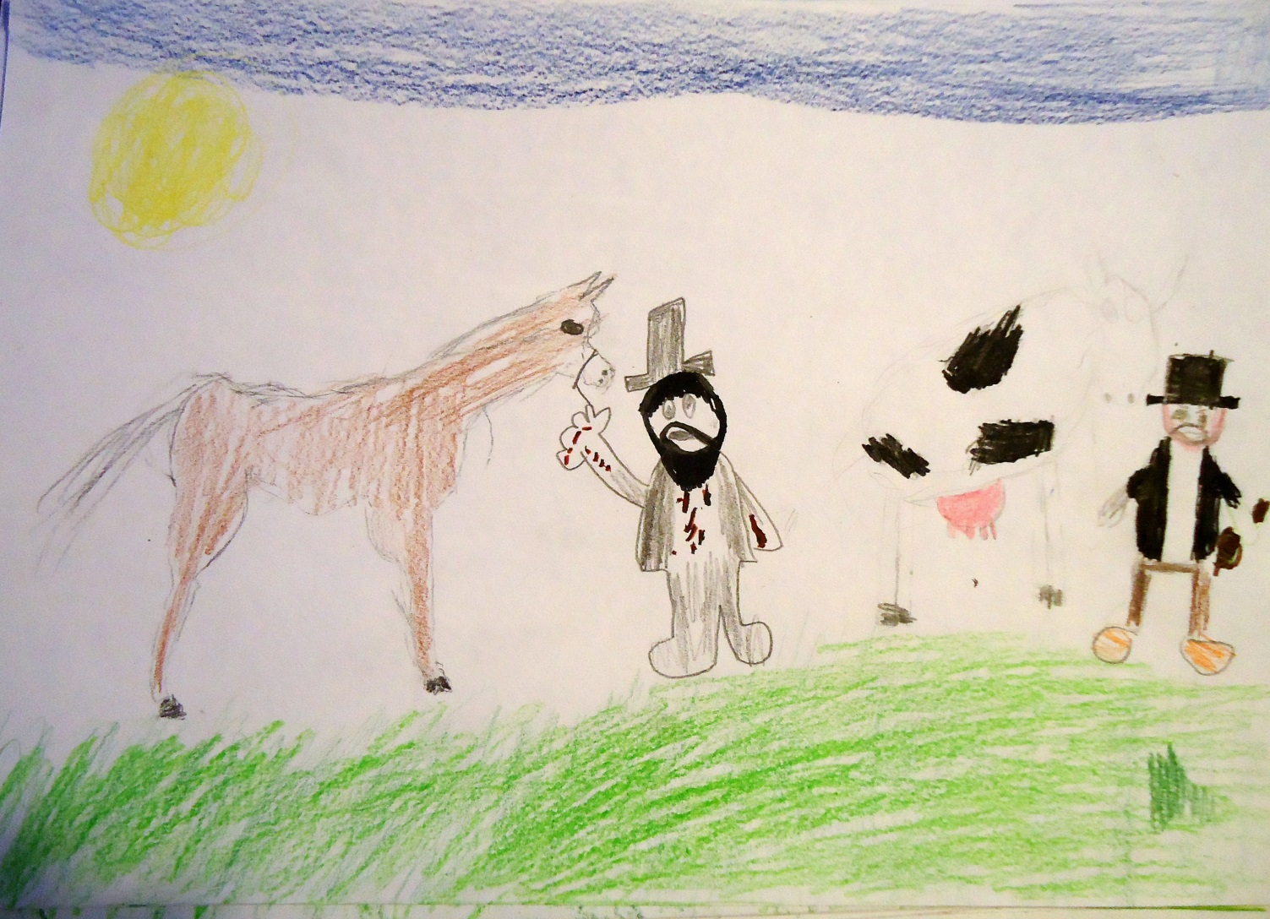
The strange man agreed with the offer, of course, and so the animals got new owners.

Slide 9
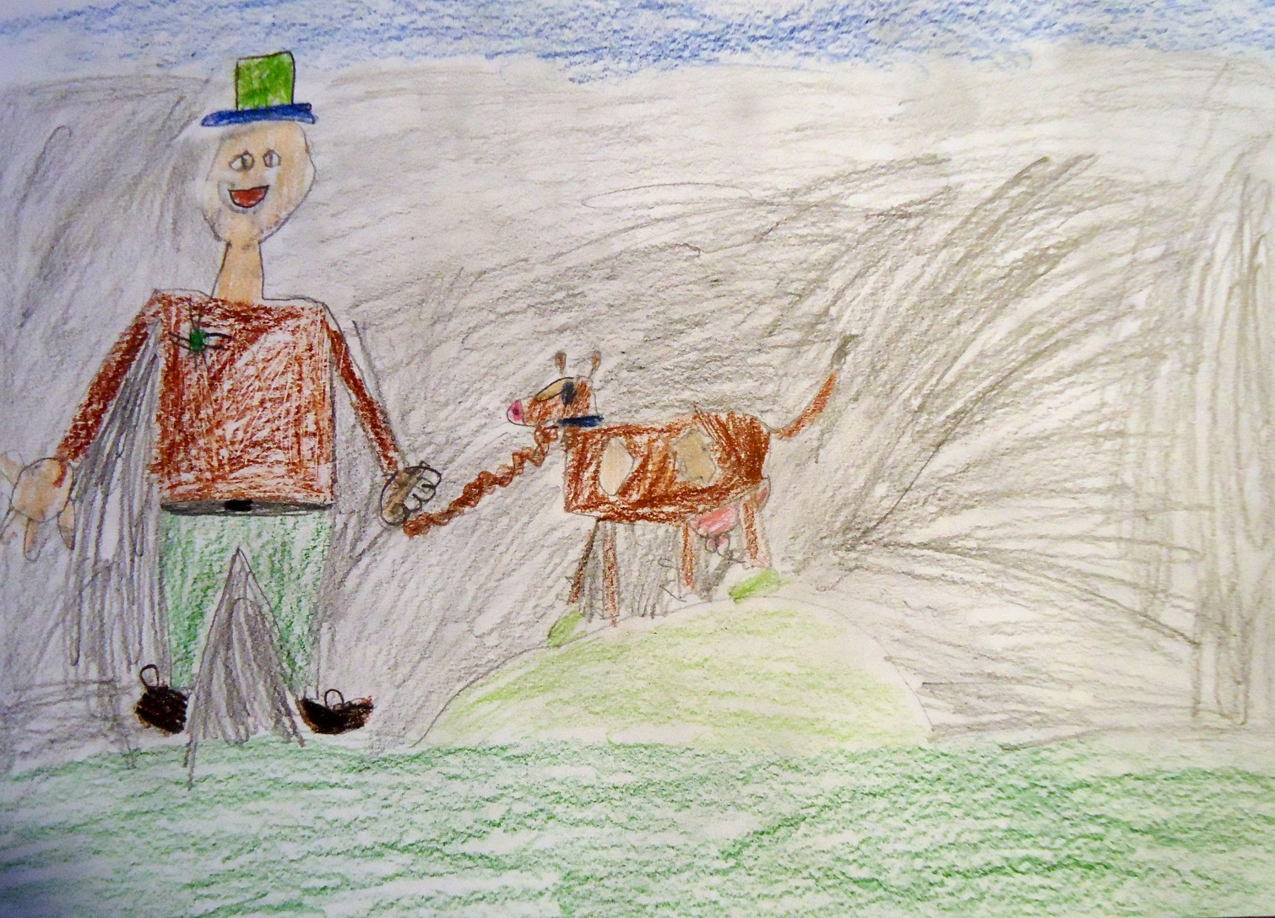
The Fool thought:”Oh, how happy my wife will be now when I bring home this cow to milk”.

Slide 10
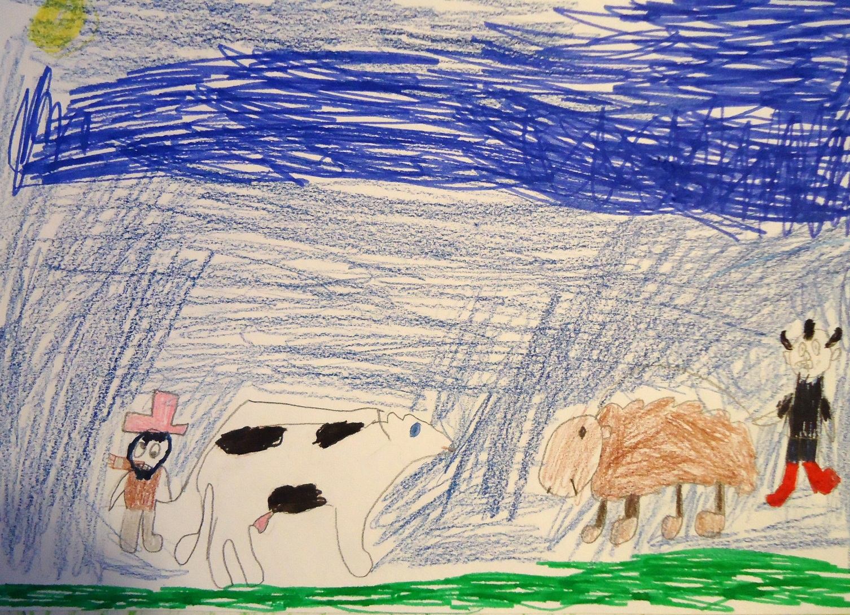
Not long after this, the Fool came across with another stranger, this time with a sheep.

Slide 11
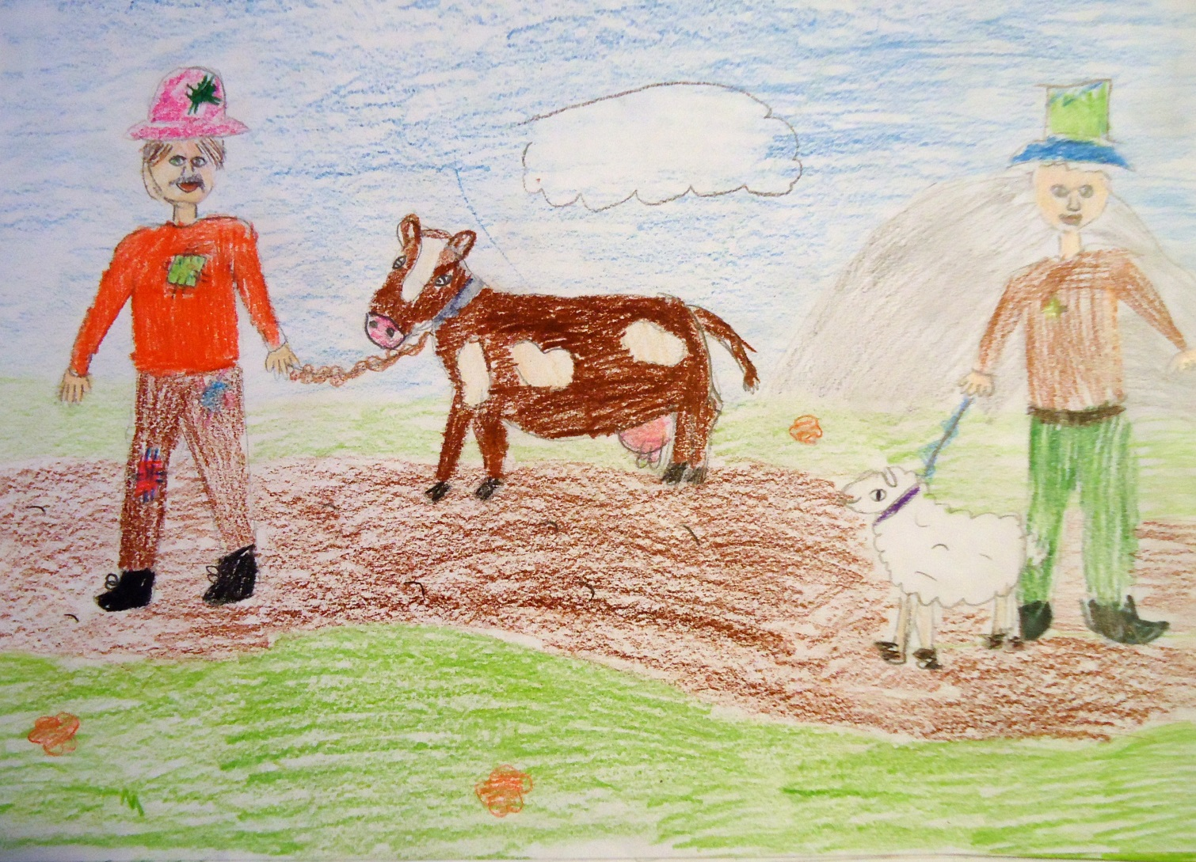
Again, the Fool propesed an exchange:”Exchange your sheep to my cow. I have no hay to feed to my cow”. The stranger agreed.

Slide 12
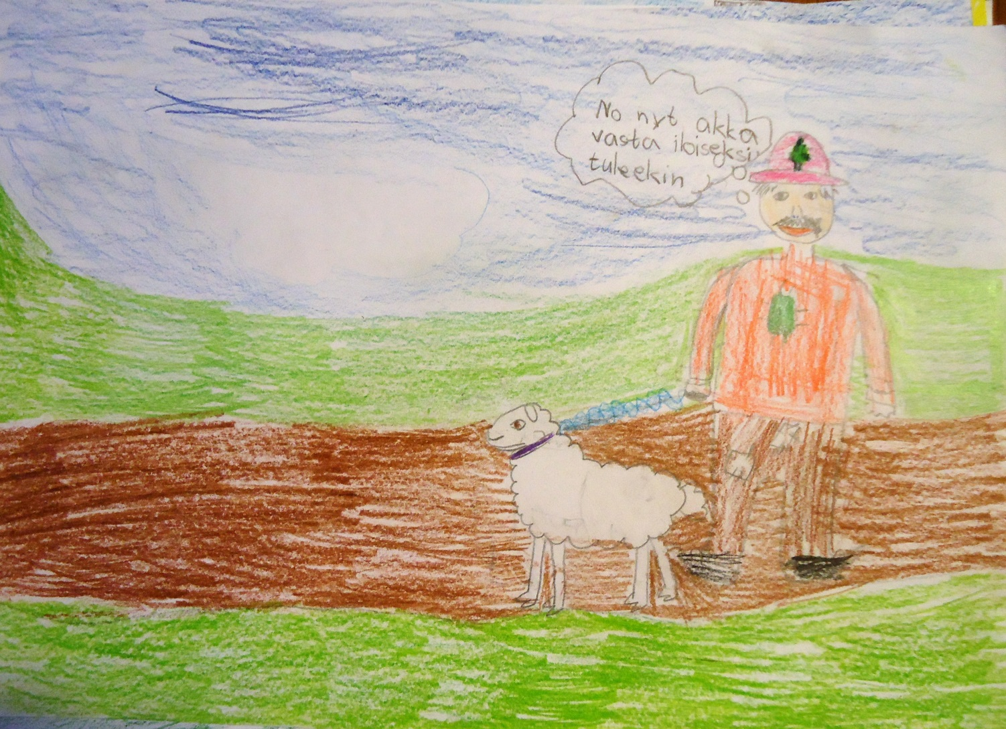
The Fool thought:”Now my wife is going to be really happy..

Slide 13
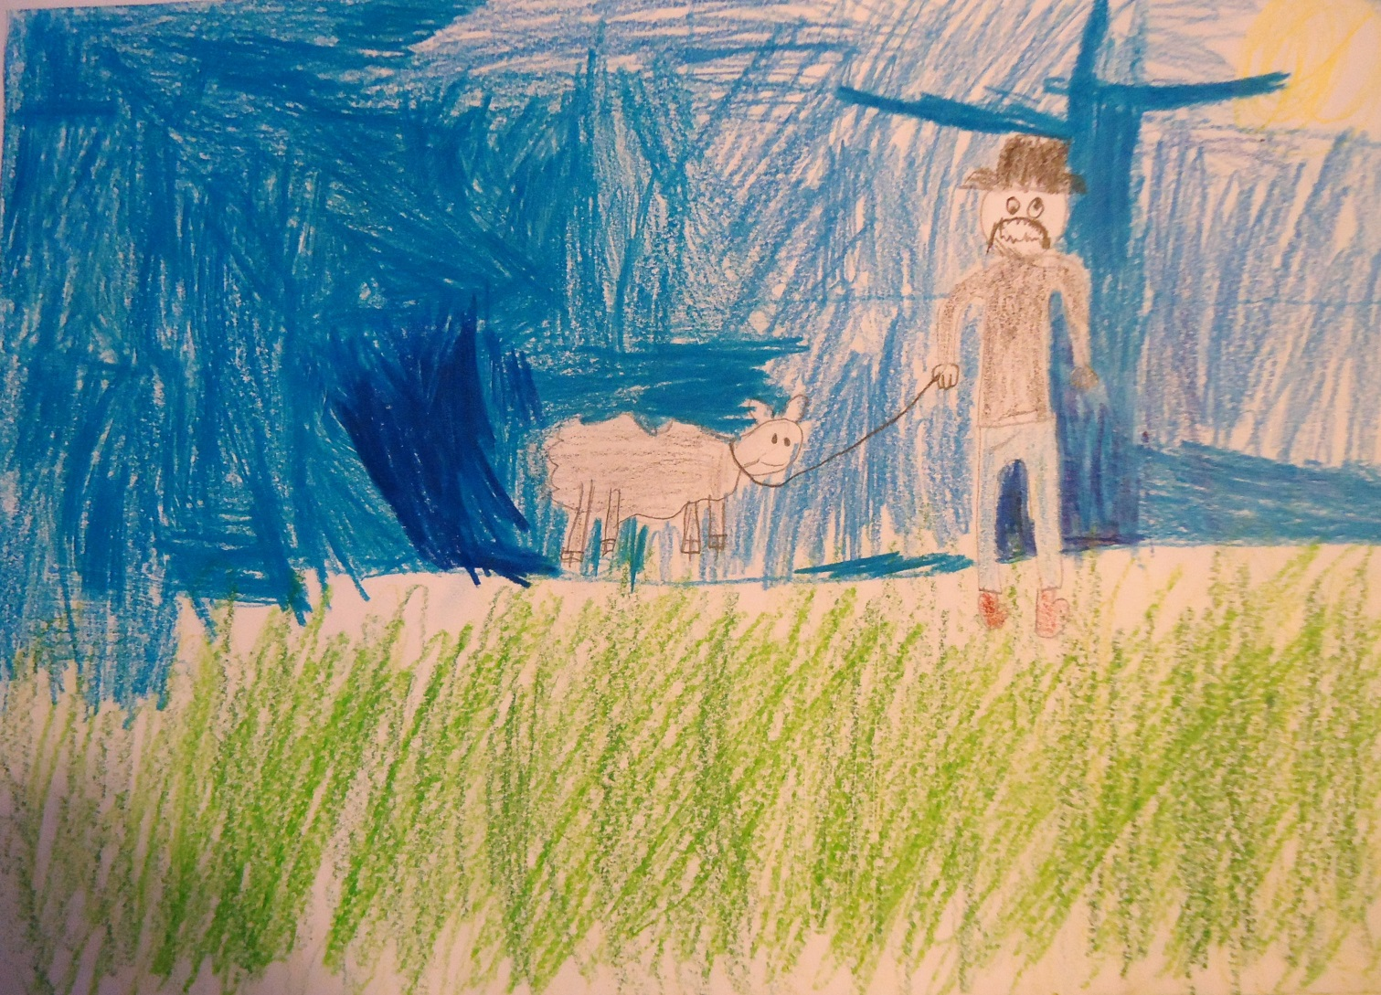
..We can get wool from the sheep and make thread”.

Slide 14
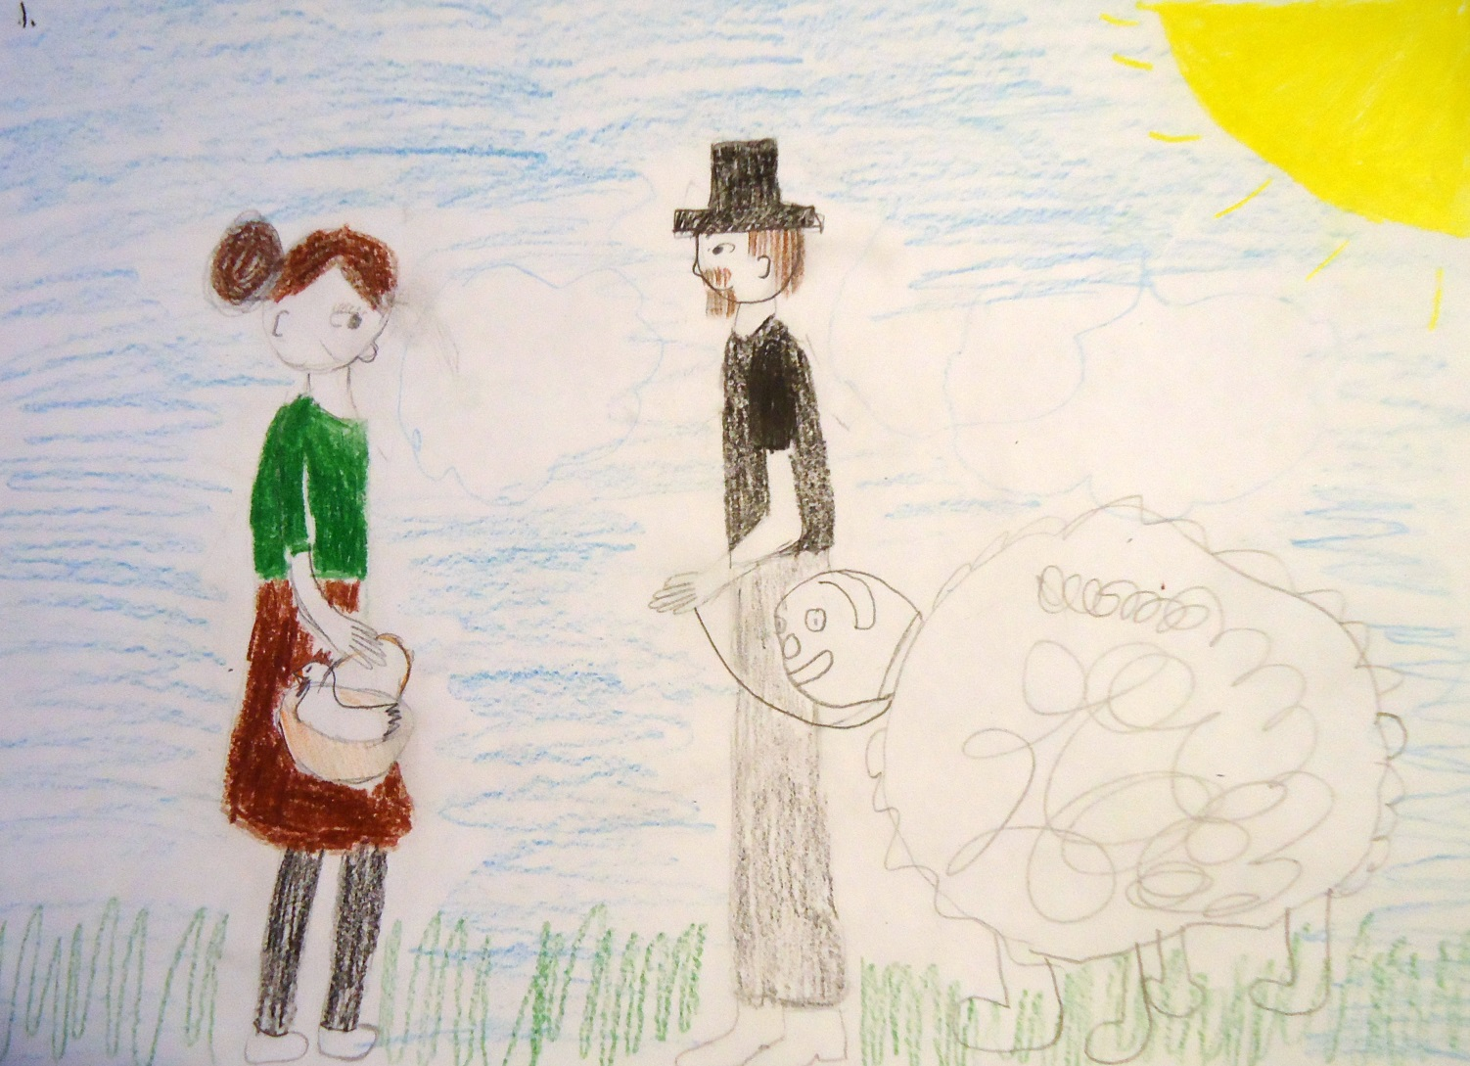
Next the Fool came across a woman with a chicken in her basket.

Slide 15
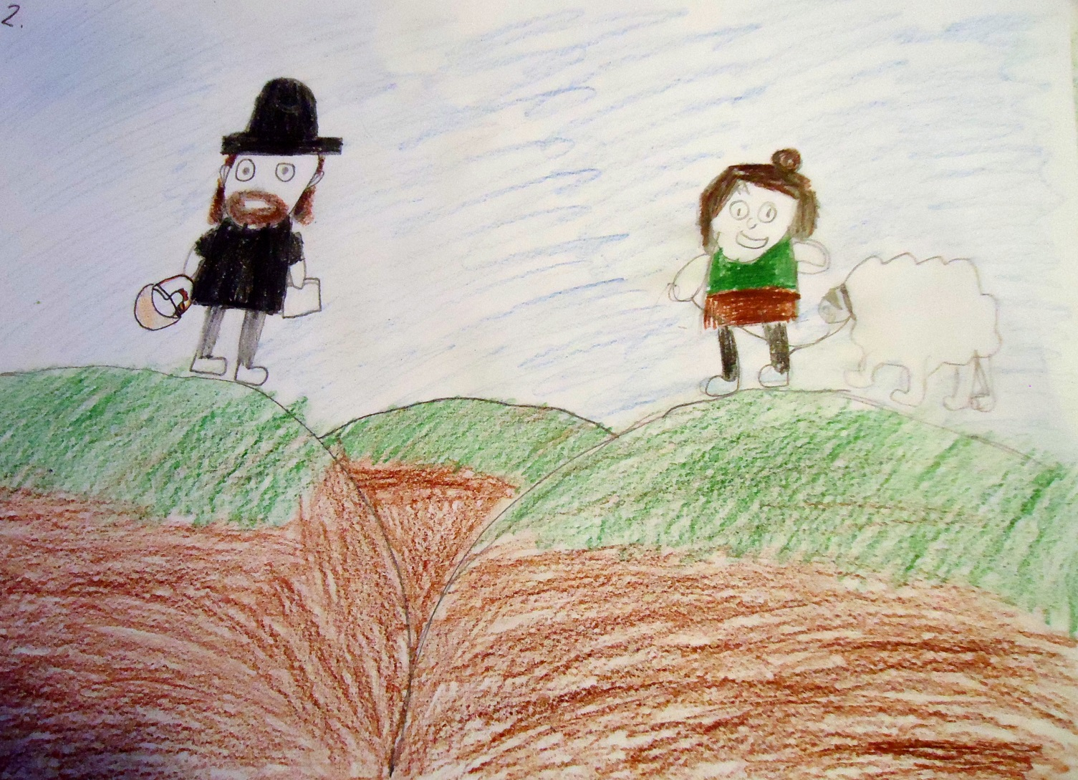
The Fool made an offer:”Exchange your chicken to my sheep. I have on hay to feed my sheep”.

Slide 16
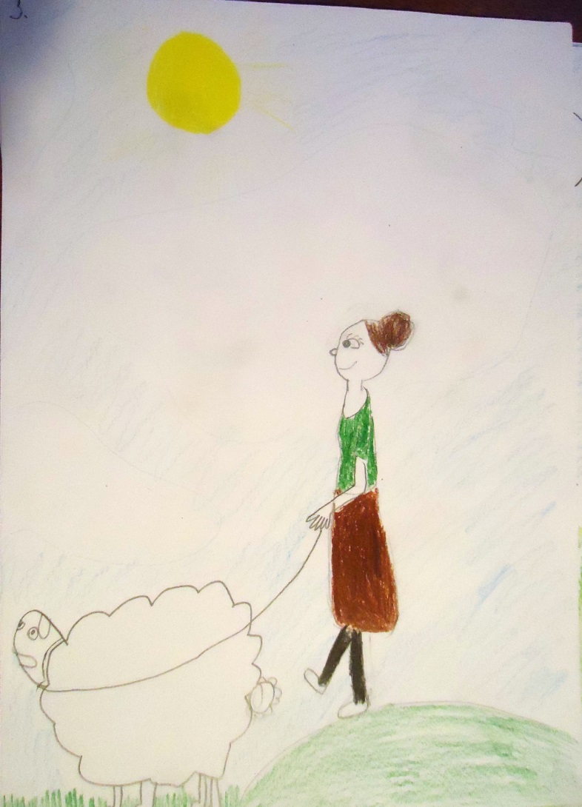
The woman immediately agreed.

Slide 17
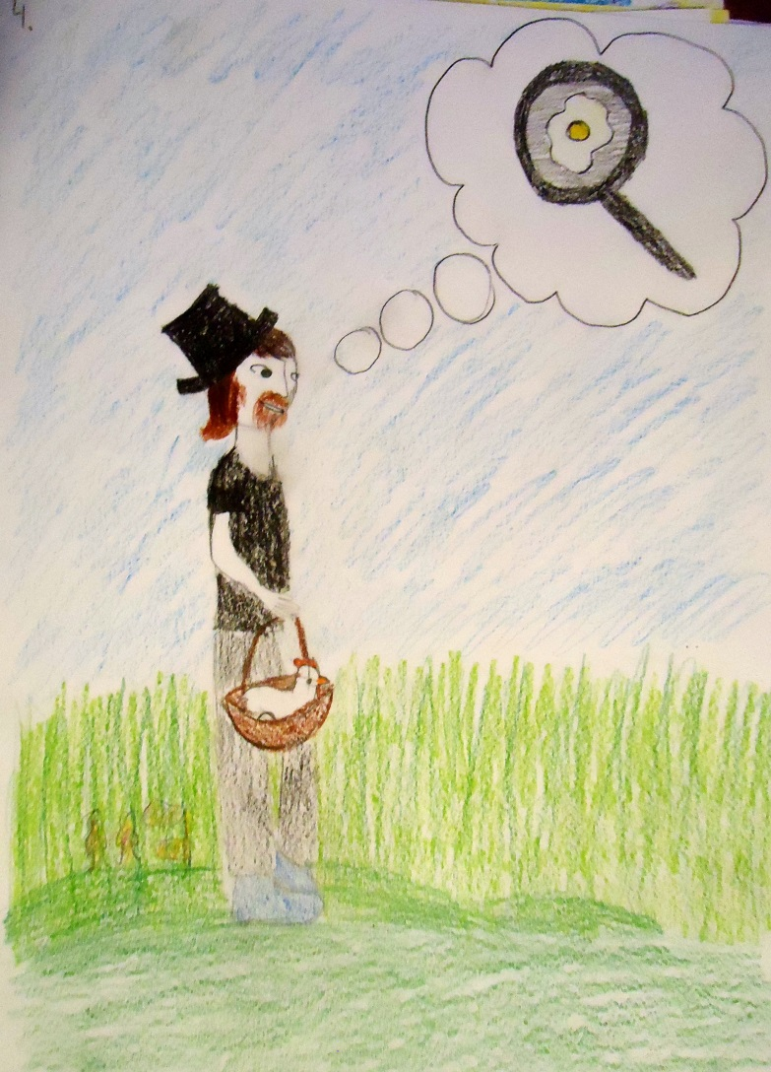
The Fool thought:”My wife is going to be so happy about the chicken; she can use the eggs for cooking”.

Slide 18
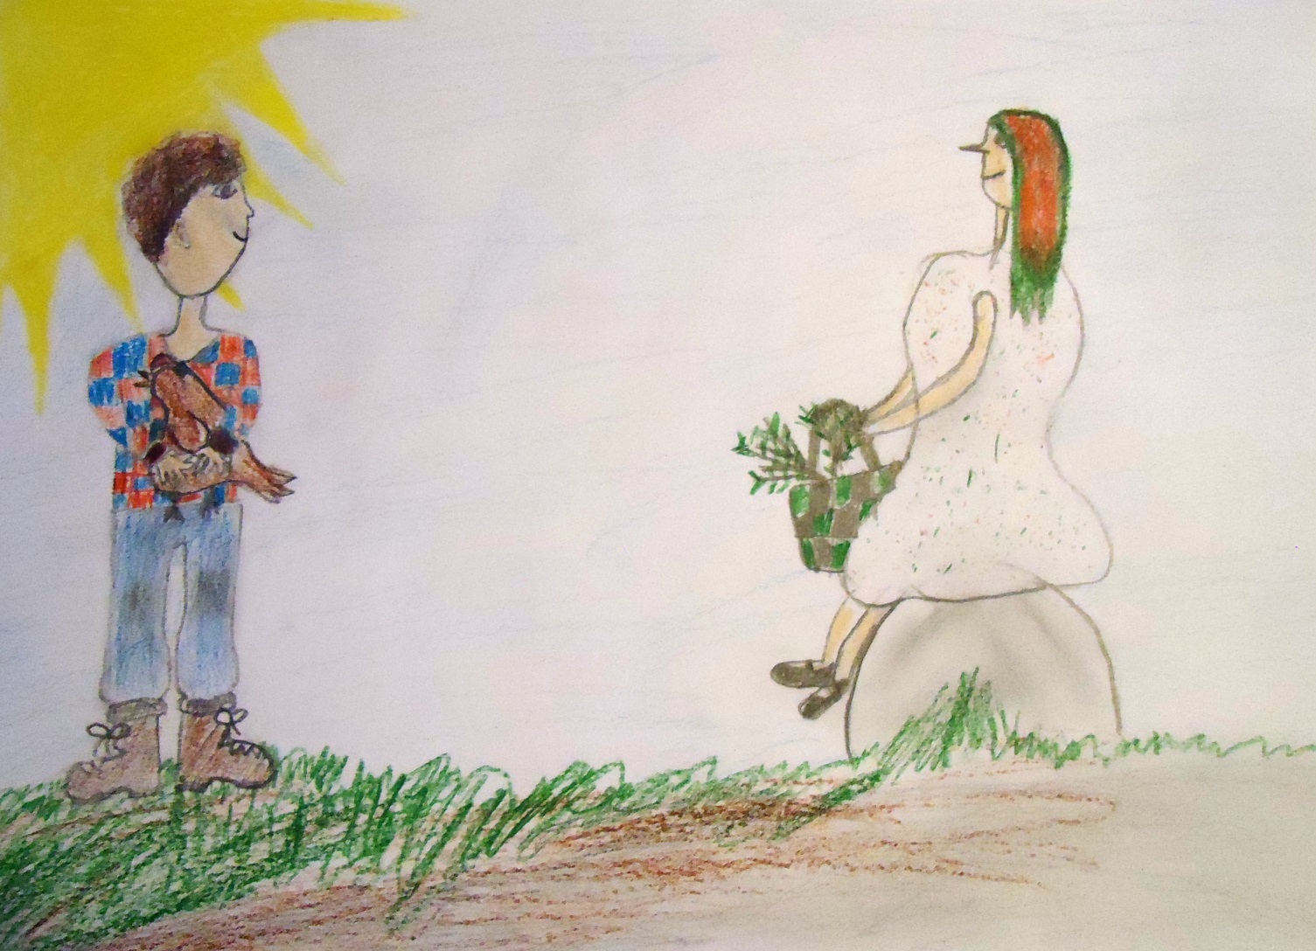
The Fool came across an old lady with birch whisks used in the sauna.

Slide 19
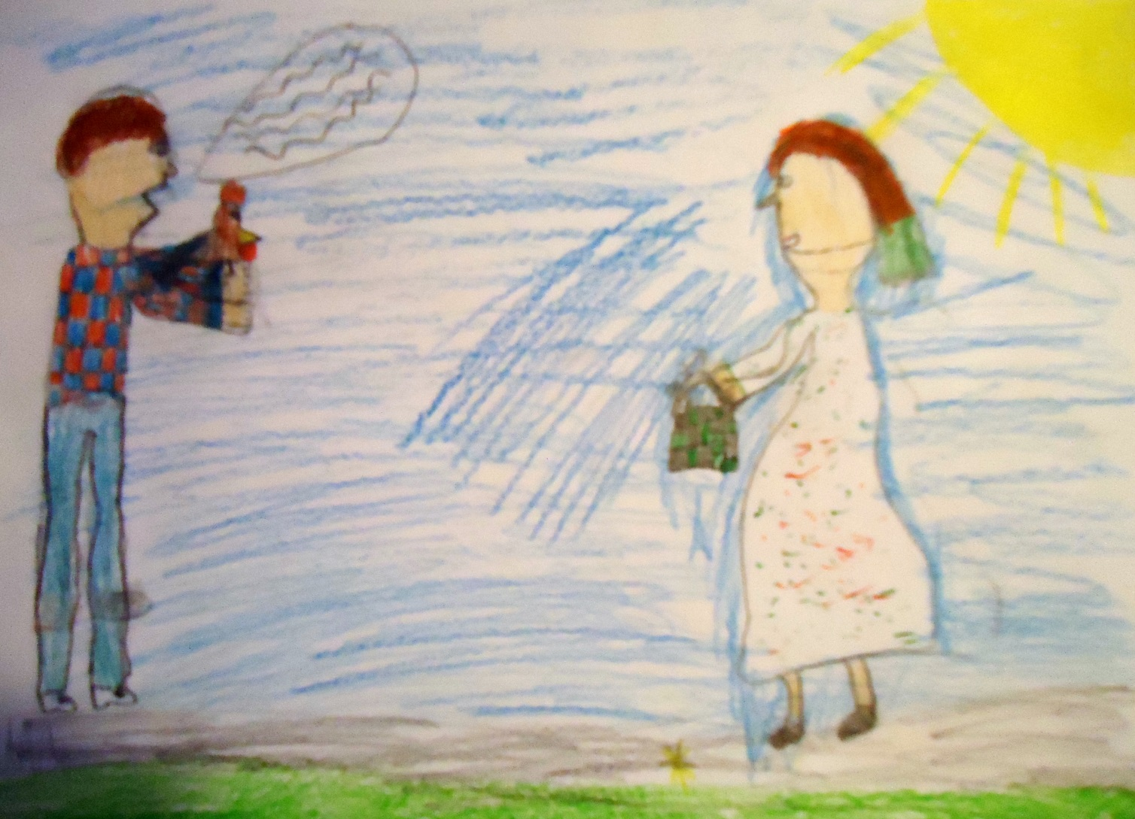
The man offered his chicken for few whisks, because he didn’t have hay to feed the chicken. The old lady agreed, as every one would.

Slide 20
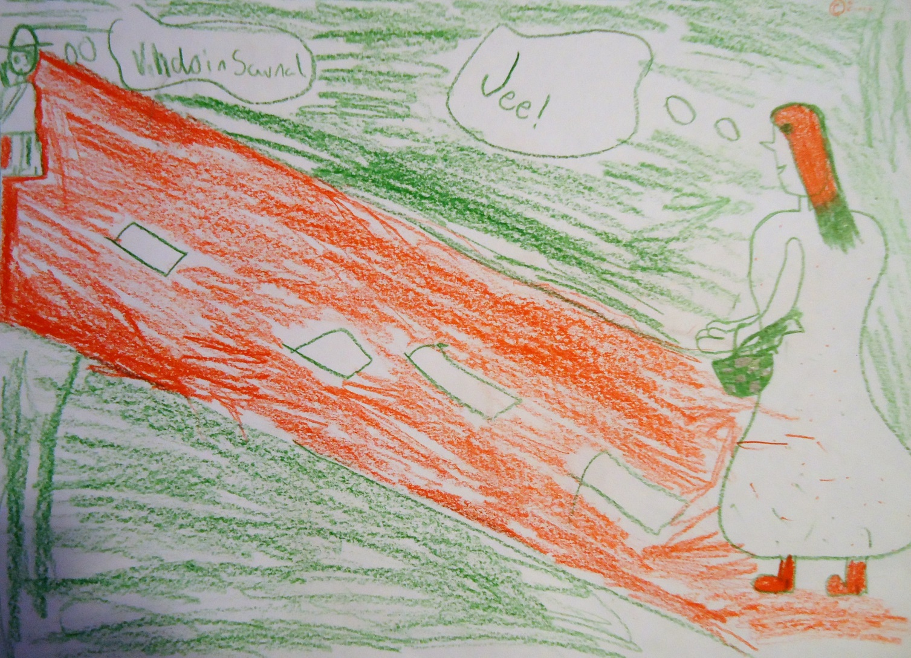
Both the Fool and the old lady were happy about the trade.

Slide 21
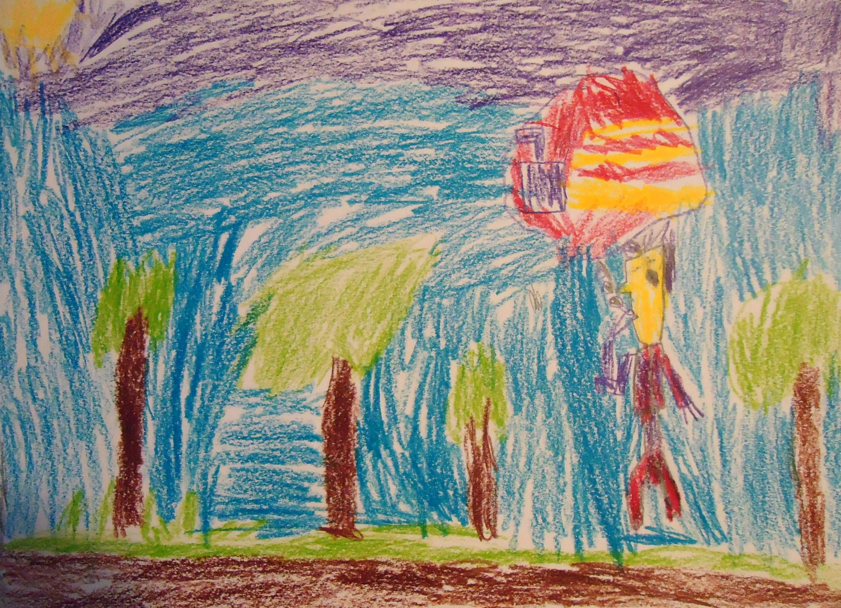
The Fool was sure that his wife would be happier than ever: now they could enjoy bathing in the sauna.

Slide 22
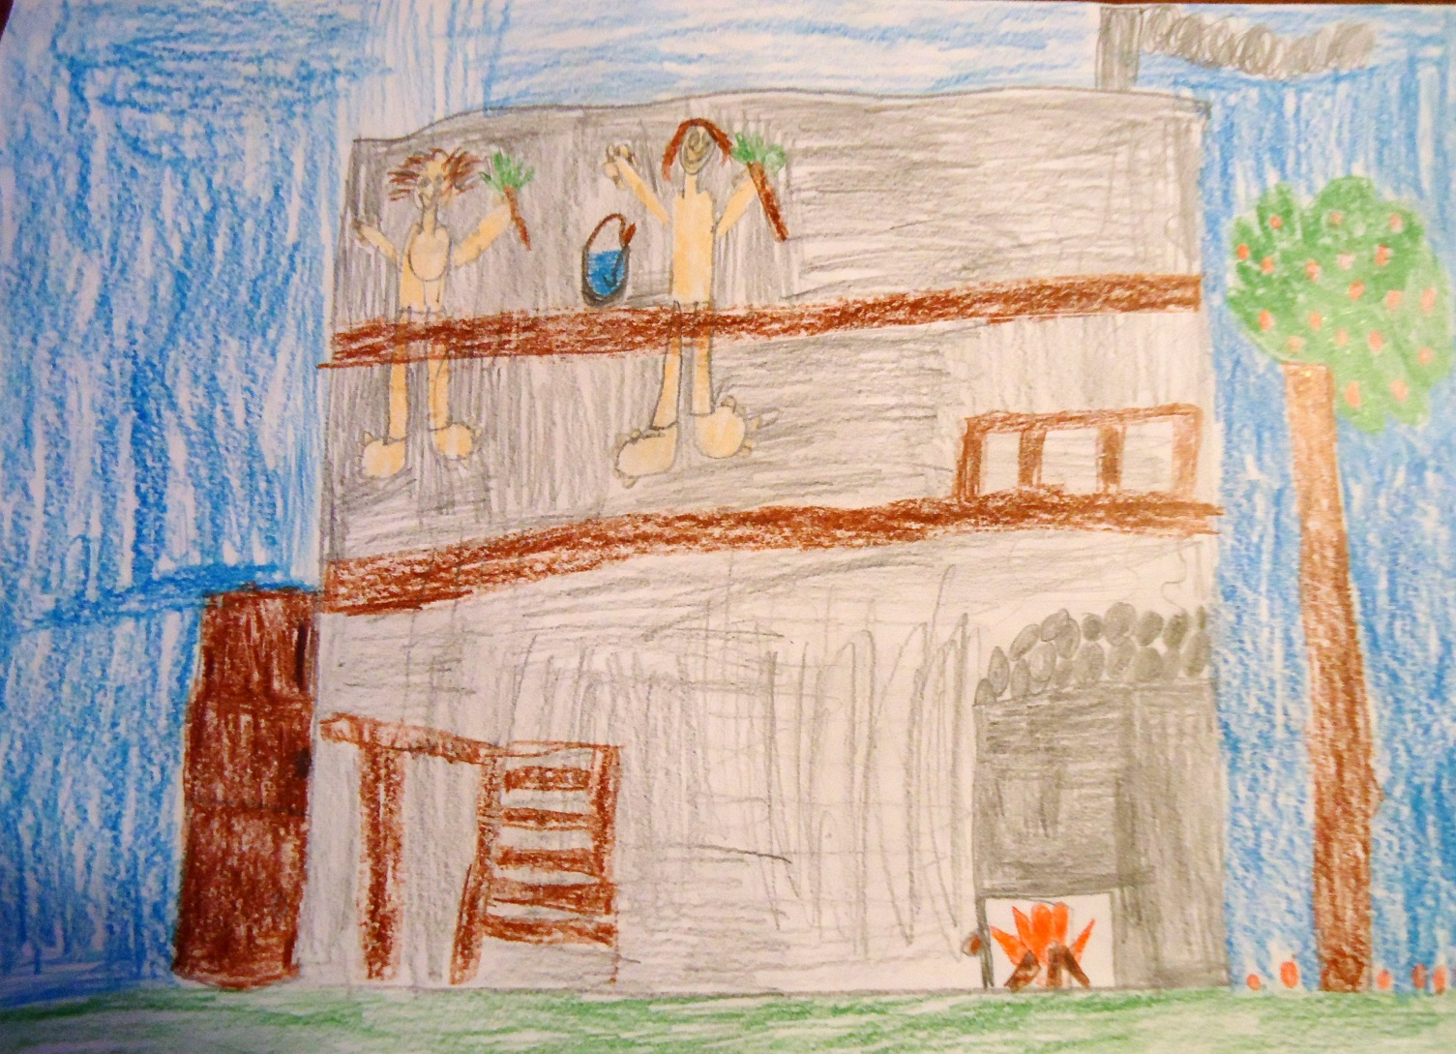
Even if the Fool ended up trading his horse to two birch whisks, both he and his wife were happy in the end, relaxing in the sauna.

