Slide 1

YETDKA - 2nd PROJECT DAY
VALENTIN VODNIK PRIMARY SCHOOL , JANUARY 2021

Slide 2
MEDIA LITERACY
After the questionnaire on media literacy in our school we did some planning of a tool, that could be used as an activity in different subjects with the goal of raising media literacy awareness among pupils and would serve as a guideline for the teachers.

Slide 3

Guide-book – our suggestion
We could turn all the activities of the 2nd project day into tools and share them for trial in partner schools to get feedback.
We could create new universal tools for medial literacy learning tools for each project day.
We could collect the most useful tools and display them on a website. We create the website for our tools.
At the end of the project we have an on-line guide-book and thus achieve one of our planned goals.

Slide 4

OUR TOOL
We created two tools we will present later on.
We implemented formative assessment as we included our pupils in the planning and evaluating of the tool.
We tried the tools in English, Maths, IT and Chemistry.

Slide 5
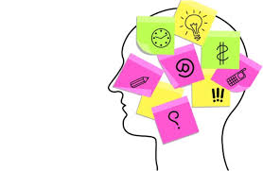
RESULTS – teacher‘s point of view
By using the tools pupils gained information about media literacy, about reliable and unreliable sources, exchanged knowledge, planned strategies for becoming critical receivers of information, they practiced critical thinking and their motivation was improved.

Slide 6

FEEDBACK FROM PUPILS
The feedback from the pupils was very positive. They enjoyed the activities. They said they had fun and the activities rose their level of motivation. They feel they also gained new knowledge about school matter or spread their general knowledge as well as gained information about reliable sources.

Slide 7
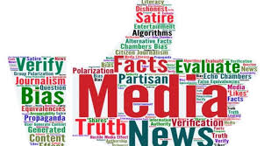
YETDKA, KEEP UP THE GOOD WORK!

Slide 8
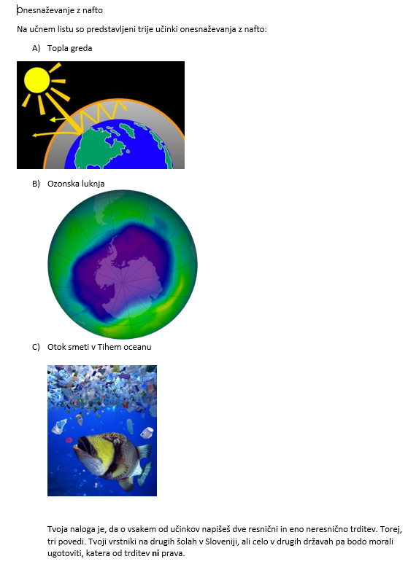
1st activity – cemistry
Individualy reshearched about oil pollution
Activity: distinguishing fact from fiction
Based on 3 topisc, pupils had to prepare 2 facts and 1 fiction
Topics: The greenhouse effect, the Ozone hole and the Great Pacific Garbage Patch
Discusion

Slide 9
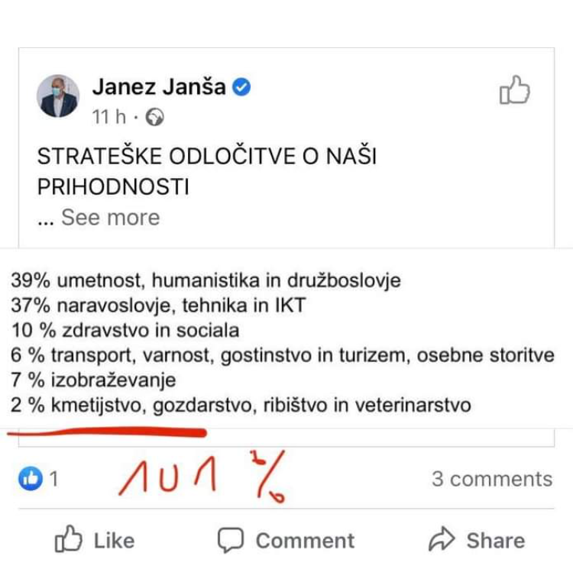
2nd activity - math
7th grade
Presentation of governmental decisions about our future, presented with percentages.
Are the data correct?
What is the problem?
How to begin the research?
Reliable sources?

