Slide 1
My Media Idols
The social networks that I follow the most are Instagram and YouTube.My favourite youtuber is also the most popular one on that platform, Felix Kjellberg.

Slide 2
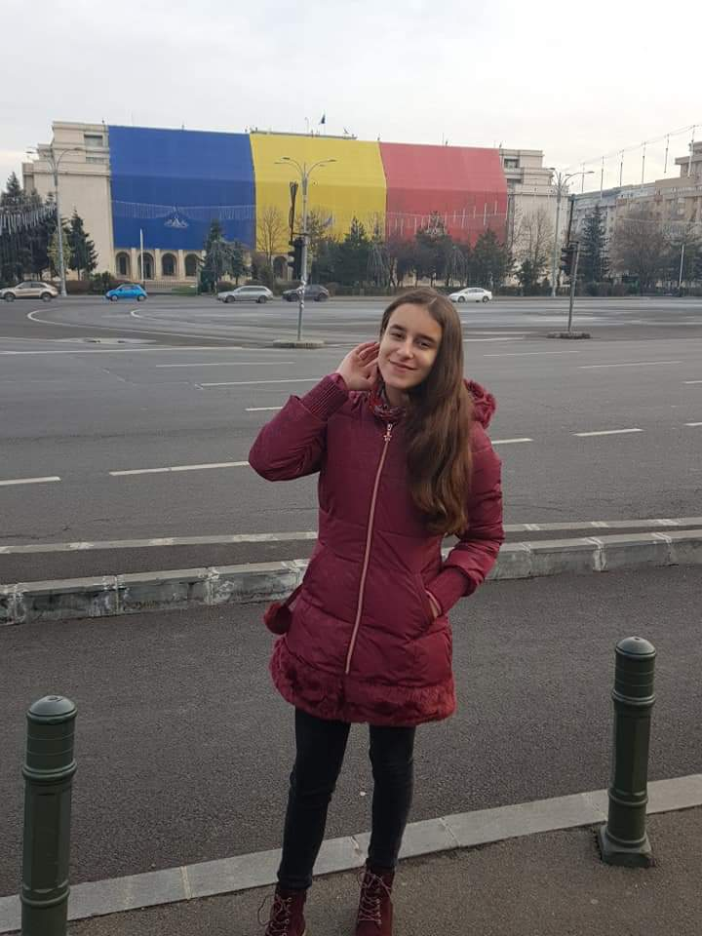
My name is Zarnoianu Ana-Maria, I am 14 years old. I am a student in 8-th grade and I study at Secondary School Number 5 Alexandria, Romania.

Slide 3
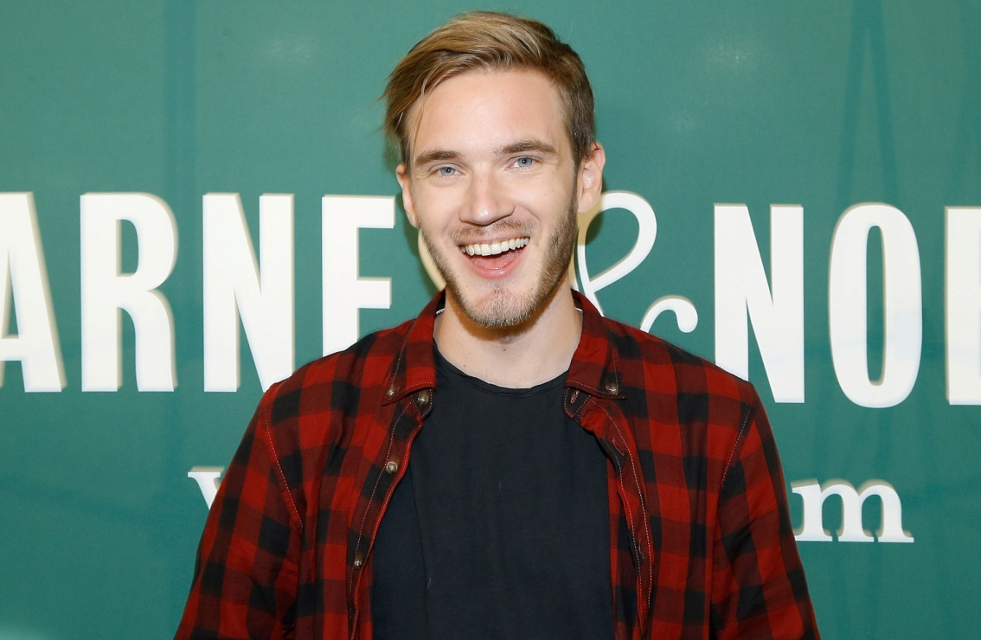
Felix Kjellberg
He is also known as PewDiePie and he is currently the most subscribed person on YouTube (almost 80 M)
He started his early career by playing video games, but now he is mainly reviewing other videos, or presenting the news and conflicts around the world or in his personal life.
I like him because he always speaks his mind and he is very genuine and he does not fake his excitement like other Youtubers.

Slide 4
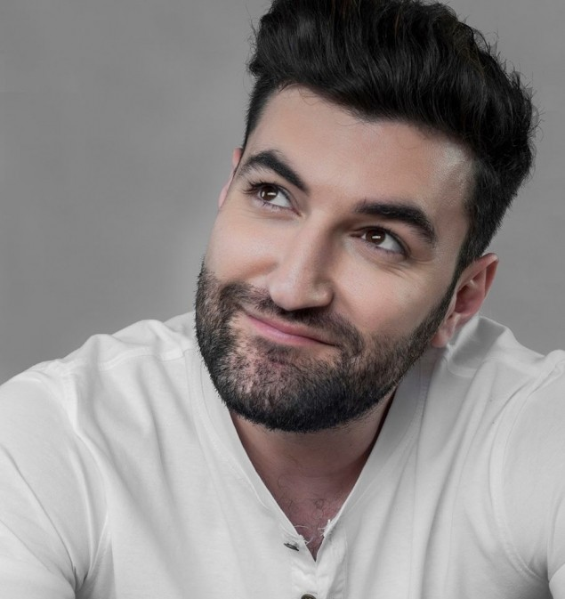
On Instagram I mostly follow singers from my country such as Smiley.
His real name is Andrei Tiberiu Maria
and he is 35 years old.
He used to be a member of the band
“Simplu” which translates as “Simple”.
His most popular songs are: Vals,
Cai verzi pe pereti and Acasa.
He is my favourite singer because I
like his voice and his lyrics

Slide 5
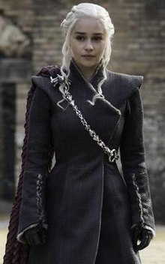
Emilia Clarke
Emilia Isabelle Euphemia Rose Clarke (born 23 October 1986) is an English actress.
I like her a lot because she features in my favourite TV Series Game of Thrones
in the role of Daenerys Targaryen, the
mother of dragons.
She is a very talented actress and
she started her acting career a short time
ago (2009).

Slide 6
Radio
I only listen to radio while in the car. I mostly listen to EuropaFM because I like the music and also they have interesting news and contests.

