Slide 1
FINGERPRINT SENSOR
Marina Marquez, Iratxe Allué, Silvia Fortuny, luna MOCK--GASPALOU, emile henry, AURIANE BILLERAULT

Slide 2
INDEX
What is it? / How does it works?
Step 1
Step 2
Step 3

Slide 3
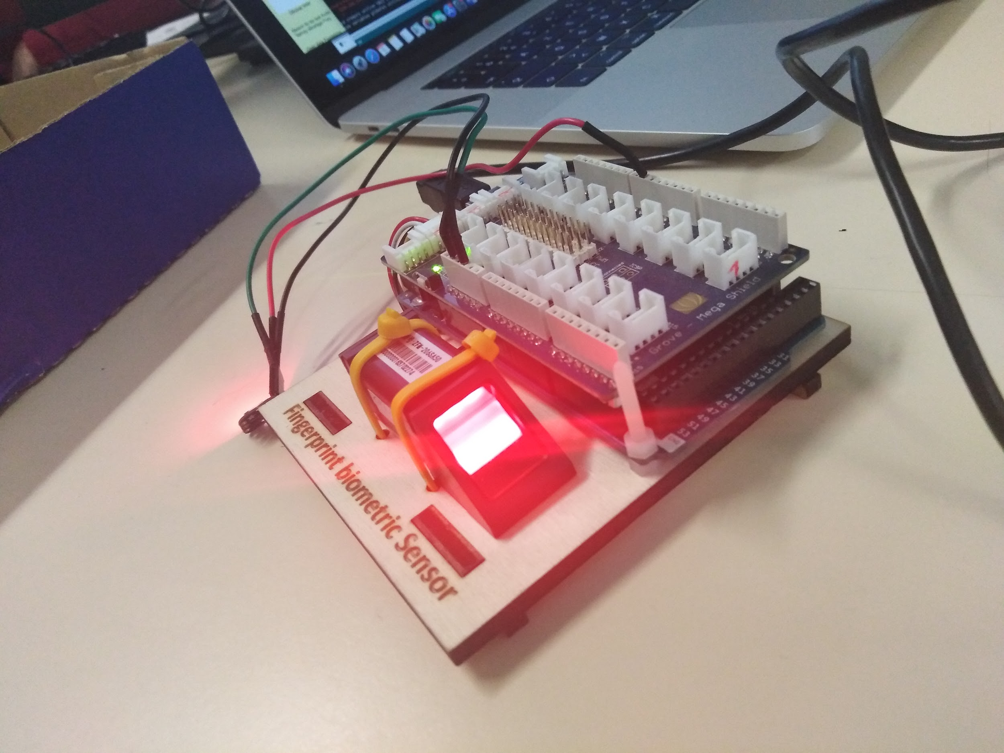
What is it?
It is a scanner.
How does it work?
Connect the Arduino card.

Slide 4
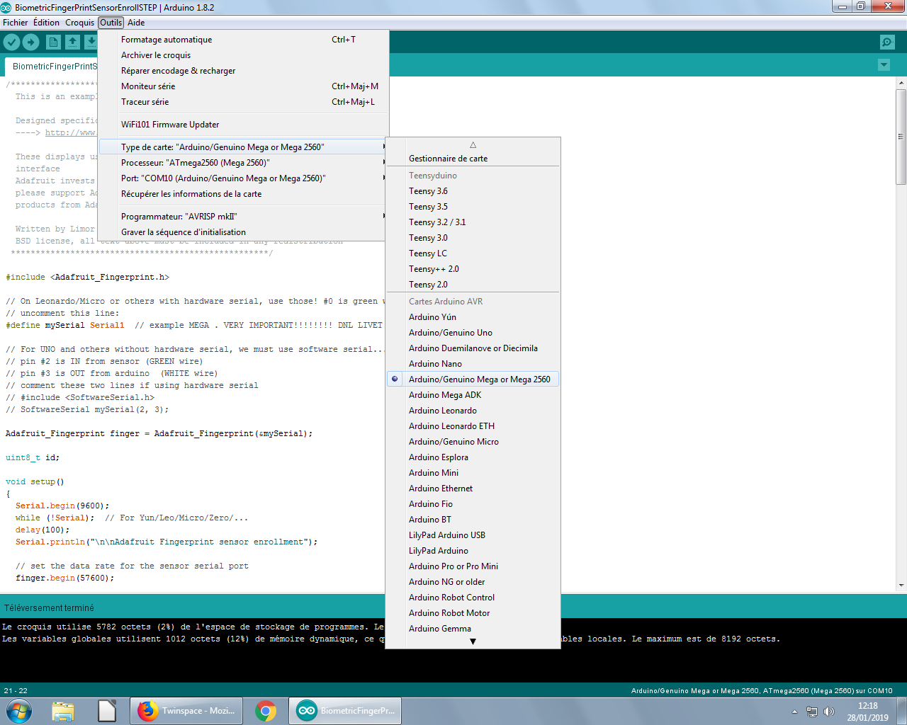
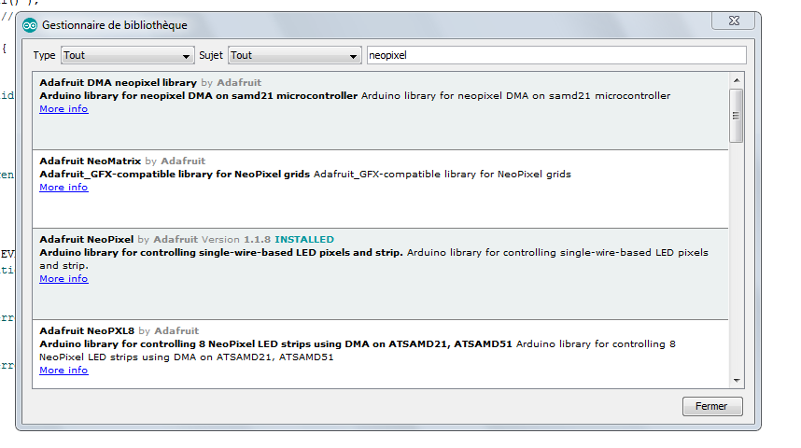
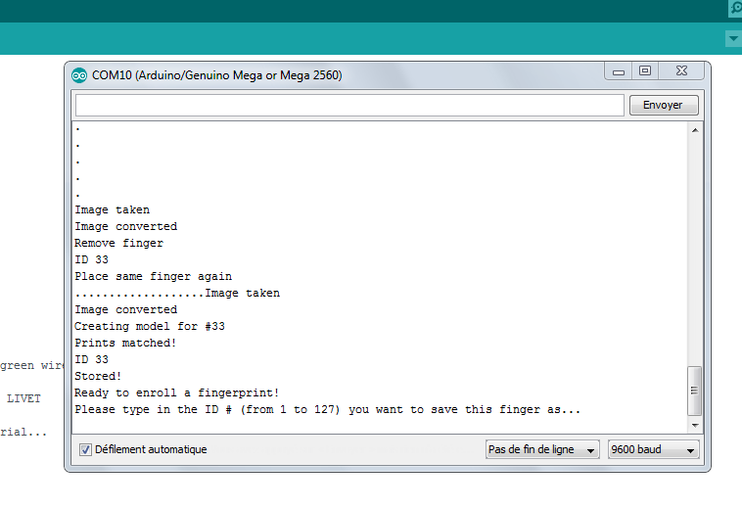
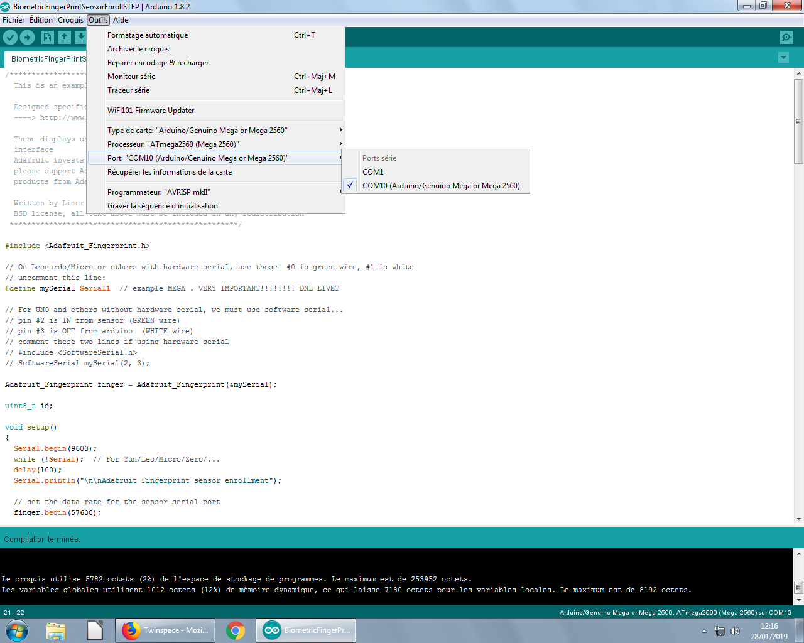
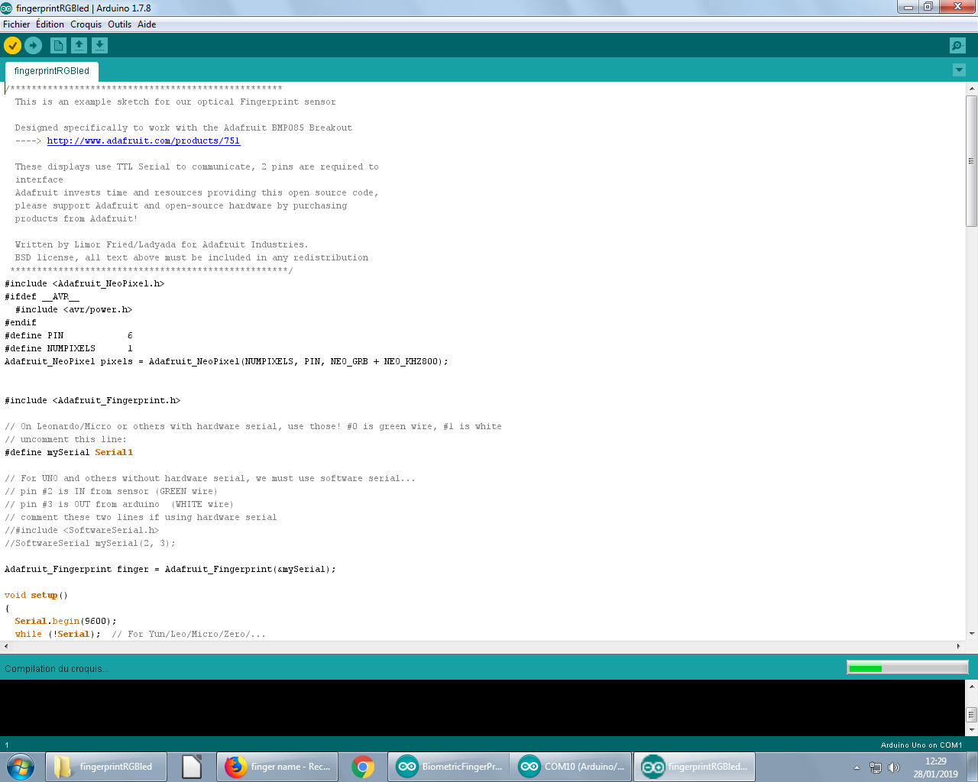
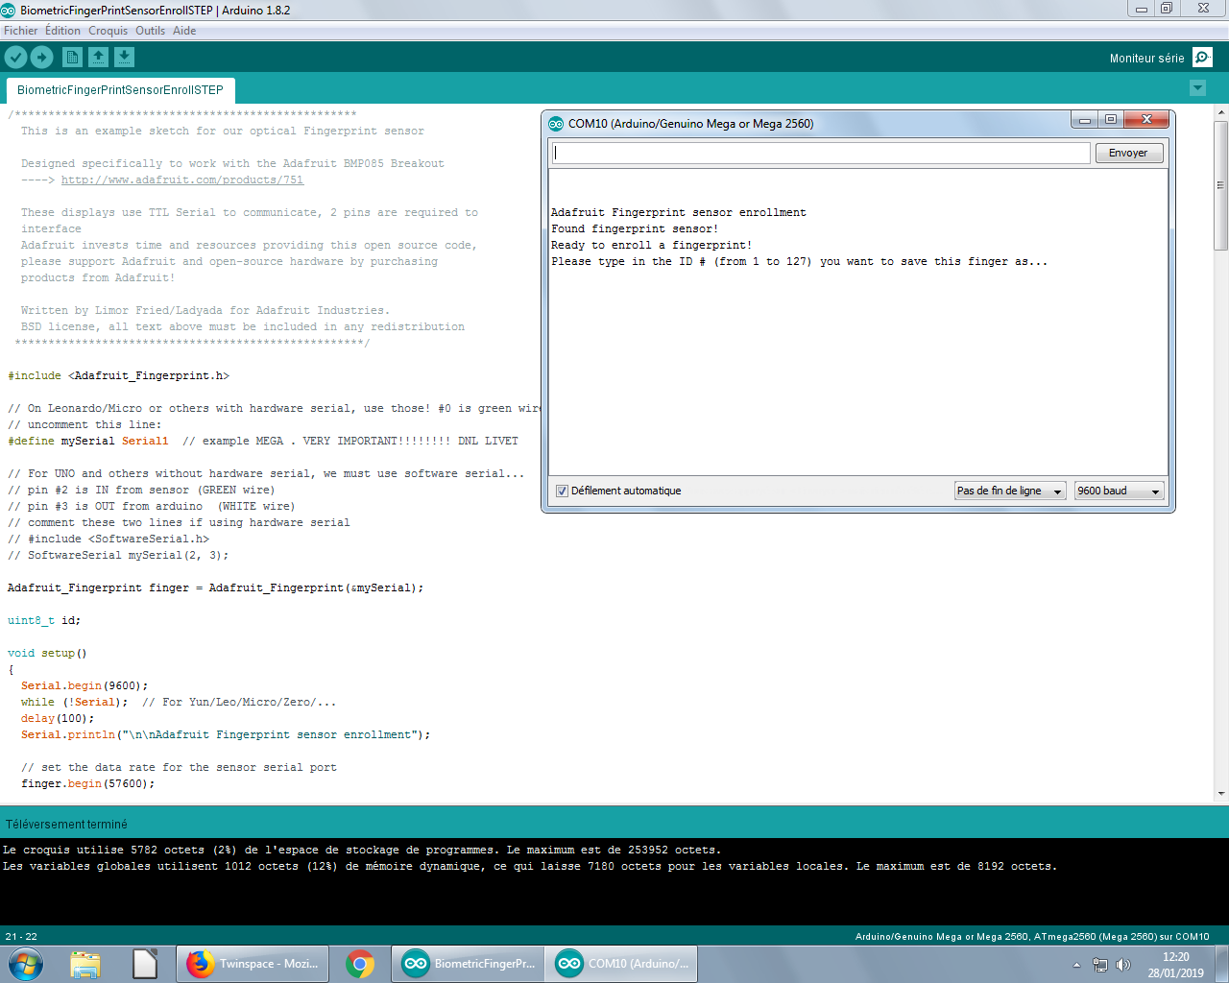
Step 1
Open arduino
Verify the program
Connect the card
Pass the information
Different numbers

Slide 5
Connexion with the cards

Slide 6
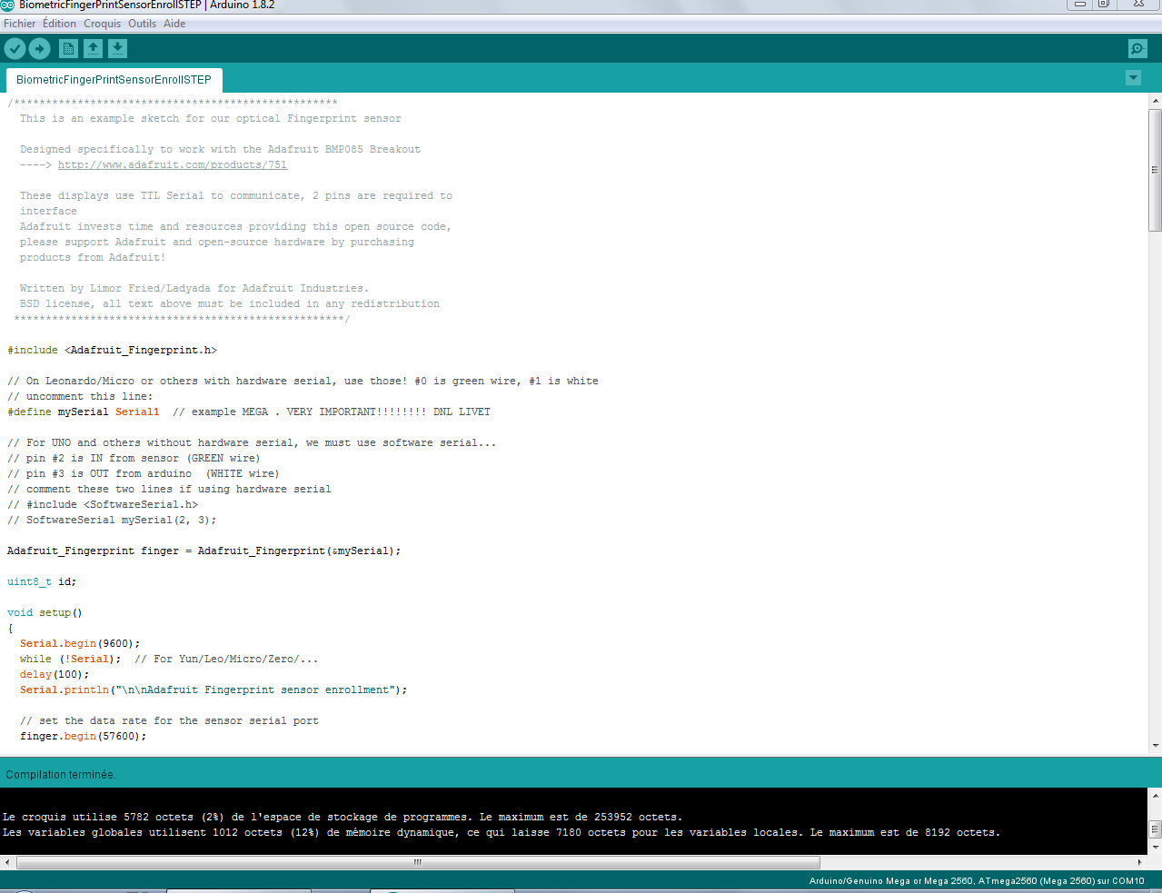
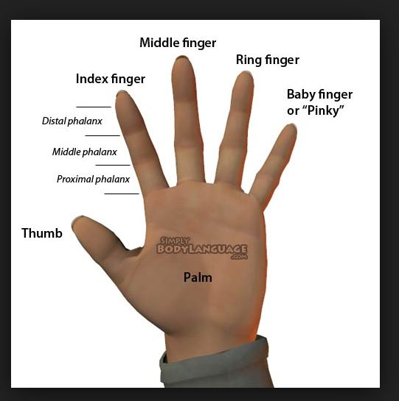
Step 2
Open other arduino
Verify
Open the serial monitor
Pass the information

Slide 7
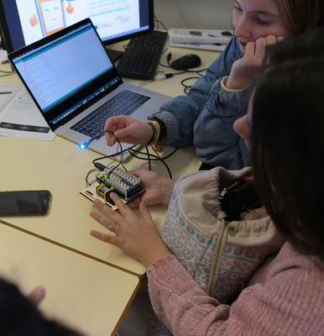
Step 3
Change the numbers
Try it

