Slide 1
GPS Tracking Report
By Cyprien – Tanguy – Maxime

Slide 2
Introduction
GPS Tracking workshop
Goal : Obtain our localization on a map

Slide 3
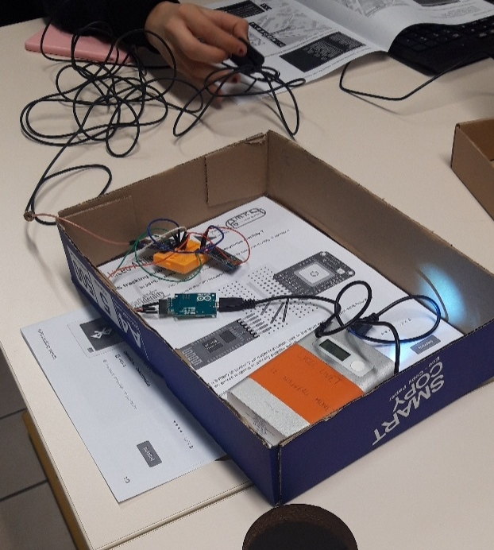
Step 1
Check the wires
Connect the Arduino card to
the Antenna

Slide 4
Step 2
Download BlueTerm
Pair it with a phone
Open BlueTerm App

Slide 5
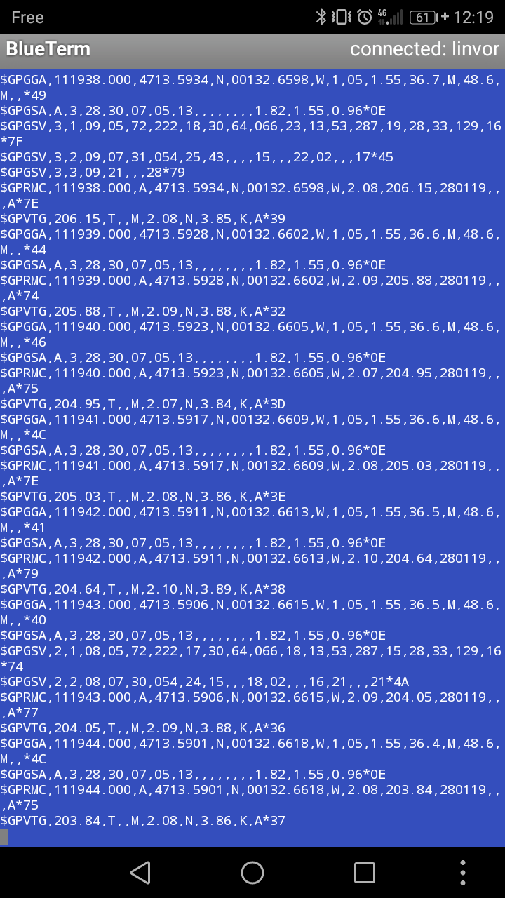
Step 3
Go outside
Take screenshots
Longitude
Hour
Latitude

Slide 6
Step 4
Go back to the classroom
Fill an Excel Table (gave by the teacher)

Slide 7
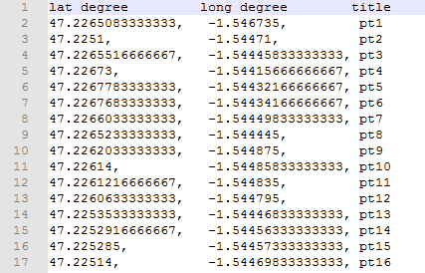
Step 5
Turn the Table into a .csv (comma separator file) file
Commas and dots are
very important

Slide 8
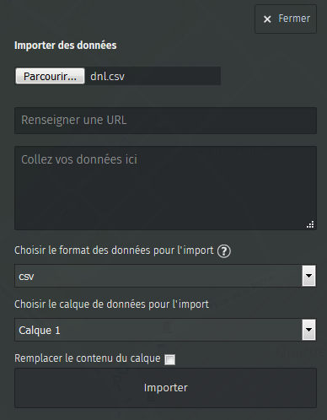
Step 6
Import the csv file into the
website called :
umap.openstreetmap.fr »

Slide 9
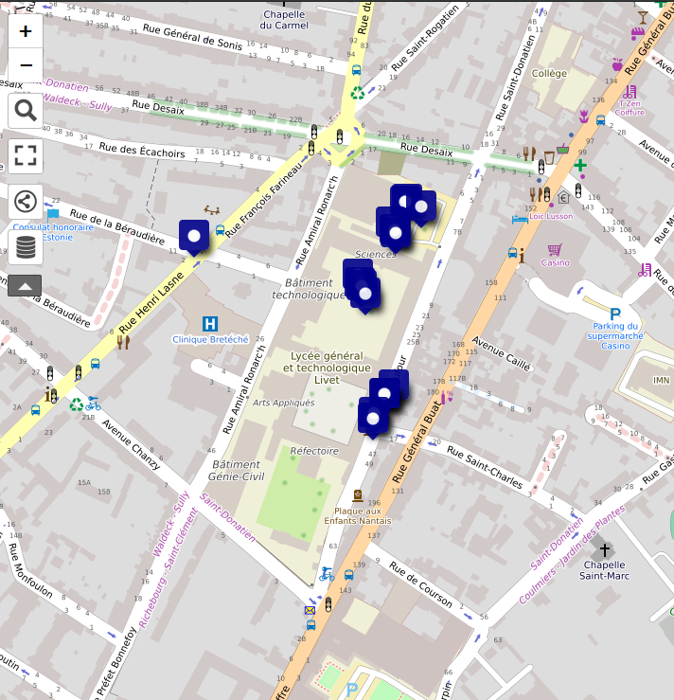
Step 7
Obtain our coordinates on a map

