Slide 1
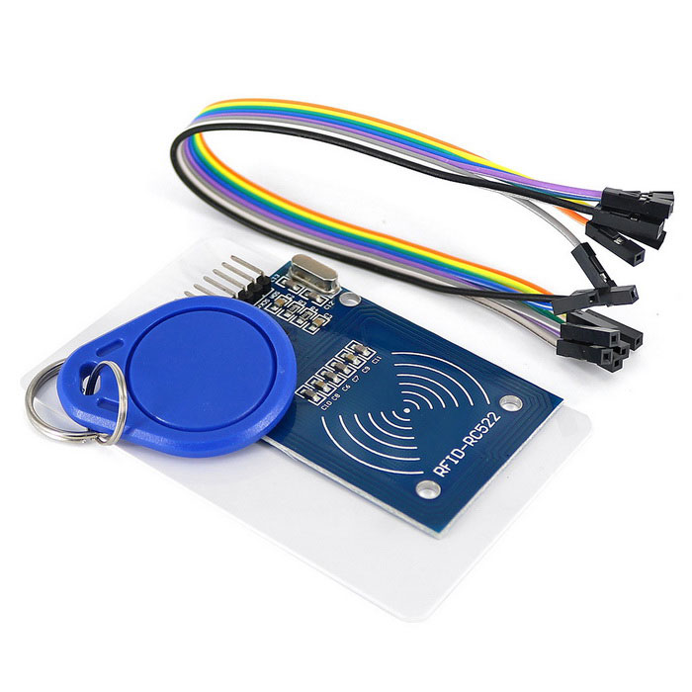
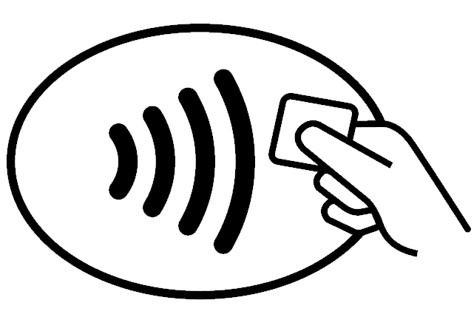
RFID card reader Tanguy, Gabriel, Cyprien, Maxime

Slide 2
introduction
In 2019, what are the strategies to check identity ?
→ RFID Card Reader (RFID= Radio Frequency IDentification)

Slide 3
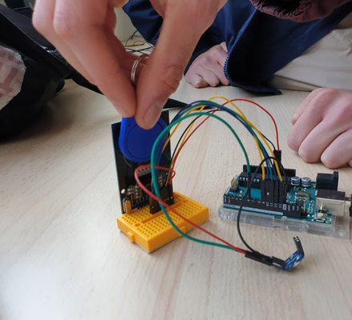
equipment
Arduino Card
USB link
Wires
RFID Card
NFC Badges
RGB Led

Slide 4
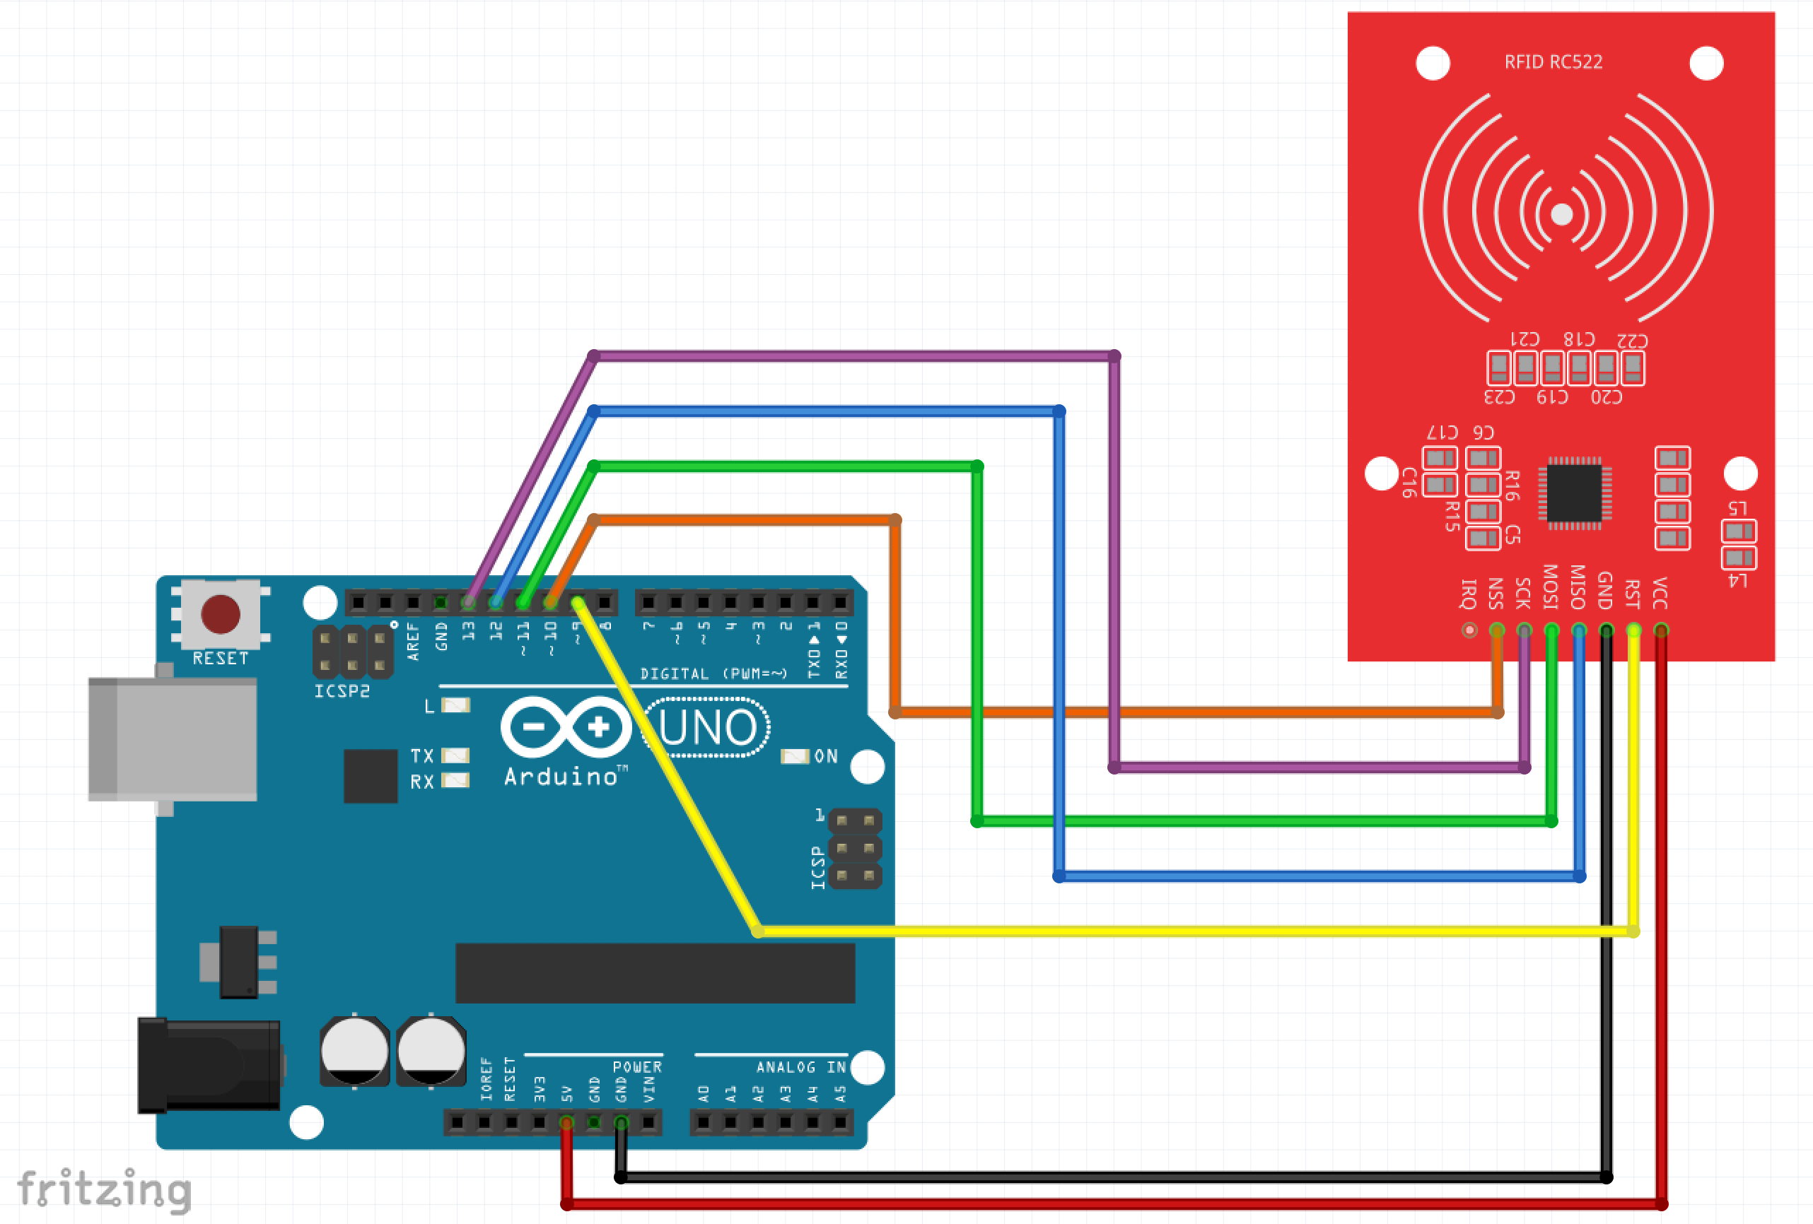
Step 1
Connect the Arduino card to the computer (USB link)
Check the wires

Slide 5
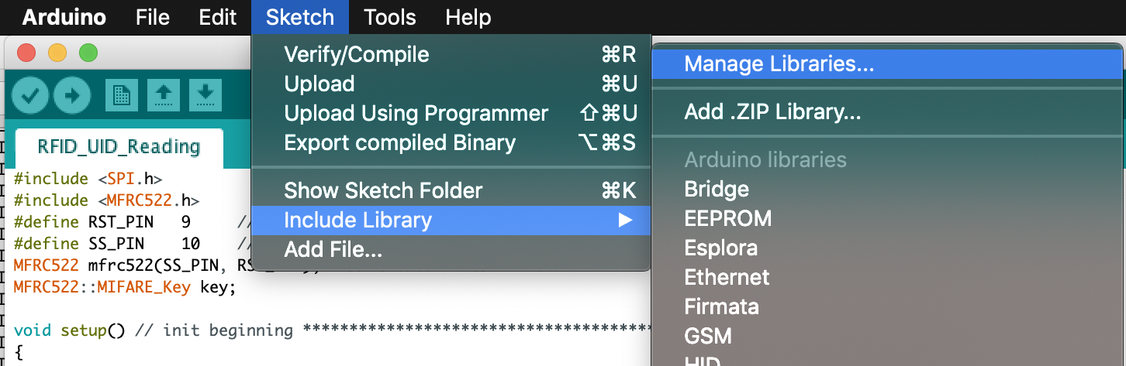
Step 2
→ Open Arduino Software
→ Include and manage libraries

Slide 6
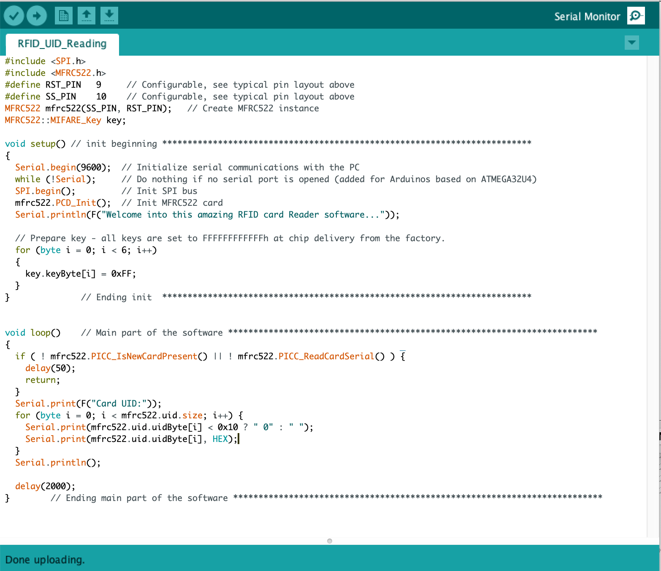
Step 3
→ Open the 1st Arduino program
→ Open a monitoring window

Slide 7
Step 4
→ Put a NFC Badge near the RFID card
→ Observe the result in the monitorring window

Slide 8
Step 5
→ Fill the table with the numbers
RFID card | Number 0 | Number 1 | Number 2 | Number 3
NFC Badge 1 | 23 | 43 | A2 | F6
Bus card | 44 | 59 | F3 | A7
NFC Badge 2 | .. | .. | .. | ..
Canteen Card | .. | .. | .. | ..

Slide 9
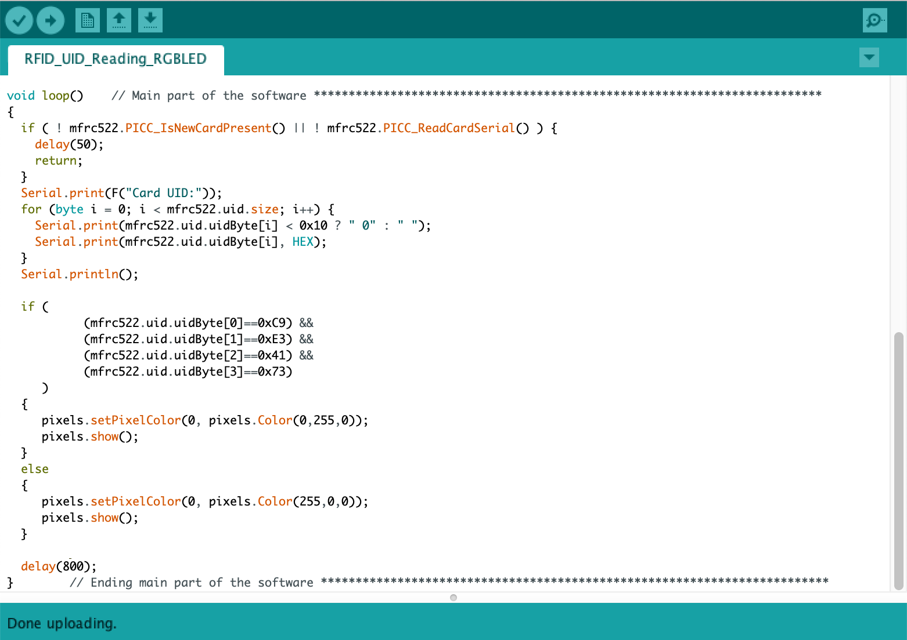
Step 6
→ Open the 2nd Arduino program
Badge/Card’s Figures
→ Customize it !!
RGB Led’s colour
RGB Led’s colour

Slide 10
Step 7
→ Put a NFC Badge near the RFID Card
→ The RGD Led colour change !

Slide 11
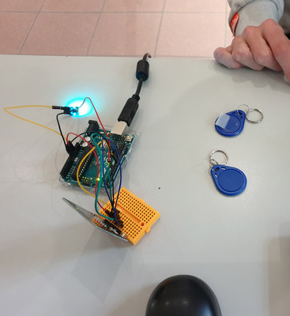
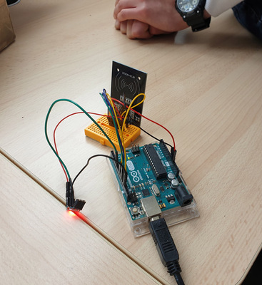
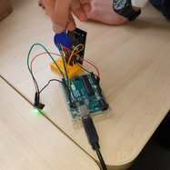
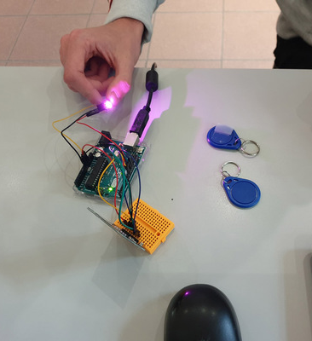
Step 7 (results)

Slide 12
Twinspace !!
→ RFID Card Reader Page + poll
→ RFID Card Reader Report

Slide 13
Thanks for listening !! Tanguy, Gabriel, Cyprien, Maxime

