Slide 1
FOLK MUSIC
Gal in Jernej Kos

Slide 2
ENSEMBLE BROTERS AVSENIK
Avsenik Brothers Ensemble is the world's probably the most successful Slovenian band . He worked from 1953 do 1990. The group was initially Refresh trio , Ki Refresh soon grew to the quartet in 1955 against the Gorenjska quintet , which was then renamed Quintet Brothers Ensemble . During the operation of both issued and about 120 plates in the cassette against a total circulation of more corner 30 million individuals . TOTAL have around 670 songs

Slide 3
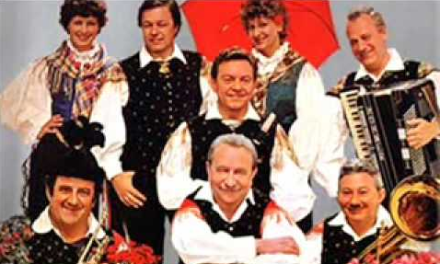
AVSENIKI

Slide 4
ENSEMBLE LOJZETA SLAKA
It was the most important year 1957, since it first appeared on the radio show "Show what you can do ! " As a stand-alone Godec . With its gameplay is convince both the professional public as a simple laymen . In 1959 he formed the ensemble Brothers Slak , the quartet is to collect Tone played trumpet , Matija clarinet, bass Stane , but Lojze accordion. In this band , both brothers played a good three years. Matija in Tone are supposed to NATO troops in Tria HAS BEEN Traffic and Transport . Lojze but not suspended , despite the topic at that time very successful. In 1964 he was Lojze Slak met with a group of guys singing with Praprotna . So that the guys from Selška valley that so soon after a meeting with Slak became a member of its ensemble. Thus arose the famous Ensemble Lojze Slak

Slide 5
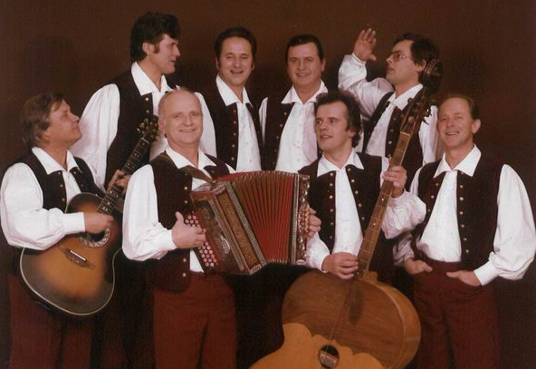
ENSEMBEL LOJZETA SLAKA

Slide 6
ENSEMBEL MODRIJANI
WE sages of four boys music group, in operation since 2000 and plays in creating the field of folk music, with "a cappella" singing while also preserving Slovenian folk music. After the crowd of festival awards in Slovenian folk festivals cousin Deadline for Blaz Švab and brothers Peter's Franjo Oset remain loyal to domestic music, with a youthful interpretation of the innovative way they entered the necessary freshness to the songs they create together with the excellent Slovenian authors in the music texts. The simplicity AND sincere attitude to do music people remain loyal audience that we are in full appearances, the energy in a good mood, and only further increases joy to do our work. Distinctive We are a four-voice singing in an extraordinary lyrical tenor Rocco Sváb, eats felt a few people in the Slovenian folk area. We published eight majors in two small plates while preparing new projects, videos of the songs that we will continue to represent Slovenia in the foreign audience

Slide 7
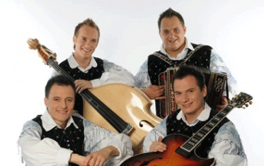
ENSEMBLE MODRIJANI

Slide 8
THANKS FOR LISTENING

