Slide 1
Slovenian anthem
Made by Kaja Cajnko
22nd November

Slide 2
Zdravljica
Slovenian anthem is difrently named Zdravljica. It was crafted by France Prešeren (1800-1849) on the November 1844. After 6th part of constitution Zdravljica is the text of anthem of Republika Slovenia. Melody is from eponyomus choral music from composer Stanko Premrl (1880-1965). Zdravljica became Slovenian anthem at the year 1989. We strict 7th stanza of Zdravljica.

Slide 3
Zdravljica or the Slovenian anthem goes like that:
Žive naj vsi narodi,
ki hrepene dočakat' dan,
da koder sonce hodi,
prepir iz sveta bo pregnan,
da rojak
prost bo vsak,
ne vrag, le sosed bo mejak!

Slide 4
This is how it looks writen down by hand:

Slide 5
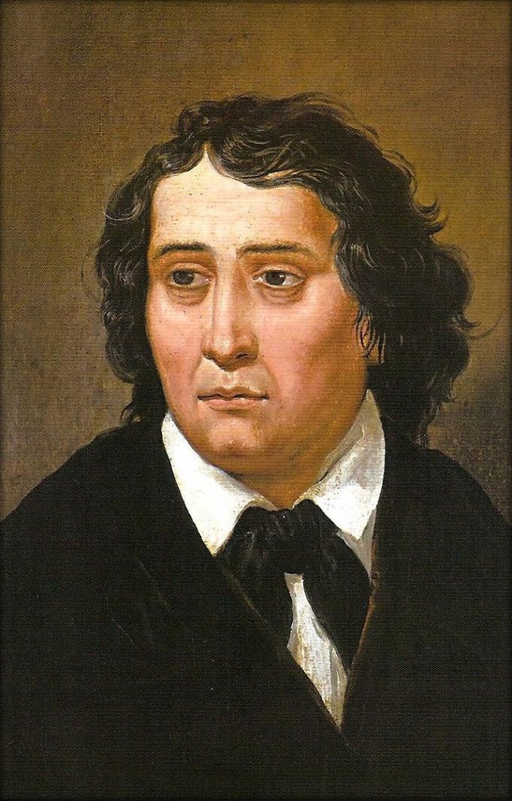
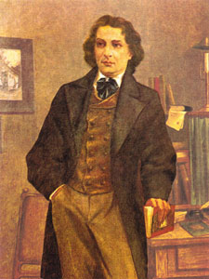
France Prešeren(1800-1849)

Slide 6
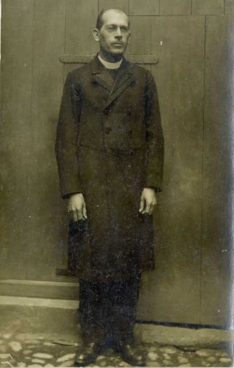
Stanko premrl (1880-1965)

Slide 7
This is how it goes:
Watch youtube video…
https://www.youtube.com/watch?v=Zc7aLyhZ94c

Slide 8
Thank you for atention!

