Slide 1
Arla foundation
Made by: Barbara Puljić, Barbara Tubanović,Bruno Tirić, Daniela Tokalić, Ivana Pejić, Tea Budžaki

Slide 3
About arla
Association for the Promotion of Urban Culture A.R.L.A., was established on 13.01.2018. continuing activities of the former Youth Association of Đakovo (UM).

Slide 4
Logo-arla

Slide 5
The origins of arla
Name A.R.L.A. originally labelled the Argument of Realism of Local Activism but the abbreviation remained open to different interpretations depending on the purpose(s) of events.

Slide 7
The persons authorized to represent the association are;
Sanja Andrić, president
Krasanka Kakaš, vice - president and
Ozren Andric, secretary.
The association counts 15 members nowadays.

Slide 9
AIMS:
Support for lifelong learning and non-institutional education
Encouragement and development of socially responsible behavior, solidarity / social economy and development of entrepreneurship
Development of humanitarian initiatives and charities
Organizing one-day events at different locations in the city and its surroundings in terms of reviving abandoned areas

Slide 11
ACTIVITIES:
Educating, counseling and training of their members and other volunteers
Organizing music festivals, forums, workshops, lectures, forums
Organizing educational workshops and seminars aiming at raising awareness about their causes and initiatives in the local society
Proposing measures and projects for the development of socially responsible business models

Slide 12
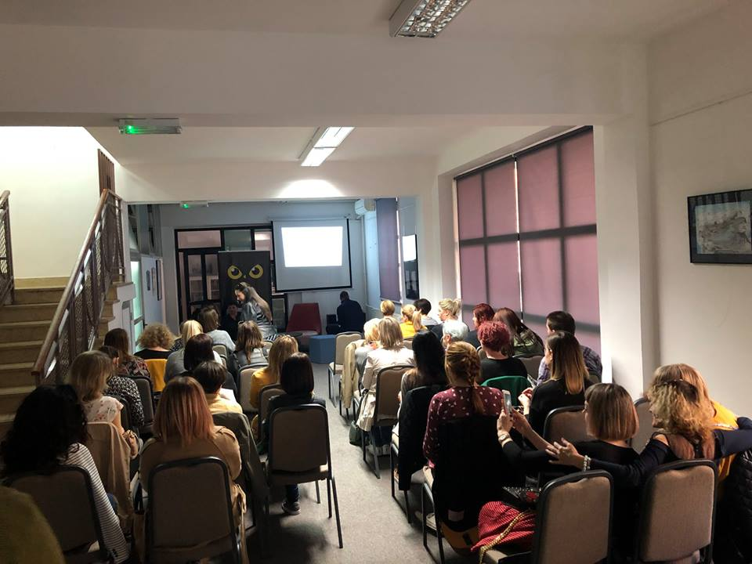

Slide 13
OBJECTIVES OF ASSOCIATION:
Creating the cultural identity of the city in terms of urban culture, supporting the development of urban culture
Cooperation with regional initiatives, interested potential partners within social and private organizations, schools and enterprises
Develop methodology for implementing culture initiatives

Slide 15
ForUm on helping to understand autistic children

Slide 16
Promotion and development of cultural-artistic and audiovisual activities
Encouraging cooperation with other stakeholders in cultural activities, with related associations, communities, cultural and educational institutions etc.

