Slide 1
Minicompanies in Budapest
THE BLIND DATE MINICOMPANY

Slide 2
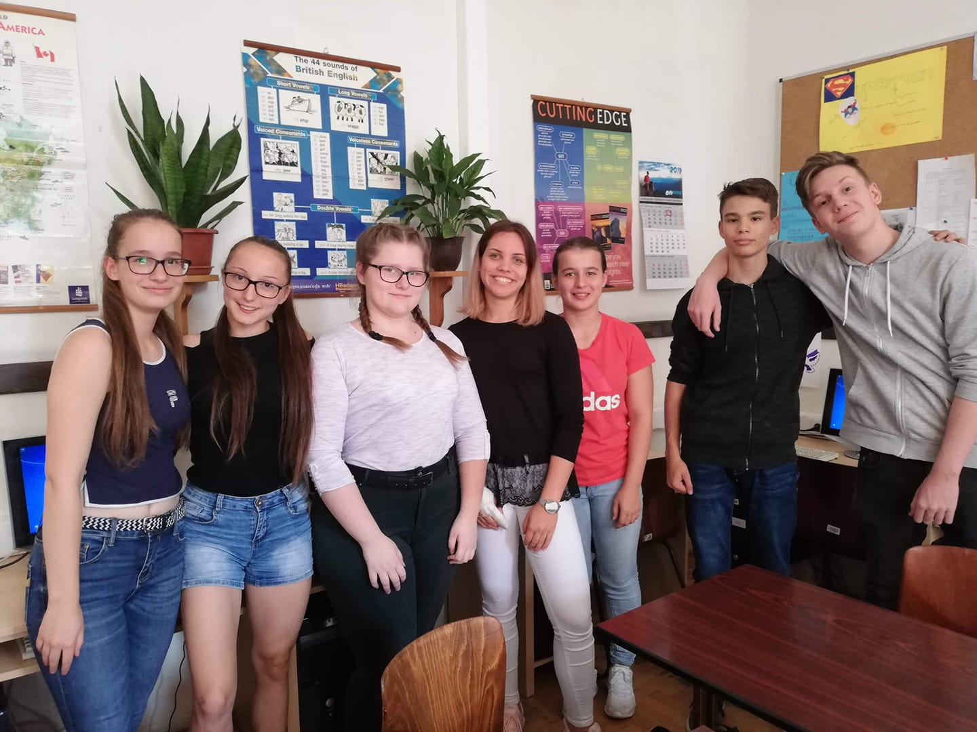
The Blind Date minicompany

Slide 3
Slogan and logo

Slide 4
Motto

Slide 5
Facebook group

Slide 6
Plans
Raise awareness
Organize charity events
Sell products
Support a guide dog centre

Slide 7
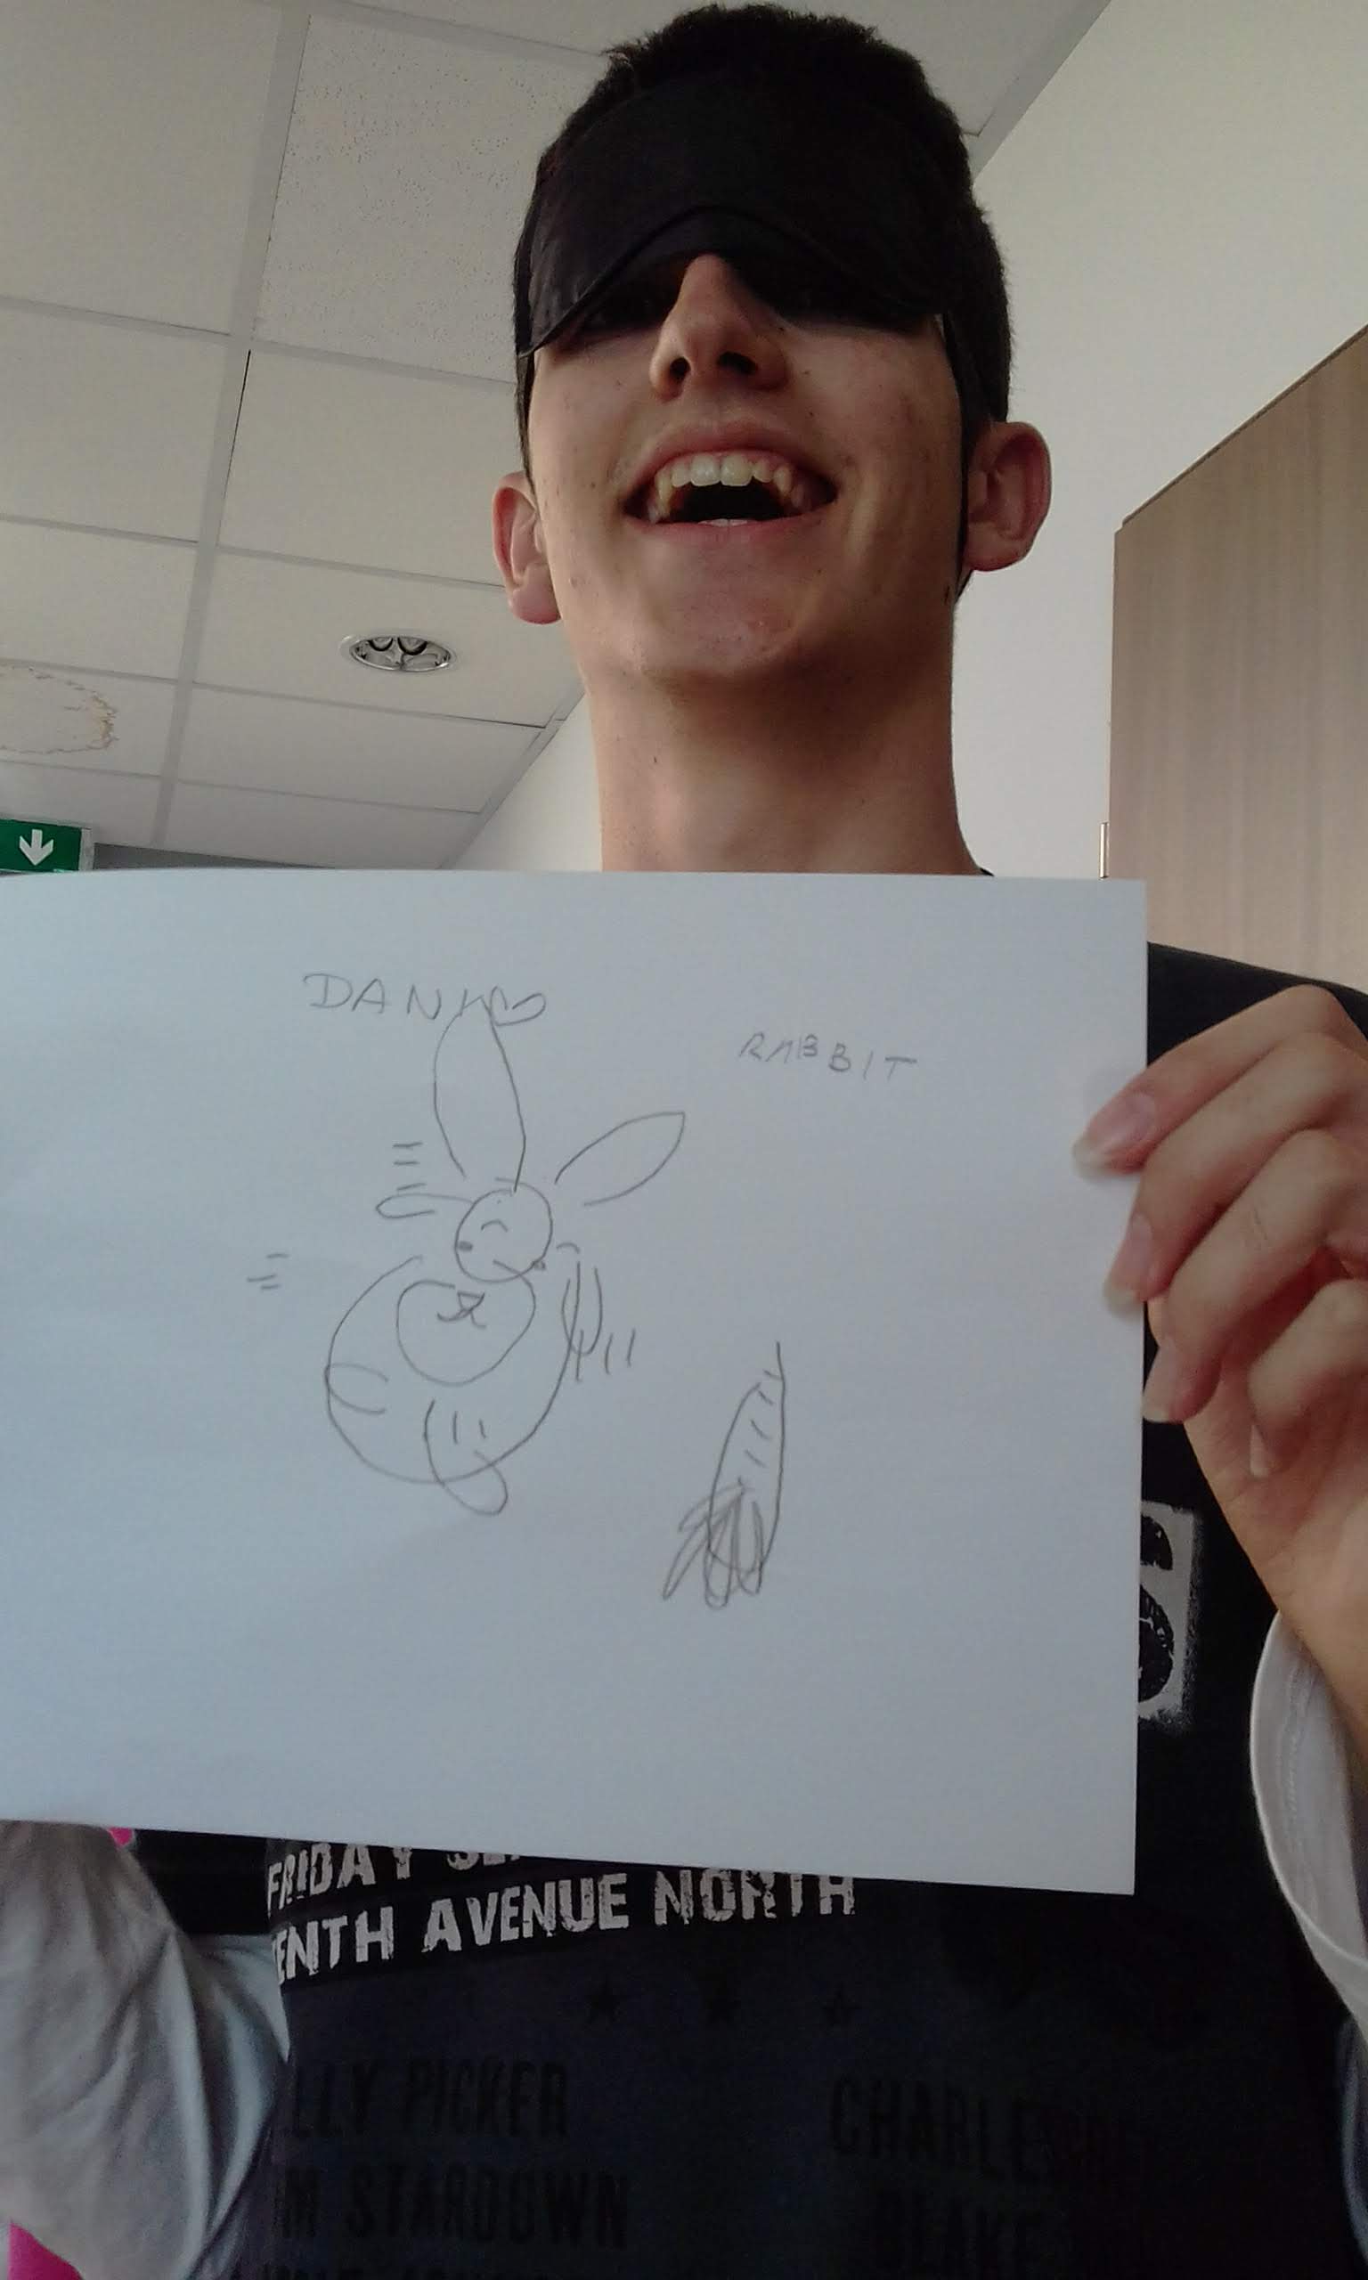
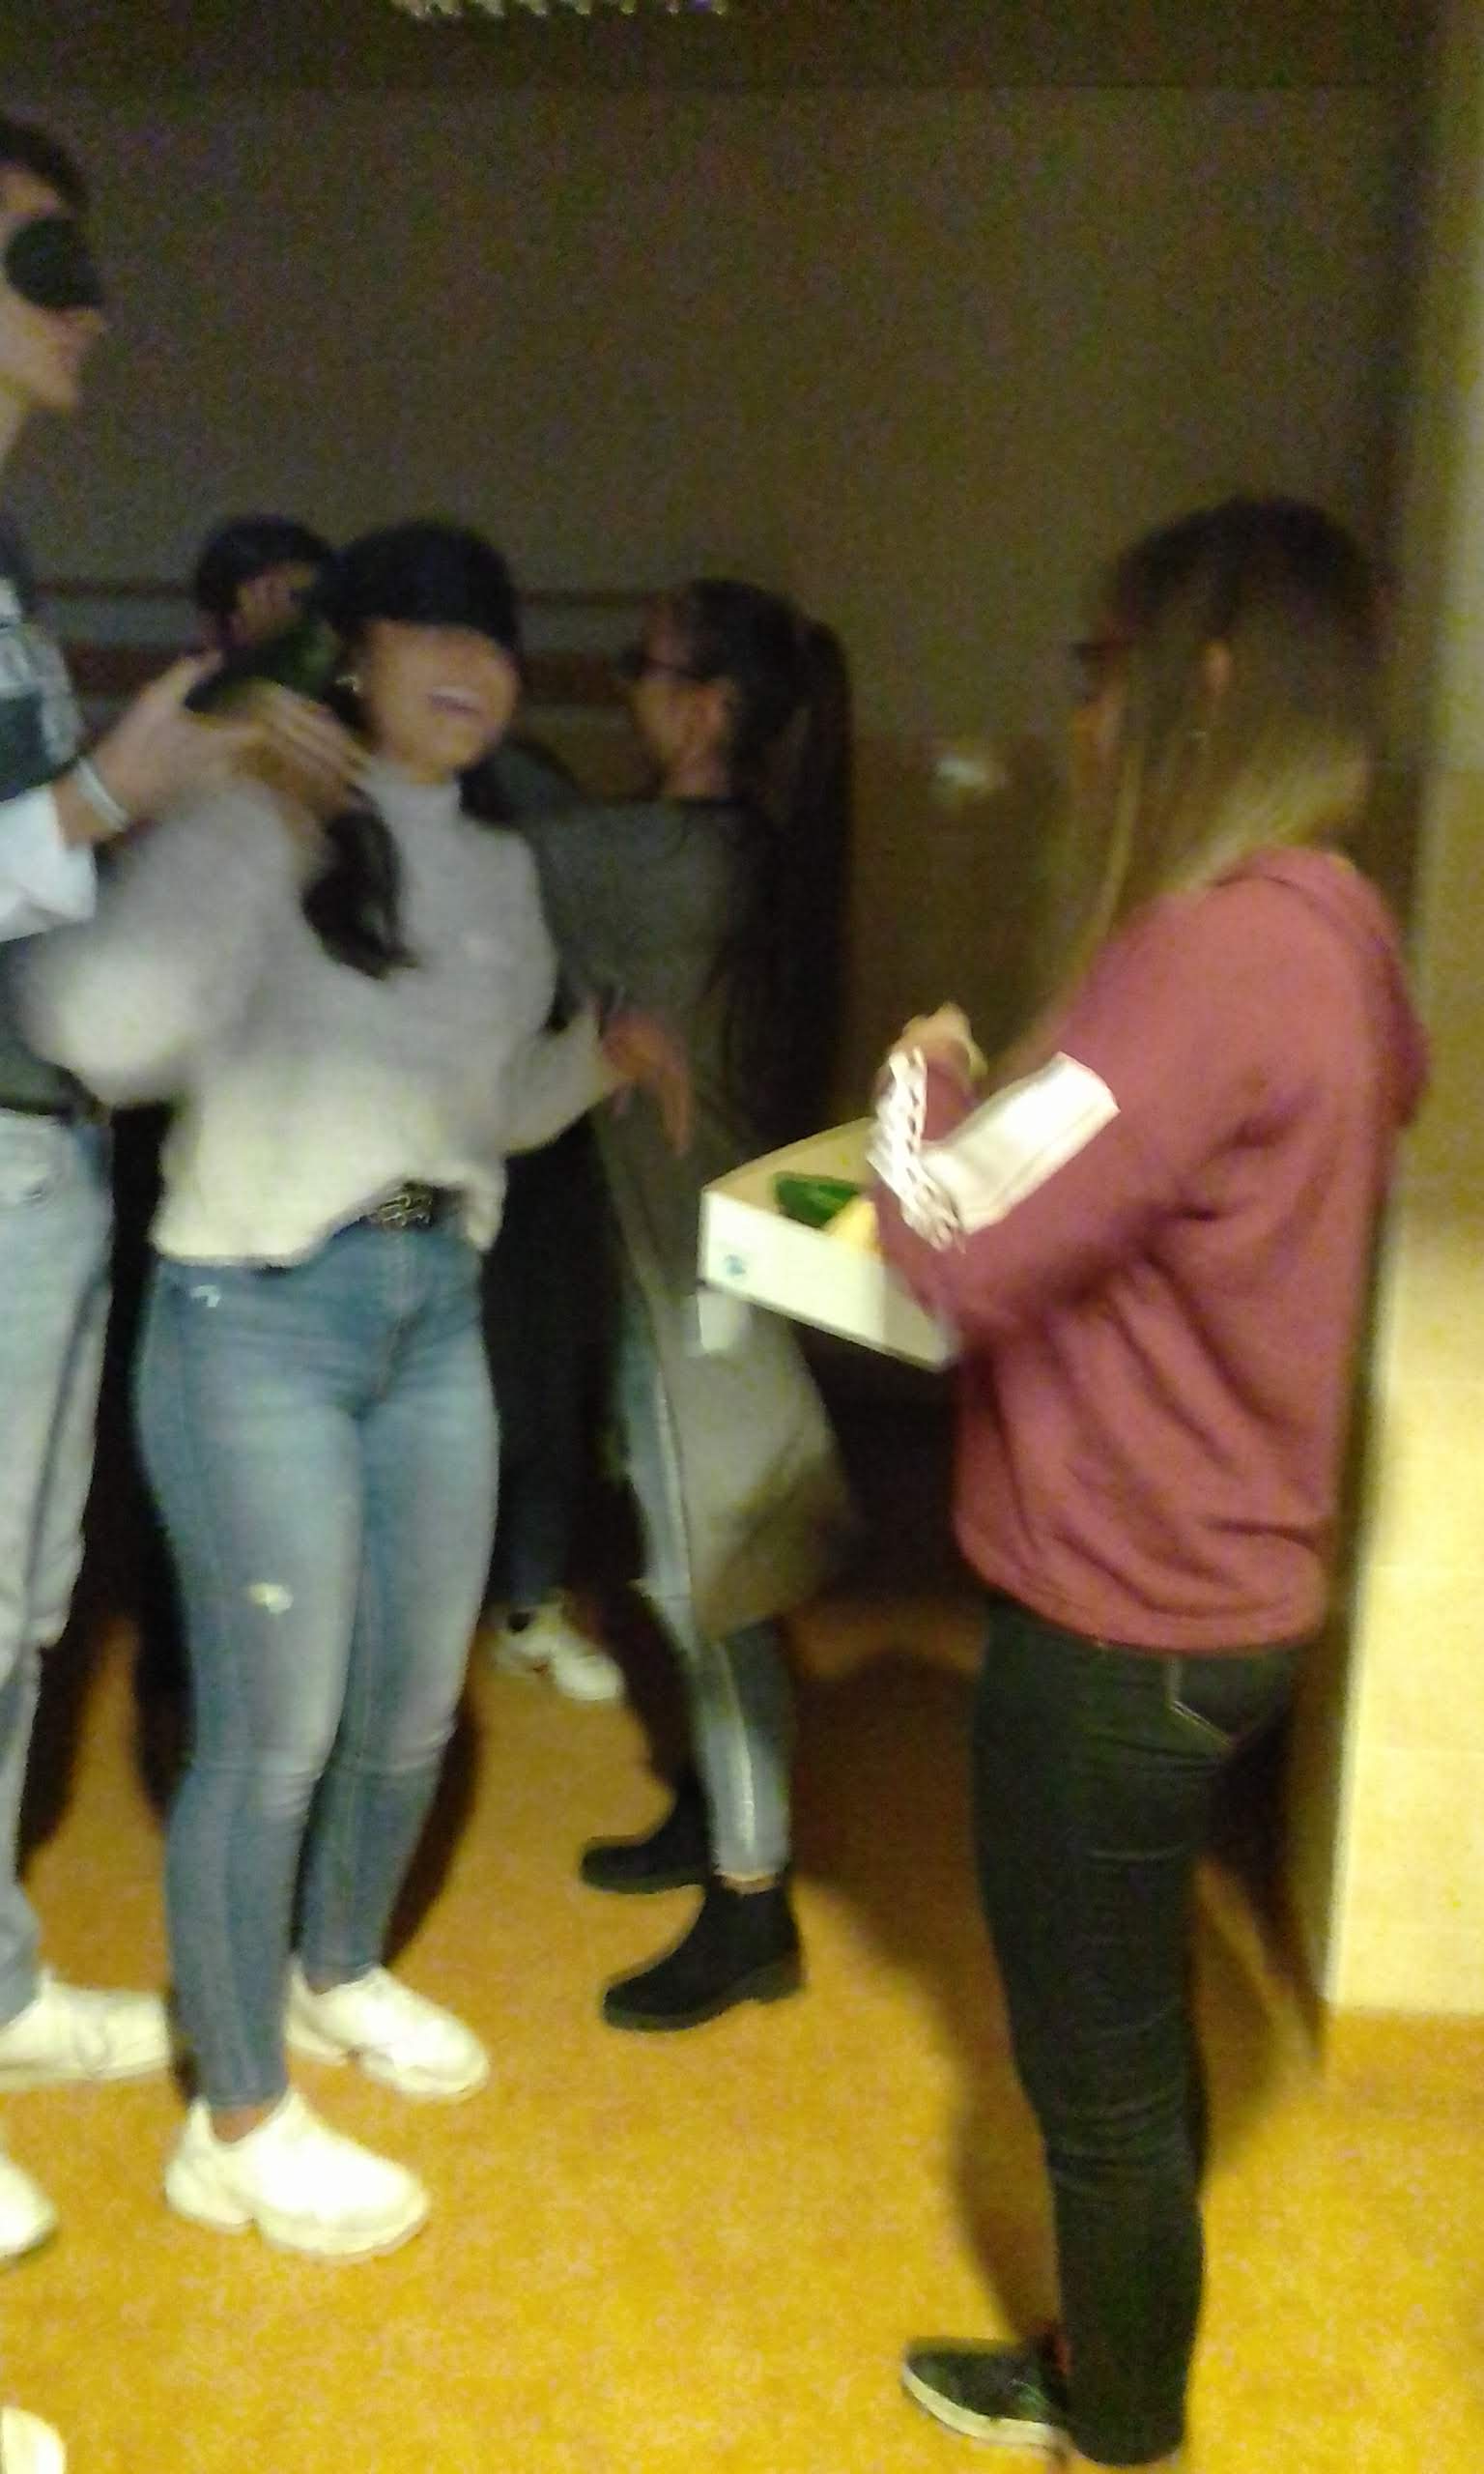
Budapest mobility October 2019

Slide 8
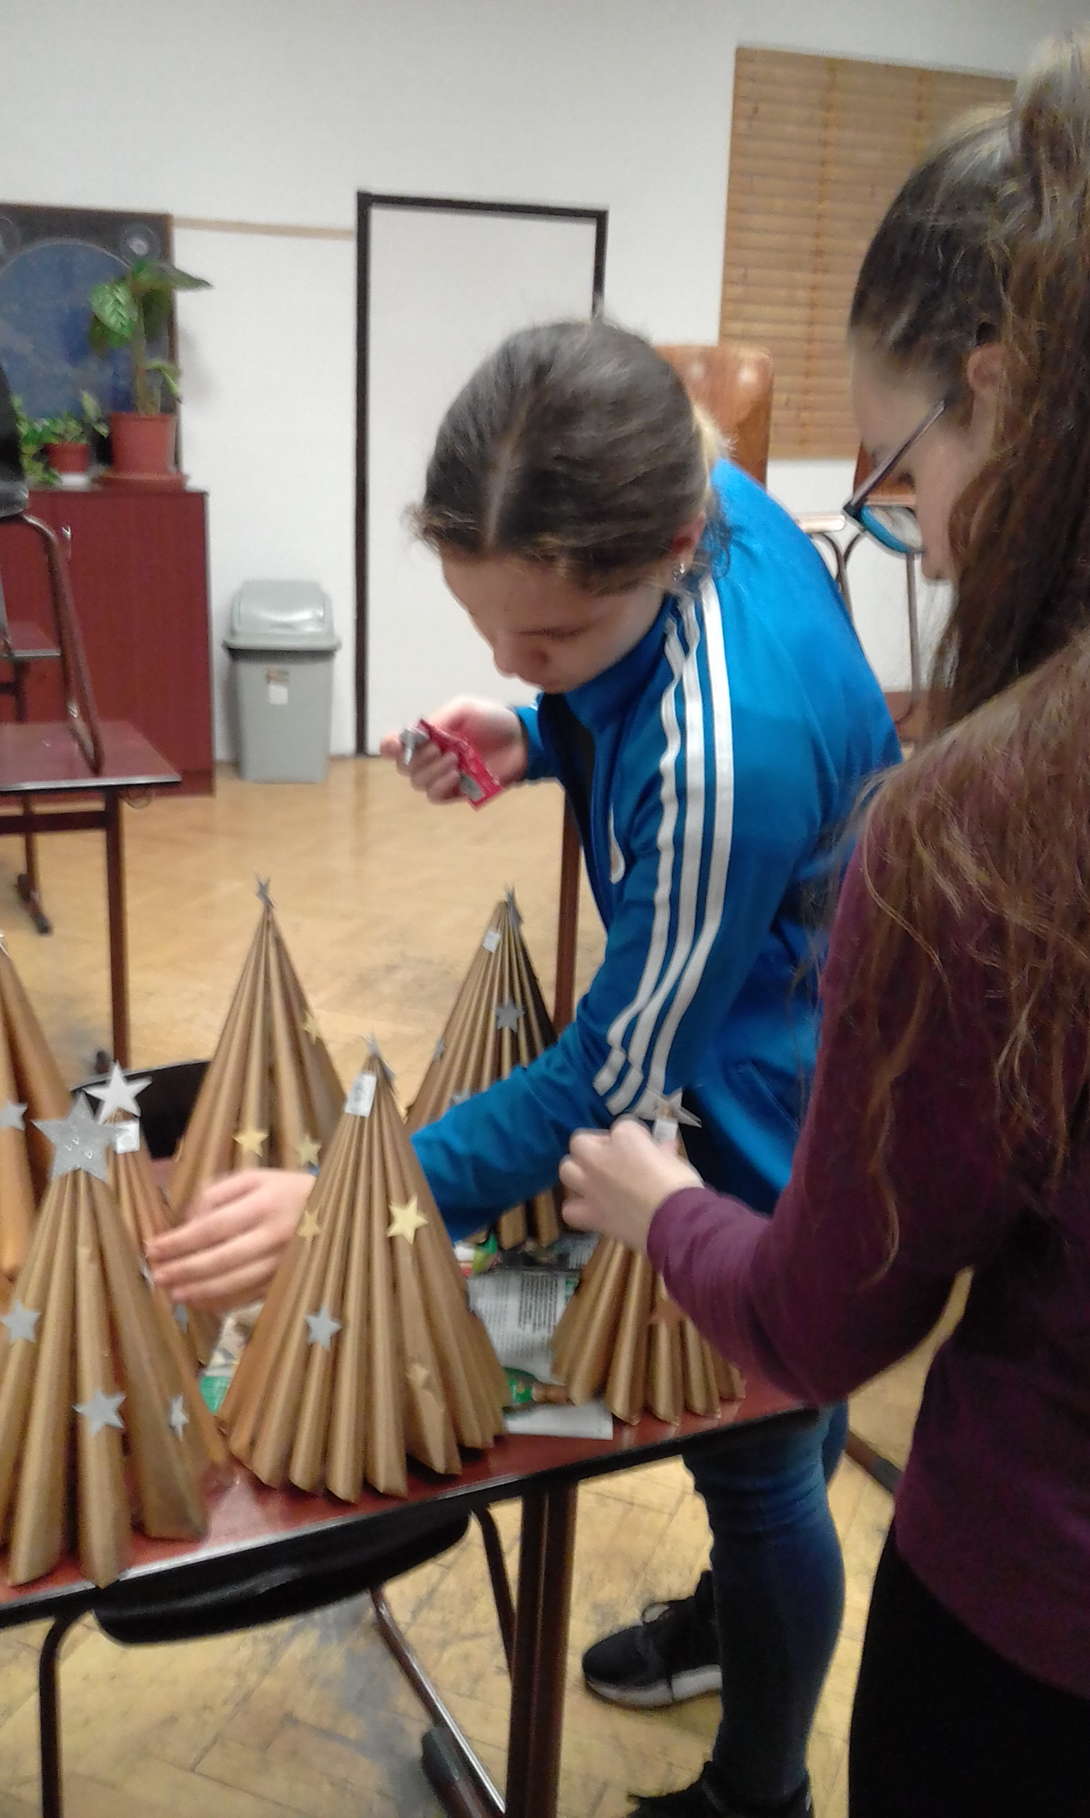
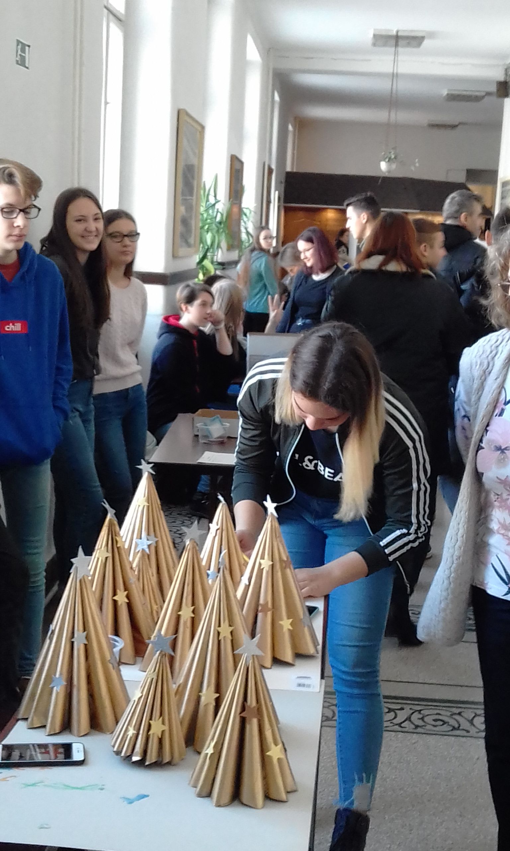
Charity fair December 2019

Slide 9
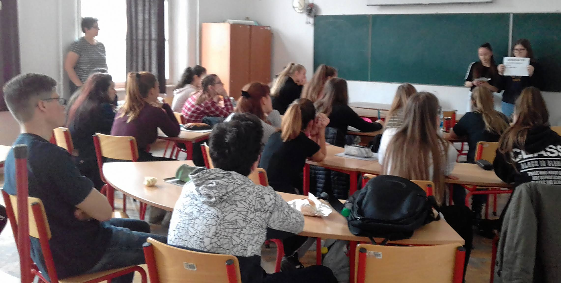
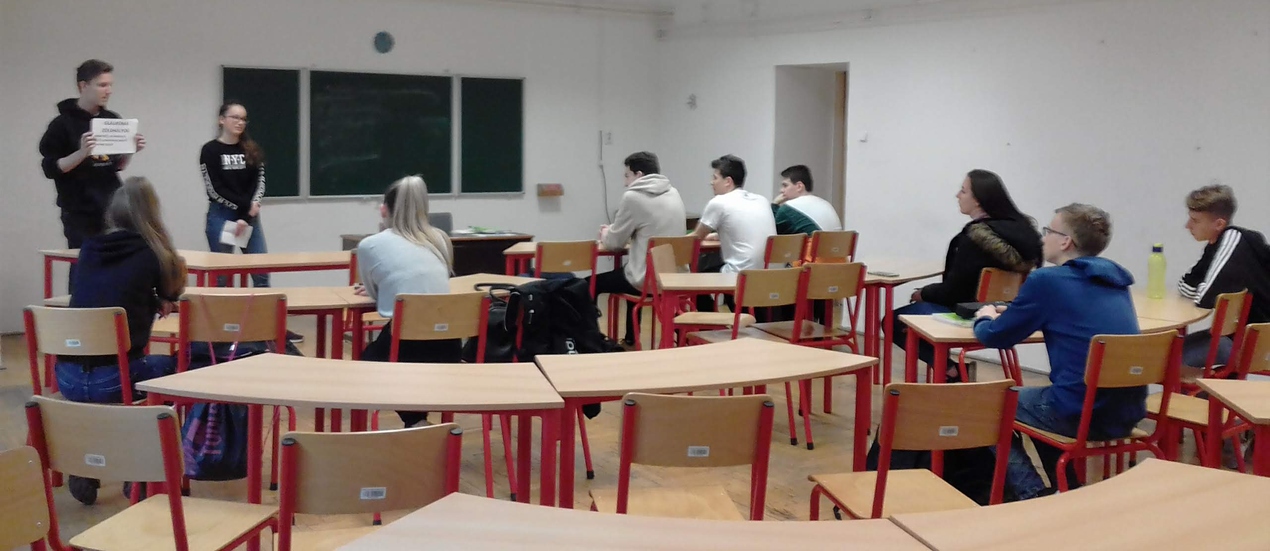
Awareness campaign – International Glaucoma week 2020 March

Slide 10
Erasmus days October 2020

Slide 11
Minicompanies in Budapest
THE DOWNSTAGE MINICOMPANY

Slide 12
The Downstage minicompany

Slide 13
plans
Invite members to join our facebook group
Raise awareness
Hand out flyers
Organise a campaign on March 21st
Design and sell products, raise money

Slide 14
Logo and slogan

Slide 15
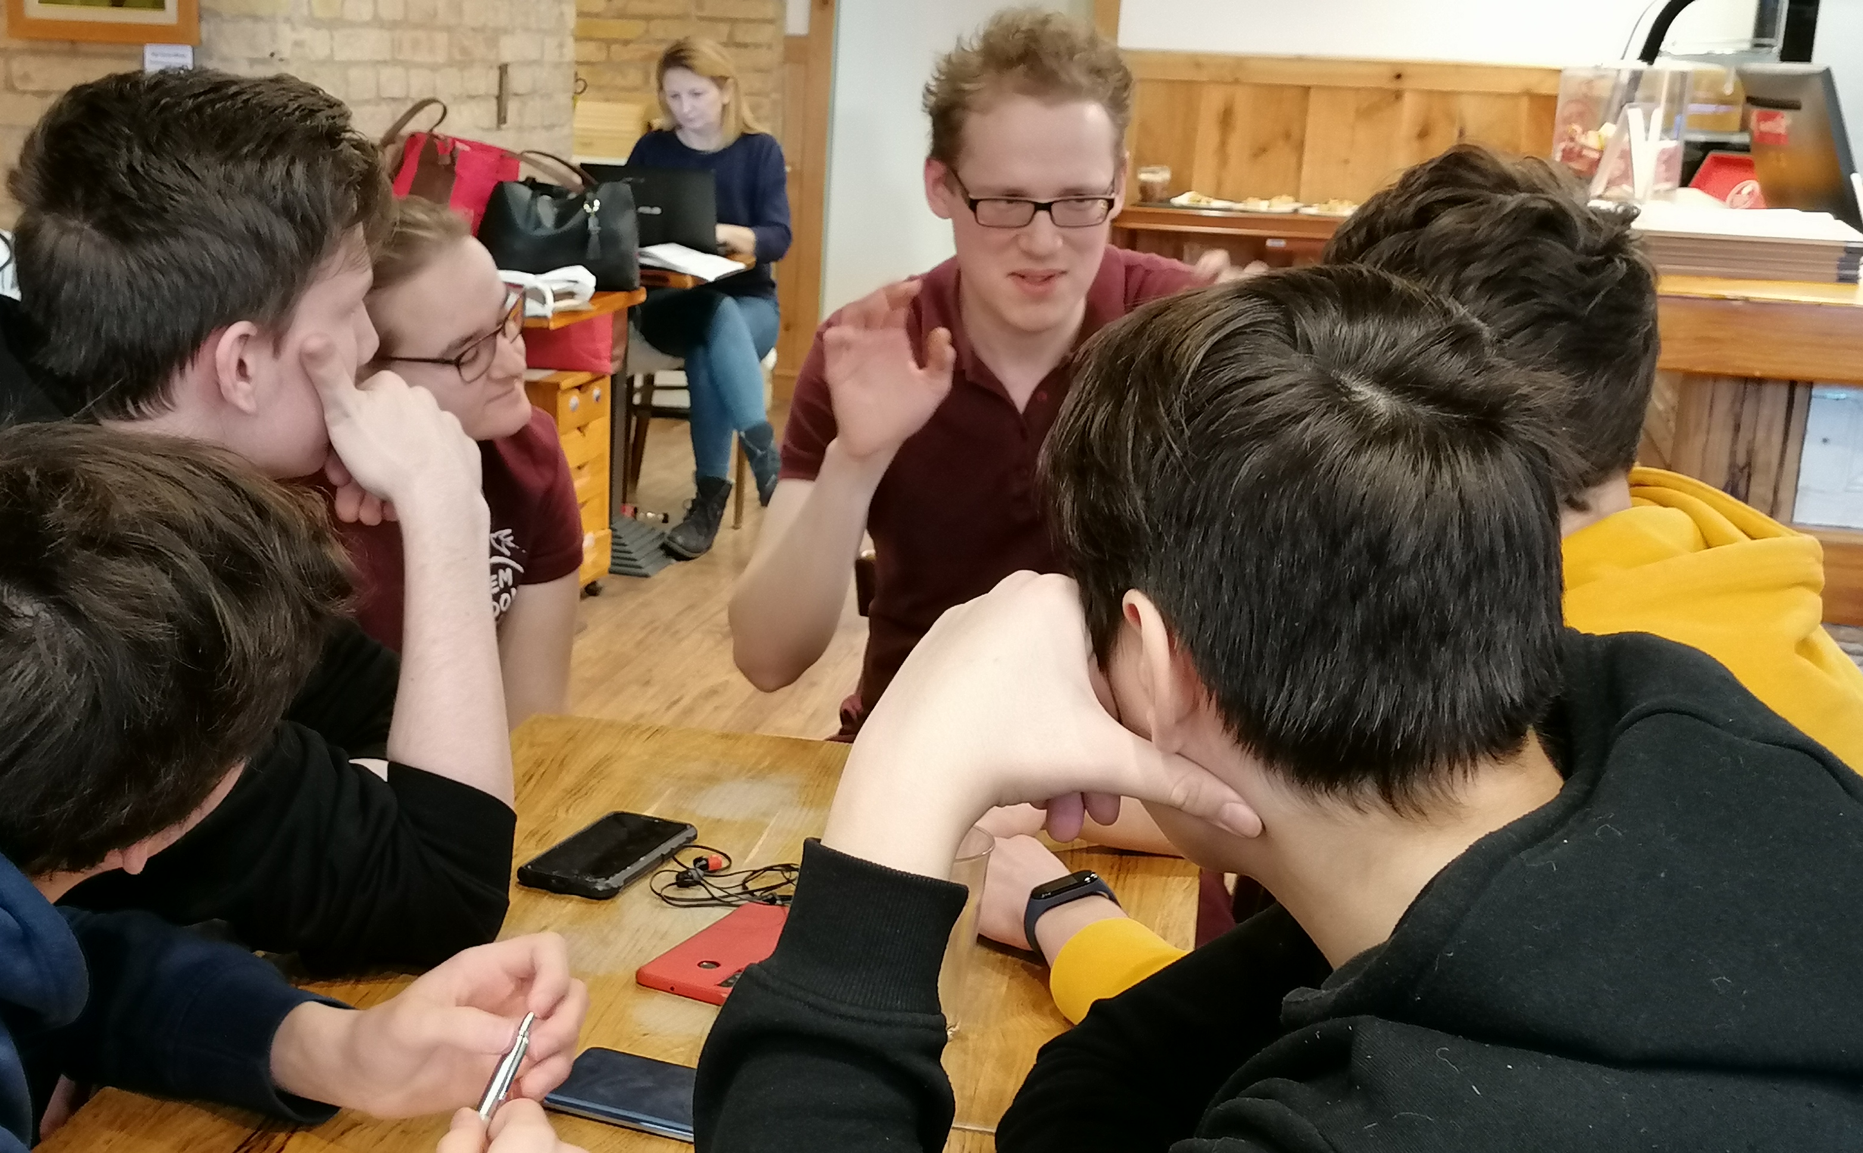
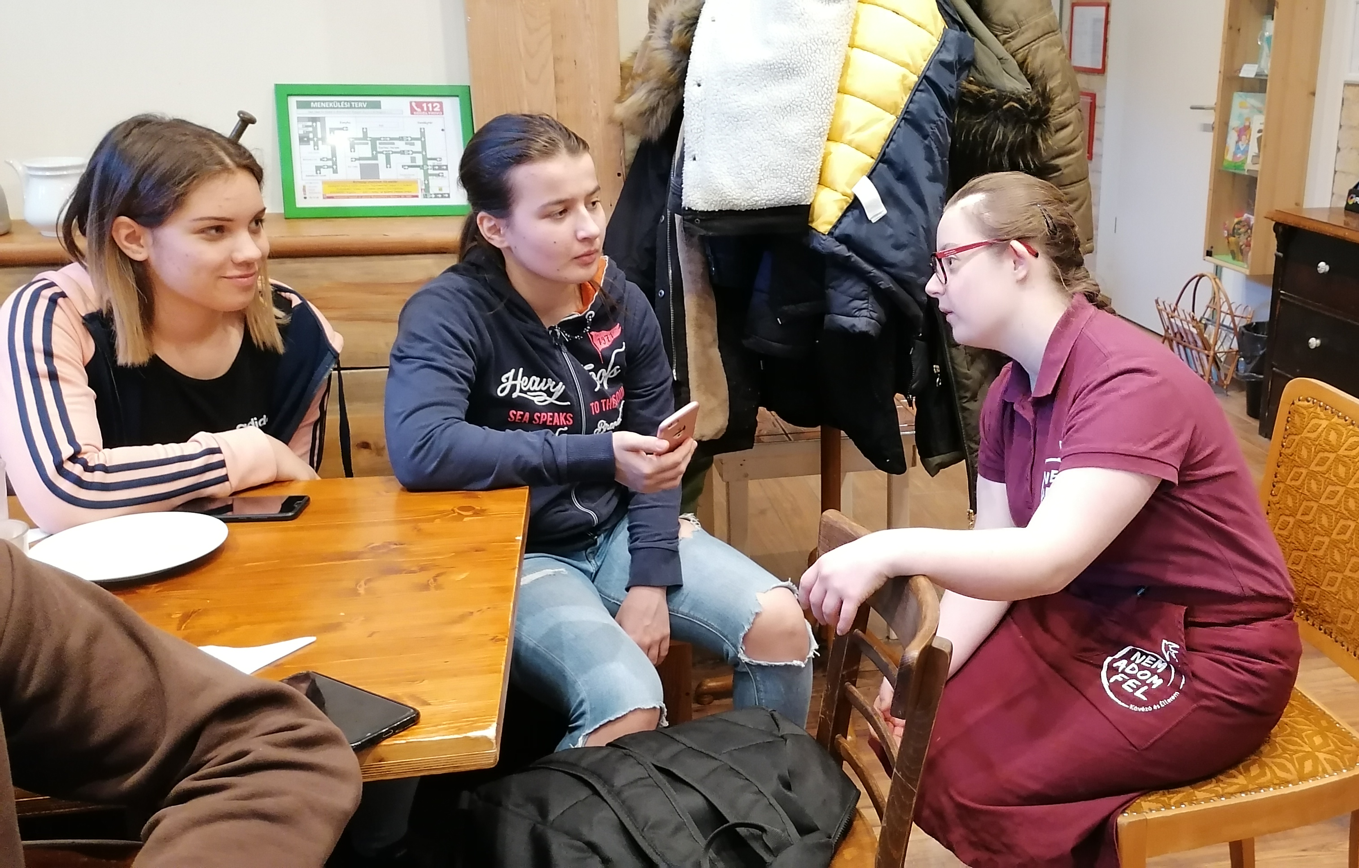
Visits to the café, Facebook posts, School campaign March 2019-2020

Slide 16
Online meeting with Vili and Gabi, 2021

Slide 17
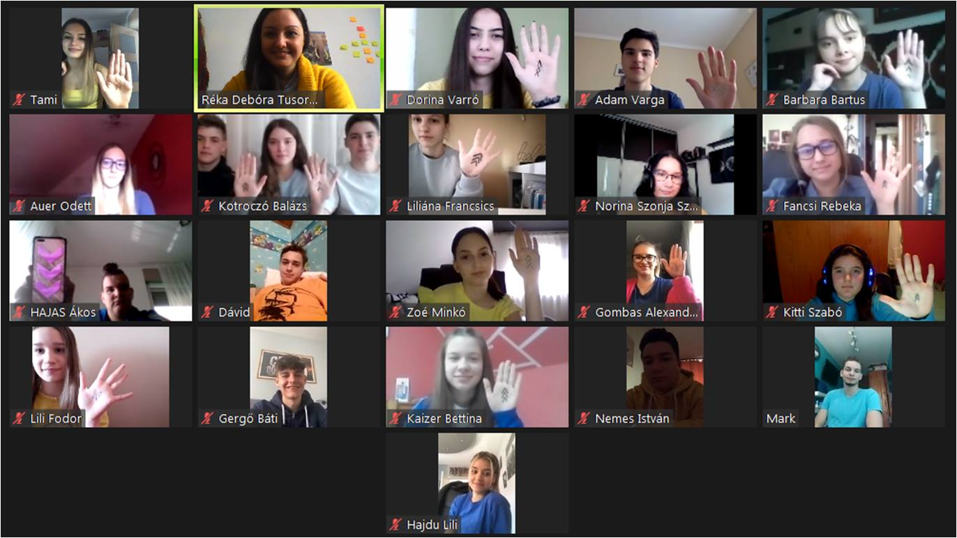
School campaign 18-21 March 2021
blue and yellow T-shirts
three arrows
photos

Slide 18
THANK YOU FOR YOUR ATTENTION

