Slide 1
activities in ekonomska škola Braće Radić Đakovo

Slide 2
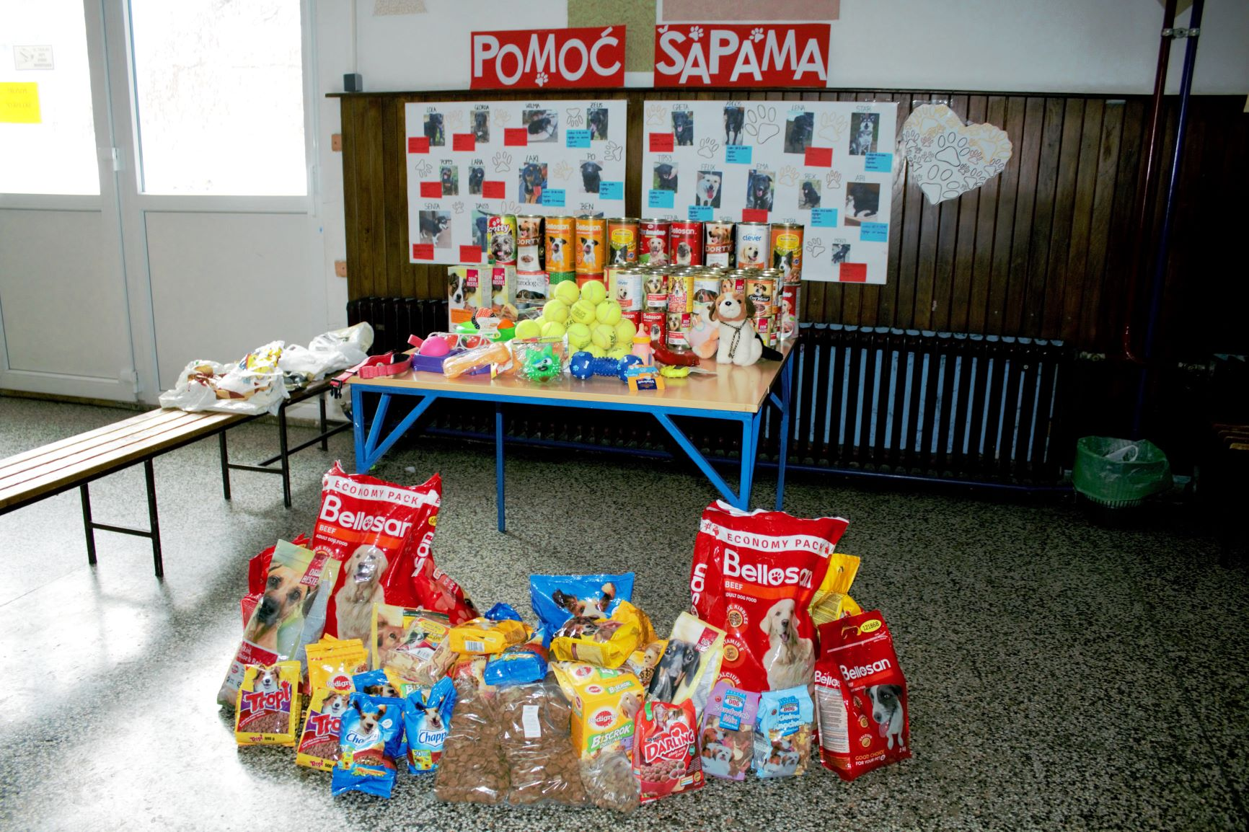
„Pomoć šapama”(Dog whisperers)
19. prosinca 2018.
In collaboration with the foundation for animal protection in Đakovo
Organisers: Students
The association provided shelter for twenty abandoned dogs
Collecting food and toys for animals

Slide 3
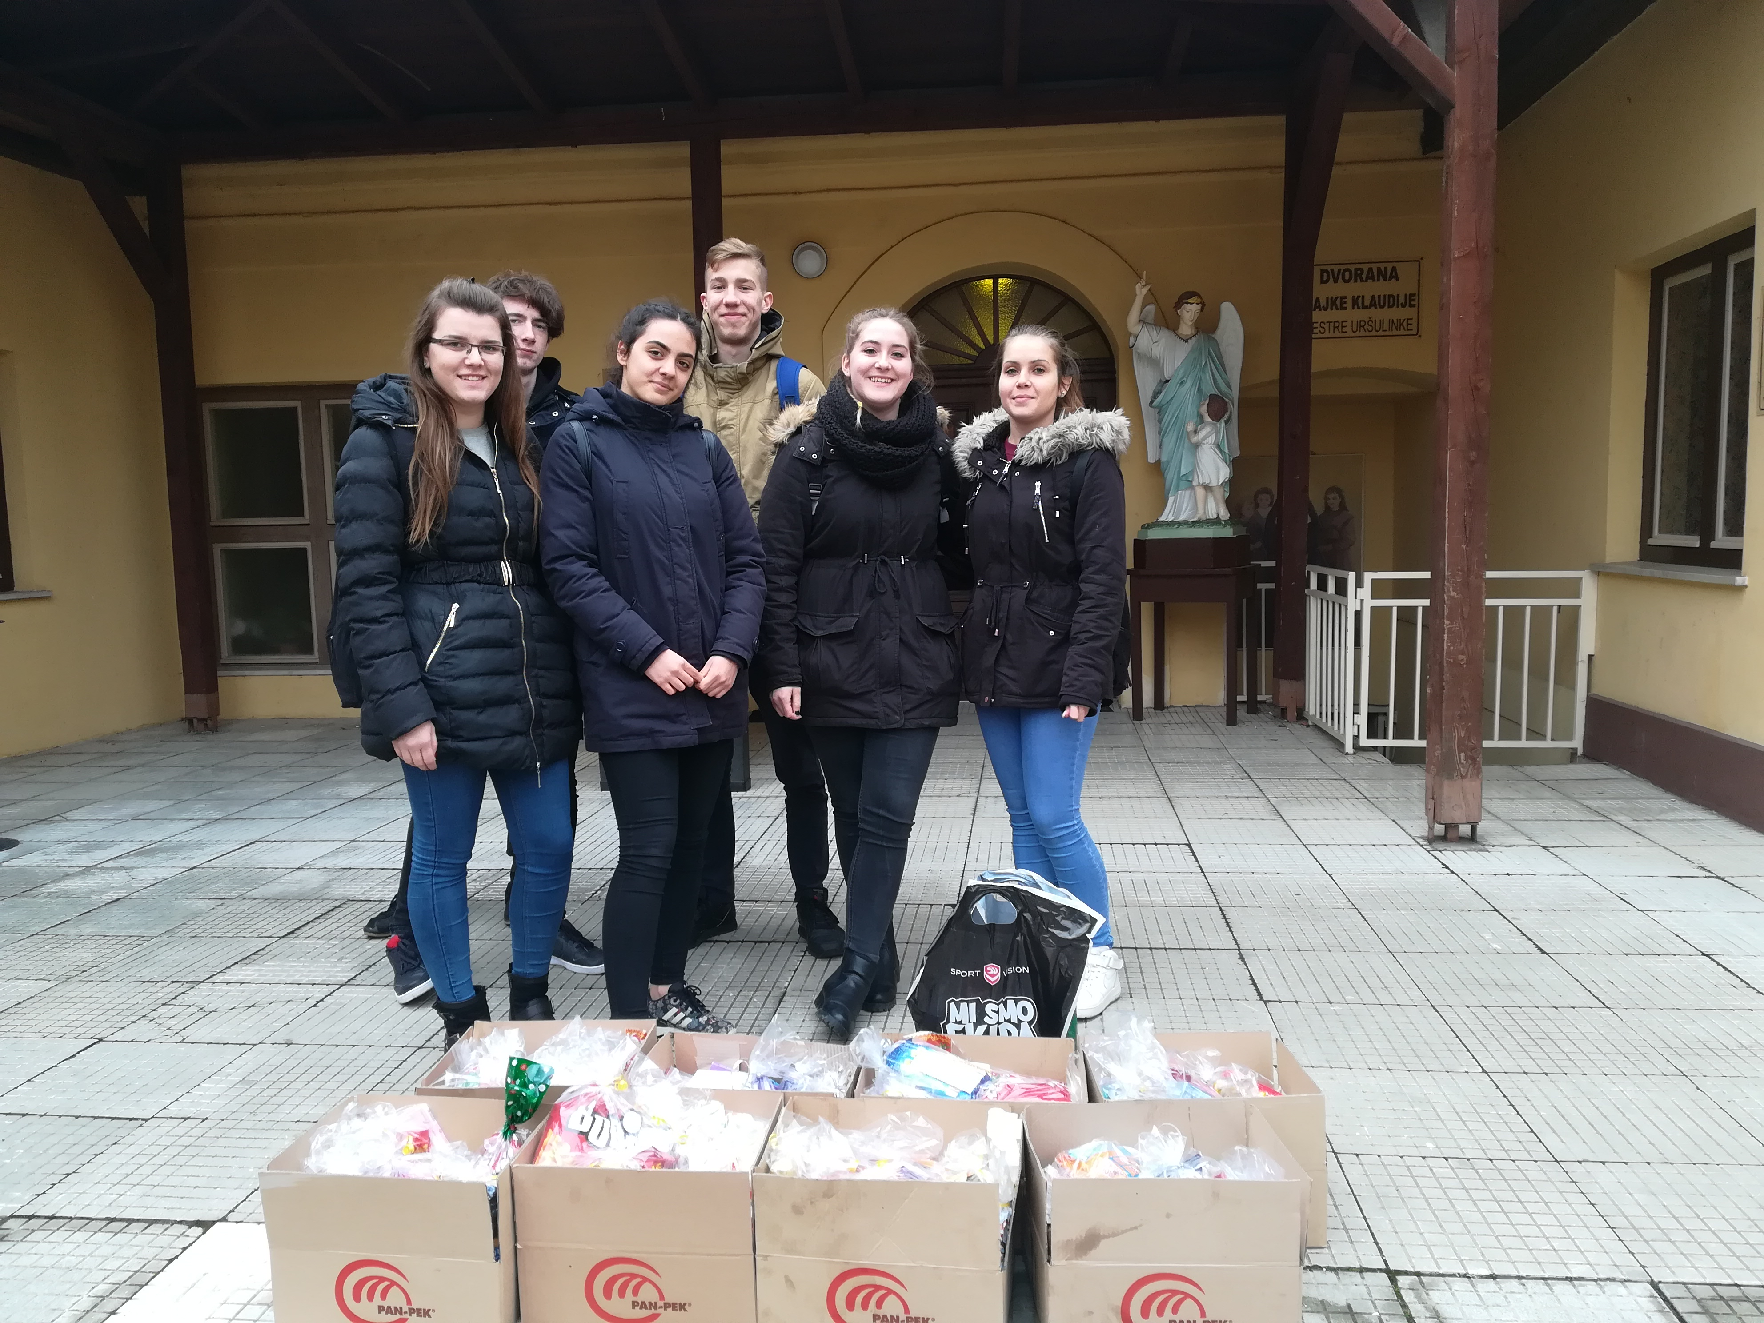
„Djed Božićnjak” – (Santa is coming) for the Saint Vincent´s Charity
13. December 2018.
Organisers: Students
The mini company provided candies and Christmas cards for children in need partners: Saint Vincent´s Charity

Slide 4
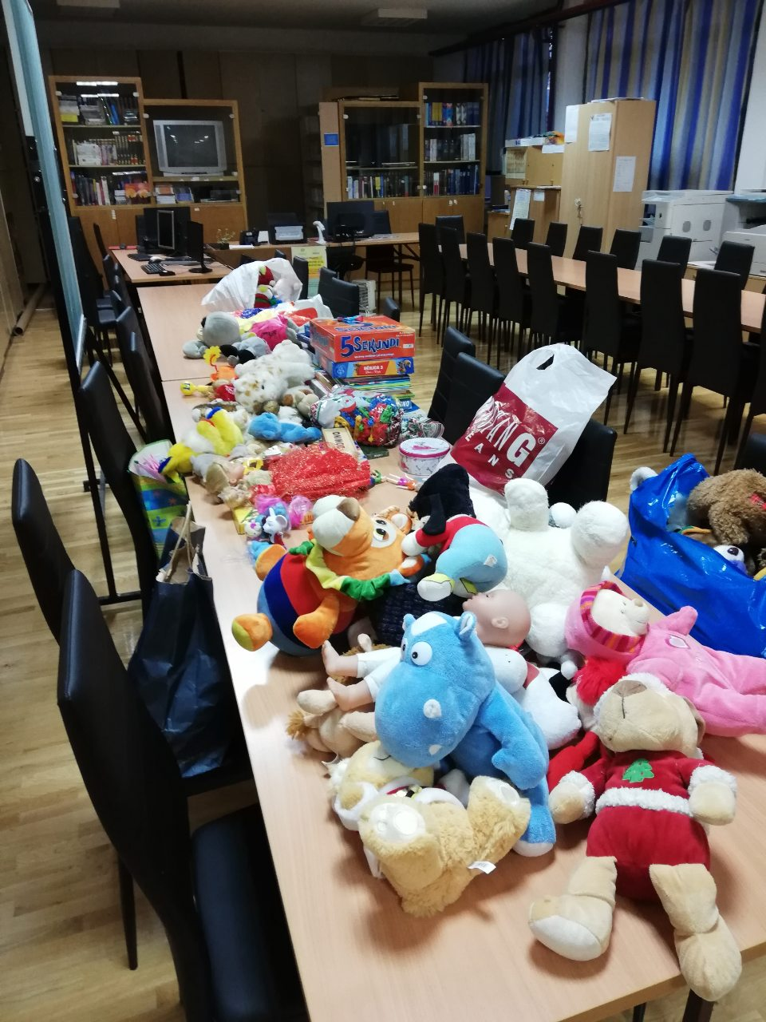
„TOYS FOR US”
4th December 2018.
The minicompany collected toys for the St. Vincent´s Charity from Đakovo

Slide 5
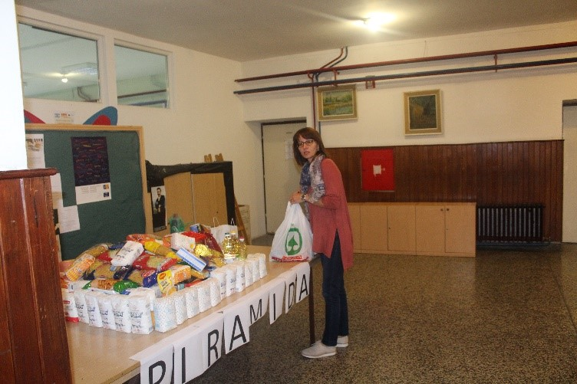
„Piramida” (the Pyramid)
12th October 2018.
A Minicompany comprised of foreign language teachers
Collecting food /products for families in need; partner Saint Vincent´s Charity

Slide 6
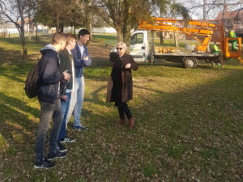
„Kućica za ptice” (Nesting boxes)
Initiated by our student Marin Vitman
The moral of the project is related to the protection of birds, their habitat and environmental issues causing vulnerability of numerous bird species, mainly caused by human activities.

