Slide 1
Pedagogy for autonomy and educational success – what relation?
Project coordinated by Isabel Barbosa

Slide 2
Main objective
Development of learner autonomy through learner involvement in the learning process
Reflection
Experimentation
Cognitive and metacognitive strategies
Negotiation
Roles
Objetives
Processes
(Self) Regulation

Slide 3
Defining autonomy
“competence to develop as a self-determined, socially responsible and critically aware participant in (and beyond) educational environments, within a vision of education as (inter)personal empowerment and social transformation”
(Jiménez Raya, Lamb & Vieira, 2007)

Slide 4
The autonomous learner
Learning competence
Metacognitive knowledge and beliefs about learning
Learning strategies
Attitudinal competence
Competence to self-motivate
Competence to think critically
(Jiménez Raya, Lamb & Vieira, 2007)

Slide 5
Why develop learner autonomy?

Slide 6
“Autonomy is a right of learners and teachers” (Benson, 2000)
“Society cannot be what its members are not. The direction society pursues is that pursued by its members.” (Brew, 1993)

Slide 7
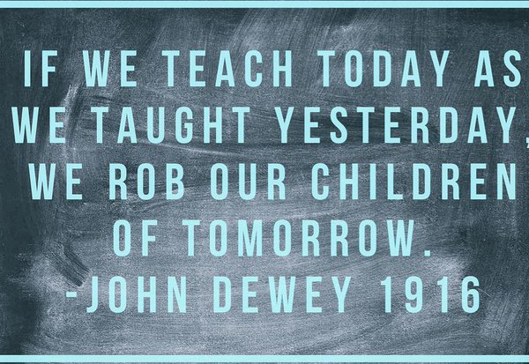
Besides…

Slide 8
Educating for autonomy – challenges and possibilities

Slide 9
What challenges?
“(…) the development of learner autonomy requires teachers to rethink their pedagogical beliefs not just once but continuously. This means that a project whose aim is to develop the autonomy of the learners is likely to succeed only to the extent that it also develops the autonomy of the teachers, giving them the same sense of purpose and control in their teaching as they are seeking to develop in their pupils’ learning.”
(Little et al., 2002)

Slide 10
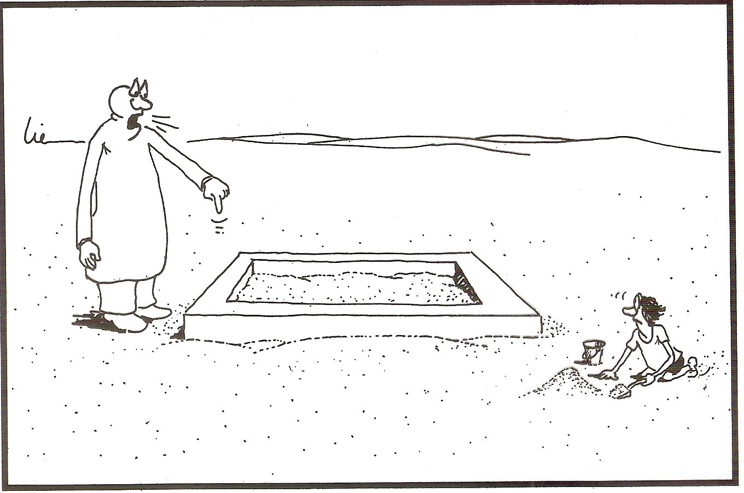
What vision of education?

Slide 11
Pedagogical principles
Encouraging responsibility, choice and flexible control
Providing opportunities for learning to learn and self-regulation
Creating opportunities for cognitive autonomy support
Creating opportunities for integration and explicitness
Developing intrinsic motivation
Accepting and providing for learner differentiation
Encouraging action-orientedness
Fostering conversational interaction
Pormoting reflective inquiry
(Jiménez Raya, Lamb & Vieira, 2007)

Slide 12
Practical implications

Slide 13
Examples of practice
Lesson observation activity
Evaluation activity (test correction)
Writing activity
Self-regulation/ supervision instrument
Self-awareness (attitudes)

Slide 14
Evaluating the project (learners’ perspective)

Slide 15
Useful type of work/ prepares for the future
The activities helped to develop learners’ competences
Motivating teaching approach
The teacher cares about pupils’ learning
The work done helped me improve my English
This type of work helps us to identify our errors and to correct them
More interesting lessons
It was good to reflect on difficulties and do self-evaluation activities
It makes us more autonomous and increases team spirit

Slide 16
It allows pupils to make suggestions in class
It promotes individual capacity to overcome difficulties
The teachers listen to their pupils and want to know their opinion
I learnt to be more responsible for my own learning
I think I learnt a lot this year, and that I’m better prepared for the future, as it made me grow and helped me to understand what made me grow
It makes me a better learner and person
I find it interesting and very appealing for the development of the school and school sport
It’s important to reflect on our work in order to improve it
The more (teaching/learning) diversity, the more motivation

Slide 17
The lessons are taught in such different and varied ways
It was a different kind of work that helped us improve
I liked the way the teacher works, challenging us
The activities helped me to better identify my difficulties. However, we wasted some time
It’s different from the usual teaching method which increased the pupils’ interest and participation levels
I think that if we had worked just with worksheets and course book, it would have been more boring and all of us would have quickçly lost interest
This type of work contributes to everyone’s intelectual development, no matter in what learning context
I liked it; I think it helped me to improve my English

Slide 18
Dissemination of the project

Slide 19
Presentations in conferences
XII Congresso Internacional Galego-Português de Psicopedagogia. Universidade do Minho (setembro de 2013)
6º Encontro do GT-PA. Universidade do Minho (julho de 2014)
XIII Congresso Internacional Galego-Português de Psicopedagogia. Universidade da Corunha (setembro de 2015)
XIV Congresso Internacional Galego-Português de Psicopedagogia. Universidade do Minho (setembro de 2017)
II COLÓQUIO - Desafios Curriculares e Pedagógicos na Formação de Professores. UM​ (setembro de 2017)
Congresso Internacional de Avaliação das Aprendizagens e Sucesso Escolar. UM (novembro de 2017)
III Colóquio Internacional de Ciências Sociais da Educação Universidade do Minho (Fevereiro 2018) *
Seminário “o Futuro da educação e dos educadores-professores”. ESSE-IPP (abril de 2018)
IIII Encontro Internacional de Formação na Docência. ESSE-IPB (maio de 2018)
Seminário “Currículo em Ação: Um olhar nacional e internacional”. Universidade do Minho (julho de 2018)
Conferência Internacional ”Making Learning Meaningful – Implications for Teachers and Teaching”. Braga (julho de 2018)
* Presentation of the paper “Educating for autonomy – a common goal within an Erasmus+ partnership”

Slide 20
Some publications
Barbosa, I. “Pedagogy for autonomy and educational success – what relation? A multi-disciplinary school project.” Independence (Newsletter of the IATEFL Learner Autonomy Special Interest Group) 45 (Winter 2008-2009): 13-19.
Barbosa, I., Kao, S. H., & Lacey, F. (2013). Teaching for autonomy – challenges and possibilities. In A. Barfiel & N. Delgado Alvarado (Eds.), Autonomy in Language Learning: Stories of Practices [Kindle]. Canterbury, England: IATEFL Learner Autonomy SIG.
Fernandes, I.S., Barbosa, I., Pereira, C. & Vieira, F. (2013). COMUNIDADES DE APRENDIZAGEM, DESENVOLVIMENTO PROFISSIONAL E EDUCAÇÃO DEMOCRÁTICA: AS VOZES DOS ATORES. Atas do XII Congresso Internacional Galego-Português de Psicopedagogia. Braga: Universidade do Minho.
Barbosa, I., Pereira, C. & Branco, C. (2015). Espelho meu, espelho meu… Imagens das Práticas nos Ensinos Básico e Secundário. Revista de estudios e investigación en psicología y educación eissn: 2386-7418, 2015, vol. Extr., No. 10. Doi: 10.17979/reipe.2015.0.10.446
Barbosa, I. (2017). AVALIAÇÃO E APRENDIZAGEM – O PAPEL DAS ATIVIDADES DECORREÇÃO DE TESTES. Atas do I Congresso Internacional de Avaliação das Aprendizagens e Sucesso Escolar. Braga: Universidade do Minho.

Slide 21
Reflecting…
“We do not learn from experience... we learn from reflecting on experience.” John Dewey
“Showing our work is like opening the window of our house to the world.”
José Guimarães e Silva
“Having the chance to show what we do is the best reward we can get.” José Guimarães e Silva

Slide 22
Thank you for your attention!

